Slide 1

Jaypee University Of Engineering and Technology
Two-way Speech-Sign Communication Platform
Hrishikesh Bhatt (211B139)
Pankaj kumar Kushwaha (211B201)
Shivam Tripathi (211B293)
Major Project 2
Project No.: AKS-3
Under the Supervision of:
Dr. Amit Kumar Srivastava
DEPARTMENT OF COMPUTER SCIENCE AND ENGINEERING
JUET GUNA

Slide 2
Table of Content
Problem Overview
Approach Overview
Literature Survey
Model Overview
Tools & Technology
Features & Challenges

Slide 3
Problem Overview
Problem: Limited tools for two-way communication between speech & hearing-impaired individuals and those who do not know Sign Language (SL).
Project Goal: Video conferencing system that enables two-way communication by converting speech to SL animations and sign language gestures to speech/text.

Slide 4
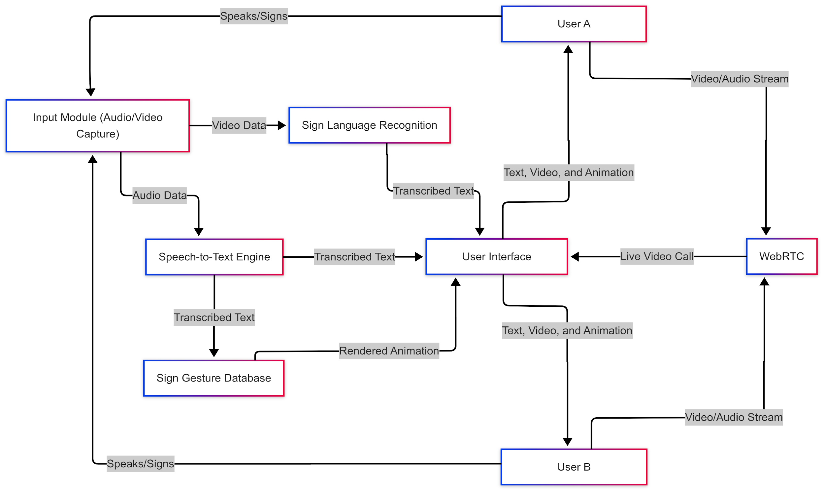
Approach Overview

Slide 5
Literature Survey
Monga H. et al.(2021) : Proposed a system that converts English audio to text, restructures it using SL grammar, and displays sign language animations.
Zecheng L. et al.(2025): Proposed a generative pre-training model for sign language translation, unifying ISLR, CSLR, and SLT for improved accuracy. This enhances pose-based gesture recognition and language modeling
Khan R. et al.(2023): Proposed an AI-driven sign language recognition using MediaPipe Holistic, LSTM, Faster R-CNN, and accelerometer-based gloves, achieving up to 98% accuracy.

Slide 6
Model Overview: Speech-to-Text
VOSK ToolKit: Uses deep neural networks and supports multiple languages with low-latency performance.
LibriSpeech Dataset
Description:
The dataset contains around 1000+ hours of speech data.
Created using LibriVox project, which provides free access to recorded audiobooks.
Source: Facebook AI Research, USA.
Purpose: To train models for recognizing spoken words and phrases.

Slide 7
Model Overview: Text-to-ISL
Indian Sign Language Grammar
Preprocessing:
Lemmatization and stop-word removal using NLTK.
Key terms mapped to ISL grammar.
SiGML Files:
Represent each ISL word/gesture in animation-friendly format.
Purpose: To map text to corresponding sign language gestures.
Links:
https://vhg.cmp.uea.ac.uk/tech/jas/std/SiGML-Player-gui.html

Slide 8
Model Overview: SL-to-Text/Speech
MediaPipe + LSTM for Gesture Recognition
Function: Captures and analyzes hand landmarks to recognize Indian Sign Language (ISL) gestures and convert them into meaningful text.
Technical Approach: Uses MediaPipe Holistic for real-time hand landmark detection and an LSTM-based deep learning model to process time-series gesture sequences for accurate classification.
Dataset: Indian Sign Language Dataset https://www.data.gov.in/catalog/indian-sign-language-dictionary
Open-Source TTS: Generates realistic speech output from text in real-time.

Slide 9
Tools & Technology
Flask & NextJs: Backend framework for API development
WebRTC & Socket.IO: Real-time communication and transmission
VOSK Toolkit: Speech Recognition
NPM Modules for lemmatization and stop word removal
Machine Learning Frameworks: TensorFlow, LSTM
Mediapipe for Gesture Recognition
SiGML Player

Slide 10
Features Challenges
Enhanced Communication: Bridges the gap between sign language users and non-signers.
Multimodal Communication: Supports speech, text, and sign language, ensuring accessibility for all users.
Utilizes Open Datasets: Leverages existing resources for improved model training.
Dataset Limitations: Dependence on the quality and diversity of datasets affect model performance.
Complexity of Sign Language: Nuances in sign language leading to potential misinterpretations.
Resource Intensive: Requires significant computational resources for training models and processing.

Slide 11
Thank you!

