Slide 1

Minor Project on: STOCK PRICE PREDICTION USING MACHINE LEARNING
Sagar Institute of Science & Technology
Presentation by:
Syeda Atiya Husain
Pankaj Lal
Project Guide by:
Dr. Rajeev Gupta

Slide 2
Introduction
Stock price prediction is the act of trying to determine the future value of a company stock or other financial instrument traded on an exchange.
The successful prediction of a stock's future price could yield significant profit.
The term stock price refers to the current price that a share of stock is trading for on the market.

Slide 3
Machine Learning in Stock Price Prediction
The field of Machine Learning is vast and plays a key role in a wide range of critical applications.
Linear regression is to map independent variables to dependent variable. Hence the concept of linear regression can be applied to predict daily stock price.
Predicting the stock market involves predicting the closing price of a company’s stock for any given number of days ahead.
Linear regression can be used for stock prediction by mapping various features (open , high , close, low ) to achieve adjusted closing price which is the target variable.

Slide 4
Scope
Objective
Aim is to predict daily adjusted closing price of stock market.
This project will focus exclusively on predicting the daily trend (price movement) of individual stocks.
The project will make no attempt to deciding how much money to allocate to each prediction. More so, the project will analyze the accuracies of these predictions.
This project is applicable for the users who wants to buy the share of company to earn profit in future.

Slide 5
About Project
Stock price prediction system is a technique that outputs the predicted stock price for the future.
On the basis of the past data of the company’s stock, prediction is made for the next day closing price in future.
Such results can be used by investors or buyers of shares of the company’s stock.

Slide 6
Technology Stack
Software
Machine learning (Supervised learning)
HTML
CSS
JS
Python
Django (Framework)
Pycharm
Visual studio Code
Jupyter Notebook

Slide 7
For the implementation of ML algorithm we have used Python programming language . This is because,
Python is a general purpose and high level programming language. You can use Python for developing desktop GUI applications, websites and web applications. Also, Python, as a high level programming language, allows you to focus on core functionality of the application by taking care of common programming tasks
Readable and Maintainable Code
Also python provides us Django framework which we have used in our project.
For user interface, we have used HTML ,CSS ,JS.

Slide 8
Work Flow
Data
Prediction
Performance Measure
Feature Selection

Slide 9
Data Flow Diagram
Input : Company name
Fetch Company Data
Feature Selection
Split data into training data and testing data
Train the model on training data
Data visualization
Compute accuracy on testing data
Prediction of companies stock price

Slide 10
Input: The system will proceed by getting the input of the company name from the user.
Fetch Company data: We will fetch the data of the company from the yahoo finance API which is defined as yahoo_fin in python. Hence we import the yahoo_fin in our source code.
Data Pre processing: Since we are fetching are data from yahoo_fin API we does not require to pre process our data as the data is already in organized and structured form . It does not contain any NAN values.
Feature selection: Since our data already have less features and those features are inter related to each other. Hence we simply selected our features (“open”, “low”, “high”, “close” , “volume”) without adopting any method for feature selection.

Slide 11
Split the data : We have splits our data in which 80% data we have given for training our model and 20% data for testing our model.
We splits our data because if we train our model with 100% of our data then it will work slightly good for the data which our model has already seen during training. Thus we are not sure that how it will going to work with unseen data. So for this purpose we split data for testing also in which we verify(test) our model that how it will going to make predictions when the input data in completely new for our model.
Compute accuracy: We compute the accuracy of our model through testing data.
Prediction: After training and testing phase of our model then comes prediction part. In prediction we predict the next day closing price of the company’s stock.

Slide 12
Algorithm
We have used Yahoo-fin API to get past dataset of the company whose stock price is to be predicted.
For prediction, we have used Linear Regression algorithm of machine learning.
For better accuracy , we have done feature selection . Hence independent variables(features) for our model are “open”, “high”, “low”, “close”, “volume”. From these features we will achieve our target variable i.e. adjusted closing price.
Then we split our data into training data set and testing data set.
After training our linear regression model on the training data , we have tested it accuracy on testing data set.
And then prediction is made through our trained model of linear regression for the next day closing price of the desired company .

Slide 13
What is Linear Regression
Linear Regression is a machine learning algorithm based on supervised learning. It performs a regression task.
Regression models a target prediction value based on independent variables. It is mostly used for finding out the relationship between variables and forecasting.
The idea behind simple linear regression is to "fit" the observations of two variables into a linear relationship between them.
Graphically, the task is to draw the line that is "best-fitting" or "closest" to the points (x_i,y_i),(xi​,yi​), where x_ixi​ and y_iyi​ are observations of the two variables which are expected to depend linearly on each other.

Slide 14
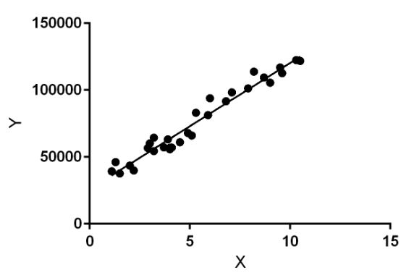
Linear regression performs the task to predict a dependent variable value (y) based on a given independent variable (x). So, this regression technique finds out a linear relationship between x (input) and y(output). Hence, the name is Linear Regression. In the figure above, X (input) is the work experience and Y (output) is the salary of a person. The regression line is the best fit line for our model.

Slide 15
Regression is a common process used in many applications of statistics in the real world. There are two main types of applications:
Predictions: After a series of observations of variables, regression analysis gives a statistical model for the relationship between the variables. This model can be used to generate predictions: given two variables xx and y,y, the model can predict values of yy given future observations of x.x. This idea is used to predict variables in countless situations, e.g. the outcome of political elections, the behavior of the stock market, or the performance of a professional athlete.
Correlation: The model given by a regression analysis will often fit some kinds of data better than others. This can be used to analyze correlations between variables and to refine a statistical model to incorporate further inputs: if the model describes certain subsets of the data points very well, but is a poor predictor for other data points, it can be instructive to examine the differences between the different types of data points for a possible explanation. This type of application is common in scientific tests, e.g. of the effects of a proposed drug on the patients in a controlled study.

Slide 16
Y = MX + C
While training the model we are given : x: input training data y: labels to data (supervised learning)
When training the model – it fits the best line to predict the value of y for a given value of x. The model gets the best regression fit line by finding the best C and M values. C: intercept M: coefficient of x
Once we find the best C and M values, we get the best fit line. So when we are finally using our model for prediction, it will predict the value of y for the input value of x.

Slide 17
Why we have used linear regression
It is simple algorithm which works on continuous data.
Stock data on which we are working is continuous data only
It is giving us good accuracy

Slide 18
Use case diagram
Stock price prediction using machine learning
Collect data
Train system using collected data
Prediction
View trade exchange
System machine
User
Include
Companies stock
View predicted outcome

Slide 19
E-R Diagram
System
Monitors
Generates
Open
Actual value
Accuracy
Date
High
Predicted value
Company symbol
Market
Prediction
Low
Close

Slide 20
Sequence of the System
User visits the website.
Enters the name of the company.
Users request for a company’s stock data.
User request for the prediction to be made.
The stock market prediction system trains a model using the companies past data.
And the closing price is predicted which will be displayed on the next page of the website.
Result is displayed along with the graph showing the accuracy of the system.

Slide 21
What is Django?
Django is a Python-based free and open-source web framework, written in Python which follows the model-template-view architectural pattern. Django's primary goal is to ease the creation of complex, database-driven websites.
Why do you need a framework?
To understand what Django is actually for, we need to take a closer look at the servers. The first thing is that the server needs to know that you want it to serve you a web page.
Imagine a mailbox (port) which is monitored for incoming letters (requests). This is done by a web server. The web server reads the letter and then sends a response with a webpage.

Slide 22
But when you want to send something, you need to have some content. And Django is something that helps you create the content.
What happens when someone requests a website from your server?
When a request comes to a web server, it's passed to Django which tries to figure out what is actually requested. It takes a web page address first and tries to figure out what to do. This part is done by Django's URL resolver (note that a website address is called a URL – Uniform Resource Locator – so the name URL resolver makes sense). It is not very smart – it takes a list of patterns and tries to match the URL. Django checks patterns from top to bottom and if something is matched, then Django passes the request to the associated function (which is called view).

Slide 23
Why Django?
Django is time-tested
Application Development
Easy to Use
Operating System Dependent
Excellent Documentation for real-world application
Scalable and reliable
Community Support

Slide 24
Django Benefits :With the uses of Django framework, we can develop and deploy web applications within hours as it takes care of much of the hassle of web development. Django is very fast, fully loaded such as it takes care of user authentication, content administration, security as Django takes it very seriously and helps to avoid SQL injection, cross-site scripting etc. and scalable as applications can be scalable to meet high demands and used to build any type of applications that’s why we call it as versatile framework. It offers lots of resources and good documentation which helps new learners to learn and experienced people for reference

Slide 25
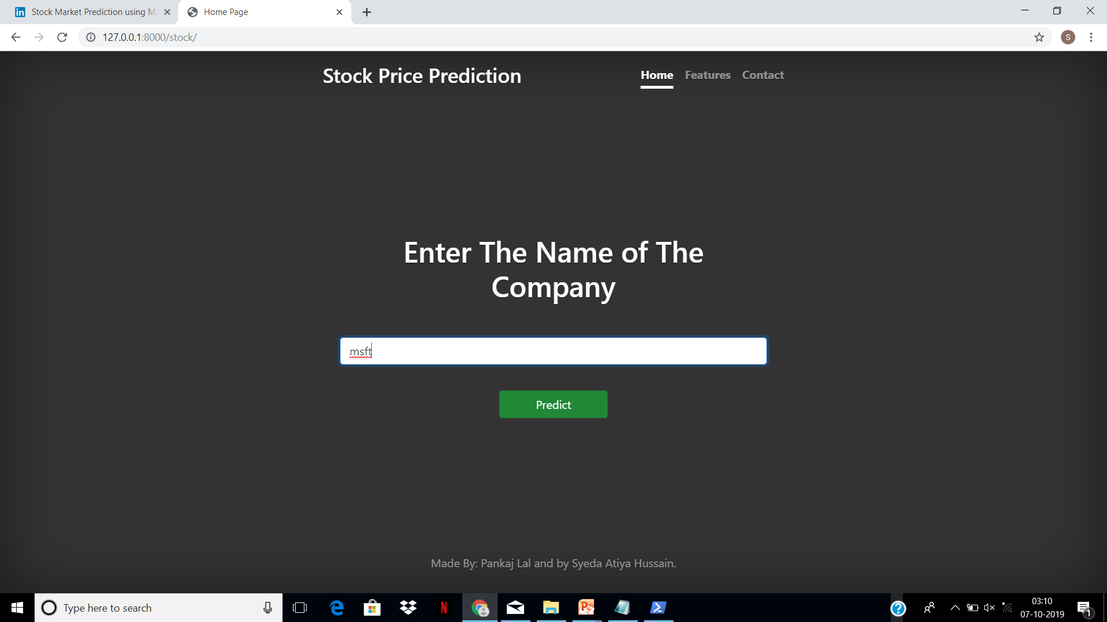
Snapshot of the website

Slide 26
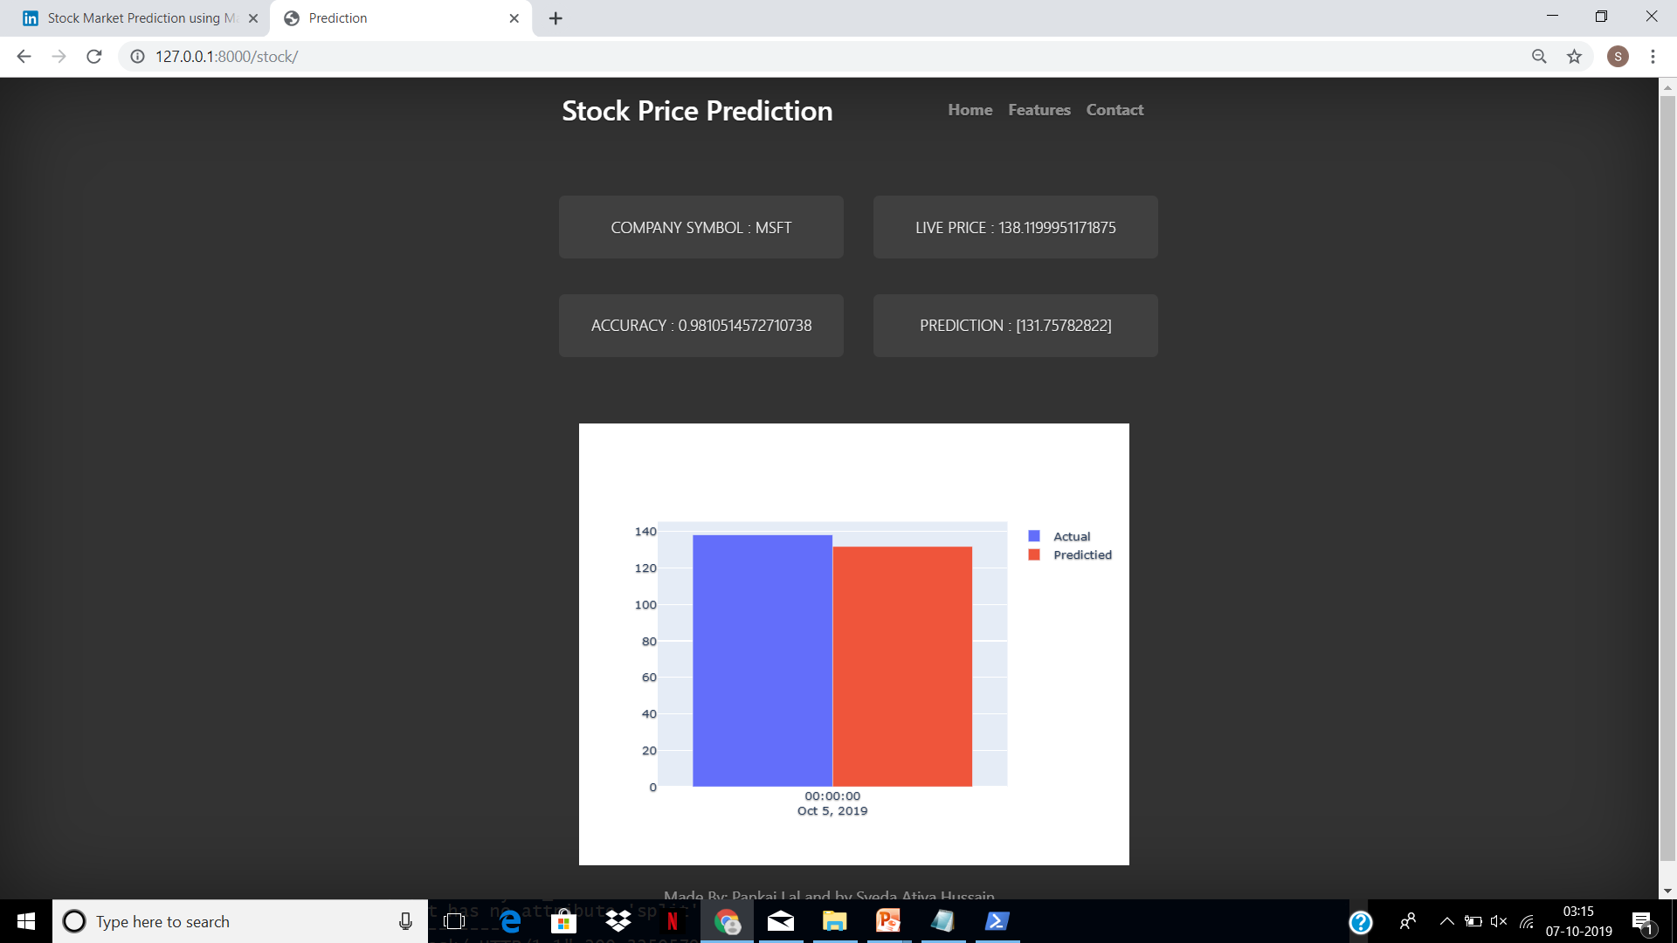

Slide 27
Feature Enhancement
In future we will modify the same system to make it more accurate system in terms of prediction.
For this purpose we have following two ideas.
Firstly, we will try to make our system more user friendly by giving them suggestion for whether they should buy the share of any company or not. To achieve this we will use are per cent change data. We will see the variation between the rows. If the difference is negative value then we will suggest not to buy the share of that company and vice versa.

Slide 28
Secondly , we will try to scrap articles from the websites so that we can get the news for any company through which we can predict the companies condition and how it will going to work in future . To achieve this we will apply natural language processing .
And will try to add more ideas for our system enhancement.

Slide 29
THANKYOU

