Slide 1
Lecture: 06 Linked List

Slide 2
Linked List
A linked list is a linear collection of data elements (called nodes), where the linear order is given by means of pointers.
Each node is divided into 2 parts:
1st part contains the information of the element.
2nd part is called the link field or next pointer field which contains the address of the next node in the list.
struct node
{
int value;
struct node *next;
}
5
7
3
1

Slide 3
Basic operations
Insert: Add a new node in the first, last or interior of the list.
Delete: Delete a node from the first, last or interior of the list.
Search: Search a node containing particular value in the linked list.

Slide 4
Insertion to a Linear Linked list
Add a new node at the first, last or in the middle of a linked list.

Slide 5
Insert First
To add a new node to the head of the linear linked list, we need to construct a new node that is pointed by pointer newitem.
Assume there is a global variable head which points to the first node in the list.
The new node points to the first node in the list. The head is then set to point to the new node.

Slide 6
Insert First (Cont.)
Step 1: Create a new node that is pointed by pointer newItem.
Step 2: Link the new node to the first node of the linked list.
Step 3: Set the pointer head to the new node.
newItem
HEAD
NULL
newItem
HEAD
NULL
newItem
NULL
HEAD

Slide 7
Insert Last
To add a new node to the tail of the linear linked list, we need to construct a new node and set it's link field to "null".
Assume the list is not empty, locate the last node and change it's link field to point to the new node

Slide 8
Insert Last (Cont.)
Step 1: Create the new node.
Step 2: Set a temporary pointer prev to point to the last node.
Sep 3: Set prev to point to the new node and new node as last node.
HEAD
newItem
NULL
HEAD
prev
newItem
NULL
HEAD
newItem
prev
NULL

Slide 9
Deletion from a Linear Linked list
Deletion can be:
At the first node of linked list.
At the end of a linked list.
Within the linked list.

Slide 10
Delete First
To delete the first node of the linked list, we not only want to advance the pointer head to the second node, but we also want to release the memory occupied by the abandoned node.

Slide 11
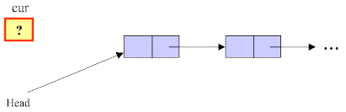
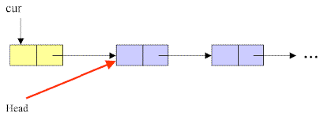
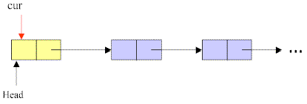
Delete First (Cont.)
Step 1: Initialize the pointer cur point to the first node of the list.
Step 2: Move the pointer head to the second node of the list.
Step 3: Remove the node that is pointed by the pointer cur.
Step 1
Step 2
Step 3

Slide 12
Delete Last
To delete the last node in a linked list, we use a local variable, cur, to point to the last node. We also use another variable, prev, to point to the second last node in the linked list.

Slide 13

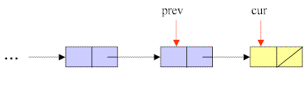
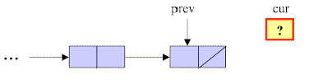
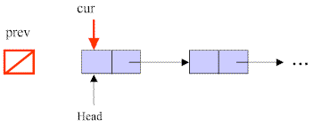
Delete Last (Cont.)
Step 1: Initialize pointer cur to point to the first node of the list, while the pointer prev has a value of null.
Step 2: Traverse the entire list until the pointer cur points to the last node of the list.
Step 3: Set NULL to next field of the node pointed by the pointer prev.
Step 4: Remove the last node that is pointed by the pointer cur.
step1
step2
step3
step4

Slide 14
Delete Any
To delete a node that contains a particular value x in a linked list, we use a local variable, cur, to point to this node, and another variable, prev, to hold the previous node.

Slide 15

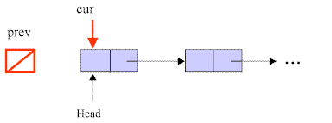
Delete Any (Cont.)
Step 1: Initialize pointer cur to point to the first node of the list, while the pointer prev has a value of null.
Step 2: Traverse the entire list until the pointer cur points to the node that contains value of x, and prev points to the previous node.
Step 1
Step 2

Slide 16
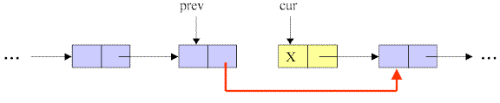

Delete Any (Cont.)
Step 3: Link the node pointed by pointer prev to the node after the cur’s node.
Step 4: Remove the node pointed by cur.
Step 3
Step 4

Slide 17


Introduction to Double Linked List
We have discussed the details of linear linked list. In the linear linked list, we can only traverse the linked list in one direction.
But sometimes, it is very desirable to traverse a linked list in either a forward or reverse manner.
This property of a linked list implies that each node must contain two link fields instead of one. The links are used to denote the predecessor and successor of a node. The link denoting the predecessor of a node is called the left link, and that denoting its successor its right link

