Slide 1
Graph

Slide 2
Graphs
A data structure that consists of a set of nodes (vertices) and a set of edges that relate the nodes to each other
The set of edges describes relationships among the vertices .
A graph G is defined as follows:
G=(V,E)
V(G): a finite, nonempty set of vertices
E(G): a set of edges (pairs of vertices)

Slide 3
Examples of Graphs
V={0,1,2,3,4}
E={(0,1), (1,2), (0,3), (3,0), (2,2), (4,3)}
1
When (x,y) is an edge,
we say that x is adjacent to y, and y is adjacent from x.
0 is adjacent to 1.
1 is not adjacent to 0.
0 is adjacent from 1.
0
2
4
3

Slide 4
Directed vs. Undirected Graphs
Undirected edge has no orientation (no arrow head)
Directed edge has an orientation (has an arrow head)
Undirected graph – all edges are undirected
Directed graph – all edges are directed
u
v
u
v
undirected edge
directed edge

Slide 5
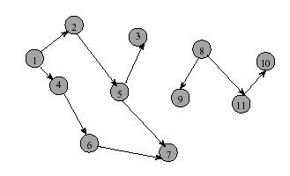
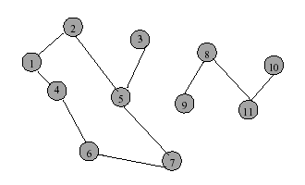
Directed graph Undirected graph
Directed Graph
Directed edge (i, j), i is incident to vertex j and j incident from vertex i
Vertex i is adjacent to vertex j, and vertex j is adjacent from vertex i

Slide 6
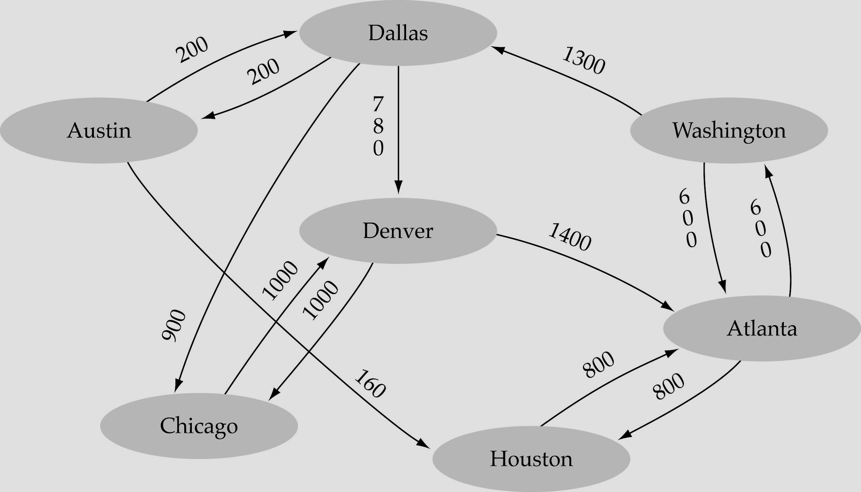
Weighted graph:
-a graph in which each edge carries a value

Slide 7
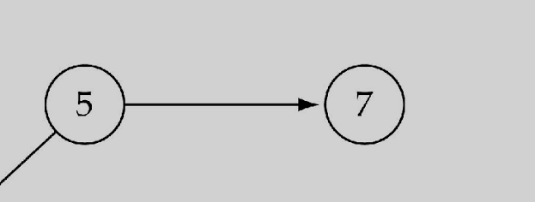
Graph terminology
Adjacent nodes: two nodes are adjacent if they are connected by an edge
Path: a sequence of vertices that connect two nodes in a graph
Complete graph: a graph in which every vertex is directly connected to every other vertex
5 is adjacent to 7
7 is adjacent from 5 5

Slide 8
Continued…
A cycle is a simple path with the same start and end vertex.
The degree of vertex i is the no. of edges incident on vertex i.
e.g., degree(2) = 2, degree(5) = 3, degree(3) = 1

Slide 9
Continued…
Undirected graphs are connected if there is a path between any two vertices
Directed graphs are strongly connected if there is a path from any one vertex to any other
Directed graphs are weakly connected if there is a path between any two vertices, ignoring direction
A complete graph has an edge between every pair of vertices
Notes:
Can a directed graph which is strongly connected be acyclic?
NO. (Except the trivial one node case.) There must be a path from A to B and a path from B to A; so, there must be a cycle.
What about a weakly connected directed graph?
YES! See the one on the slide.
There are also further definitions of these; for example, the concept of biconnectivity showed up in my satisfiability research:
Does the graph have two distinct paths between any two vertices.

Slide 10
Continued…
Loops: edges that connect a vertex to itself
Paths: sequences of vertices p0, p1, … pm such that each adjacent pair of vertices are connected by an edge
Multiple Edges: two nodes may be connected by >1 edge
Simple Graphs: have no loops and no multiple edges

Slide 11
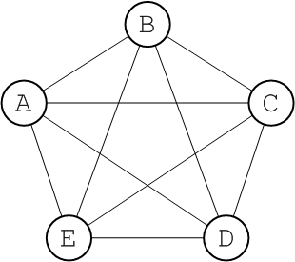
Graph Properties
Number of Edges
The no. of possible pairs in an n vertex directed graph is n*(n-1). This type of graph is called complete graph.
Since edge (u,v) is the same as edge (v,u), the number of edges in an undirected graph is n*(n-1)/2.
4+3+2+1+0=10 5nodes
5+4+3+2+1+0=15 6nodes
7+6+5+4+3+2+1+0=28 8nodes
1……n-1=(n-1)(n)/2

Slide 12

In-degree of vertex i is the number of edges incident to i (i.e., the number of incoming edges).
e.g., indegree(2) = 1, indegree(8) = 0
Out-degree of vertex i is the number of edges incident from i
(i.e., the number of outgoing edges).
e.g., outdegree(2) = 1, outdegree(8) = 2

Slide 13
Graph Representation
For graphs to be computationally useful, they have to be conveniently represented in programs
There are two computer representations of graphs:
Adjacency matrix representation
Adjacency lists representation

Slide 14
Adjacency Matrix
A square grid of boolean values
If the graph contains N vertices, then the grid contains N rows and N columns
For two vertices numbered I and J, the element at row I and column J is true if there is an edge from I to J, otherwise false

Slide 15
Adjacency Matrix
0 1 2 3 4
0 false false true false false
1 false false false true false
2 false true false false true
3 false false false false false
4 false false false true false
1
3
2
4
0

Slide 16
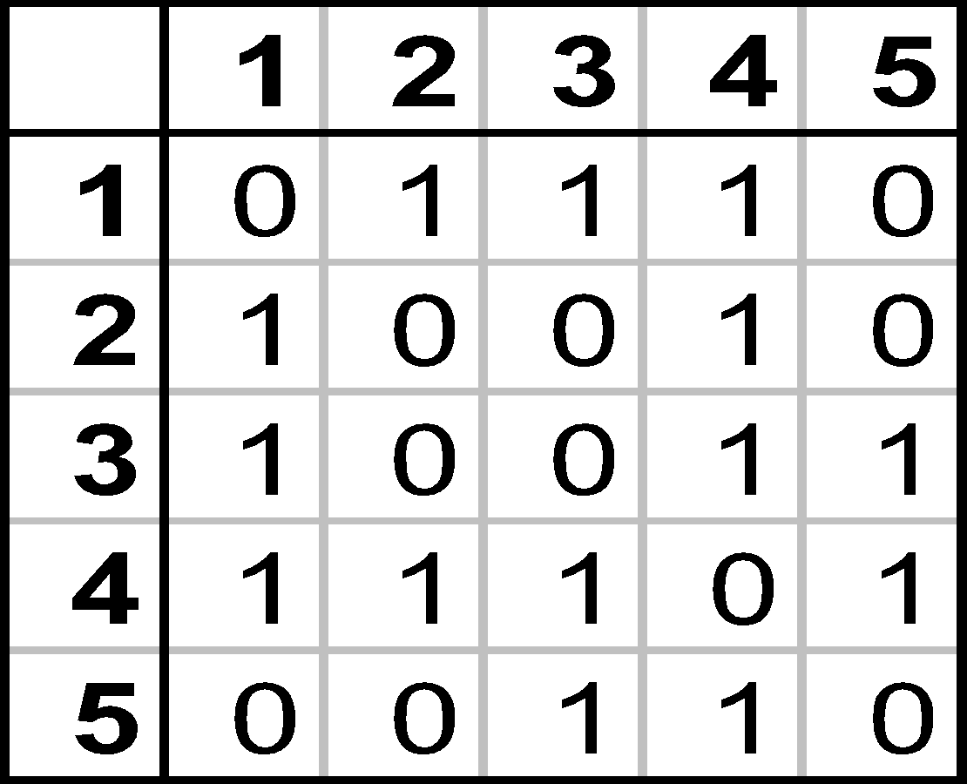
Adjacency Matrix
1
2
3
4
5

Slide 17
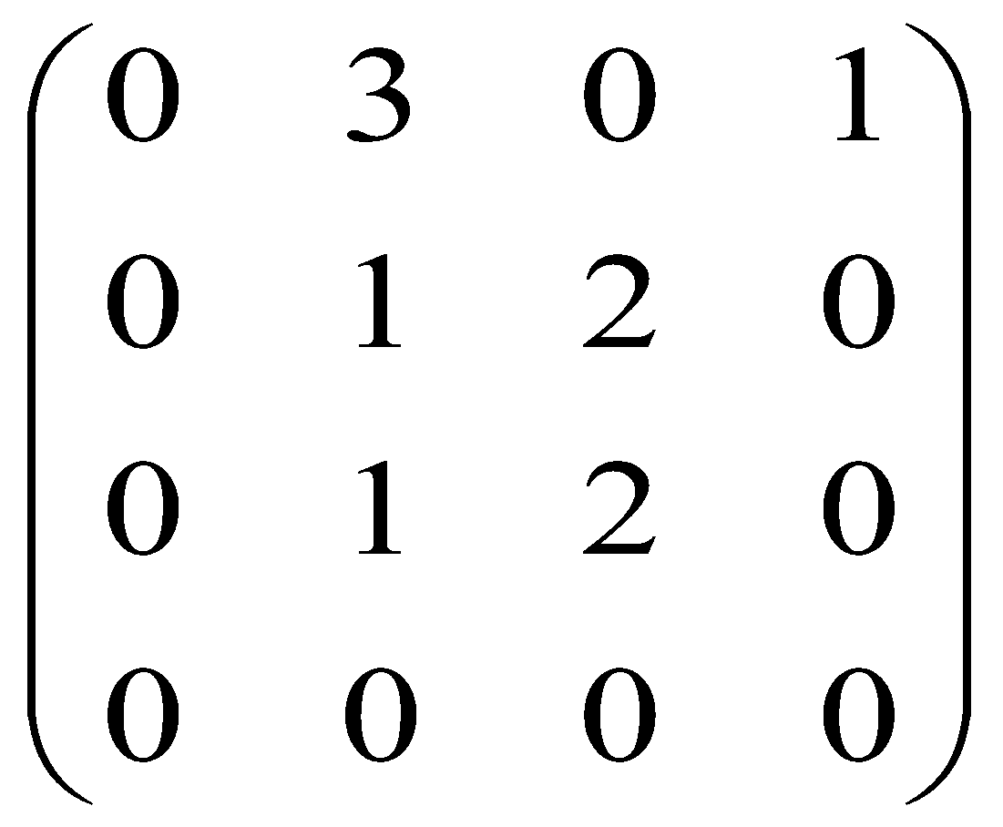
Adjacency Matrix -Directed Multigraphs
2
A:
1
4
3

Slide 18
Adjacency Lists Representation
A graph of n nodes is represented by a one-dimensional array L of linked lists, where
L[i] is the linked list containing all the nodes adjacent from node i.
The nodes in the list L[i] are in no particular order

Slide 19
Graphs: Adjacency List
Adjacency list: for each vertex v ∈ V, store a list of vertices adjacent to v
Example:
Adj[1] = {2,3}
Adj[2] = {3}
Adj[3] = {}
Adj[4] = {3}
Variation: can also keep a list of edges coming into vertex
1
2
4
3

Slide 20
Graphs: Adjacency List
How much storage is required?
The degree of a vertex v = # incident edges
Directed graphs have in-degree, out-degree
For directed graphs, # of items in adjacency lists is Σ out-degree(v) = |E| For undirected graphs, # items in adjacency lists is Σ degree(v) = 2 |E|
So: Adjacency lists take O(V+E) storage

Slide 21
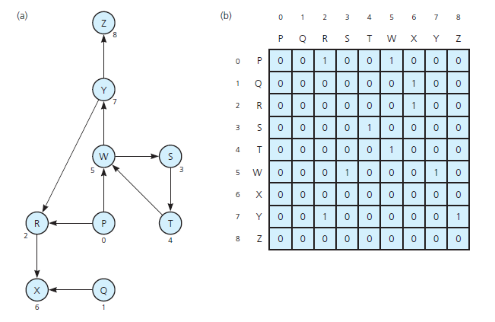
Implementing Graphs

Slide 22
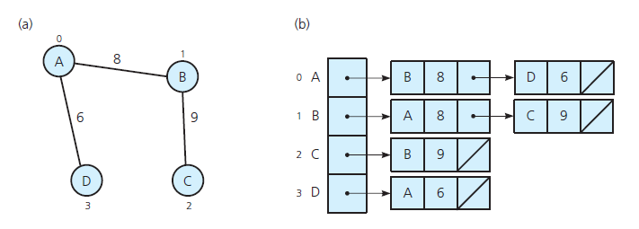
Implementing Graphs
(a) A weighted undirected graph and (b) its adjacency list

Slide 23
