Slide 1
Tree
1

Slide 2
Tree
A nonlinear data structure
Contain a distinguished node R, called the root of tree and a set of sub trees.
Two nodes n1 and n2 are called siblings if they have the same parent node.
Root
Subtrees
Figure: Tree

Slide 3
Root: node without parent (A)
Siblings: nodes share the same parent
Internal node: node with at least one child (A, B, C, F)
External node (leaf ): node without children (E, I, J, K, G, H, D)
Ancestors of a node: parent, grandparent, grand-grandparent, etc.
Descendant of a node: child, grandchild, grand-grandchild, etc.
Depth / Height: maximum number of node in a branch of tree
Degree of a node: the number of its children
Subtree: tree consisting of a node and its descendants
A
B
C
D
E
F
G
H
I
J
K

Slide 4
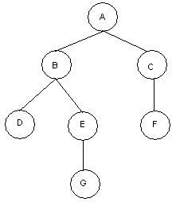
Binary Tree
A binary tree T is defined as a finite set of elements, called nodes such that:
T contains a distinguished node R, called the root of T and the remaining nodes of T form an ordered pair of disjoint binary trees T1 and T2. T1 and T2 are called the left and right subtrees of R.
Any node N in a binary tree T has either 0, 1 or 2 successors.
Nodes with no successors are called terminal nodes or leaf nodes.
Example:
Binary Tree: T
Root: A
Nodes with 2 Successors: A, B
Nodes with 1 Successors: C, E
Terminal Nodes: D, F, G
Figure: Binary Tree T
4

Slide 5
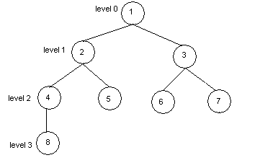
Some Basic Terms
Edge: A line from a node N of T to a successor is called an edge.
Path: A sequence of consecutive edges is called a path.
Branch: A path from root node to a leaf node is called branch.
Level of Binary Tree: Each node in a binary tree T is assigned a level number. The root R of T has level number 0 and every other node has level number which is one more than the level number of its parent.
Depth of Binary Tree: Maximum number of nodes in a branch of T is the depth of T.
Binary Tree: T
Edge: (1, 2), (3, 6) ....
Path: (1, 2, 4), (1, 3, 6)
Branch: (1, 2, 4, 8), (1, 2, 5), (1, 3, 6), (1, 3, 7)
Depth: 4
Figure: Binary Tree T.
5

Slide 6
A
Property Value
Number of nodes
Height
Root Node
Leaves
Interior nodes
Ancestors of H
Descendants of B
Siblings of E
Right subtree of A
Degree of this tree
B
C
D
E
F
G
H
I

Slide 7
Representation of Algebraic Expression Using Binary Tree
Expression E = ( ( a + b ) * r + w / t ) * x
*
+
x
*
/
+
r
w
t
a
b
Figure: Binary Tree T Expressing the Algebraic Expression E.
7

Slide 8

Representation of Algebraic Expression Using Binary Tree
E=(a-b)/((c*d)+e)
${\text{(2}\text{x}\text{+}\text{y}\text{)(5}\text{a}\text{−}\text{b}\text{)}}^{3}$

Slide 9
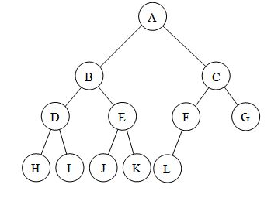
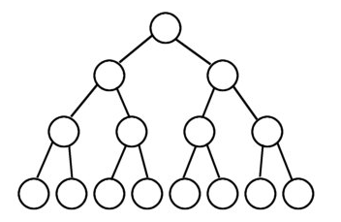
Complete binary tree
A complete binary tree is a binary tree in which every level, except possibly the last, is completely filled, and all nodes are as far left as possible.
Full binary tree
A full binary tree (sometimes proper binary tree or 2-tree) is a tree in which every node other than the leaves has two children.

Slide 10
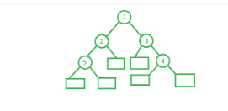
Extended binary tree
Extended binary tree is a type of binary tree in which all the null sub tree of the original tree are replaced with special nodes called external nodes whereas other nodes are called internal nodes.

Slide 11
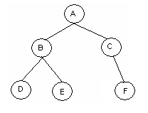
Sequential Representation of Binary Tree
Use only a single liner array Tree.
Tree[1] represents the Root of T.
If node N is in Tree[K], then its left child is in Tree[2K] and right child is in Tree[2K+1].
Tree[1] = NULL indicates T is empty.
Example:
1
2
3
4
5
6
7
8
9
10
Tree =
A
B
C
D
E
F
Figure: Binary Tree T and its sequential representation.
11

Slide 12

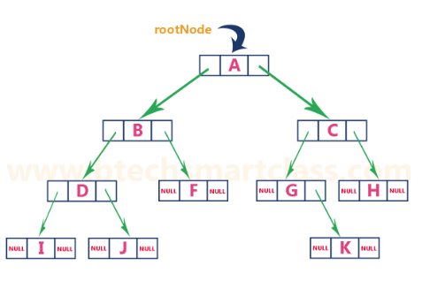
Linked List Representation of Binary Tree
We use a double linked list to represent a binary tree. In a double linked list, every node consists of three fields.
First field for storing left child address, second for storing actual data and third for storing right child address. In
this linked list representation, a node has the following structure.
The above example of the binary tree represented using Linked list representation is shown as follows...

Slide 13
Traversing a Binary Tree
13

Slide 14
Traversing Binary Tree
There are 3 ways of traversing a binary tree T having root R.
Pre-order Traversing
Steps:
(a) Process the root R
(b) Traverse the left subtree of R in preorder.
(c) Traverse the right subtree of R in preorder.
A
B
C
D
E
F
G
H
I
J
Preorder Traversal of T
A, B, D, H, E, C, F, I, J, G
14

Slide 15
A
2. In-order Traversing
Steps:
(a) Traverse the left subtree of R in inorder.
(b) Traverse the root R.
(c) Traverse the right subtree of R in inorder.
B
C
D
E
F
G
H
I
J
Inorder Traversal of T
D, H, B, E, A, I, F, J, C, G
15

Slide 16
3. Post-order Traversing
Steps:
(a) Traverse the left subtree of R in postorder.
(b) Traverse the right subtree of R in postorder.
(c) Traverse the root R.
A
B
C
D
E
F
G
H
I
J
Postorder Traversal of T
H, D, E, B, I, J, F, G, C, A
16

Slide 17
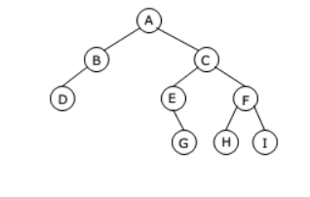
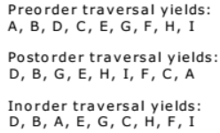
Find Preorder, Postorder and Inorder traversing of following tree:

Slide 18
Let E denote the following algebraic expression: [a+(b-c)]*[(d-e)/(f+g-h)]
Draw the binary tree and
Find out the preorder and postorder traversal of T to match with the following notations:
Prefix: * + a - b c / - d e - + f g h
Postfix: a b c - + d e – f g + h - / *
…………………….. Preorder
……………………… Postorder

Slide 19
Binary Tree Construction
Can you construct the binary tree, given two traversal sequences?
Depends on which two sequences are given.

Slide 20
Some Examples
preorder = ab
a
a
b
b
inorder = ab
b
a
a
b
postorder = ab
b
b
a
a

Slide 21
Inorder And Preorder
inorder = g d h b e i a f j c
preorder = a b d g h e i c f j
Scan the preorder left to right using the inorder to separate left and right subtrees.
a is the root of the tree; gdhbei are in the left subtree; fjc are in the right subtree.
a
gdhbei
fjc

Slide 22
Inorder And Preorder
a
gdhbei
fjc
inorder = g d h b e i a f j c
preorder = a b d g h e i c f j
b is the next root; gdh are in the left subtree; ei are in the right subtree.
a
b
fjc
gdh
ei

Slide 23
Inorder And Preorder
a
b
fjc
gdh
ei
inorder = g d h b e i a f j c
preorder = a b d g h e i c f j
d is the next root; g is in the left subtree; h is in the right subtree.
a
b
fjc
d
ei
g
h

Slide 24
Inorder And Postorder
Scan postorder from right to left using inorder to separate left and right subtrees.
inorder = g d h b e i a f j c
postorder = g h d i e b j f c a
Tree root is a; gdhbei are in left subtree; fjc are in right subtree.

Slide 25
Preorder And Postorder
preorder = ab
a
a
postorder = ba
b
b
Preorder and postorder do not uniquely define a binary tree.

Slide 26
Suppose the following sequences list the nodes of a binary tree T in preorder and inorder, respectively: Preorder: G B Q A C K F P D E R H Inorder: Q B K C F A G P E D H R Draw the diagram of the tree.
Example: 7.1-7.8
Solved Problems: 7.1-7.5
Supplementary Problems: 7.1-7.6

