Slide 1
Stacks

Slide 2
Introduction to Stacks
A Stack is a list of elements in which an element may be inserted or deleted only at one end, called the top of the stack.
Stacks are also called last-in first-out (LIFO) lists.
40
30
20
10
STACK
TOP

Slide 3
Operation on Stacks
Two basic operations associated with Stacks,
PUSH.
POP.
PUSH
PUSH is the term used to insert an element into stack.
POP
POP is the term used to delete an element from a stack.

Slide 4
Operation on Stacks
Algorithm: PUSH(STACK, TOP, MAXSTK, ITEM)
IF(TOP=MAXSTK)
OVERFLOW
TOP:=TOP+1
STACK[TOP]:=ITEM
MAXSTK
40
30
20
10
TOP

Slide 5
Operation on Stacks
Algorithm: POP(STACK, TOP, ITEM)
IF(TOP=O)
UNDERFLOW
ITEM:= STACK[TOP]
TOP:=TOP-1
40
30
20
10
TOP

Slide 6
Expression Transformation: Polish
In common arithmetic operations, the operator symbol is placed between its two operands is called infix notation.
A+B C-D
Polish Notation
Polish notation named after the polish mathematician Jan Lukasiewicz, refers to the notation in which the operator symbol is placed before its two operands. It is also called prefix notation.
+AB -CD
Infix | Polish/Prefix
(A+B)*C | *+ABC
A+(B*C) | +A*BC
(A+B)/(C-D) | /+AB-CD

Slide 7
Expression Transformation: Postfix
Postfix Notation
Reverse Polish notation analogously refers to Postfix notation. That means in Postfix notation, operator symbol placed after its two operands.
AB+ CD-
Infix | Postfix
(A+B)*C | AB+C*
A+(B*C) | ABC*+
(A+B)/(C-D) | AB+CD-/

Slide 8
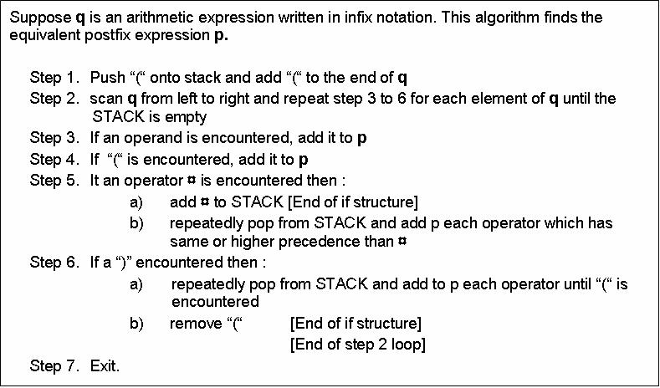

Slide 9
Transformation: Infix to Postfix
Infix Q: A+(B*C-(D/E^F)*G)*H
PUSH “(” onto the STACK and Add “)” at the end of Q,
Infix Q: (A+(B*C-(D/E^F)*G)*H)
Serial | Symbol Scanned | STACK | Expression P
1 | A | ( | A
2 | + | ( + | A
3 | ( | ( + ( | A
4 | B | ( + ( | A B
5 | * | ( + ( * | A B
6 | C | ( + ( * | A B C
7 | - | ( + ( - | A B C *
8 | ( | ( + ( - ( | A B C *
9 | D | ( + ( - ( | A B C * D

Slide 10
Transformation: Infix to Postfix
Serial | Symbol Scanned | STACK | Expression P
10 | / | ( + ( - ( / | A B C * D
11 | E | ( + ( - ( / | A B C * D E
12 | ^ | ( + ( - ( / ^ | A B C * D E
13 | F | ( + ( - ( / ^ | A B C * D E F
14 | ) | ( + ( - | A B C * D E F ^ /
15 | * | ( + ( - * | A B C * D E F ^ /
16 | G | ( + ( - * | A B C * D E F ^ / G
17 | ) | ( + | A B C * D E F ^ / G * -
18 | * | ( + * | A B C * D E F ^ / G * -
19 | H | ( + * | A B C * D E F ^ / G * - H
20 | ) |  | A B C * D E F ^ / G * - H * +

Slide 11
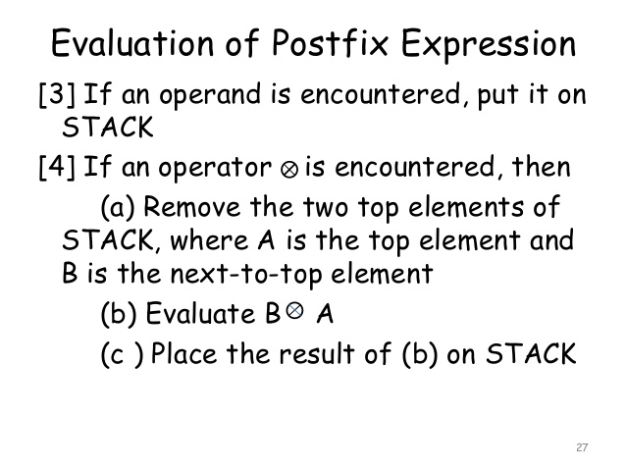

Slide 12
Evaluation of a Postfix Expression
The Computer usually evaluates an arithmetic expression written in infix notation in two steps,
Converts infix to postfix.
Evaluate the postfix expression.
Infix Q: 5*(6+2)-12/4
Postfix P: 5, 6, 2, +, *, 12, 4, /, -
Add a sentinel right parenthesis
at the end of P.
P: 5, 6, 2, +, *, 12, 4, /, -, )
Serial | Scanned Symbol | STACK
1 | 5 | 5
2 | 6 | 5, 6
3 | 2 | 5, 6, 2
4 | + | 5, 8
5 | * | 40
6 | 12 | 40, 12
7 | 4 | 40, 12,4
8 | / | 40,3
9 | - | 37
10 | )

