Slide 1
Data Structures- Chapter 6
Queues
A queue is a linear list of elements in which deletions can take place only at one end, called the front, and insertions can take place only at the other end, called the rear.
Queues are also called first-in first-out (FIFO) lists, since the first element in a queue will be the first element out of the queue. In other words, the order in which elements enter a queue is the order in which they leave.
Example:
A line of people waiting at a bus stop form a queue, where the first person in line is the first person to board the bus.
A line of people waiting to be served by an ATM machine.
Collection of documents sent to a shared printer.

Slide 2
Data Structures- Chapter 6
Representation of Queues
Queues may be represented in the computer by a linear array QUEUE and two pointer variables: FRONT, containing the location of the front element of the queue; and REAR, containing .the location of the rear element of the queue.
FRONT = NULL indicates that the queue is empty.
The following Figure indicates the way elements will be deleted from the queue and the way new elements will be added to the queue. Whenever an element is deleted from the queue, the value of FRONT is increased by 1.
FRONT := FRONT + 1
Similarly, whenever an element is added to the queue, the value of REAR is increased by 1.
REAR := REAR + 1

Slide 3
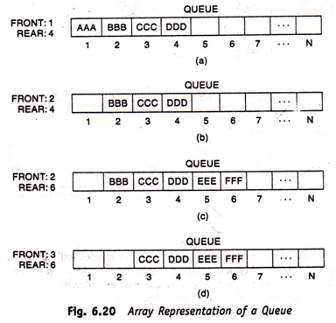
Data Structures- Chapter 6
Representation of Queues

Slide 4
Data Structures- Chapter 6
Procedure 6.13: Write a procedure that inserts an ITEM onto a queue.
QINSERT (QUEUE, N, FRONT, REAR, ITEM)
This procedure inserts an element ITEM into a queue.
1. If FRONT = 1 and REAR = N, or if FRONT = REAR + 1, then
Write: OVERFLOW, and Return.
2. If FRONT = NULL, then
Set FRONT = 1 and REAR = 1
Else if REAR = N, then
Set REAR = 1
Else
Set REAR = REAR + 1
[End of If structure.]
3. Set QUEUE [REAR] = ITEM
4. Return.

Slide 5
Data Structures- Chapter 6
Procedure 6.14: Write a procedure that deletes an element from a queue.
QDELETE(QUEUE, N, FRONT, REAR, ITEM)
This procedure deletes an element from a queue and assigns it to the variable ITEM.
1. If FRONT:= NULL, then: Write: UNDERFLOW, and Return.
2. Set ITEM:= QUEUE[FRONT].
3. If FRONT= REAR, then:
Set FRONT := NULL and REAR := NULL.
Else if FRONT = N, then:
Set FRONT := 1.
Else:
Set FRONT := FRONT + 1
[End of If structure.]
4. Return.

Slide 6
Data Structures- Chapter 6
DEQUES
A deque is a linear list in which elements can be added or removed at either end but not in the middle. The term deque is a contraction of the name double-ended queue.
Deque is maintained in memory by a circular array DEQUE with pointers LEFT and RIGHT, which point to the two ends of the deque.
Elements extend from the left end to the right end in the array.
Figure pictures two deques, each with 4 elements maintained in an array with N = 8 memory locations.
LEFT = NULL indicates that a deque is empty.

Slide 7
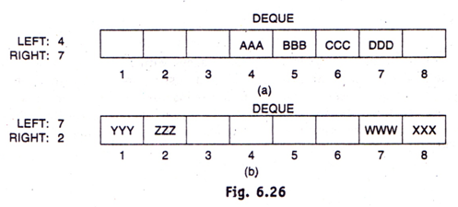
Data Structures- Chapter 6
DEQUES

Slide 8
Data Structures- Chapter 6
DEQUES
There are two variations of a deque:
An input-restricted deque
An input-restricted deque is a deque which allows insertions at only one end of the list but allows deletions at both ends of the list.
An output-restricted deque
An output-restricted deque is a deque which allows deletions at only one end of the list but allows insertions at both ends of the list.

Slide 9
Data Structures- Chapter 6
Priority Queues
A priority queue is a collection of elements such that each element has been assigned a priority and such that the order in which the elements are deleted and processed comes from the following rules:
An element of higher priority is processed before any element of lower priority.
Two elements with the same priority are processed according to the order in which they were added to the queue.

Slide 10
Data Structures- Chapter 6
One-Way List Representation of a Priority Queues
One way to maintain a priority queue in memory is by means of a one-way list as follows:
a) Each node contains three items of information:
An information field INFO, a priority number PRN and a link number
LINK.
b) A node X proceeds a node Y in the list:
When X has higher priority than Y OR
When both have the same priority but X was added to the list before Y.

Slide 11
Data Structures- Chapter 6
One-Way List Representation of a Priority Queues
Start
PRN
AAA
1
BBB
2
CCC
2
DDD
4
EEE
5
FFF
6
×

