Slide 1

Tower of Hanoi

Slide 2
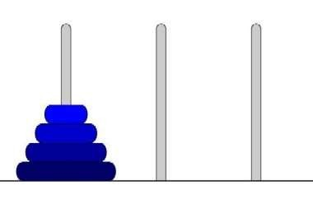
What????
Three rods, one with n disks of decreasing diameter; two other rods are empty

Slide 3
Objective
The Objective is to transfer the entire tower to one of the other rods.

Slide 4
Rules
Only one disk may be moved at a time. Specifically, only the top disk
on any disk on any rod may be moved to any other rod.
At no time can a larger disk be placed on a smaller disk.

Slide 5
Tower of Hanoi

Slide 6
Tower of Hanoi

Slide 7
Tower of Hanoi

Slide 8
Tower of Hanoi

Slide 9
Tower of Hanoi

Slide 10
Tower of Hanoi

Slide 11
Tower of Hanoi

Slide 12
Tower of Hanoi

Slide 13
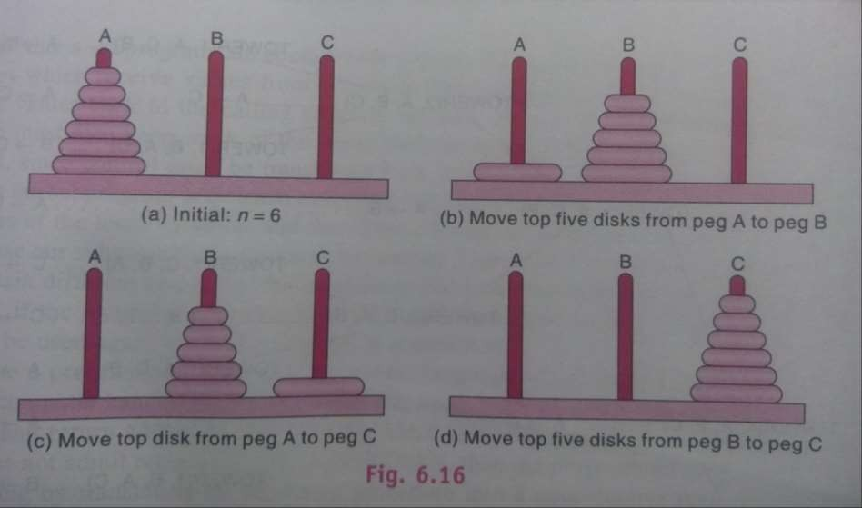
Tower of Hanoi

Slide 14
Algorithm
Let’s call the three rod BEG(Source), AUX(AUXiliary) and st(Destination).
Move the top N – 1 disks from the Source to AUXiliary tower
Move the Nth disk from Source to Destination tower
Move the N – 1 disks from AUXiliary tower to Destination tower. Transferring the top N – 1 disks from Source to AUXiliary tower can again be thought of as a fresh problem and can be solved in the same manner.

Slide 15
Algorithm
TOWER(N,BEG,AUX,END)
If N=1 then BEG → END TOWER(N-1,BEG,END,AUX)
RETURN
BEG → END TOWER(N-1,AUX,BEG,END)
RETURN

Slide 16
Tower of Hanoi( N= 3)
Move from BEG to END
Move from BEG to AUX
Move from END to AUX
Move from BEG to END
Move from AUX to BEG
Move from AUX to END
Move from BEG to END

Slide 17
Tower of Hanoi( N= 4)
Move from BEG to AUX
Move from BEG to END
Move from AUX to END
Move from BEG to AUX
Move from END to BEG
Move from END to AUX
Move from BEG to AUX

Slide 18
Tower of Hanoi( N= 4)
Move from BEG to END
Move from AUX to END
Move from AUX to BEG
Move from END to BEG
Move from AUX to END
Move from BEG to AUX
Move from BEG to END
Move from AUX to END

Slide 19
Thank You

