Slide 1


Hospitality Insights
Go To Power BI

Slide 2
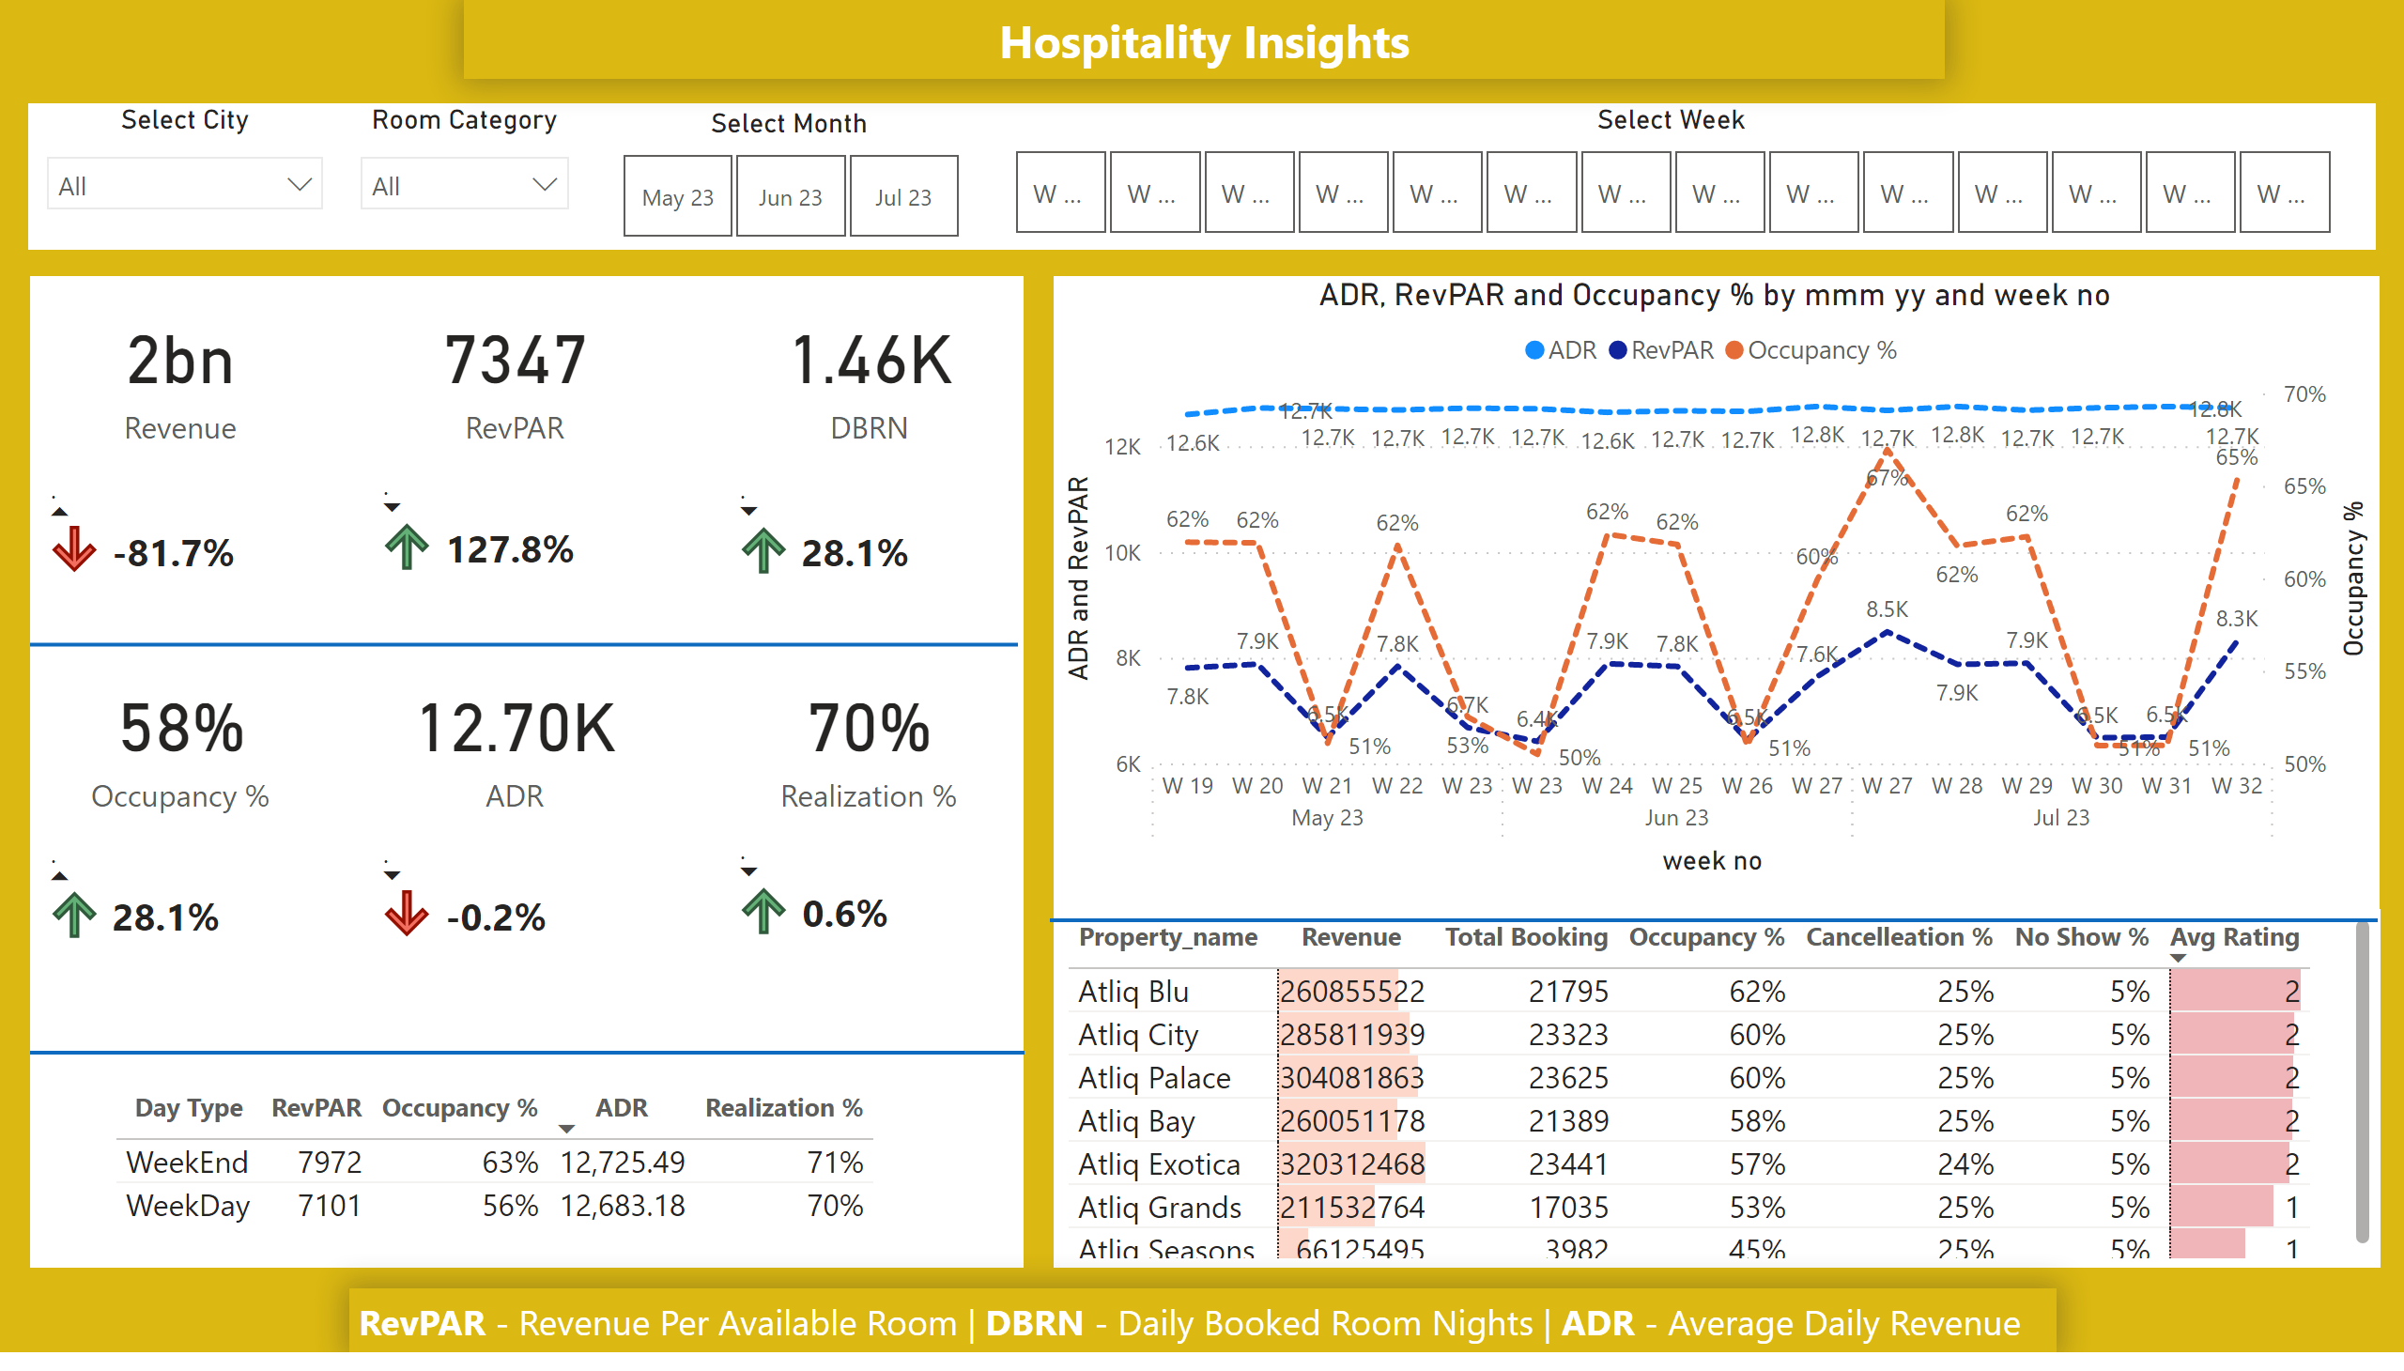
DashBoard
Notes:
Select Month
No alt text provided
Select Week
No alt text provided
Select City
No alt text provided
Room Category
No alt text provided
lineChart
No alt text provided
tableEx
No alt text provided
card
No alt text provided
card
No alt text provided
card
No alt text provided
card
No alt text provided
card
No alt text provided
card
No alt text provided
tableEx
No alt text provided
tableEx
No alt text provided
tableEx
No alt text provided
tableEx
No alt text provided
tableEx
No alt text provided
tableEx
No alt text provided
shape
No alt text provided
tableEx
No alt text provided
shape
No alt text provided
textbox
No alt text provided
shape
No alt text provided
shape
No alt text provided
shape
No alt text provided
textbox
No alt text provided

Slide 3
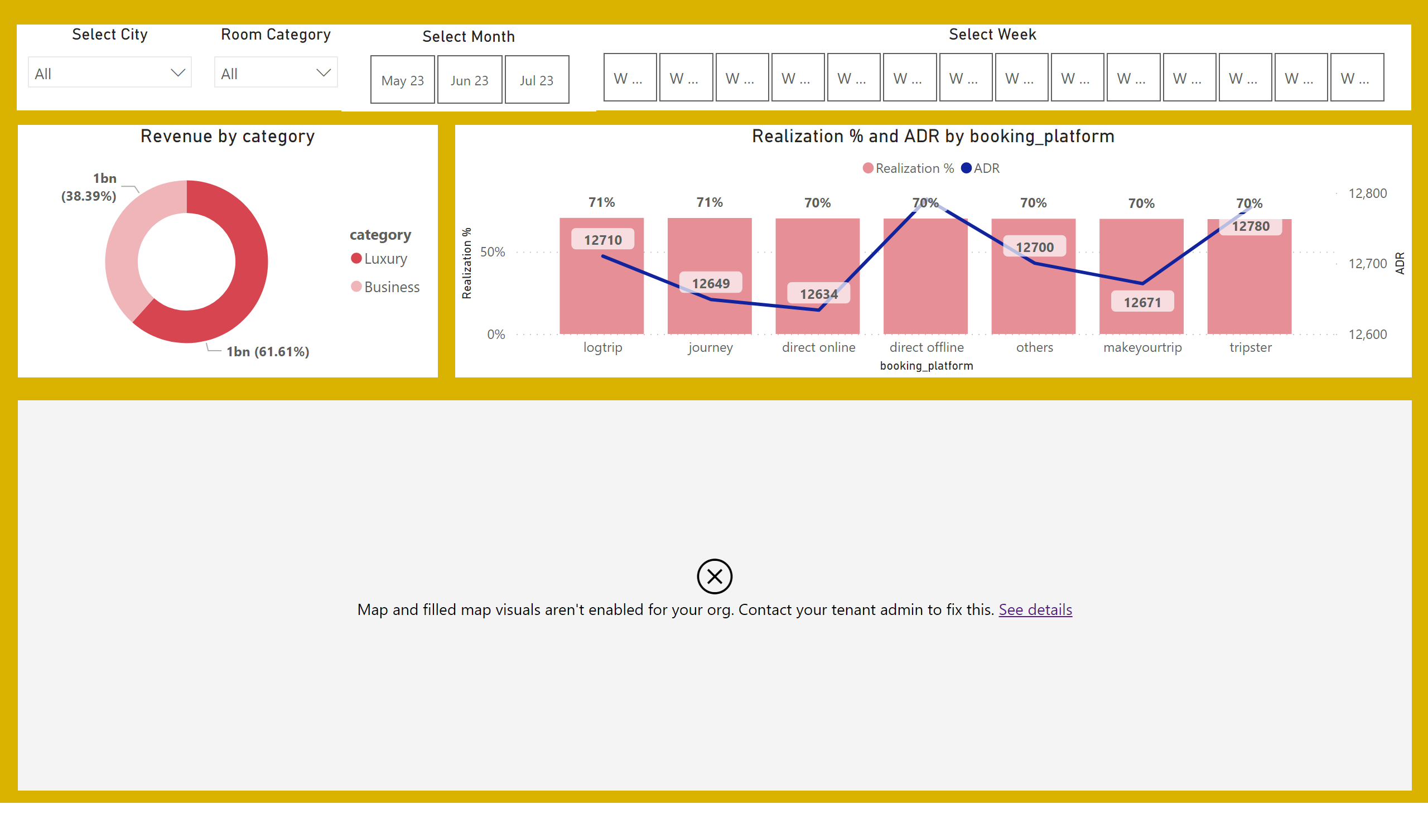
Details
Notes:
donutChart
No alt text provided
lineClusteredColumnComboChart
No alt text provided
Select Month
No alt text provided
Select Week
No alt text provided
Select City
No alt text provided
Room Category
No alt text provided
map
No alt text provided

Slide 4
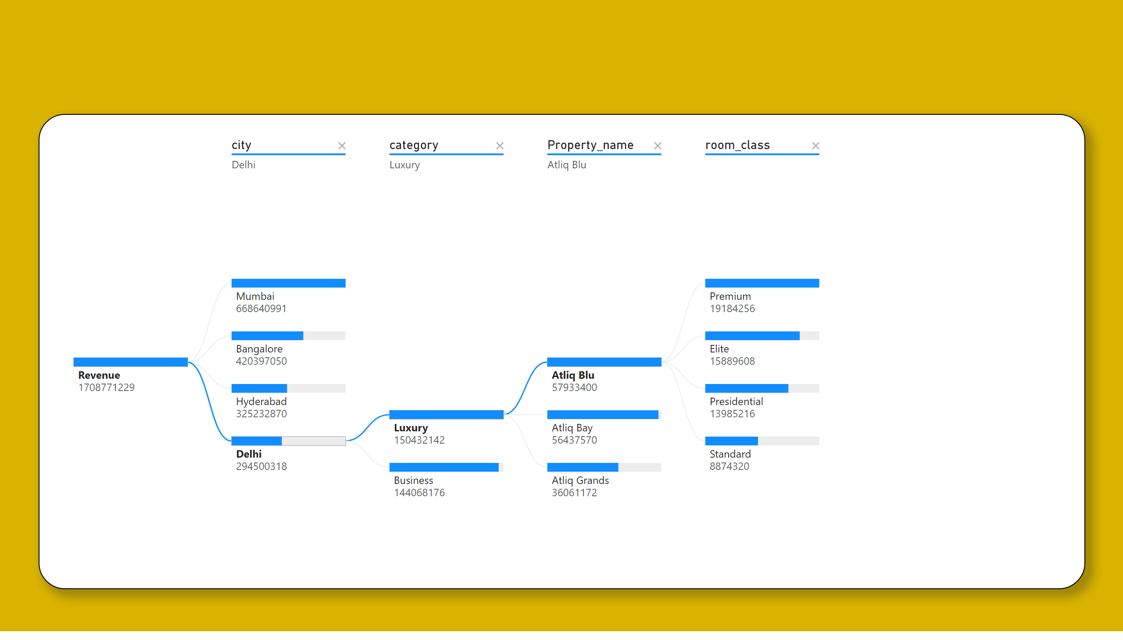
Decomposition Tree
Notes:
decompositionTreeVisual
No alt text provided

Slide 5
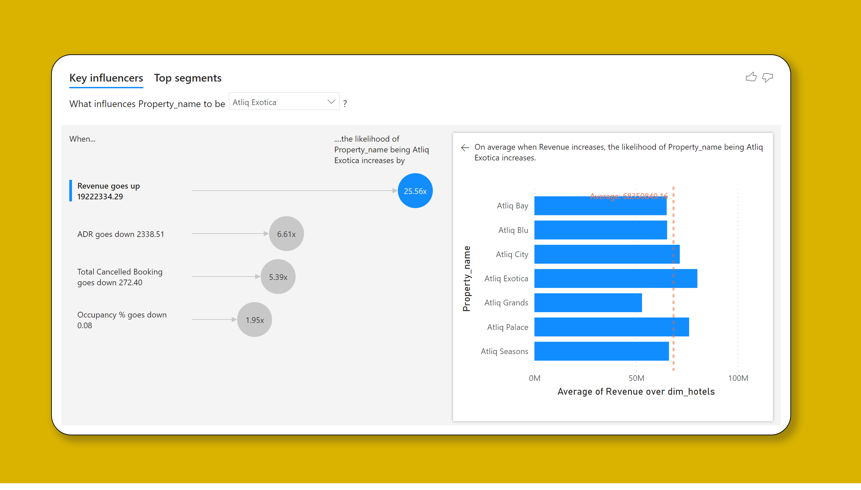
Key Influncers
Notes:
keyDriversVisual
No alt text provided

