Slide 1
Home Appliance Demand Forecasting
Pankaj Bajirao Patil

Slide 2
Problem Statement
Generate quarterly forecasts for Industry Shipment Demand for Q3 and Q4 of 2015 for each of the 13 product categories - 2 Door Bottom Mount, Front Load, Built-in Ovens, French Door, Dishwasher, MHC, Top Mount, Freezer, Free Standing Ranges.

Slide 3
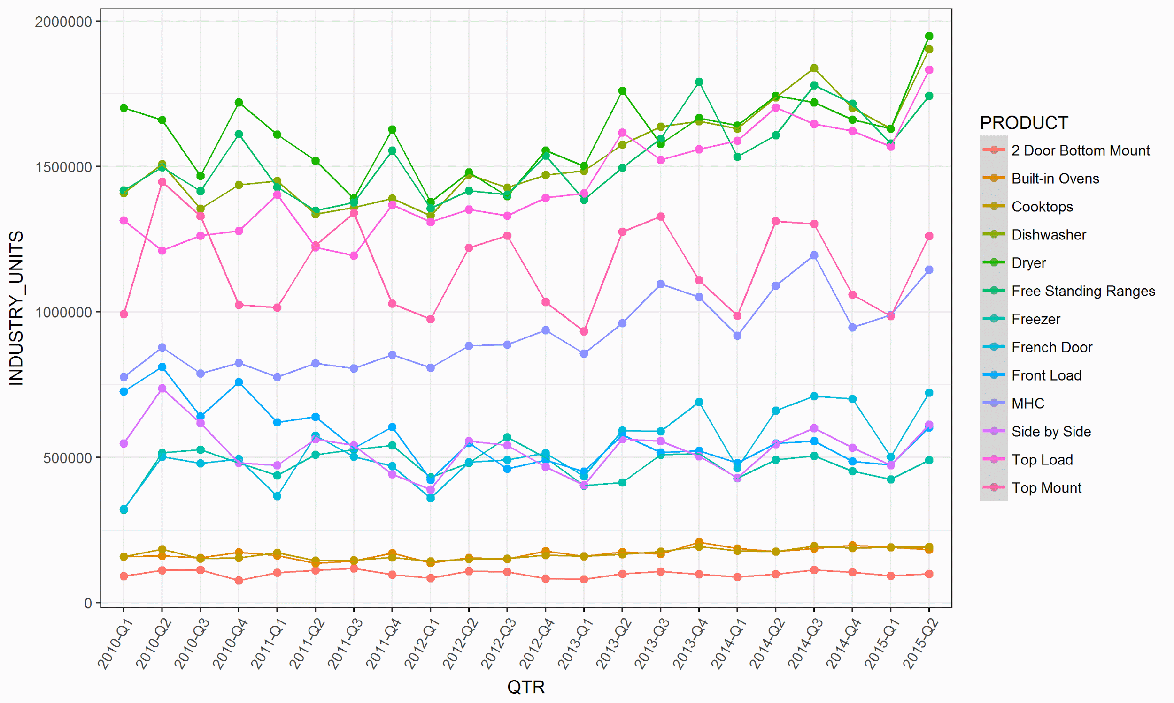

Slide 4
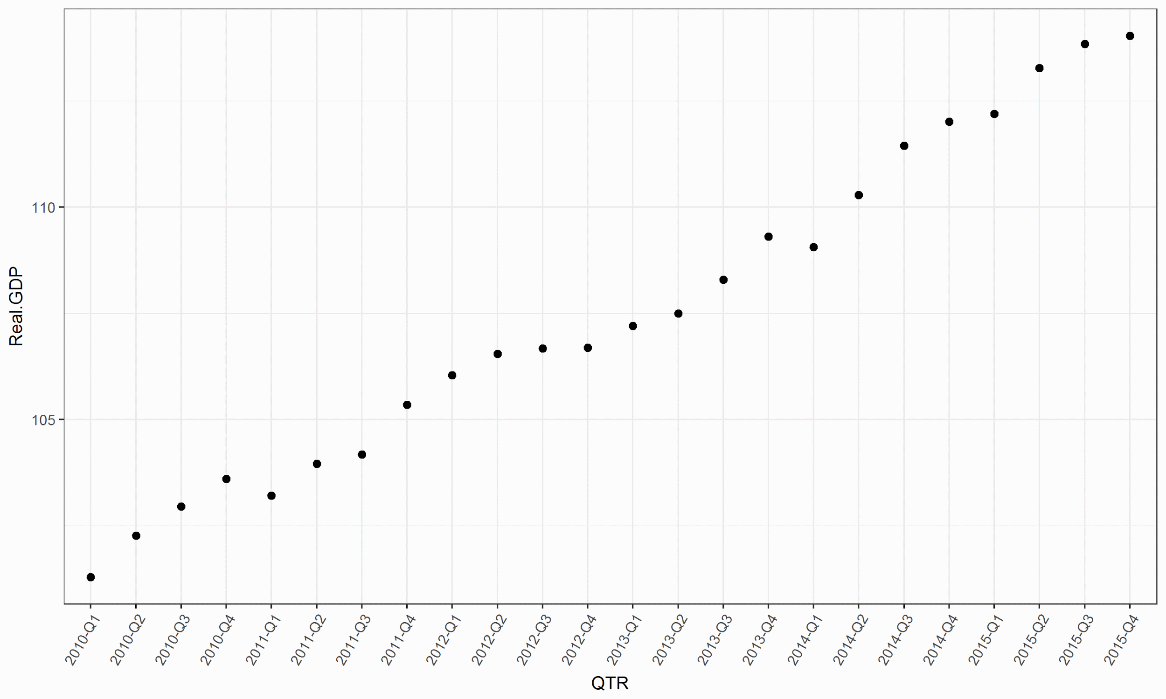

Slide 5
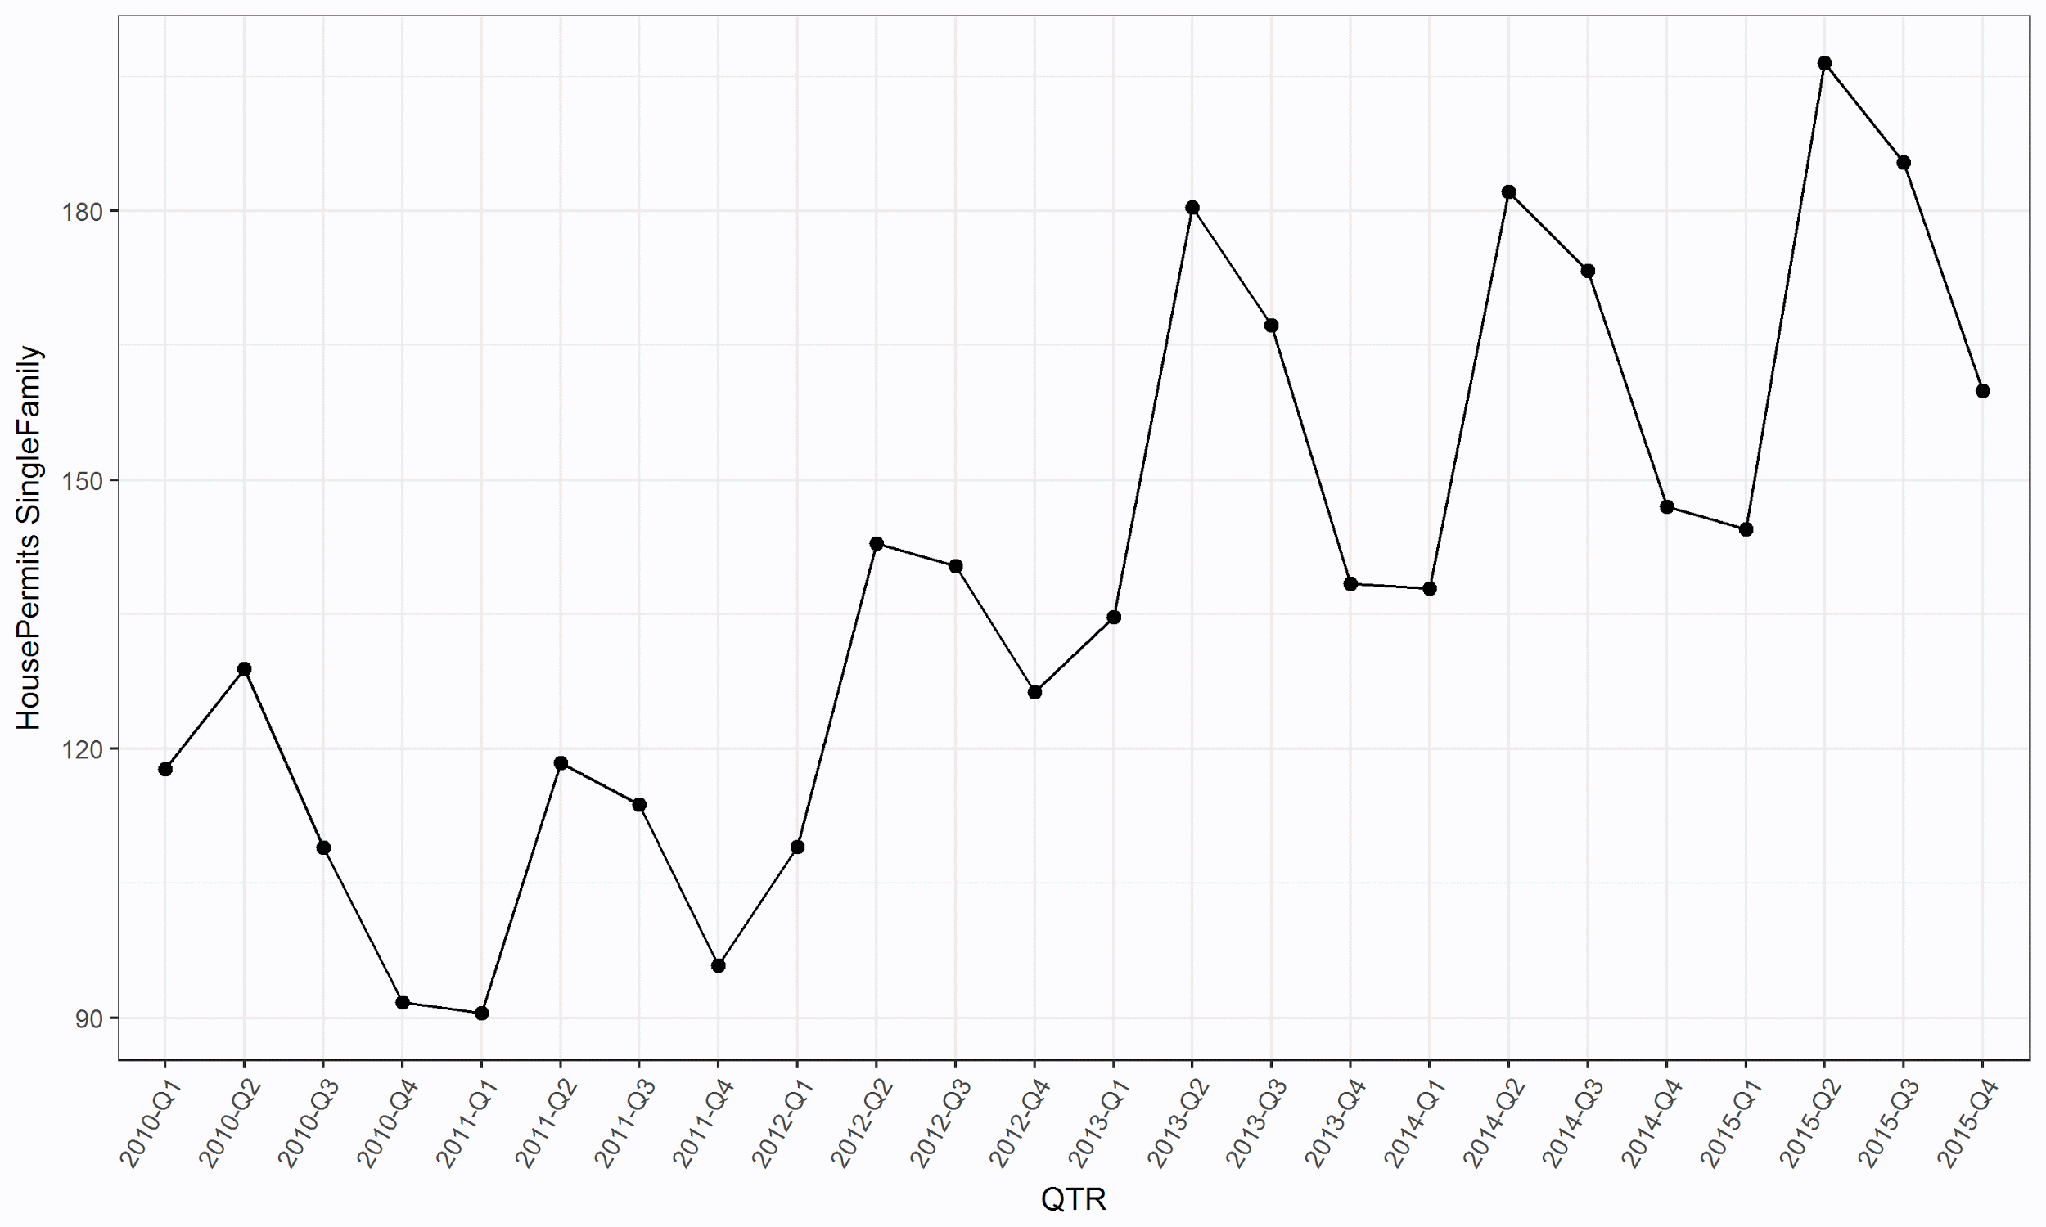

Slide 6
Key Observations
No outliers in data
Macroeconomic Factors varies consistently *
Enough data points on each product

Slide 7
Key Observations
Few macroeconomic variables vary inconsistently and they need to be checked

Slide 8
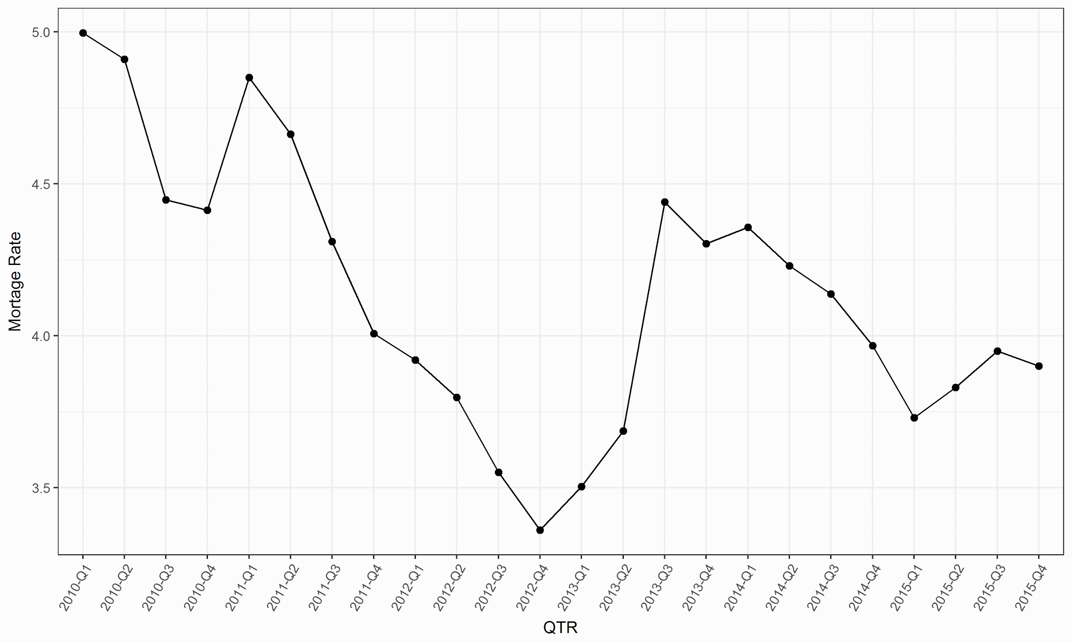

Slide 9
Assumptions
Significant macroeconomic factors do not vary inconsistently
There are no major market upsets

Slide 10
Variable Selection: Boruta
Details: package(Boruta)
Function: boruta.train
Tentative Fix Function: TentativeRoughFix

Slide 11
Modeling
Linear Regression
ARIMA Time Series
Forecast
HoltWinters**
**Selected Model

Slide 12
Modeling
HoltWinters method provided accurate forecasts
Seasonality was captured using additive process

Slide 13
Results
MAPE : 5.67%
Maximum Inaccuracy = 21.49%
Maximum accuracy = 0.61%

Slide 14


Thank You

