Slide 1
IBM DataScience Final Capstone Battle of Neighborhoods

Slide 2
1. Introduction and Business Problem
Introduction:
People seeking better career opportunities migrate from one city to another city. It is often difficult for them to find a neighborhood which is nearby to their new work location and suitable for their family in the new city. Most of the cases people love their current neighborhood because of its amenities, venues and tourist spots, so they look for neighborhood which is more similar to their current neighborhood.

Slide 3
Business Problem:
Today migration from one place to another place for better career opportunities is a most common phenomenon. Such a drastic change in the neighborhood from their currently habituated neighborhood is usually difficult for an individual and his family to adjust. On a positive note every city has its own unique and diverse neighborhoods which usually people like to explore. We can find aspects in which both the cities are similar based on the information like venues, tourist spots, restaurants etc. The goal is to analyze neighborhoods in cities and find similar neighborhoods to help people migrating to new cities to live comfortably as they are doing in their current city. In my case study, A person from Toronto wants to migrate to New York seeking a better career opportunity. By, Analyzing the Current Neighborhood of that person in Toronto we should be able to suggest a Similar Neighborhood for that person in New York.

Slide 4
2. Data Acquisition and Data Cleaning
Data Acquisition:
The data on Neighborhoods and Boroughs in New York City is obtained from an open source spatial data repository. Link - https://geo.nyu.edu/catalog/nyu_2451_34572.
The data on Neighborhoods and Borough in Toronto the information is taken from the Wikipedia list. Link - https://en.wikipedia.org/wiki/List_of_postal_codes_of_Canada:_M
The Geo Spatial Coordinates CSV of the Toronto Neighborhoods and Borough is obtained from different dataset of Latitude and Longitude of different Postal Codes.
The information such as venues, restaurants, parks, hotels etc. is collected using the Foursquare API for the neighborhoods in Toronto and New York. Foursquare API provides location-based experiences with information like venues, check-ins. Foursquare API provides the venue information in the JSON format.

Slide 5
Data Cleaning:
1. The data on Neighborhoods and Boroughs in New York City is
obtained in the JSON Format. So pandas.io.json is used to transform
this JSON data into Pandas Dataframe
2. The data of Neighborhoods of Toronto is obtained by Web Scraping the List of Postal Code of Canada : M using Beautiful Soap python package. Beautiful Soap is a popular python package for web scraping and parsing HTML files. The Resultant Pandas DataFrame of Neighborhood of Toronto is created from the Wikipedia lists web page.
3. The Geo Spatial Coordinates CSV is loaded into Pandas Dataframe to obtain the latitude and longitude information of Postal Code of Borough and Neighborhoods of Toronto

Slide 6
4. The Pandas Dataframe on Borough and Neighborhoods of Toronto is merged with the Geo Spatial Coordinates CSV of Toronto to obtain a single Dataframe consisting Neighborhoods and Borough of Toronto and their respective Latitude and Longitude information
5. The FourSquare API venue information is obtained through API call using requests python package through FourSquare API credentials. The obtained result is JSON using pandas.io.json the JSON is transformed into a pandas Dataframe.
6. The Final Dataframe after combining the FourSquare API venue data with the Dataframe of Neighborhoods and Borough of Toronto and New York Cities Seperately and renaming the Columns of the resulting Dataframe { name – Venue , lat – Venue Latitude , lng – Venue Longitude and categories – Venue Category }. The Dataframe obtained for Newyork after keeping only Manhattan Borough and The Dataframe obtained for Toronto after keeping only Downtown Toronto Borough

Slide 7
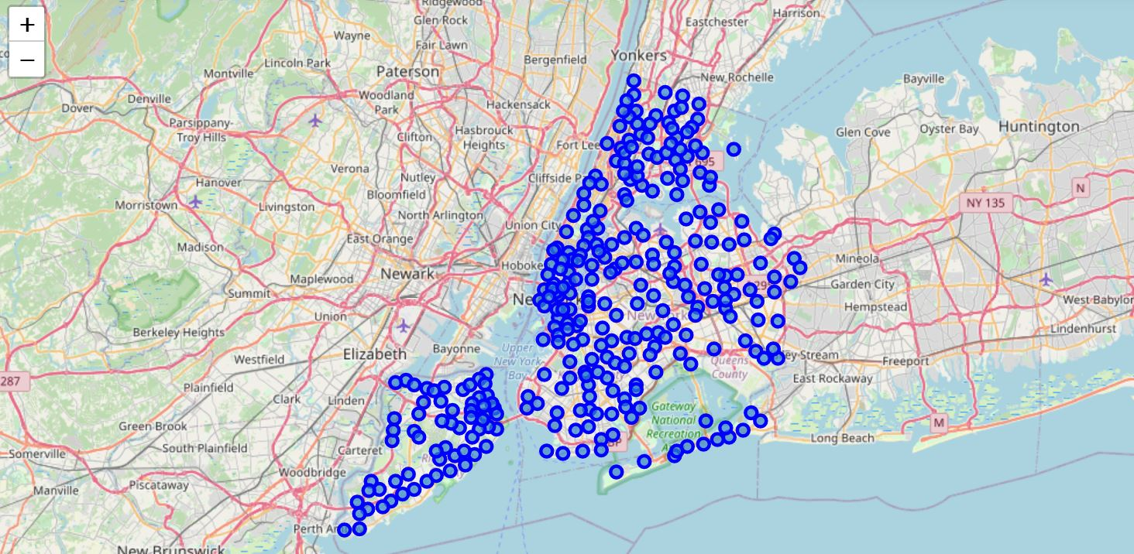
3. Methodology
Data Analysis:
Separate Data Analysis is performed for the Venue Data Extracted for the Neighborhoods of Toronto and Neighborhoods of New York. The areas Highlighted in Blue in the Map are the Neighborhoods of Newyork that is plotted using Folium from the Newyork Borough Neighborhoods Dataframe

Slide 8
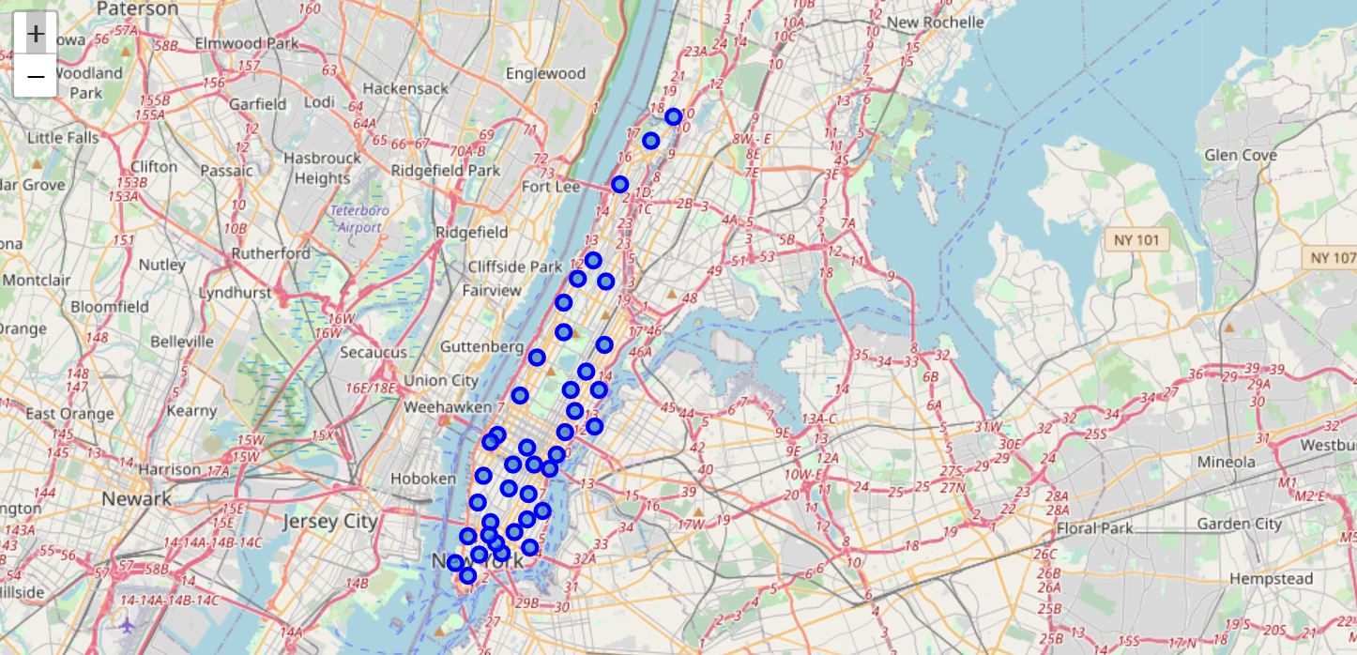
A Dataframe of Borough Manhattan is created with it’s neighborhoods containing latitude and longitude. The Manhattan Neighborhoods are separately viewed using Folium for better understanding the Manhattan Neighborhoods

Slide 9
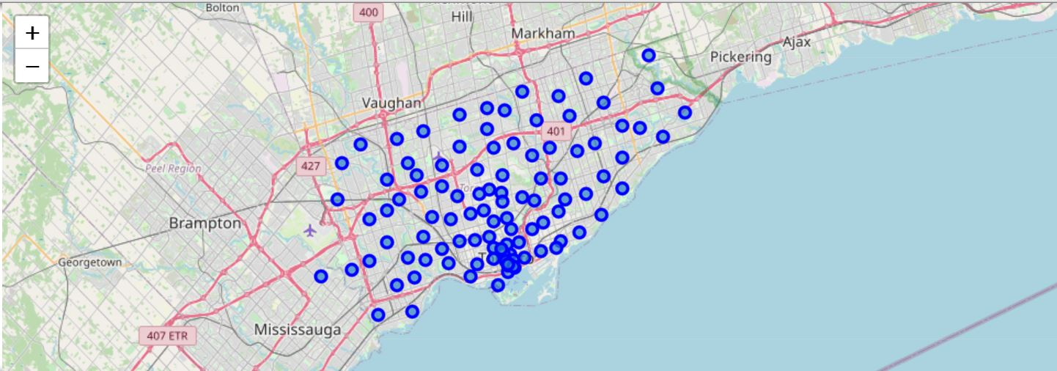
The areas highlighted in Blue in the Map are the Neighborhoods of Toronto that is plotted using Folium from the Toronto Borough Neighborhoods Data

Slide 10
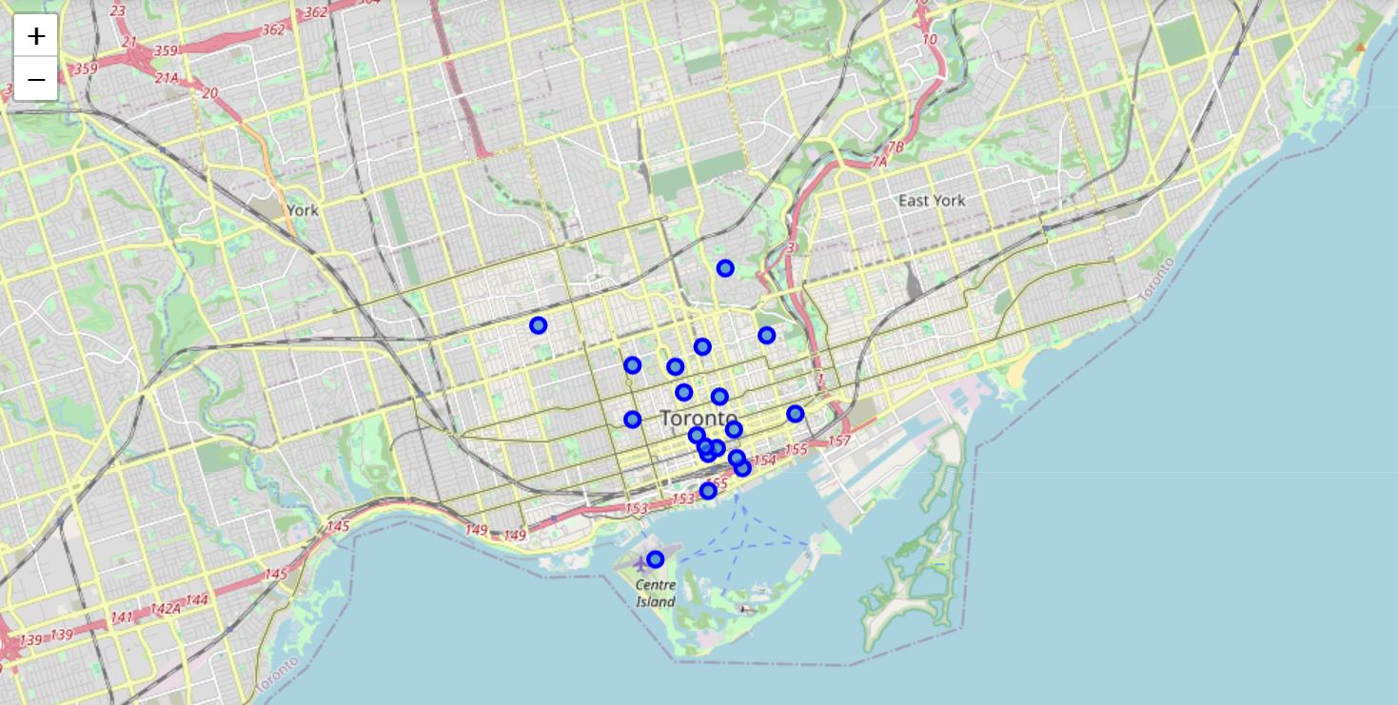
A Dataframe of Borough Downtown Toronto is created with it’s neighborhoods containing latitude and longitude. The Downtown Toronto Neighborhoods are separately viewed using Folium for better understanding the Downtown Toronto Neighborhoods

Slide 11
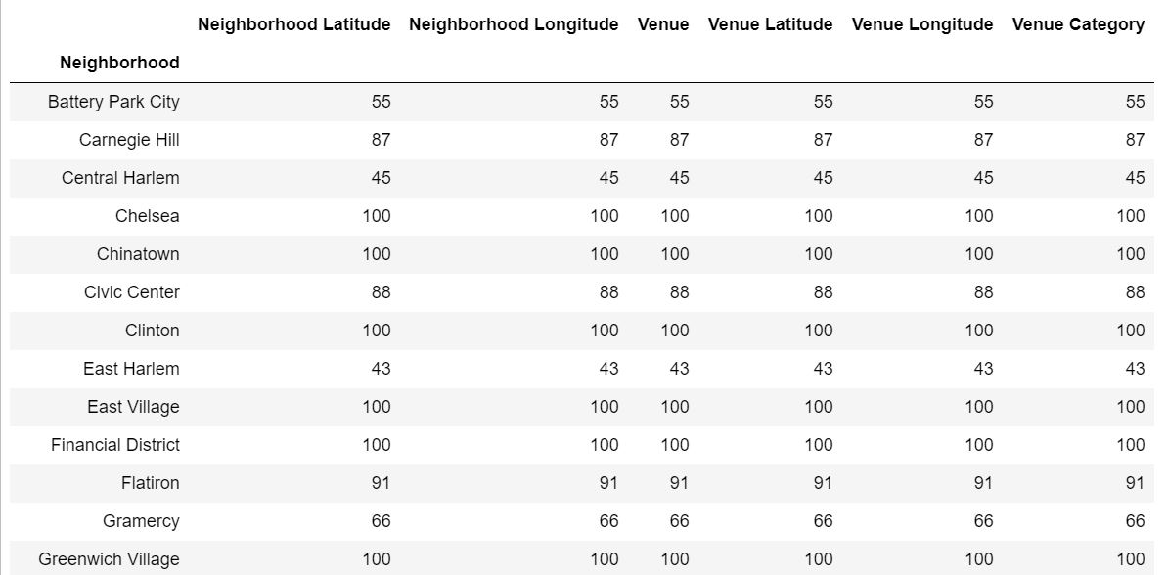
The response of the Foursquare API venues information for the Neighborhoods of Downtown Toronto result after converting into Dataframe, The Venues are Categorized into Venue Categories using data obtained from the Foursquare API.The number of Venues returned in each neighborhood is counted for Downtown Toronto and Manhattan
Manhattan

Slide 12
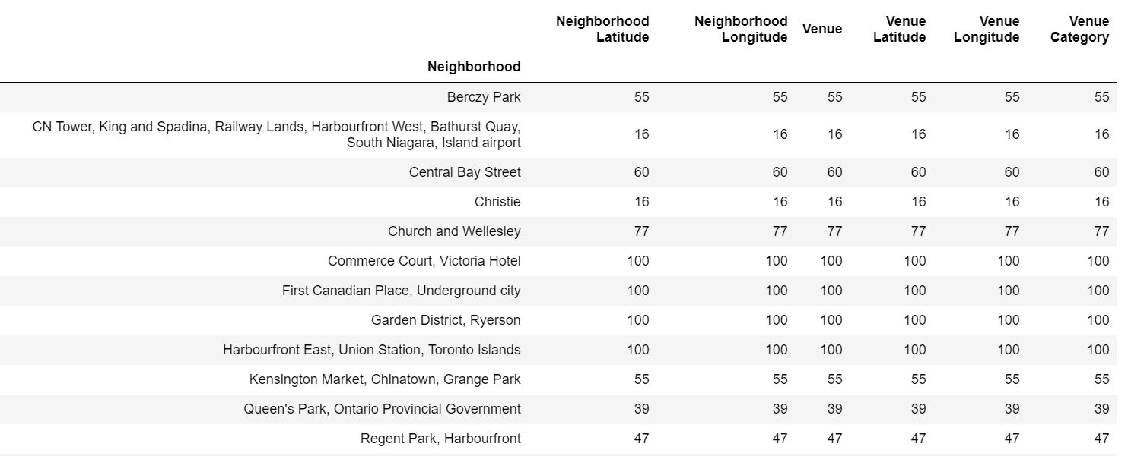
Downtown Toronto

Slide 13
Modelling:
The Final Dataframe of Manhattan containing neighborhoods with latitude and longitude information can be used to find the venues surrounding each neighborhoods within 500 meters radius by requesting the data from FourSquare API. The JSON File returned from the Foursquare API is converted into pandas Dataframe.
Preprocessing:
This Dataframe contains the venues information along with venue categories to corresponding neighborhoods. One hot encoding should be performed. The Venue Category that is present for a neighborhood is assigned 1 and else is assigned 0. Resultant Dataframe of Manhattan Neighborhoods venue data. Resultant Dataframe of Downtown Toronto Neighborhoods venue data.

Slide 14
The Venue data after one hot encoding is grouped by Neighborhoods and the mean of the frequency of occurrence of venues in each venue category for the Neighborhoods is calculated. The Frequency of occurrence of each venue category for the Manhattan. The Frequency of occurrence of each venue category for the Downtown Toronto
Finally, a Dataframe of 10 common venues is created for the neighborhoods in Manhattan and 10 common venues for the neighborhoods in Downtown Toronto
The Similarity between the Manhattan and Downtown Toronto Neighborhoods will be found using clustering the Neighborhoods that are similar using K-means clustering which is an unsupervised machine learning algorithm. K-means clustering uses a predefined cluster size for clustering. The Cluster Size of 5 shall be used to cluster the Neighborhoods of Manhattan and Downtown Toronto into 5 clusters. Based on the clusters of neighborhoods obtained from the similar venues the neighborhood from Manhattan can be shortlisted based on the amenities, venues, tourist spots etc. which is similar to the neighborhood current city Downtown Toronto.

Slide 15
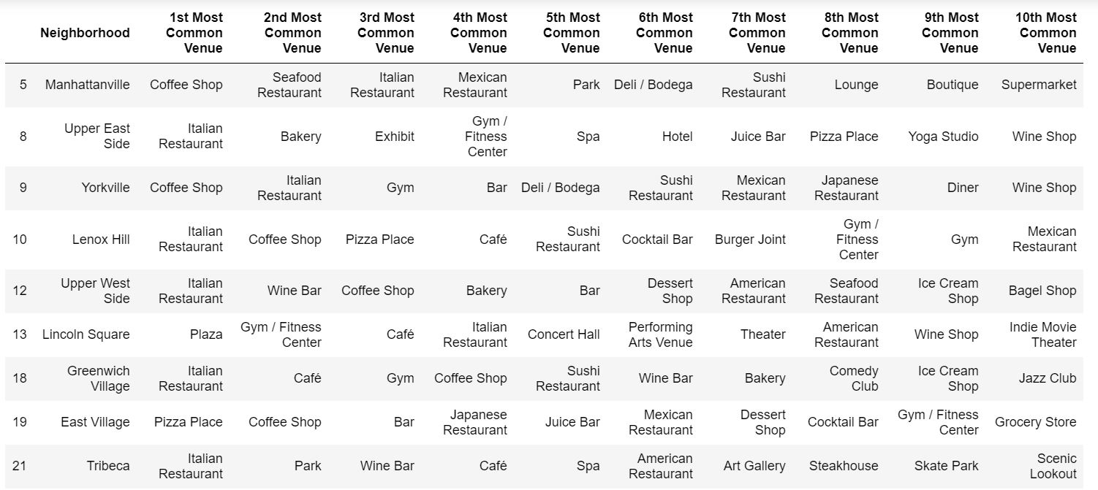
4. Results
The resultant 5 clusters obtained from K-means clustering. Examining each cluster of Manhattan Neighborhood and Downtown Toronto Neighborhood.
Cluster 1 Manhattan

Slide 16
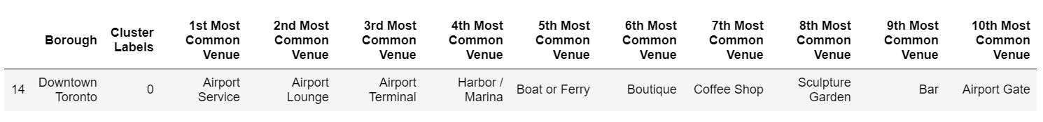
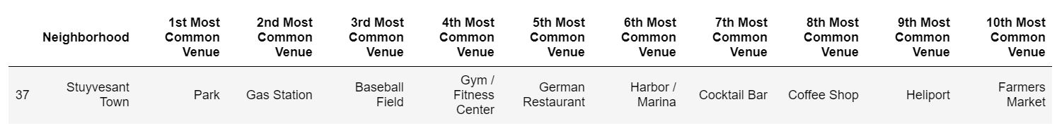
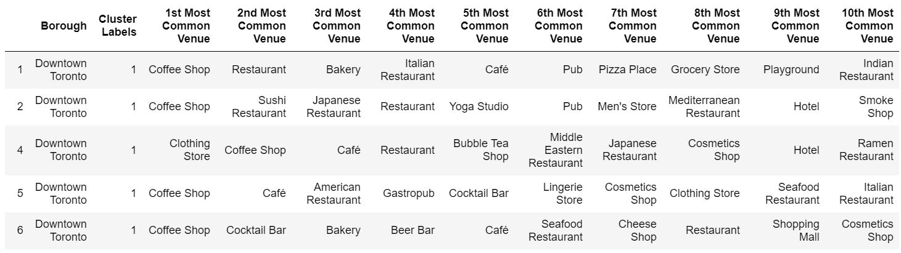
Cluster 1 Downtown Toronto
Cluster 2 Manhattan
Cluster 2 DowntownToronto

Slide 17
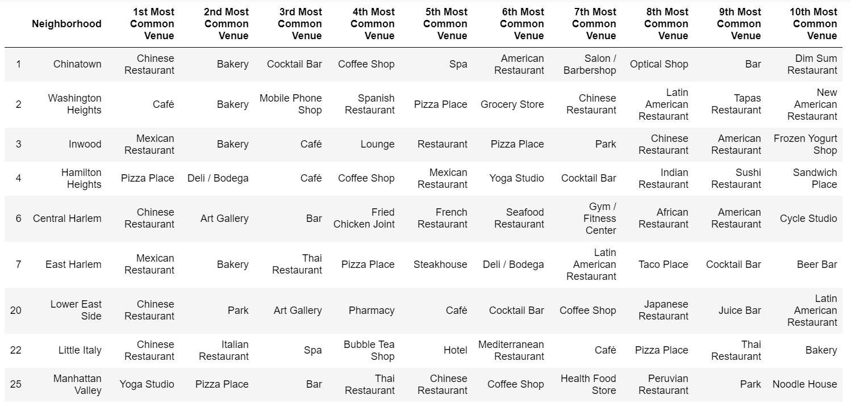
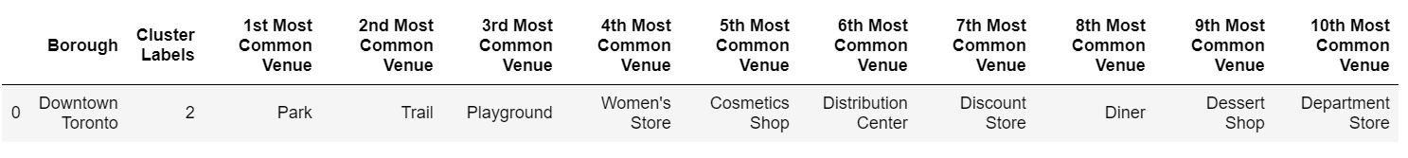
Cluster 3 Manhattan
Cluster 3 Downtown Toronto

Slide 18
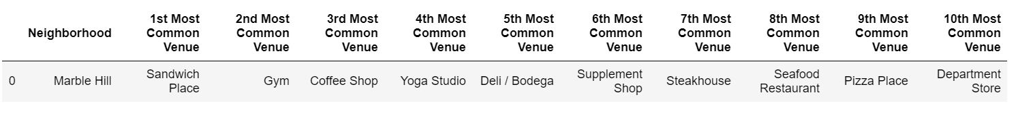
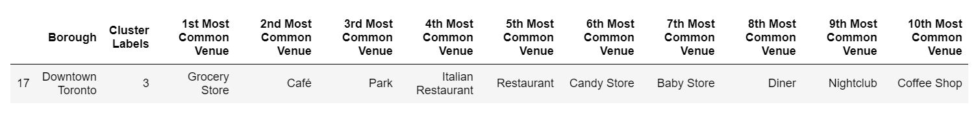
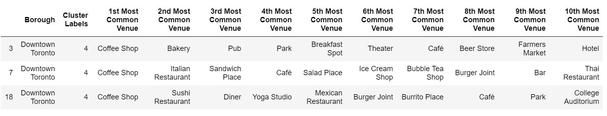
Cluster 4 Manhattan
Cluster 4 Downtown Toronto
Cluster 4 Downtown Toronto
Cluster 5 Downtown Toronto

Slide 19
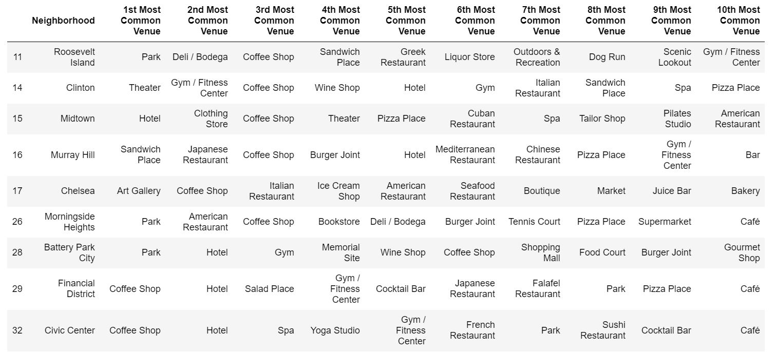
Cluster 5 Manhattan

Slide 20
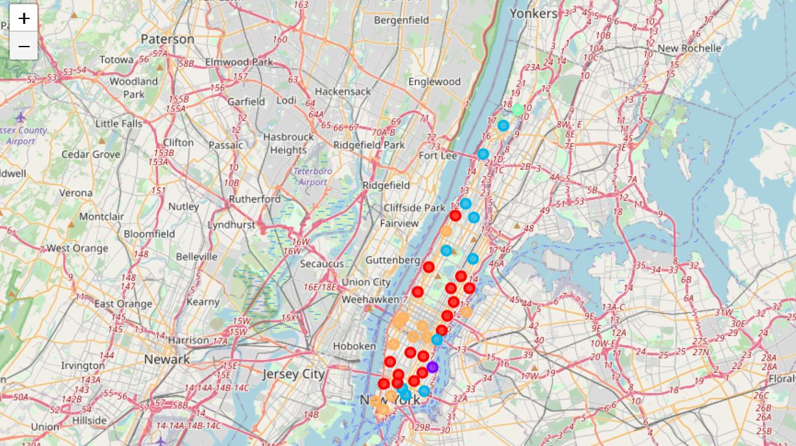
Visualizing Clustered Neighborhood using folium for Manhattan

Slide 21
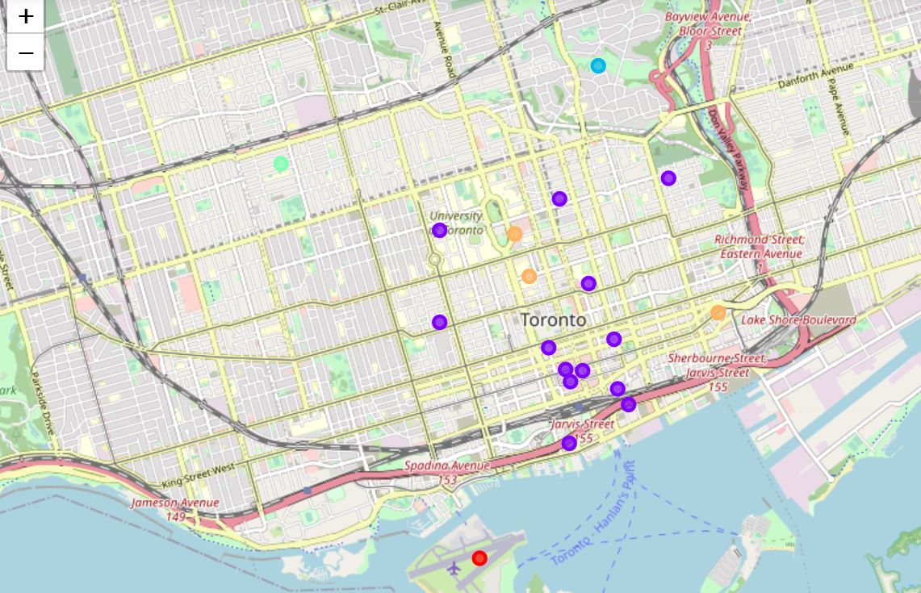
Visualizing Clustered Neighborhood using folium for Downtown Toronto

Slide 22
The Cluster 1 in Manhattan most common venues are Restaurant, Pizza place, Coffee Shop whereas the Cluster 1 in Downtown Toronto most common venue is Airport.
The Cluster 2 in Manhattan most common venue is Park and cluster 2 in Downtown Toronto most common venue is Coffee Shop.
The Cluster 3 in Manhattan most common venue is Restaurant, Pizza place and cluster 3 in Downtown Toronto most common venue is park.
The Cluster 4 in Manhattan most common venue is Sandwich place and cluster 3 in Downtown Toronto is grocery store.
The Cluster 5 in Manhattan most common venue is Park, Coffee shop, Cluster 5 in Downtown Toronto is Coffee Shop.
Each Cluster is Color coded and is plotted using Folium for Manhattan and Downtown Toronto.

Slide 23
5. Discussion
Based on the most common venues the Restaurants, Parks, Coffee Shop are similar in both Manhattan and Downtown Toronto. But based on the Clusters there is an another observation that Manhattan is more diverse in terms of availability of restaurants when compared to Downtown Toronto, There are Chinese restaurants, Italian Restaurants, Mexican Restaurants in Manhattan. This depicts that there are people of different cultures living in Manhattan. So, the people migrating from Downtown Toronto to Manhattan, New York will find it more similar as far the venues, Parks for children and Coffee shops are concerned and provides a great opportunity to explore the people from diverse cultures living in Manhattan. If the family is more interested in amenities like theatre, Park, Coffee Shop then Cluster 5 of Manhattan is more suitable but if they are interested to explore the diverse culture in Manhattan then Cluster 3 and Cluster 1 is more Suitable.

Slide 24
6. Conclusion
This project helps a person migrating to new city and is unaware of the neighborhoods. But due to the love with his current neighborhood he wants to find a neighborhood similar to his current neighborhood. Based on the venue data we could find a similar neighborhood to the current neighborhood and in addition to that suggest more neighborhood options to the person who really wants to explore a diverse culture existing in the new place. We can further expand this idea such that based on the user input we can immediately give recommendations possible suitable neighborhood based on his current neighborhood information and also based on his favorite type of restaurant and food, favorite weekend venue etc. to recommend more suitable neighborhoods during their migration to a new city.

