Slide 1

Efficient Hardware Accelerator for Real-Time Facial Computing on Resource-Constrained Edge Devices
MSc in Embedded Systems and IC Design
Name: P.A.P.S. Perera
Index: 23PG1-015
Supervisor: Eng. Kasun K. Herath
Co-Supervisor: Dr. Lasith Yasakethu

Slide 2
Introduction
Edge computing enables real-time processing on devices with limited resources. [3, 4, 6]
Facial computing tasks (e.g., recognition, detection) rely on Convolutional Neural Networks (CNNs). [ 8, 10, 11]
Challenges:
High computational demands of CNNs.
Limited processing power and memory in edge devices.
Objective: Design a hardware accelerator to optimize CNNs for edge devices.

Slide 3
Research Problem
Problem:
Achieving real-time facial computing on resource-constrained devices is difficult due to:
Slow processing speeds
High power consumption
Limited memory
Solution:
Custom FPGA-based hardware accelerator to speed up CNN computations.

Slide 4
Research Objectives
Design and implement FPGA-based hardware accelerators for CNNs.
Optimize memory hierarchy and data transfer mechanisms.
Offload computational tasks from CPU to hardware.
Benchmark the performance of the hardware accelerator vs. software-based CNN processing.

Slide 5
Literature Review Highlights
Deep learning on edge devices requires hardware accelerators (FPGA, GPU, etc.). [6, 8]
Existing solutions lack real-time performance on constrained devices.
FPGA: Ideal for parallel processing and optimizing computational tasks like CNN operations. [8, 10, 11]
Gap: In practical, Real-time facial computing on edge devices with CNN has not been fully explored between FPGA-based vs software with FPGA-Based systems.

Slide 6
Methodology (conti..)
Overview
Design custom hardware accelerator (Net Engine IP).
Implement CNN layers for convolution and max-pooling.
Perform benchmarking:
Compare accuracy and processing time for hardware and software based and pure software-based implementations.

Slide 7
Methodology (conti..)
System Design
Architecture of the hardware accelerator includes:
Net Engine IP for convolution and max-pooling operations.
With 5 stage pipelining
DMA controllers for efficient data transfer between memory and processing unit/ Programmable Logic unit.
PL (Programmable Logic) for CNN operations.
Goal: Reduce latency, increase processing efficiency.

Slide 8
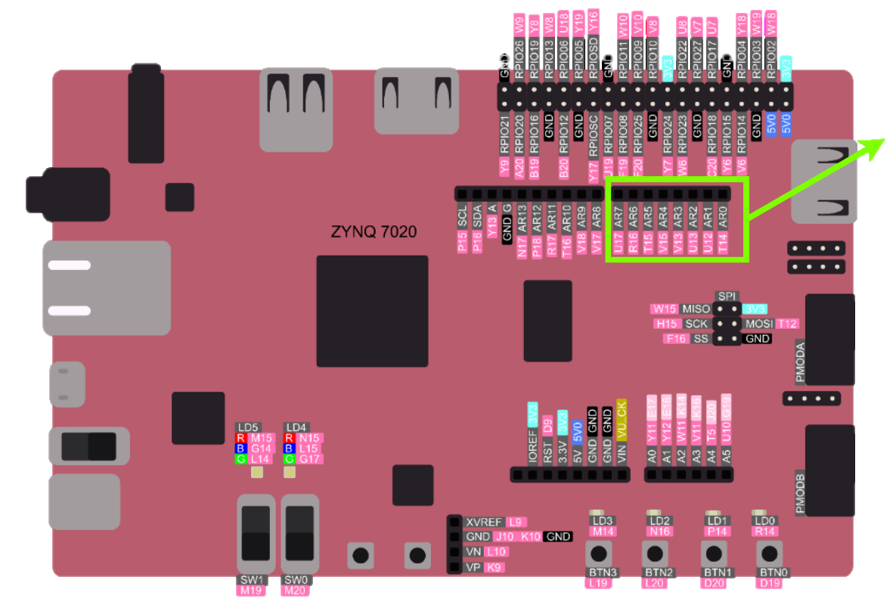
Methodology (conti..)
Time Measuring GPIOs
Hardware Setup
Platform: PYNQ-Z2 development board (ZYNQ-7000 SoC).
Tools:
Vivado 2023.2 for hardware design.
Vitis 2023.2 for driver and software development.
Design focus: Efficient use of FPGA resources for CNN layers and data handling.

Slide 9
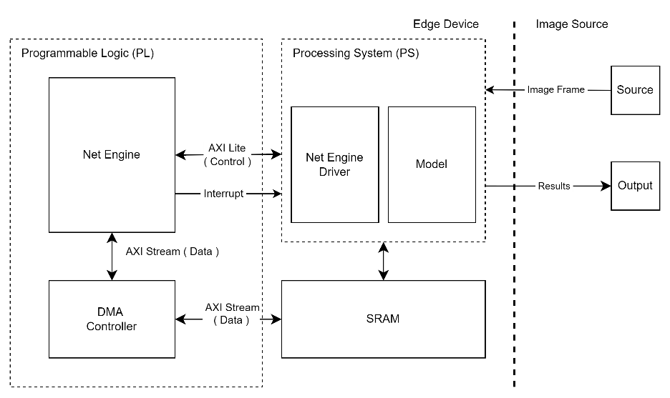
Methodology (conti..)
System Design

Slide 10
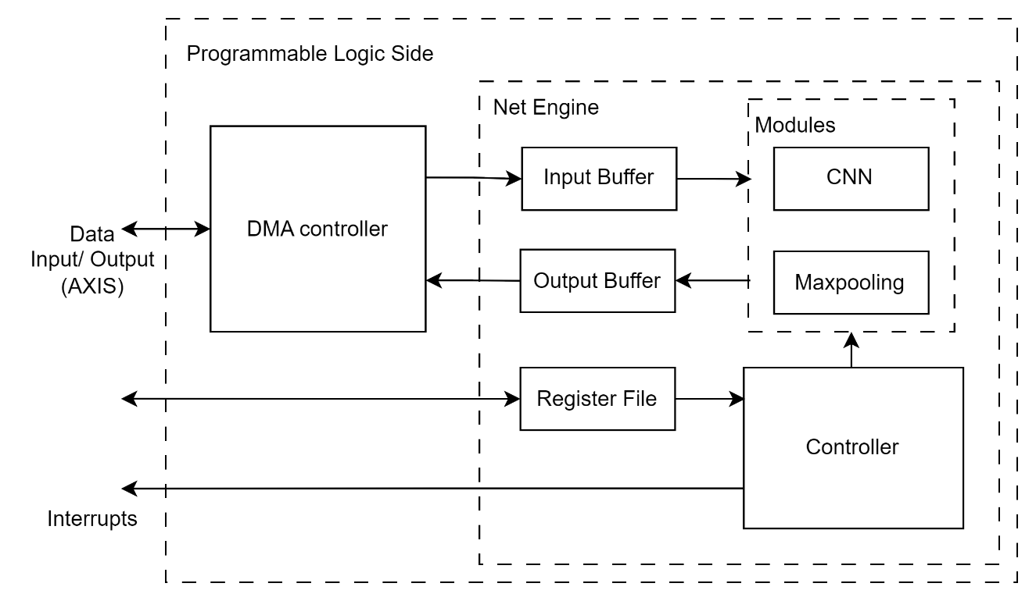
Methodology (conti..)
PL Implementation

Slide 11
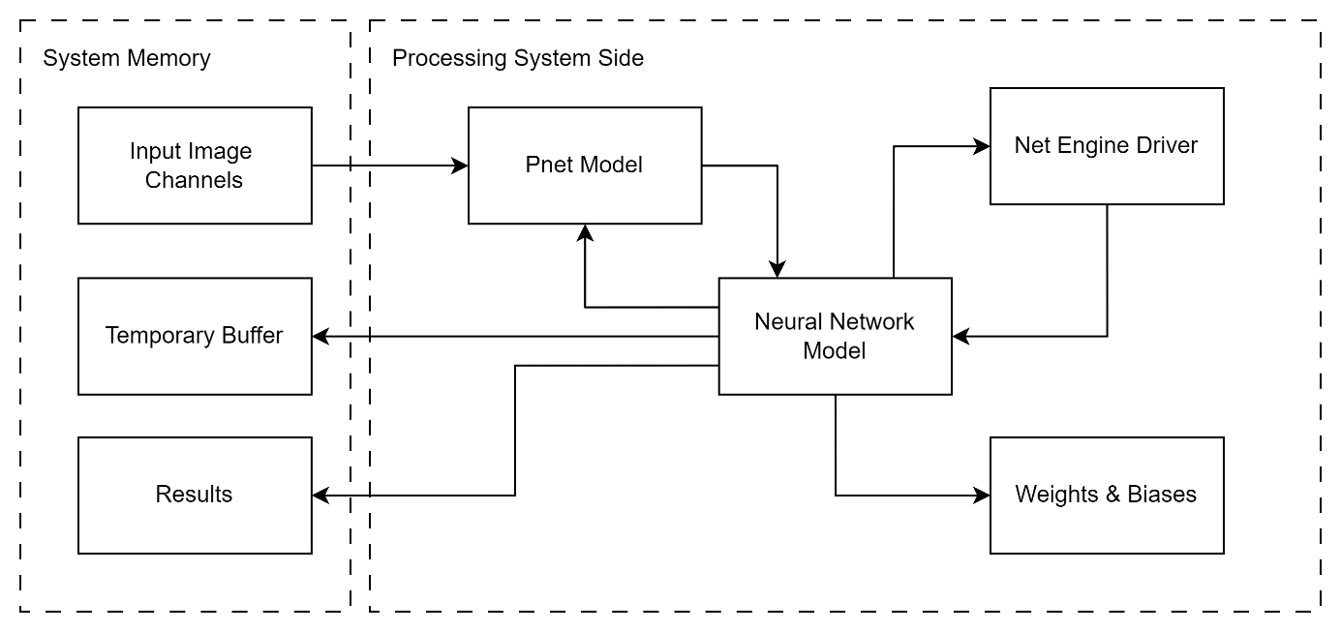
Methodology (conti..)
PS Implementation

Slide 12
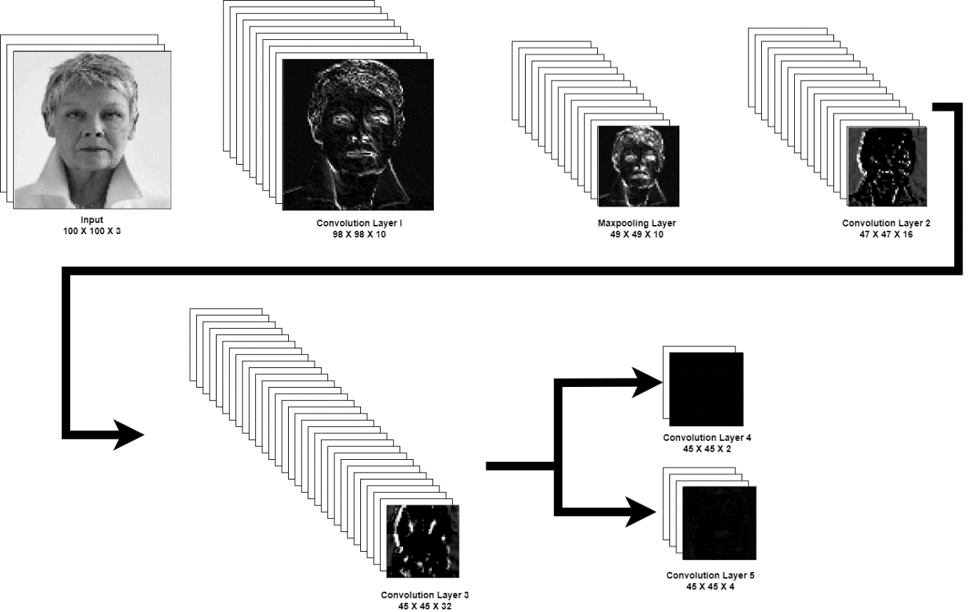
Methodology (conti..)
Proposed Network (PNet)

Slide 13
Methodology (conti..)
Pseudocode
Convolution Operation:
Loop through the image pixels.
Apply convolution kernel (3x3) over the input pixels.
Store the output.
Designed to work in parallel for faster execution with 5 stage pipeline.
Max-Pooling Operation:
Loop through the image.
Apply max-pooling (3x3 window).
Store the maximum value in the output.
5 stage pipelining

Slide 14
Result
Accuracy Evaluation (Respect to the software-based solution)
Numerical Comparison
Visual Comparison
Entire Model Accuracy Comparison
Power Utilization
Timing Analysis

Slide 15
Result (conti..)
Accuracy - Numerical Comparison
Channel | Correlation Coefficient | Chi-Square Statistic | Histogram Intersection
Channel 1 | 1.000 | 0.099 | 1.000
Channel 2 | 1.000 | 0.032 | 0.999
Channel 3 | 1.000 | 0.012 | 1.000
Channel 4 | 1.000 | 0.011 | 1.000
Channel 5 | 1.000 | 0.004 | 1.000
Channel 6 | 1.000 | 0.078 | 0.999
Channel 7 | 1.000 | 0.074 | 0.999
Channel 8 | 1.000 | 0.029 | 0.999
Channel 9 | 1.000 | 0.039 | 1.000
Channel 10 | 1.000 | 0.039 | 0.999

Slide 16
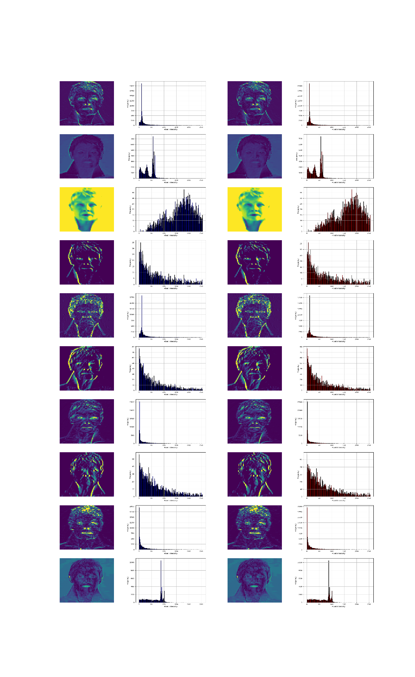
Result (conti..)
Accuracy - Visual Comparison
Software Only
Software with Net Engine
Software Only
Software with Net Engine

Slide 17
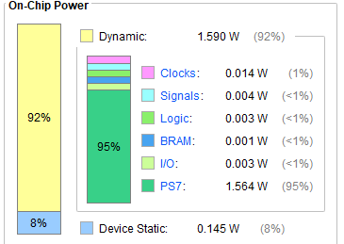
Result (conti..)
Power Consumption
Dynamic Power | Clocks | 0.014w
 | Signals | 0.004w
 | Logic | 0.003w
 | BRAM | 0.001w
 | I/O | 0.003w
 | PS7 | 1.564w
Device Static Power |  | 0.145w
Total Power |  | 1.735w

Slide 18
Result (conti..)
Timing Analysis

Slide 19
Result (conti..)
Timing Analysis (Conti..)

Slide 20
Discussion
Performance gains:
Significant reduction in processing time (82% reduction).
High accuracy in hardware replication of CNN.
Energy efficiency: Suitable for real-time edge AI applications.
Scalability: Can be adapted for other CNN-based tasks on embedded systems.

Slide 21
Conclusion
Achieved objectives: Efficient real-time facial computing on constrained devices respect to the pure software based solution.
Net Engine:
Improves processing time and power efficiency.
Maintains high accuracy.
Contribution: Provides a practical solution for deploying CNNs on edge AI devices.

Slide 22
Future Work
Explore scaling the Net Engine for more complex CNNs.
Optimize memory usage further to handle larger networks.
Optimized CNN implementation on Software Side
Extend the solution to other real-time applications (e.g., gesture recognition).

Slide 23
References
A. B S, S. R. (2022). "NC-Emotions: Neuromorphic hardware accelerator design for facial emotion recognition,". 29th IEEE International Conference on Electronics, Circuits, and Systems (ICECS), 1-4. doi:Glasgow, United Kingdom
A. Baobaid, M. M. (2022). "Hardware Accelerators for Real-Time Face Recognition: A Survey,". IEEE Access, 10, 83723-83739. doi:10.1109/ACCESS.2022.3194915
al., A. M. (2019). "Deep Learning for Edge Computing: Current Trends, Cross-Layer Optimizations, and Open Research Challenges,". 2019 IEEE Computer Society Annual Symposium on VLSI (ISVLSI), 553-559. doi:10.1109/ISVLSI.2019.00105
al., X. L. (2022, Feb). "Collaborative Edge Computing With FPGA-Based CNN Accelerators for Energy-Efficient and Time-Aware Face Tracking System,". IEEE Transactions on Computational Social Systems, 9, 252-266. doi:10.1109/TCSS.2021.3059318

Slide 24
References (Conti..)
Rao, B. S. (2021). "Binary neural network based real time emotion detection on an edge computing device to detect passenger anomaly,". 2021 34th International Conference on VLSI Design and 2021 20th International Conference on Embedded Systems (VLSID), 175-180. doi:10.1109/VLSID51830.2021.00035
S. Liu, L. L. (2019, Aug). "Edge Computing for Autonomous Driving: Opportunities and Challenges,". Proceedings of the IEEE, 107, 1697-1716. doi:10.1109/JPROC.2019.2915983
Talib, M. M. (2021, Feb). A systematic literature review on hardware implementation of artificial intelligence algorithms. J Supercomput 77, 1897–1938. doi:10.1007/s11227-020-03325-8
Dasgupta, F. S. (2017). "Automated flow for compressing convolution neural networks for efficient edge-computation with FPGA". California: MLPCD workshop, NIPS. doi:https://doi.org/10.48550/arXiv.1712.06272

Slide 25
References (Conti..)
Xue Lv, M. S. (2021). Application of Face Recognition Method Under Deep Learning Algorithm in Embedded Systems. Microprocessors and Microsystems. doi:10.1016/j.micpro.2021.104034
Y. S. Mounika, B. B. (2022). "FPGA BASED HARDWARE ACCELERATOR FOR CONVOLUTION NEURAL NETWORK,". 2022 International Conference on Recent Trends in Microelectronics, Automation, Computing and Communications Systems (ICMACC), 260-264. doi:10.1109/ICMACC54824.2022.10093648.
Yu, C. F. (2019). "FPGA-based Power Efficient Face Detection for Mobile Robots,". 2019 IEEE International Conference on Robotics and Biomimetics (ROBIO), 467-473. doi:10.1109/ROBIO49542.2019.8961745

Slide 26

Thank You
Any Questions?
GitHub Repo:
https://github.com/Pankaja-Suganda/Net-Engine-FPGA-With-Software.git

Slide 27
Register File
Register Name | Description | Offset
Status Registers
NET_ENGINE_STATUS_REG_1 | Status information | 0x00
NET_ENGINE_STATUS_REG_2 | Status information | 0x04
NET_ENGINE_STATUS_REG_3 | Status information | 0x08
NET_ENGINE_STATUS_REG_4 | Status information | 0x0C
NET_ENGINE_STATUS_REG_5 | Status information | 0x10
NET_ENGINE_STATUS_REG_6 | Status information | 0x14
Configuration Registers
NET_ENGINE_CONFIG_REG_1 | Select convolution / max-pooling Operation | 0x18
NET_ENGINE_CONFIG_REG_2 | Input Row Length | 0x1C
NET_ENGINE_CONFIG_REG_3 | Net Engine Enable/Disable | 0x20
NET_ENGINE_CONFIG_REG_4 | Reserved | 0x24
Kernel and Bias Registers
NET_ENGINE_BIAS_REG | Bias values for convolution operations | 0x28
NET_ENGINE_KERNEL_REG_1 | Kernel weights for convolution operations | 0x2C
NET_ENGINE_KERNEL_REG_2 | Kernel weights for convolution operations | 0x30
NET_ENGINE_KERNEL_REG_3 | Kernel weights for convolution operations | 0x34
NET_ENGINE_KERNEL_REG_4 | Kernel weights for convolution operations | 0x38
NET_ENGINE_KERNEL_REG_5 | Kernel weights for convolution operations | 0x3C
NET_ENGINE_KERNEL_REG_6 | Kernel weights for convolution operations | 0x40
NET_ENGINE_KERNEL_REG_7 | Kernel weights for convolution operations | 0x44
NET_ENGINE_KERNEL_REG_8 | Kernel weights for convolution operations | 0x48
NET_ENGINE_KERNEL_REG_9 | Kernel weights for convolution operations | 0x4C

Slide 28
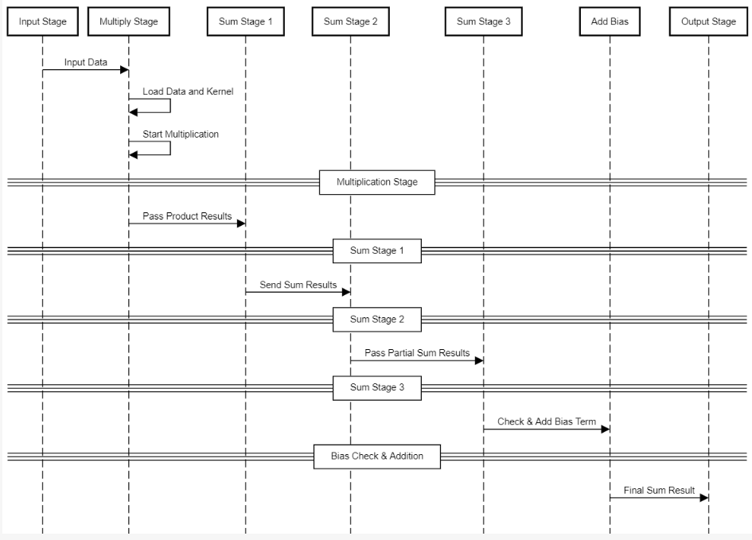
Convolution Implementation

Slide 29
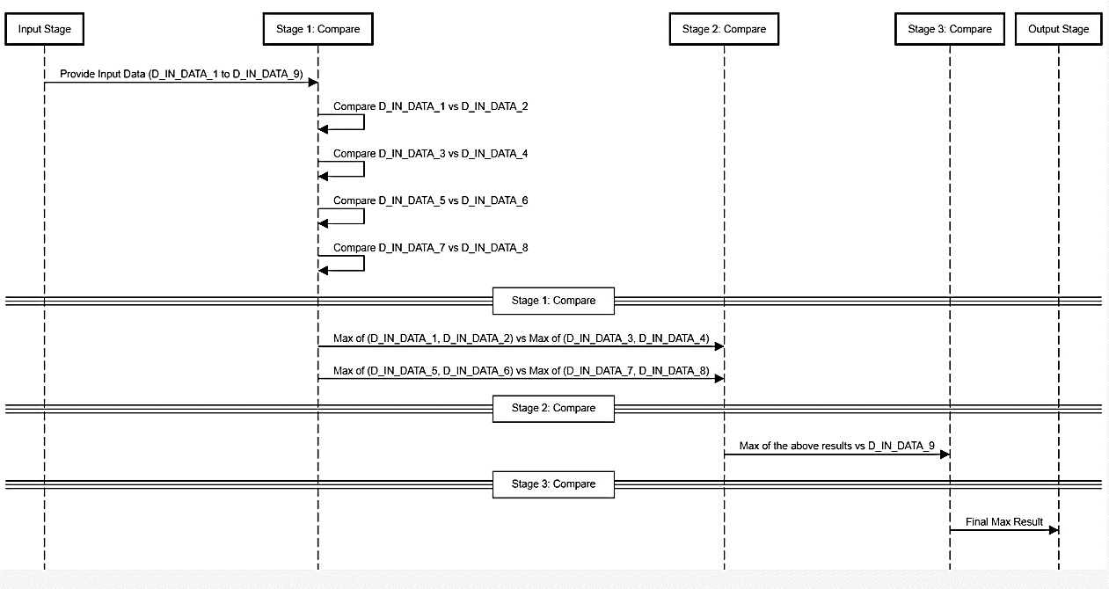
Maxpooling Implementation

Slide 30
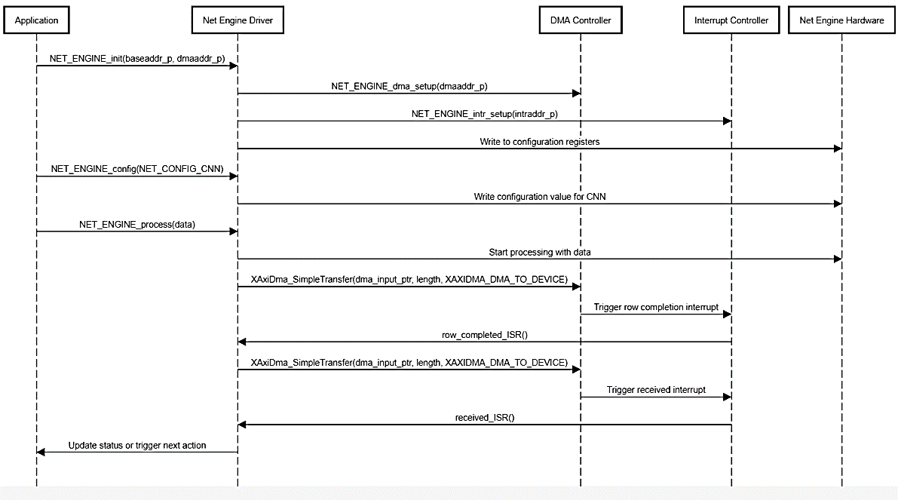
Net-Engine Driver Implementation

Slide 31
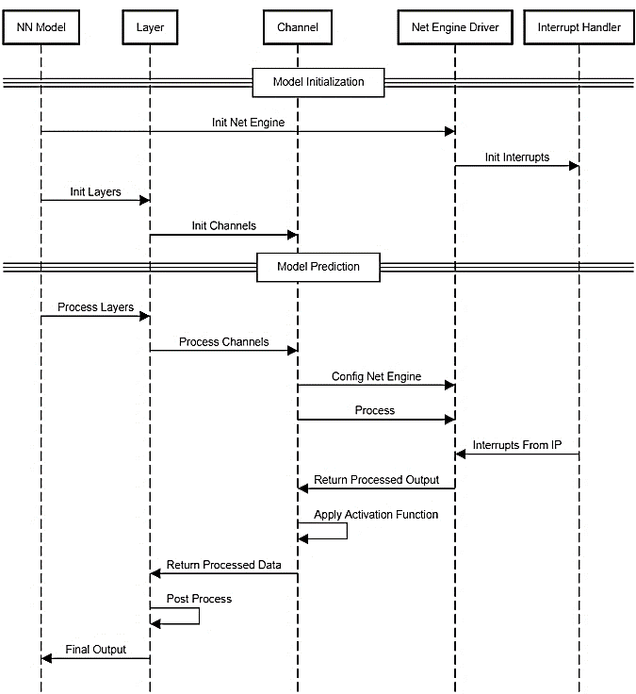
Neural Network Implementation

Slide 32
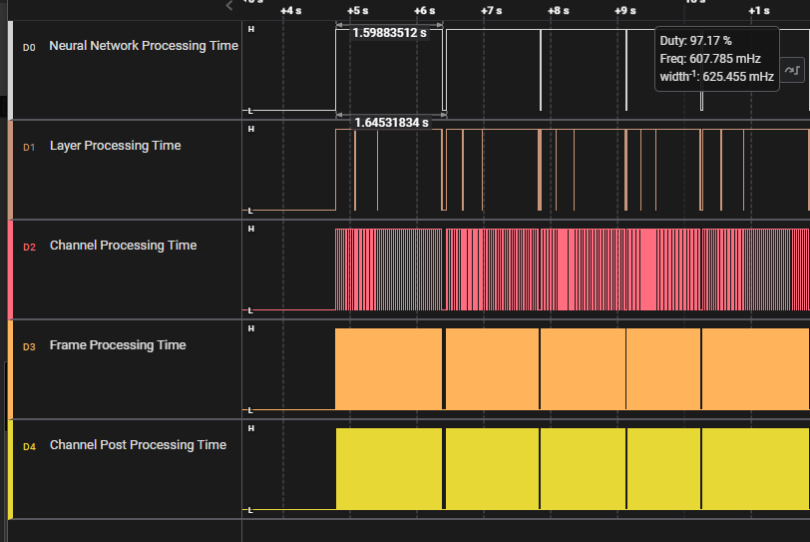
Time Measurement

Slide 33
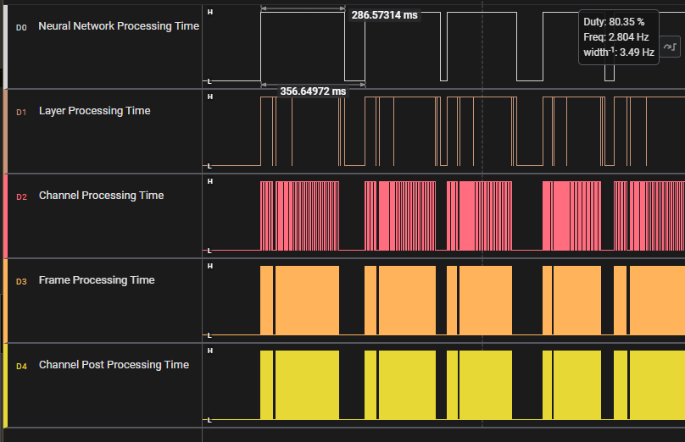
Time Measurement

