Slide 1

National institute of technology Uttarakhand
Summer training Presentation
Submitted to:
Computer science and engineering, NIT UTTARAKHAND
Submitted by : Pankaj Kumar
Roll no: BT18CSE010

Slide 2
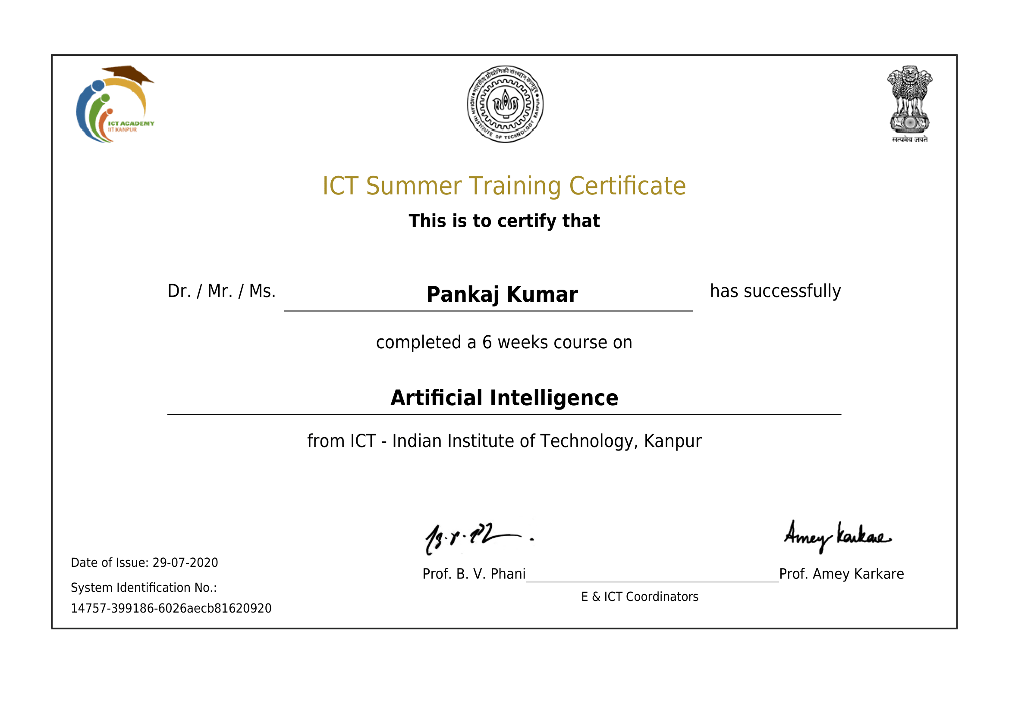

Slide 3
OVERVIEW WHAT I LEARNED DURING SUMMER TRAINING
Python
Machine learning
Different libraries of python
Different algorithm for machine learning
Different strategy to separate data
Train test split technique
K-fold cross validation technique
Leave one out cross validation

Slide 4
Different performance evaluation metrices
For logistic regression
Classification accuracy
Logarithmic loss
Area under ROC curve
Confusion matrix
For Linear regression
Mean absolute error
Mean squared error

Slide 5
Summer training project
I made two project in summer training. One with help of class teacher and second one was assignment for marks evaluation and I done that perfectly.
Brain tumor: Model is based on brain tumor dataset and you can find out it easily on Kaggle site. This is done with help of class teacher and got an accuracy of 96 % (approx.)
Heart attack : This is my real work. This is trained on heart attack dataset which is also available on Kaggle. This was given as a assignment by professor for marks evaluation purpose. I worked successfully and got accuracy as 83% approx. using BernouliiNB algorithm. So lets discuss it in detail now….

Slide 6
Libraries used in project
NumPy
This is a python libraries to work smoothly with n dimensional array. In this libraries we can play with array easily and this is easy to use.
Pandas
This is one of the important libraries of python for machine learning. This libraries is mainly used for data reading and cleaning. It read every thing like a dataframe. Dataframe is a kind of data structure and pandas read everything as a dataframe which allow to change information of any row or column easily.
Matplotlib
This is a plotting libraries and it run on top of NumPy. We can use it for data visualization.

Slide 7
Seaborn
Seaborn is also a plotting libraries of python but it is used to draw statistical graphics like confusion matrix, normal distribution
Sklearn
It is a free python libraries which has all the algorithm of regression, classification, etc.
Joblib
I used it only to save model for further prediction.

Slide 8
Techniques used in project
Data observation
Data cleaning
Data formatting
Data standardization
Spot cheeking techniques
Concept of pipeline

Slide 9
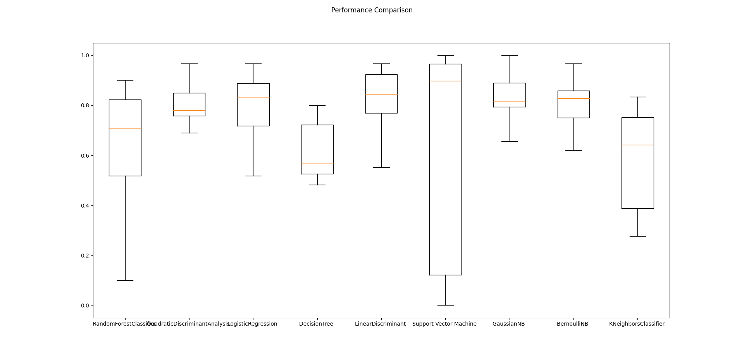
Challenges That I faced
Prepare data for training
How to increase accuracy and decrease training time.
Some picture
Accuracy of algorithm without standardization.

Slide 10
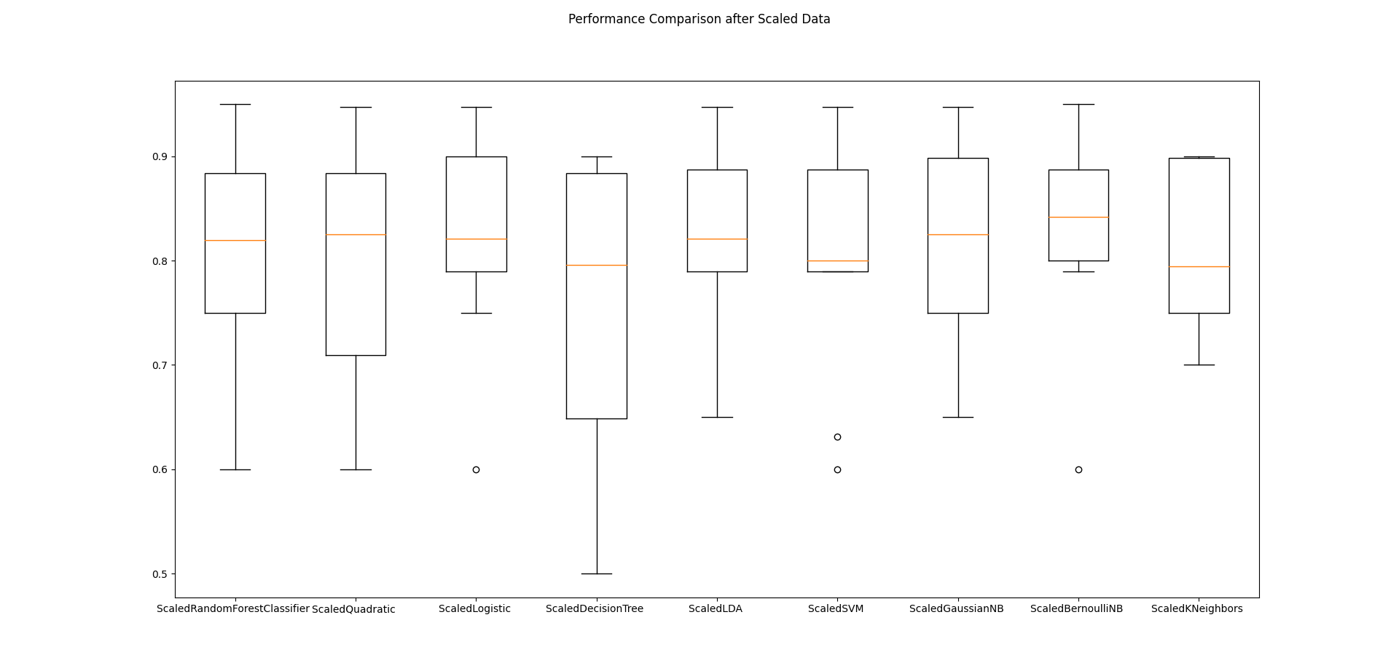
Increase in accuracy after standerization.

Slide 11
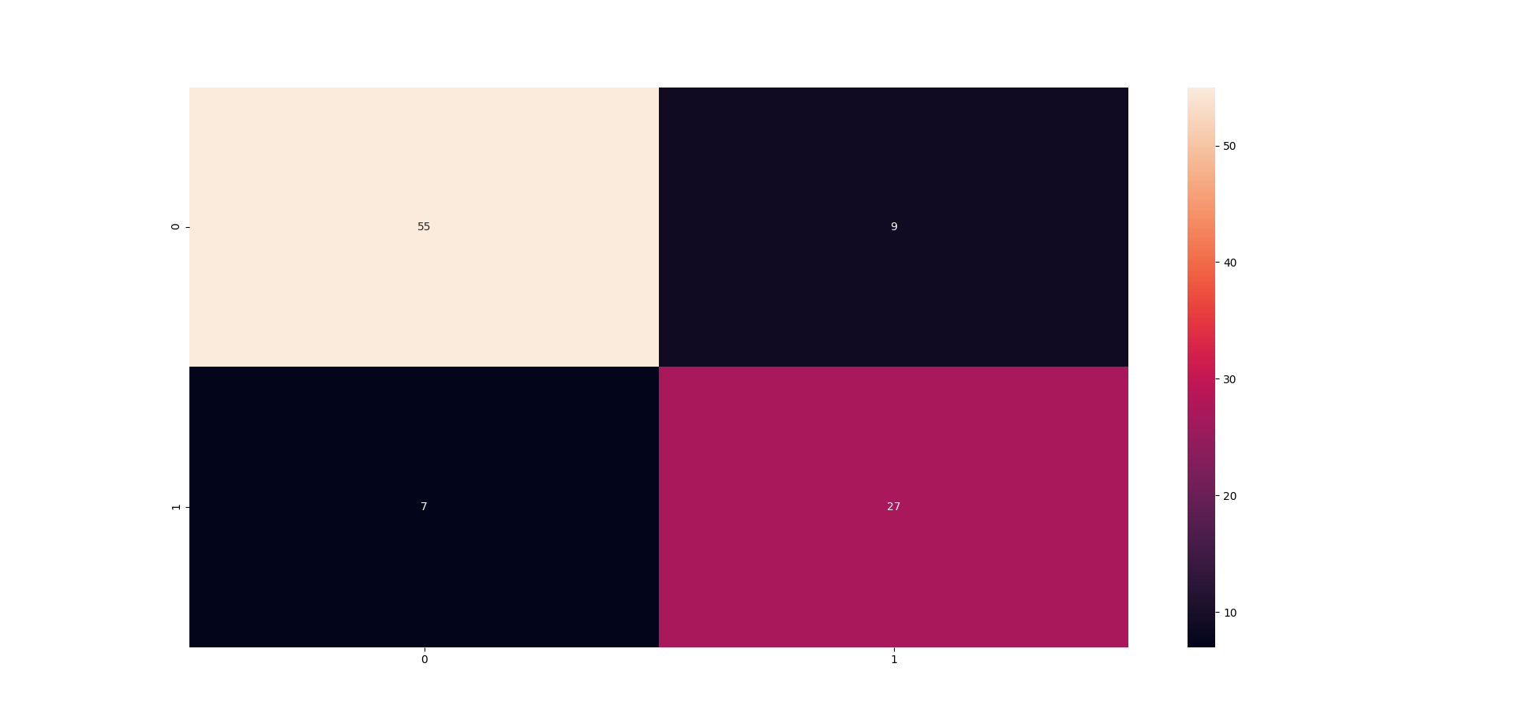
Final confusion matrix

Slide 12
THANK YOU

