Slide 1
SQL Injection Attack on Today’s Technologies Using MySQL Database Queries
Prepared By,
PANKAJ
Guided By,
Zakir Hussain

Slide 2
TABLE OF CONTENT
Introduction
Types Of SQL Injection
Preventing SQL Injection Attacks
Execution and Results
Conclusion

Slide 3
Introduction
SQL Injection (SQLi):
An attacker can execute arbitrary SQL code by inserting it into an application's query fields, such as forms, URL parameters, cookies, or HTTP headers.
An SQLi can lead to the following types of attacks:
Unauthorized access to protected data.
Database modification, including adding, updating, or deleting records.
Execution of administrative operations on the database.
Denial of service or complete system compromise.

Slide 4
2. Type Of SQL Injection
There are several distinct forms of SQL Injection attacks, each with varying levels of complexity and risk. Below are the primary types of SQL Injection attacks:
1. Classic or In-Band SQL Injection:
Classic SQL Injection involves injecting SQL code into input fields like login forms, allowing attackers to interact directly with the database, retrieve data, or make modifications.
Example:
SELECT * FROM users WHERE username = 'admin' -- ' AND password = 'password';

Slide 5
2. Blind SQL Injection:
Blind SQL Injection infers information from the application's behavior (like timing or Boolean results) without directly returning data, making it harder to detect but still dangerous over time.
Example:
SELECT * FROM users WHERE id = 1 AND 1=1;
SELECT * FROM users WHERE id = 1 AND 1=2;
3. Time-Based SQL Injection:
Time-based SQL Injection exploits delays in the database’s response to infer information, often used when feedback from the application is limited.
Example:
SELECT * FROM users WHERE IF (username='admin', SLEEP (5), 0);

Slide 6
4. Out-of-Band SQL Injection:
Out-of-band SQL Injection uses external channels like HTTP or DNS to send data, effective when database responses are restricted.
Example:
They may use a DNS-based approach to send sensitive data.

Slide 7
3. Preventing SQL Injection Attacks
Preventing SQL Injection attacks is crucial. However, There are several best practices and techniques to mitigate SQLi risks:
Use Prepared Statements: Prepared statements separate SQL code from user input, ensuring the query is defined first and preventing query manipulation.
Example: SELECT * FROM users WHERE username = ? AND password = ?;
Parameterized Queries: Like prepared statements, parameterized queries treat user input as data, not code, stopping SQL Injection.

Slide 8
Input Validation and Sanitization: Validates user input by enforcing strict rules, such as regex patterns, to filter out dangerous characters like ';--.
Use ORMs (Object-Relational Mappers): ORM frameworks (e.g., Hibernate, SQLAlchemy) abstract SQL queries, reducing the risk of SQL Injection.
Escaping Special Characters: If prepared statements aren't available, escape special characters in user input to prevent SQL query alteration.
Database Privilege Management: Limit the database permissions of the application to the minimum required, avoiding excessive access like full admin rights.

Slide 9
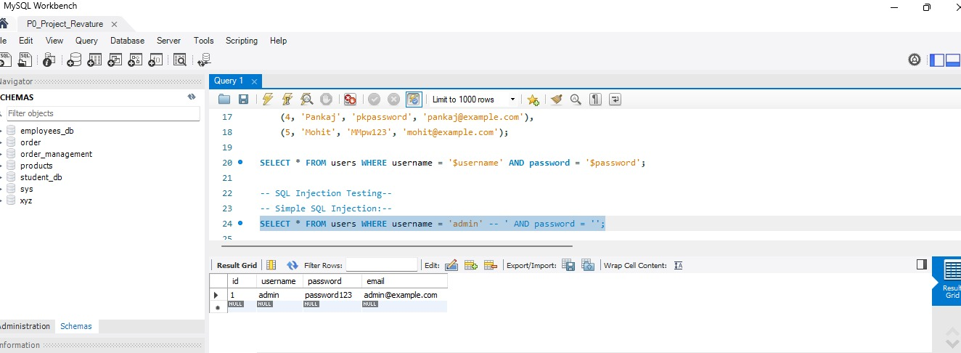
4. Execution & Results
Simple SQL Injection Results:
After executing the simple SQL Injection query:
SELECT * FROM users WHERE username = 'admin' -- ' AND password = '';
You will notice that the query logs in as admin without needing the actual password. This confirms that the application is vulnerable to SQL Injection.

Slide 10
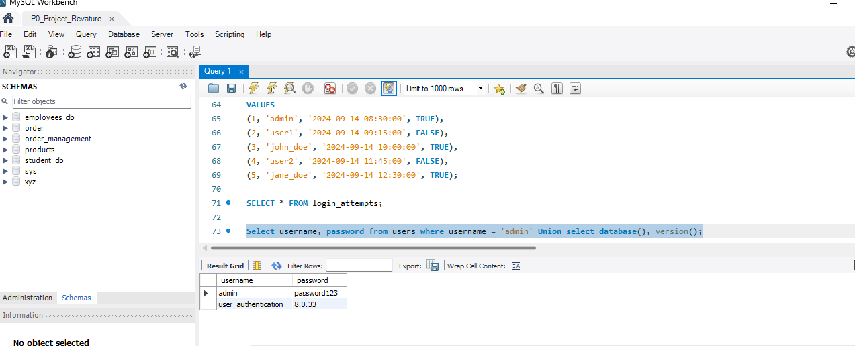
Union-Based Injection Results:
The union-based SQL Injection query:
SELECT username, password FROM users WHERE username = 'admin' UNION SELECT database(), version();
should return the username and password of the admin user, as well as information about the database and MySQL version.

Slide 11
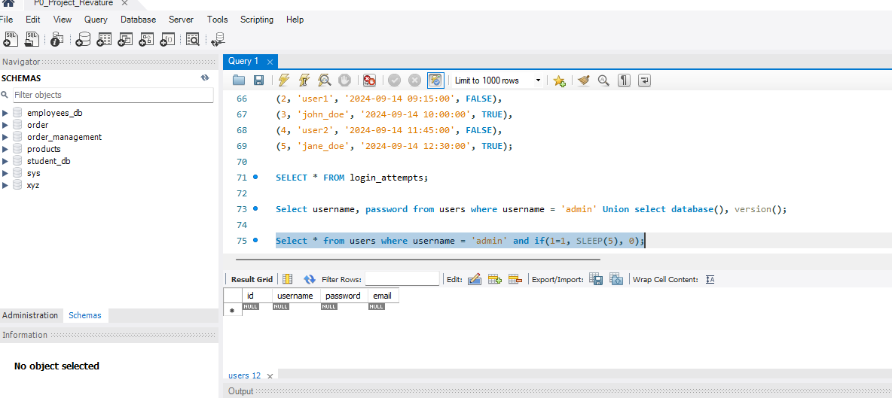
Blind SQL Injection Results:
When executing the blind SQL Injection query:
SELECT * FROM users WHERE username = 'admin' AND IF(1=1, SLEEP(5), 0);
you will observe that the query causes a delay in the application's response. This proves that the attacker can infer information from the database without directly seeing query results.

Slide 12
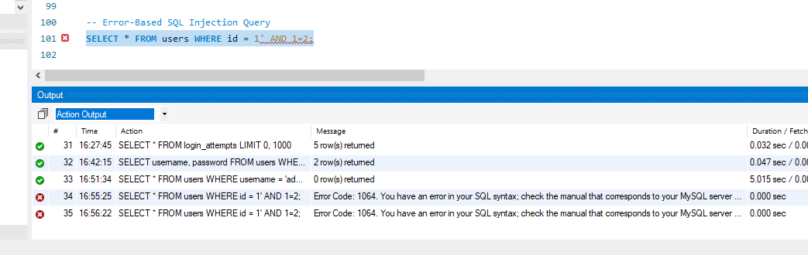
Error-Based SQL Injection Results:
When running the error-based query:
SELECT * FROM users WHERE id = 1' AND 1=2;
you might receive an error message revealing the internal structure of the database.

Slide 13
5. Conclusion
SQL Injection is still one of the most widespread vulnerabilities, allowing attackers to execute unauthorized queries with severe consequences like data theft and system compromise.
Using prepared statements and parameterized queries is a key defense, ensuring that user inputs are treated as data rather than executable SQL code.
Proper input validation and escaping of special characters are crucial to minimizing the risk of SQL Injection by filtering and sanitizing user data.
Limiting database access rights can significantly reduce the impact of a successful attack, restricting the potential damage.
Ongoing vigilance with tools like vulnerability scanners, code reviews, and security best practices is essential to safeguard applications from SQL Injection threats.

