Slide 1

1
National Institute of Technology Meghalaya
Mobility-Aware Intelligent Reflecting Surface Assisted Wireless Communication Framework for Dynamic Urban Environments
Presented By:
Jitendra Dubey b22ec038
Pankaj Saraswat b22ec040
Under the Guidance of:
DR. SATYENDRA SINGH YADAV Assistant Professor Department of Electronics and Communication Engineering
DATE: 19-05-2026
Department of Electronics and Communication Engineering

Slide 2
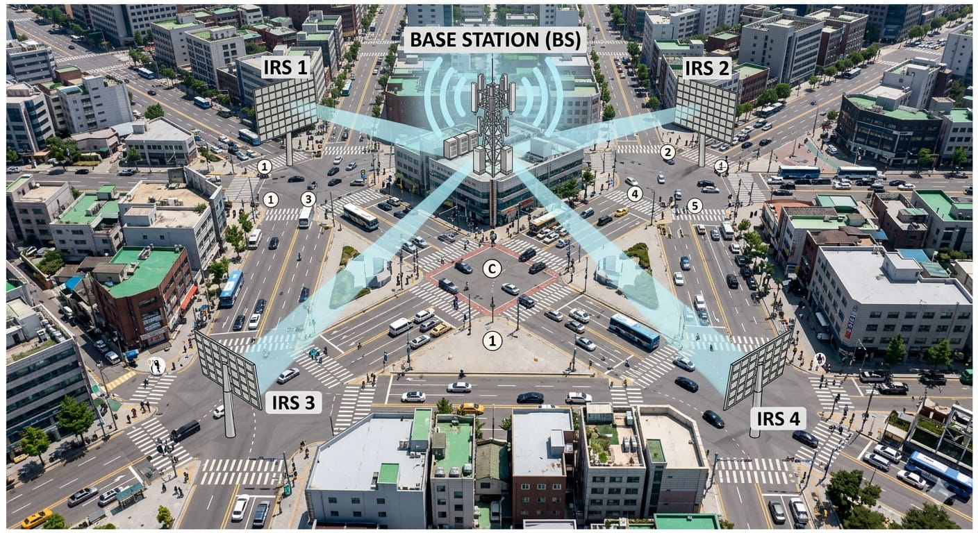
Introduction and Motivation
2
Future 6G systems require:
High data rates
Ultra-low latency
Smart wireless environments
Urban communication challenges:
Signal blockage
Multipath fading
NLOS propagation
IRS enables:
Intelligent beam steering
Adaptive signal reflection
Energy-efficient communication
Motivation:
Improve communication reliability
Support mobility-aware smart city communication
Figure: IRS-Assisted Wireless Communication Architecture

Slide 3
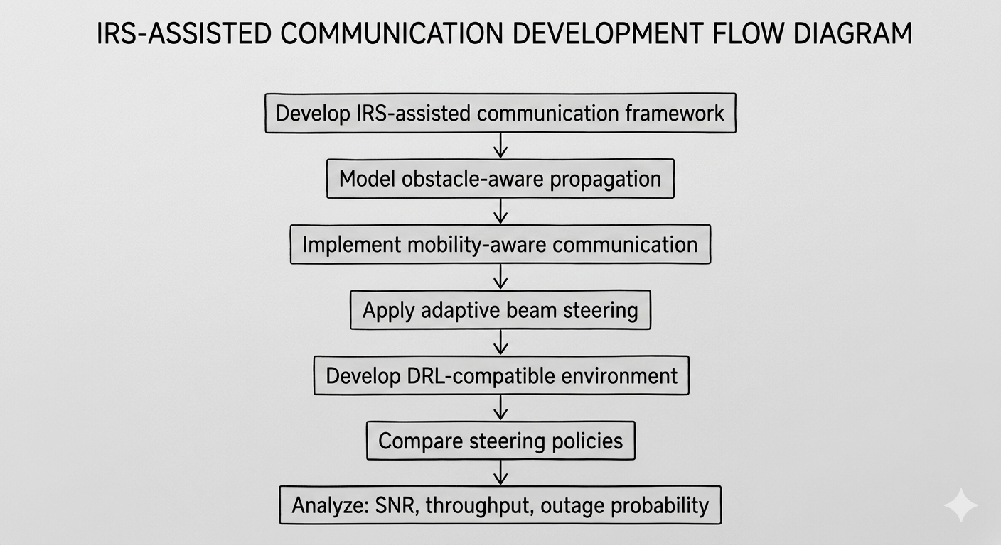
OBJECTIVES
3
Develop IRS-assisted communication
framework
Implement mobility-aware communication
Model obstacle-aware propagation
Apply adaptive beam steering
Compare steering policies Analyze:
SNR
Throughput
Outage probability
Develop DRL-compatible environment
Fig : IRS Assisted communication Flow Diagram

Slide 4
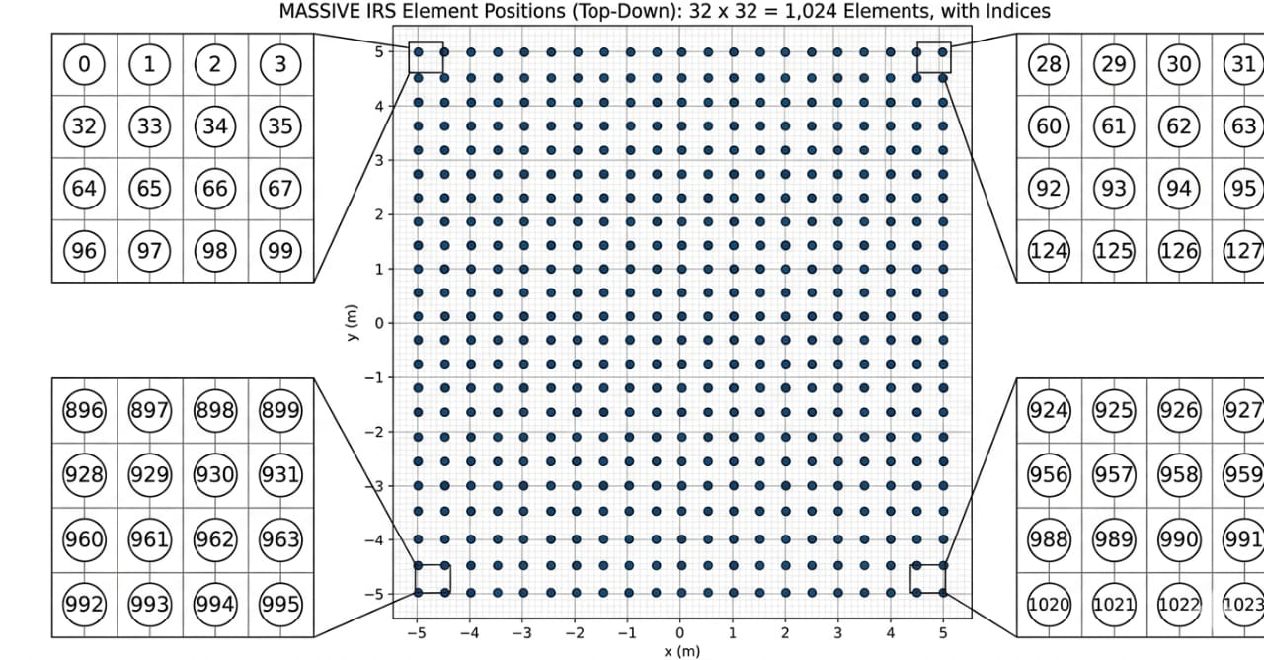
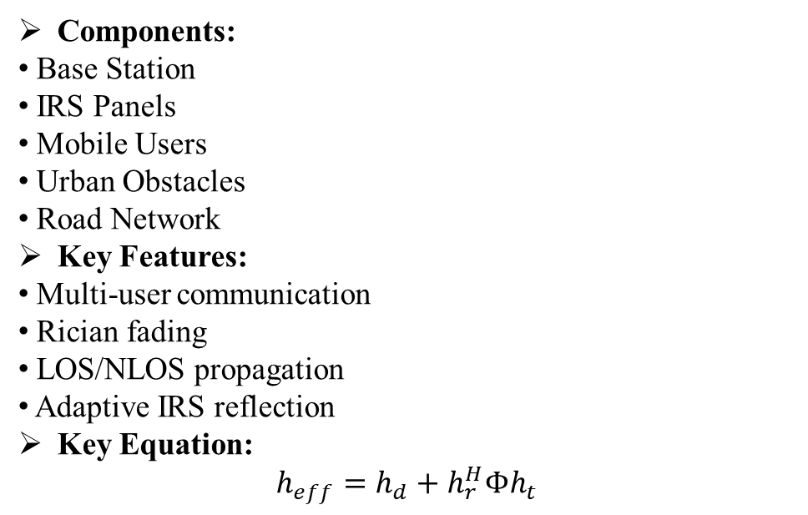
4
Proposed System Architecture
Components:
Base Station
IRS Panels
Mobile Users
Urban Obstacles
Road Network
Key Features:
Multi-user communication
Rician fading
LOS/NLOS propagation
Adaptive IRS reflection
Key Equation:
$$h_{eff}=h_{d}+h_{r}^{H}Φh_{t}$$
Fig : IRS element arrangement

Slide 5
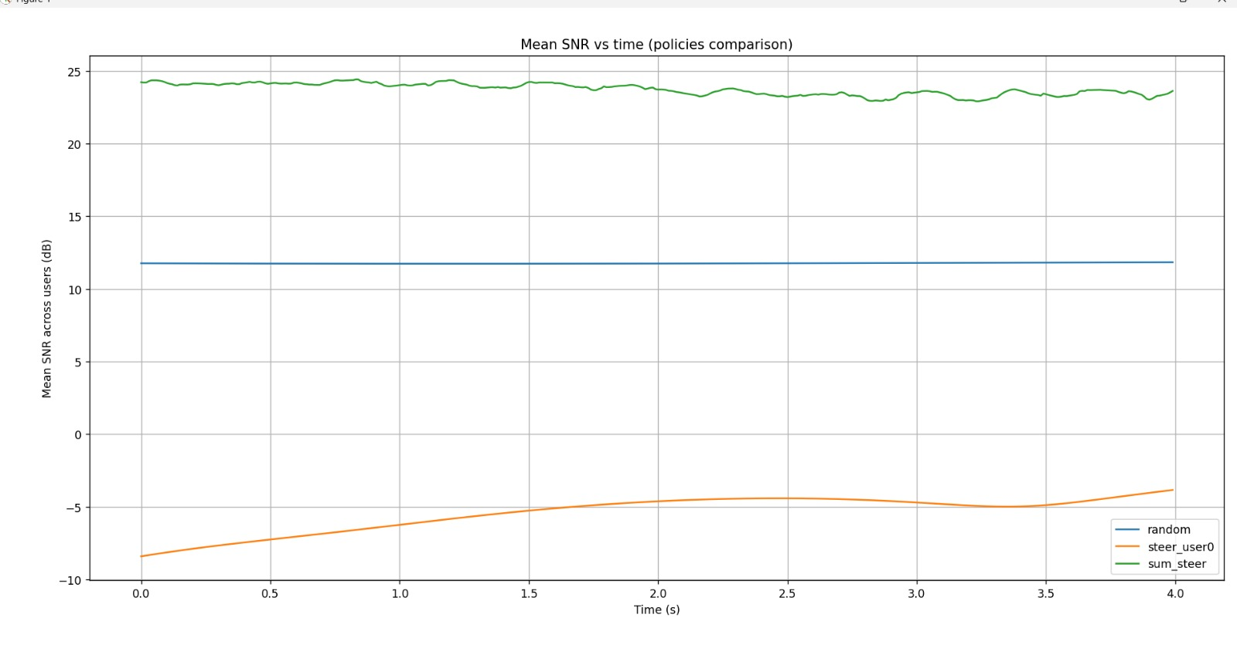
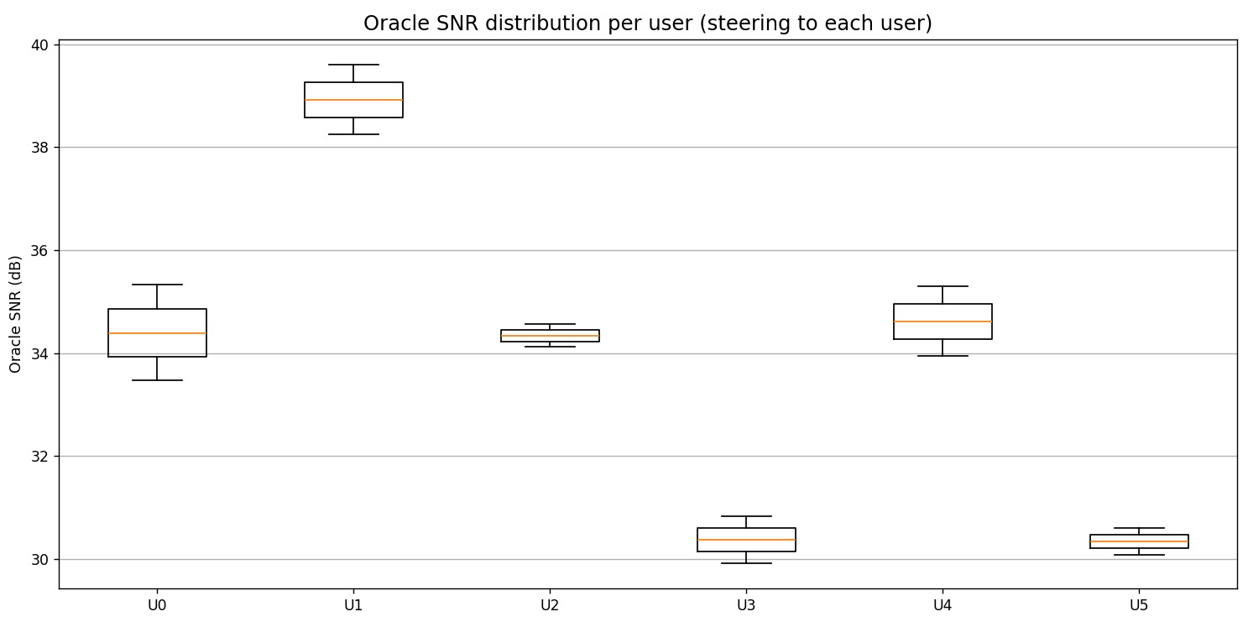
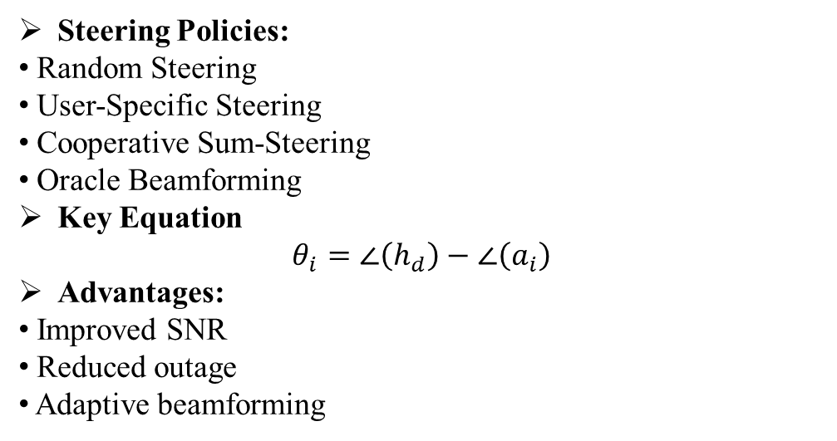
5
IRS Beam Steering and Optimization
Steering Policies:
Random Steering
User-Specific Steering
Cooperative Sum-Steering
Oracle Beamforming
Key Equation
$$θ_{i}=∠\left(h_{d}\right)−∠\left(a_{i}\right)$$
Advantages:
Improved SNR
Reduced outage
Adaptive beamforming
Fig: Mean SNR vs Time for Different Policies
Fig: Oracle SNR distribution per User

Slide 6
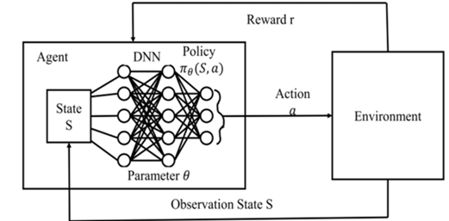
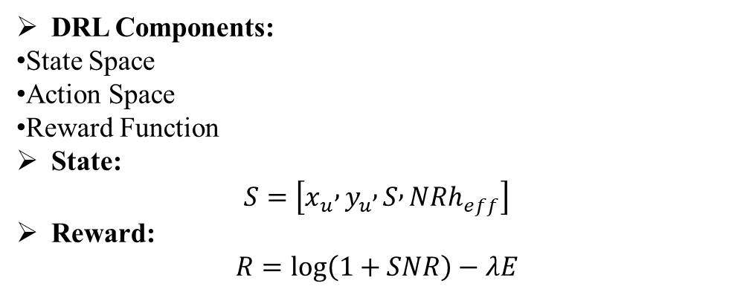
6
6
Deep Reinforcement Learning Framework
DRL Components:
State Space
Action Space
Reward Function
State:
$$S=\left[x_{u} , y_{u} , S , NRh_{eff}\right]$$
Reward:
$$R=log⁡\left(1+SNR\right)−λE$$
Fig : DRL Architecture

Slide 7
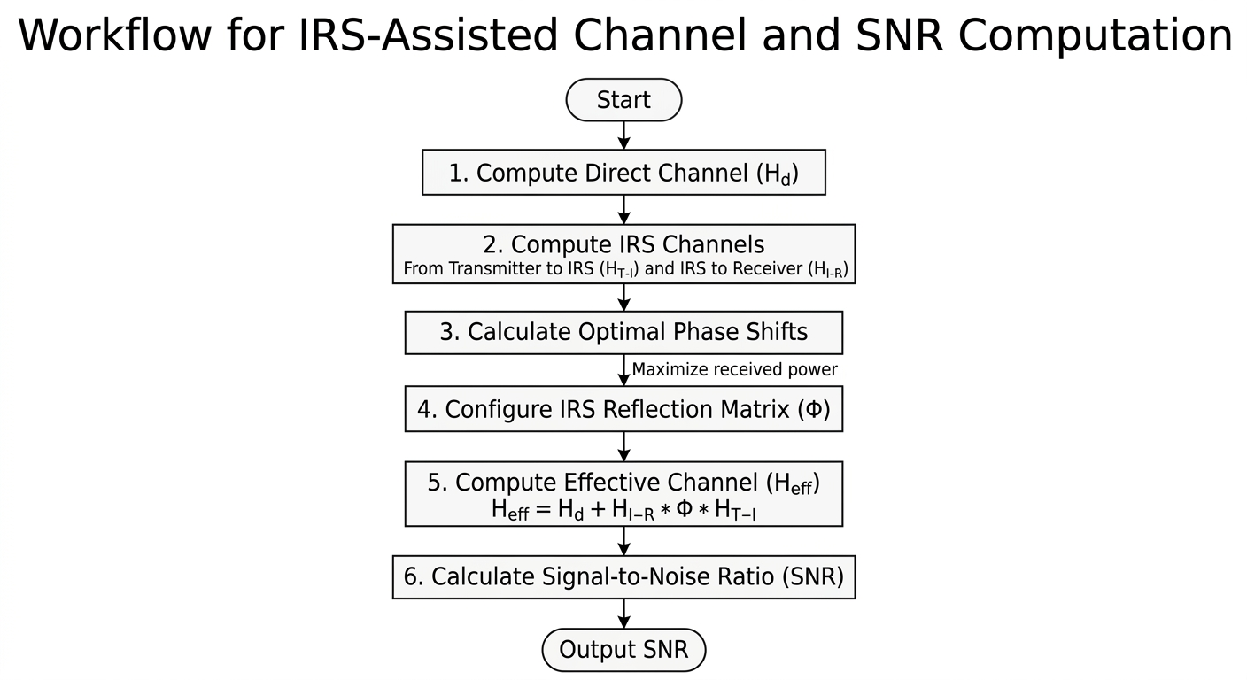
7
IRS Beam Steering Algorithm
Pseudo Code
1. Compute direct channel 2. Compute IRS channels 3. Calculate optimal phase 4. Configure IRS reflection matrix 5. Compute effective channel 6. Calculate SNR
Advantages:
Adaptive phase optimization
Mobility-aware updates
Dynamic beam steering
Fig : IRS Beam Steering Flow Chart

Slide 8
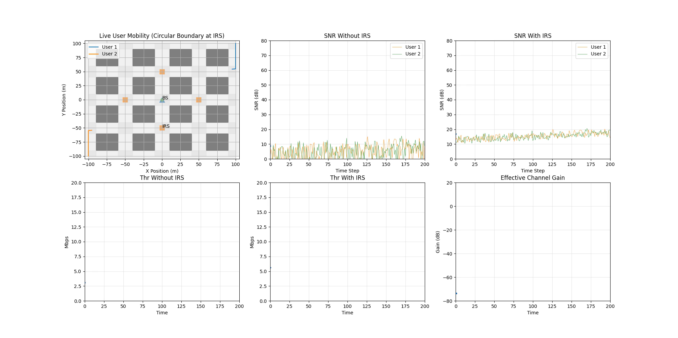
8
Simulation Results

Slide 9
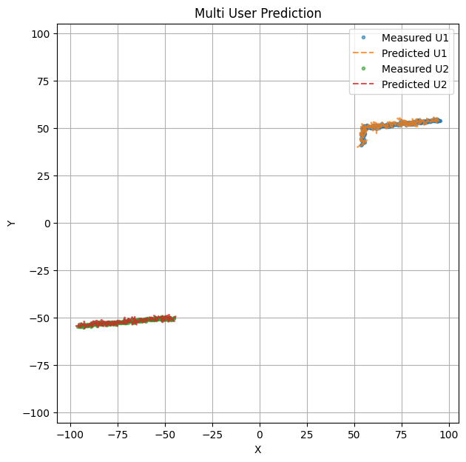
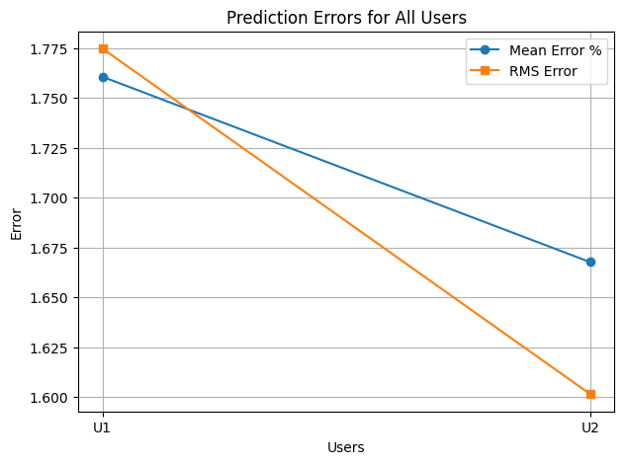
8
Simulation Results

Slide 10
Conclusion and Future Work
10
Conclusion Points
IRS improves communication reliability
Adaptive beam steering enhances SNR
Mobility-aware optimization improves coverage
DRL framework supports intelligent control
Future Work
PPO/SAC optimization
FPGA implementation
UAV-assisted IRS
SDR testing
ISAC integration
“IRS-assisted communication is a promising technology for future 6G smart wireless environments.”

Slide 11
References
11
[1] Q. Wu and R. Zhang, “Towards smart and reconfigurable environment: Intelligent reflecting surface aided wireless network,” IEEE Communications Magazine, vol. 58, no. 1, pp. 106–112, 2020.
[2] M. Di Renzo et al., “Smart radio environments empowered by reconfigurable intelligent surfaces,” IEEE Journal on Selected Areas in Communications, vol. 38, no. 11, pp. 2450–2525, 2020.
[3] E. Basar et al., “Wireless communications through reconfigurable intelligent surfaces,” IEEE Access, vol. 7, pp. 116753–116773, 2019.
[4] S. Gong et al., “Towards smart wireless communications via intelligent reflecting surfaces: A survey,” IEEE Communications Surveys & Tutorials, vol. 22, no. 4, pp. 2283–2314, 2020.
[5] Z. Zhang et al., “Intelligent reflecting surface aided wireless communications: A tutorial,” IEEE Communications Surveys & Tutorials, vol. 23, no. 1, pp. 5–47, 2021.
[6] H. Huang et al., “Deep reinforcement learning for intelligent reflecting surface assisted wireless systems,” IEEE Wireless Communications Letters, vol. 10, no. 2, pp. 243–247, 2021.
[7] Y. Liu et al., “Reconfigurable intelligent surface aided multi-user communication,” IEEE Transactions on Communications, vol. 68, no. 10, pp. 6589–6605, 2020.
[8] C. Pan et al., “Multicell MIMO communications relying on intelligent reflecting surfaces,” IEEE Transactions on Wireless Communications, vol. 19, no. 8, pp. 5218–5233, 2020.
THANK YOU
Any Queries

