Slide 1
PlaceDetails
The way of being always touched with your favourite places

Slide 2
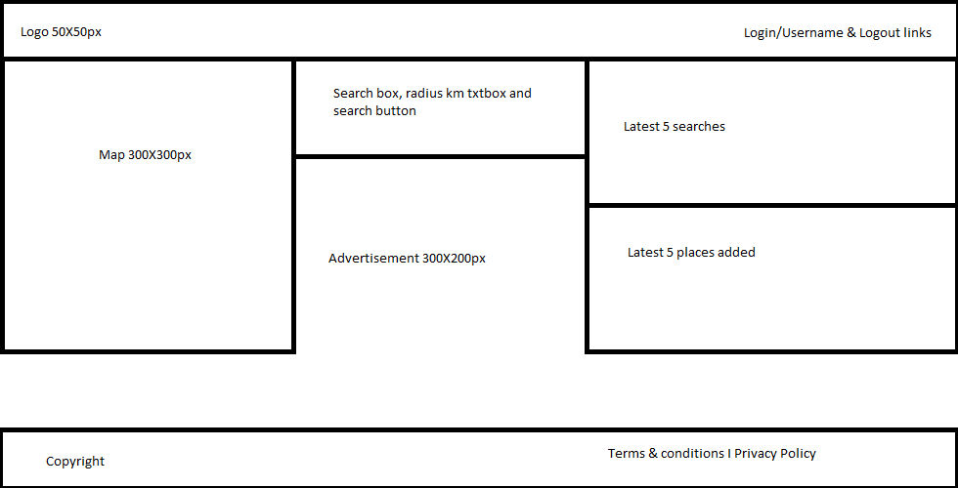
Home page

Slide 3
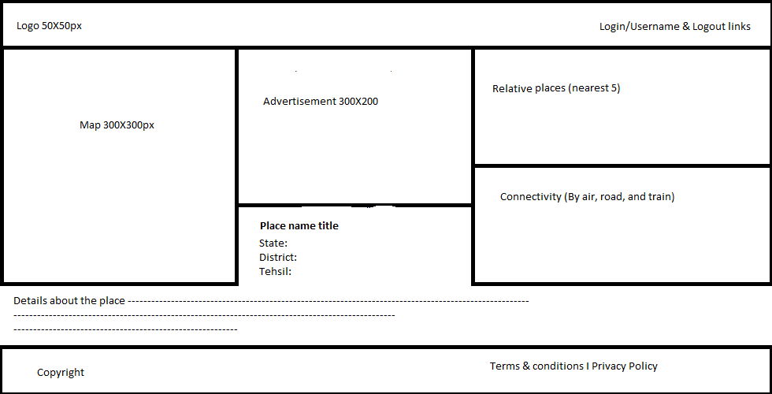
Detail page

