Slide 1
BANKRUPTCY PREVENTION
MEMBERS OF PROJECT
1.KONETI RAVI TEJA
2.PANKHURI SHARMA
3.JONNADULA MANIKANTA
4.MANAKURU GANESH BABU

Slide 2
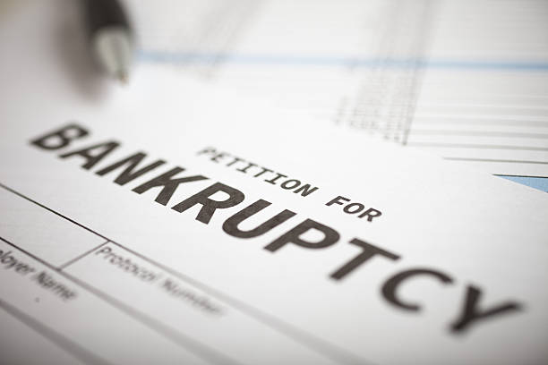
OBJECTIVE
Classify Bankrupt or not Bankrupt

Slide 3
DataSet Overview
1.Industrial Risk: Measures the risk associated with the company's industry (values between 0 and 1).
2.Management risk : Measures the risk related to management decisions (values between 0 and 1).
3.Financial flexibility: Measures how flexible a company is financially (values between 0 and 1).
4.Credibility : Measures the company’s credibility (values between 0 and 1).
5.Competitiveness : Measures how competitive the company is (values between 0 and 1).
6.Operating risk : Measures the operational risk of the company (values between 0 and 1)
7.Class : The target variable, indicating whether the company is at risk of bankruptcy or non-bankruptcy.

Slide 4
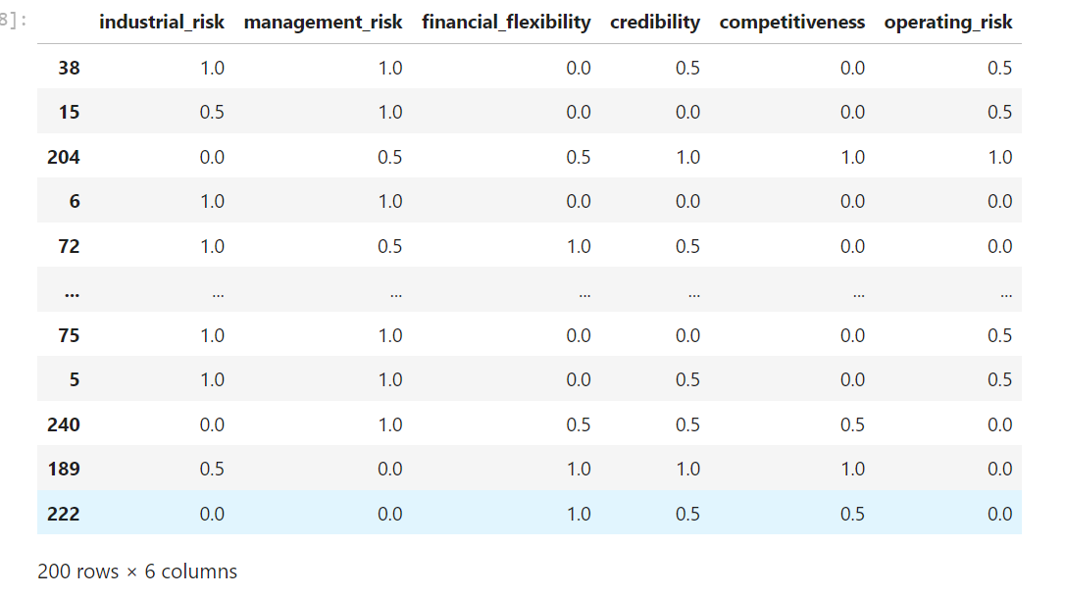
Steps to EDA
1.Import Python Libraries
2.Reading Dataset
3.Analyzing data using data.head(),data.shape , data.info , data.describe
4.Check for Duplicates , missing values.
5.Heat Map for Correlation of dataset
6.Visualizing the dataset
7.Label Encoding the Target Column(class).

Slide 5
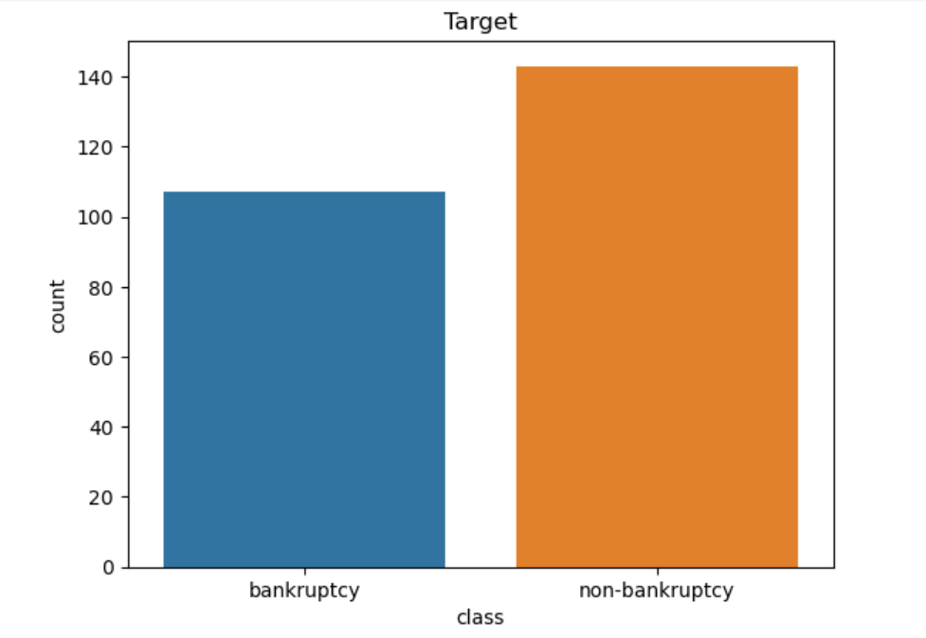
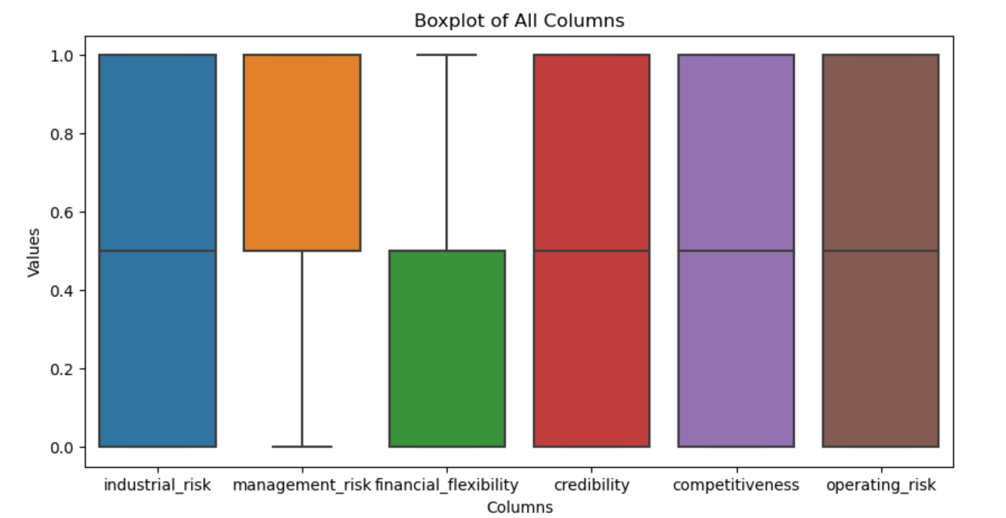
VISUALIZATION

Slide 6
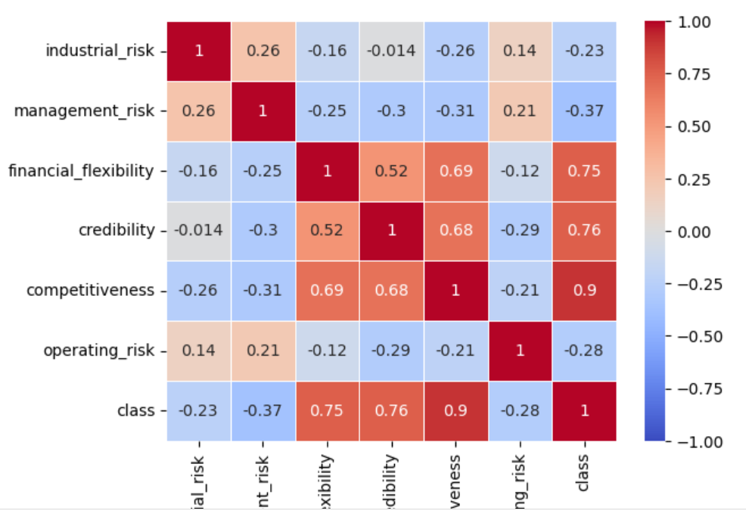
HEAT MAP

Slide 7
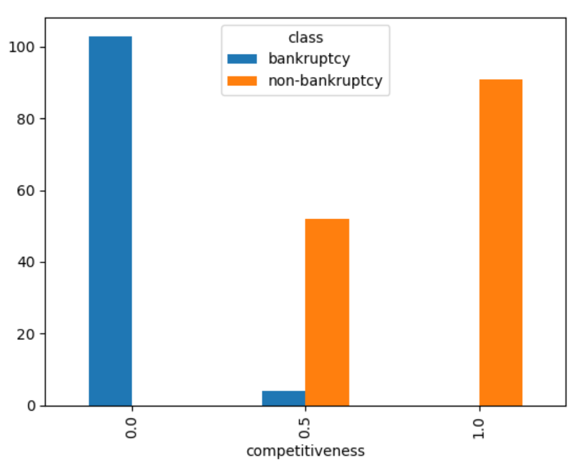
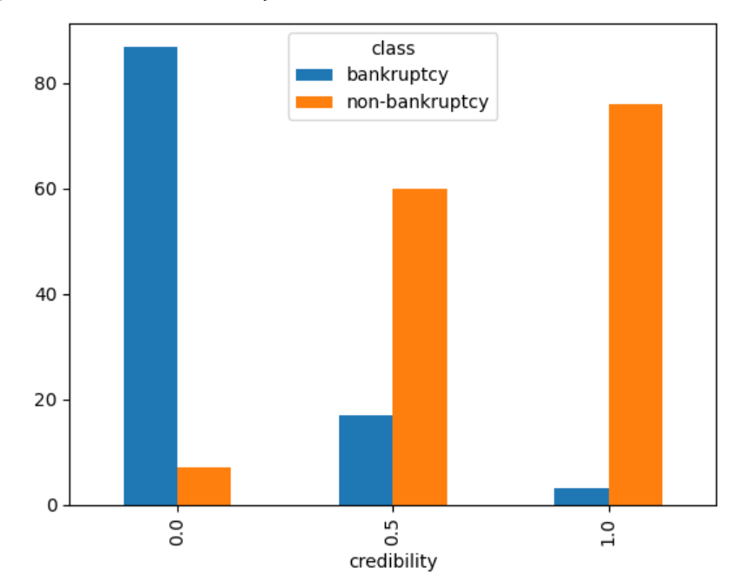
BAR CHART FOR EACH COLUMN WITH RESPECT TO CLASS COLUMN

Slide 8
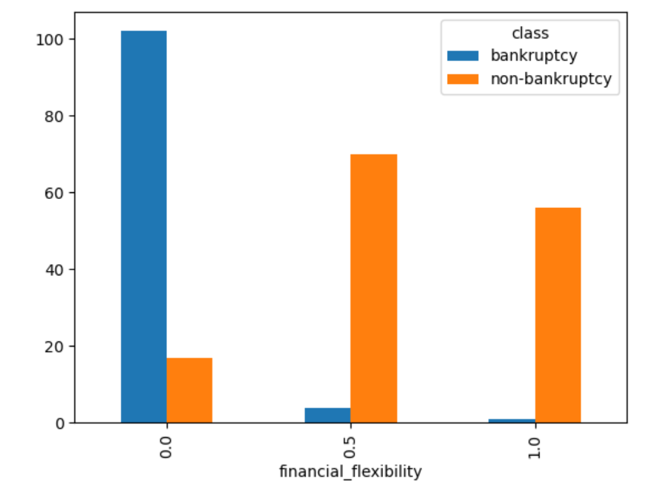
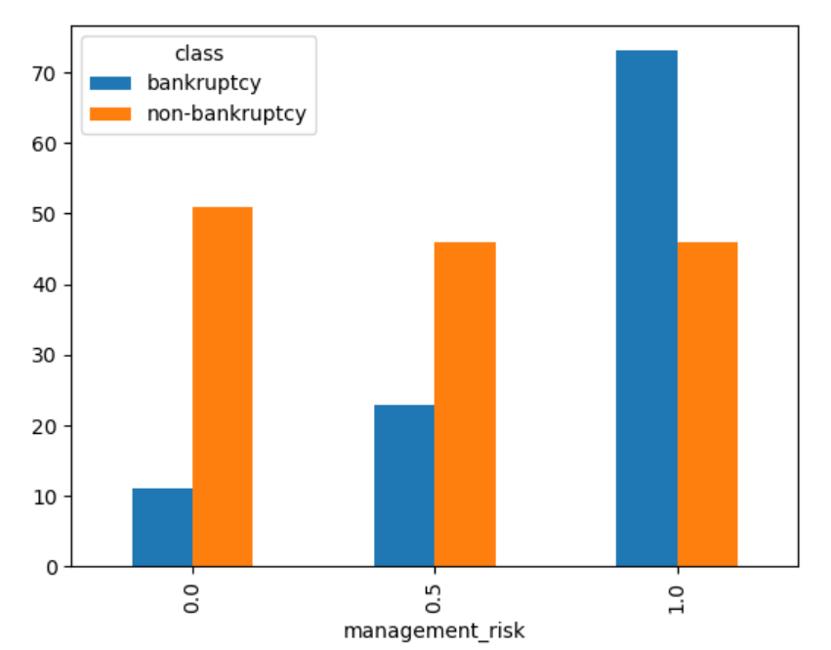
BAR CHART FOR EACH COLUMN WITH RESPECT TO CLASS COLUMN

Slide 9
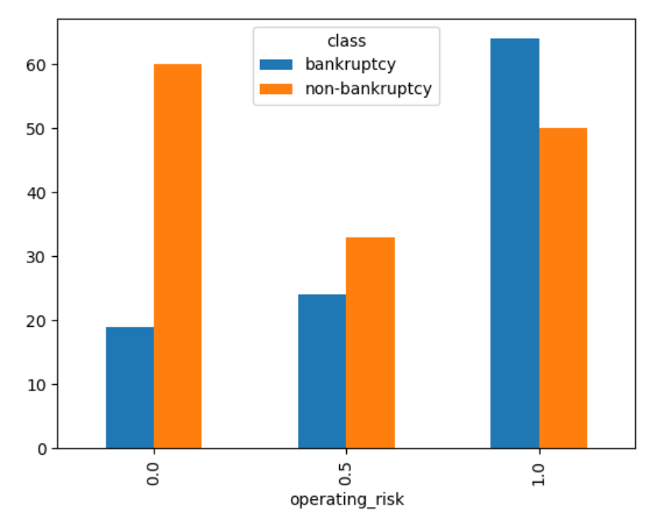
BAR CHART FOR EACH COLUMN WITH RESPECT TO CLASS COLUMN

Slide 10
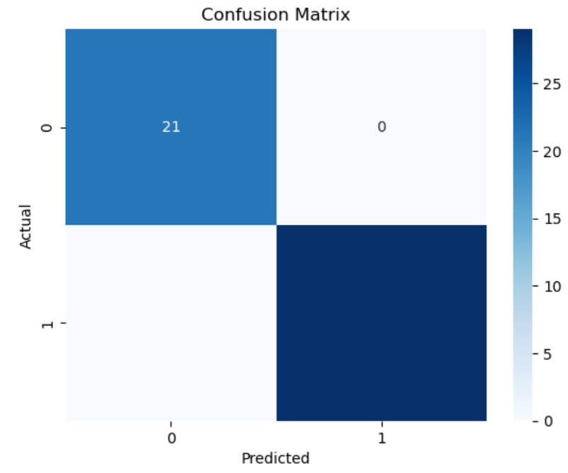
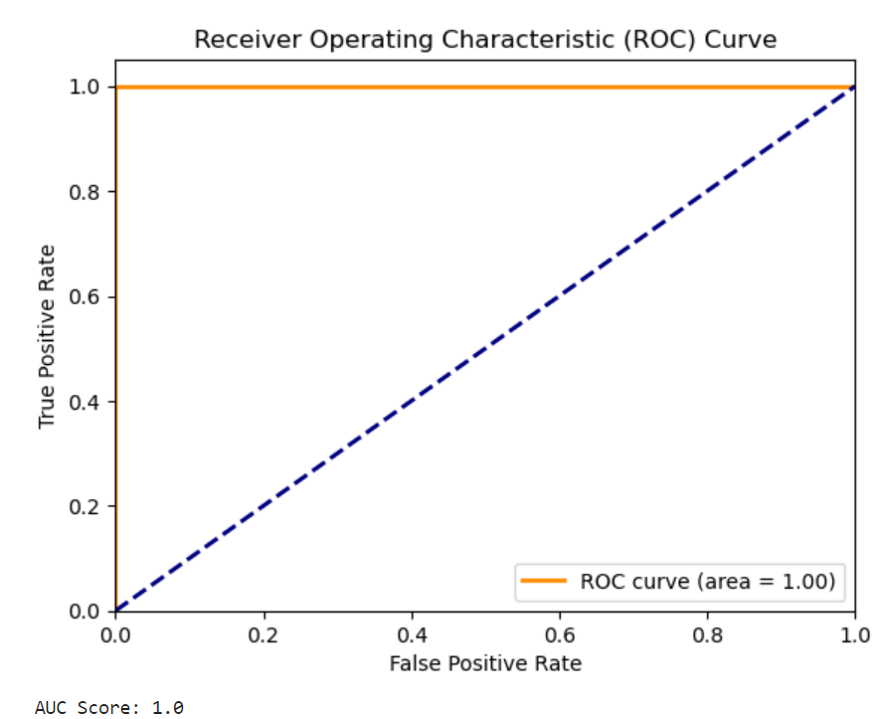
Performance of ML Models with ROC Curve and Accuracy
Logistic Regression
A simple yet effective model for binary classification. It predicts the probability of a business being bankrupt or non bankrupt based on the features extracted from the data.

Slide 11
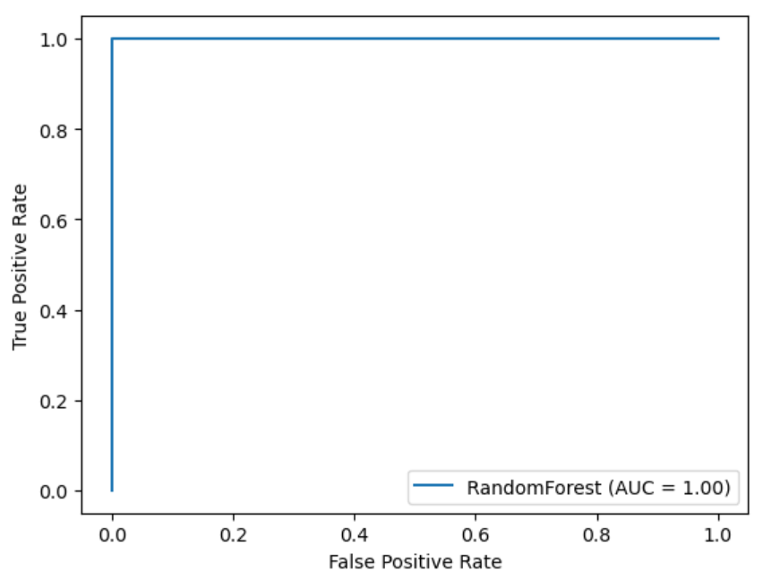
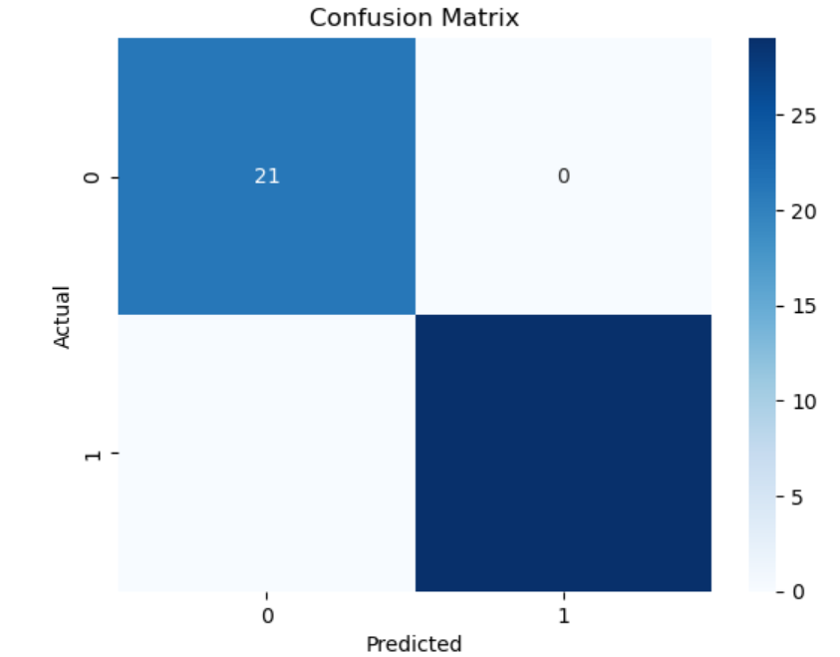
2. Random Forest Classifier An ensemble model that builds multiple decision trees and merges them to improve prediction accuracy and control overfitting.

Slide 12
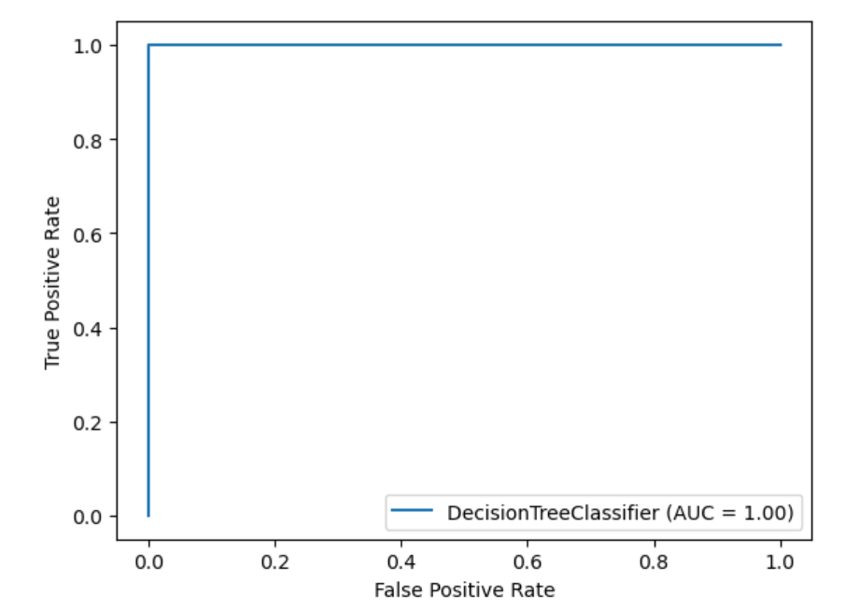
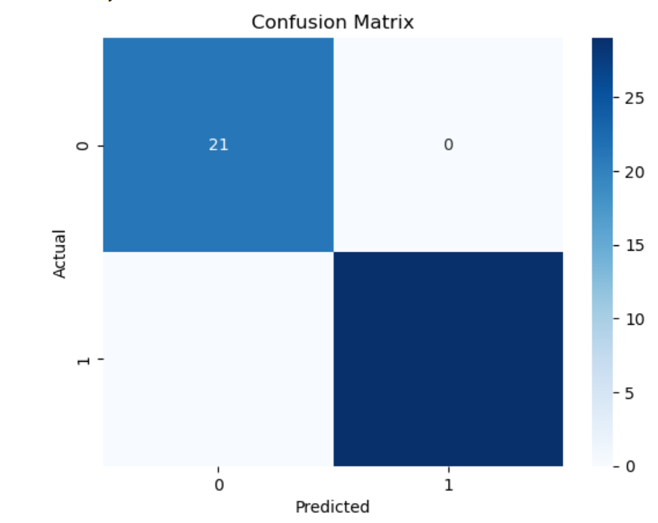
3. Decision Tree Classifier A Decision Tree Classifier is a model that uses a tree-like structure to make decisions based on input features. It splits the data into branches to predict whether the business is bankrupt or not. Each node represents a decision based on a feature, and the leaves represent the final classification.

Slide 13
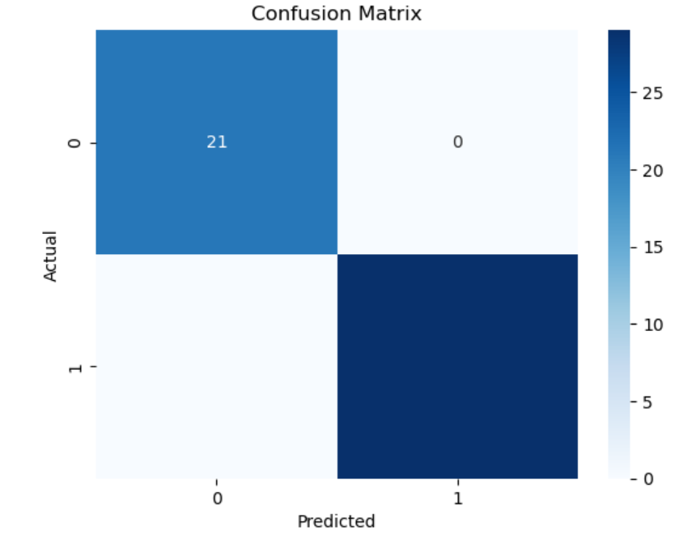
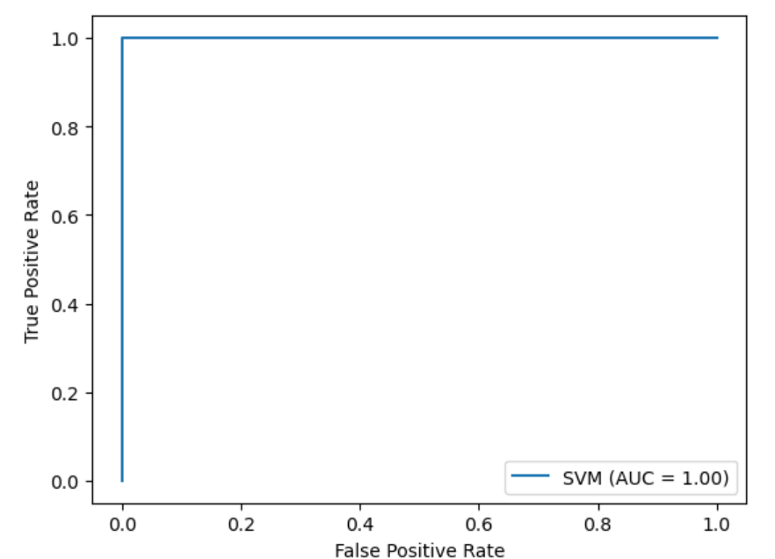
4. Support Vector Machine (SVM)
A powerful model that finds the optimal hyperplane to separate bankrupt and not bankrupt. It’s effective in high dimensional spaces.

Slide 14
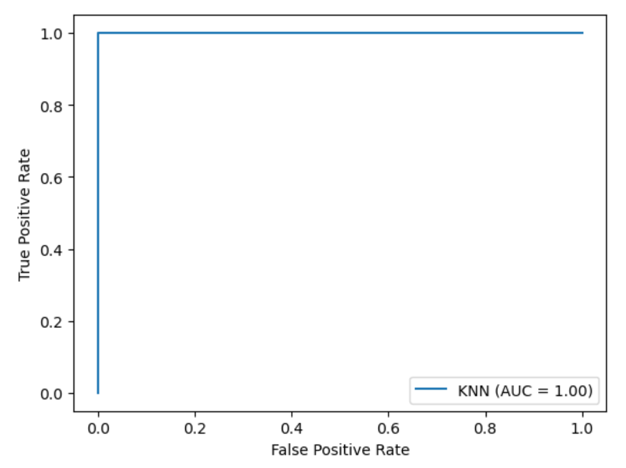

6.KNN Classifier
K-Nearest Neighbors (KNN) is a simple, instance-based learning algorithm that classifies a business based on its proximity to other labeled data points in the feature space.

Slide 15
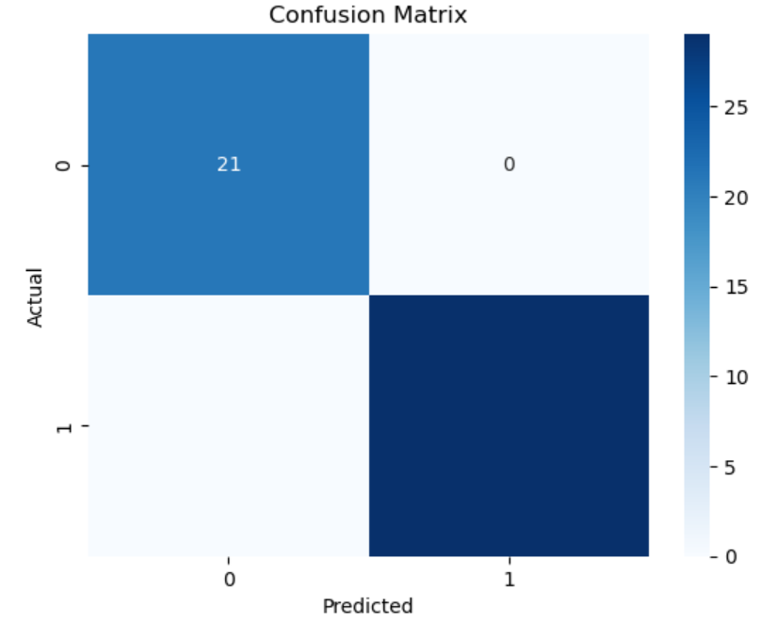
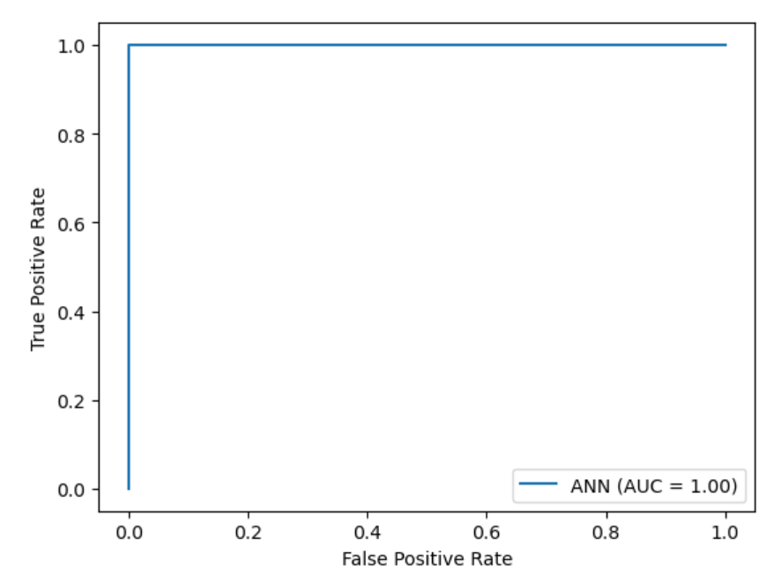
7.ANN

Slide 16
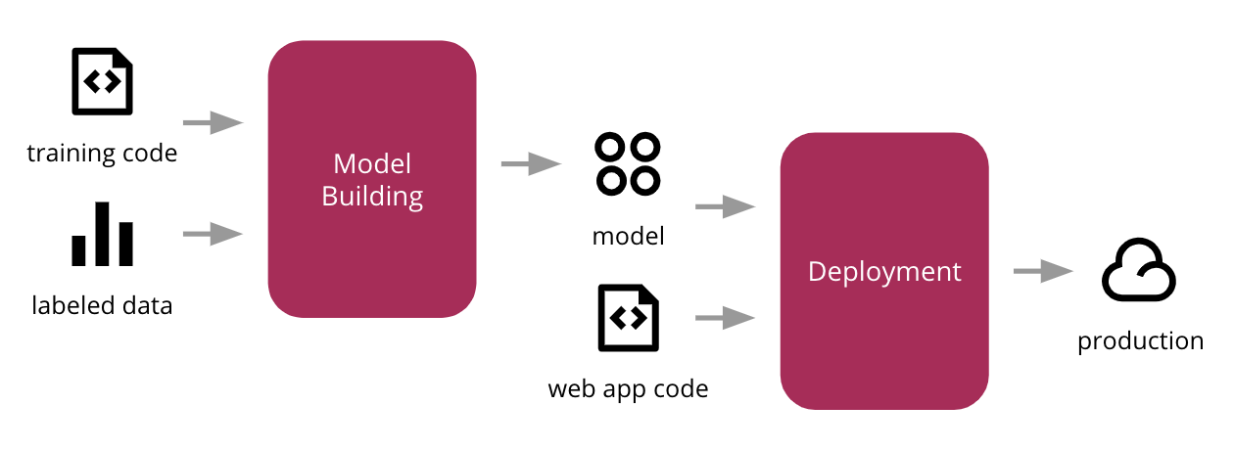
DEPLOYMENT
It is the process of making your trained machine learning model available for use in a production environment, where it can interact with real users and data

Slide 17
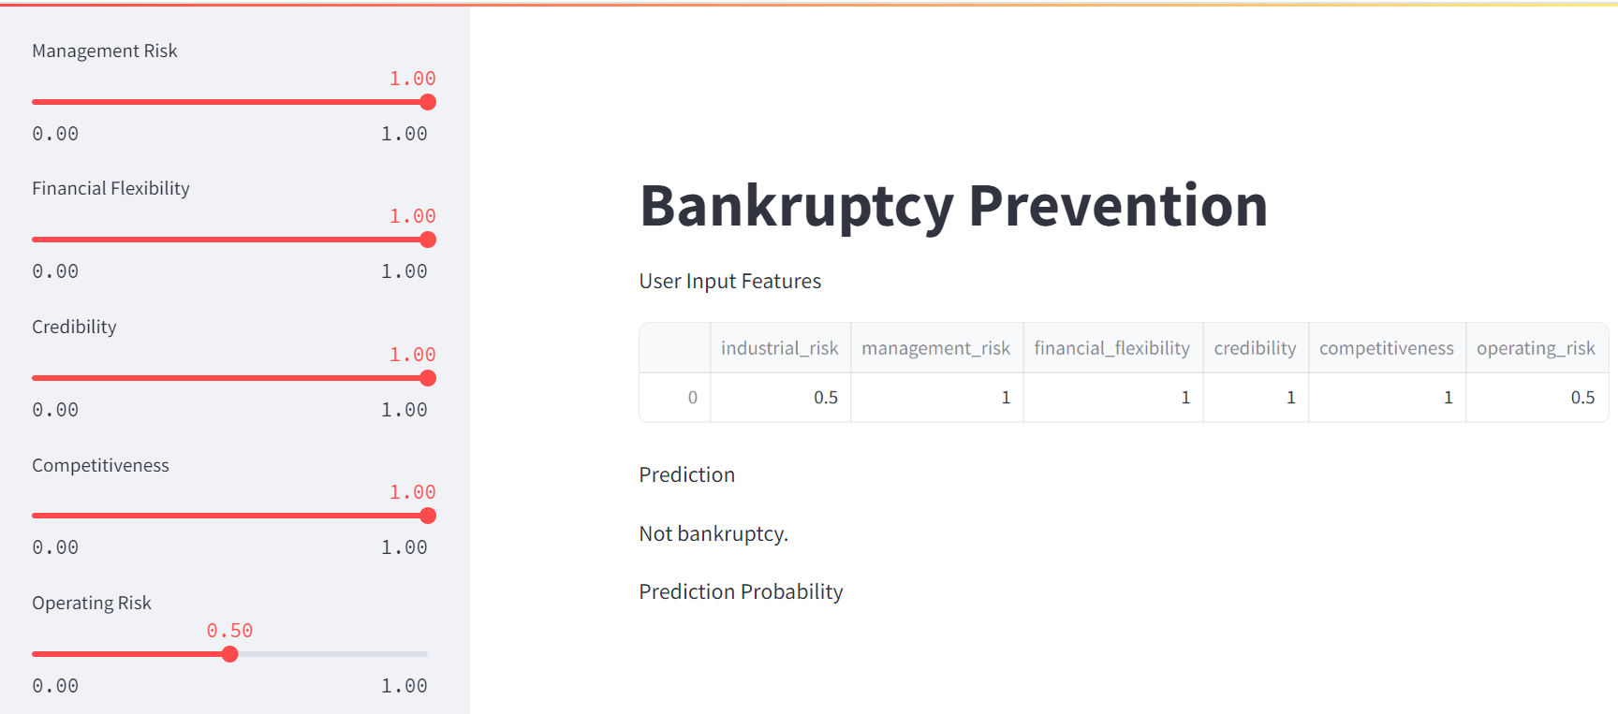

Slide 18
Conclusion
The successful deployment of the bankrupt vs not bankrupt classification model is a testament to the power of machine learning and modern web technologies in solving complex societal challenges. By making this tool widely accessible, we take a step towards a more informed and discerning public, capable of navigating the complexities of today's information landscape.

Slide 19


