Slide 1
Artificial Intelligence Project
THE LUCKY RABBIT GAME in PROLOG

Slide 2
Introduction
The Lucky Rabbit Game is a multi-player game made in SWI Prolog
The GUI has been developed using XPCE
The goal is to reach to the goal state. The goal state is the center of the spiral here number 63 on the board
There are several constraints includes jail, super rabbit, well, bridge
The player who passes all the constraints and reaches the goal state first is the winner
This is basically a dice and board game

Slide 3
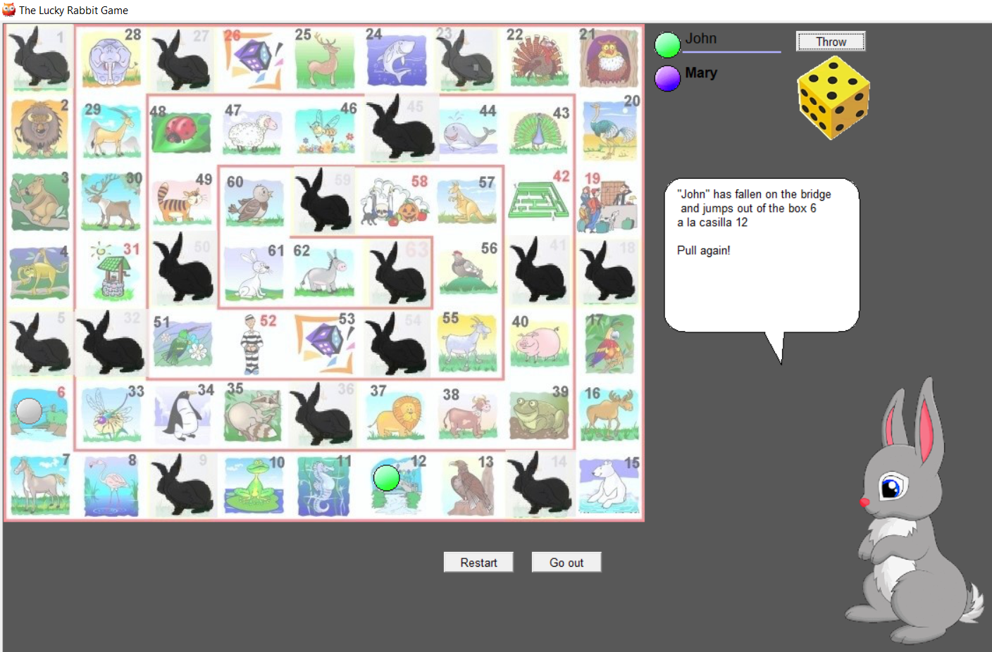
Screenshot

Slide 4
Inside’s Intel
This is purely based on the numbers on the dice
I tried to device a probabilistic model which determines the winning of a player based on the position of the player on board
The winning probability also increases with more number of players playing the game
The above analysis is made based on testing with the multiple inputs given various number of players playing the game

Slide 5
Algorithm
Major steps include:
[p] Creating images...
[p] Creating images of the game...
[p] Creating players chips...
[p] Creating dynamic predicates...
[p] Launching main menu...

Slide 6
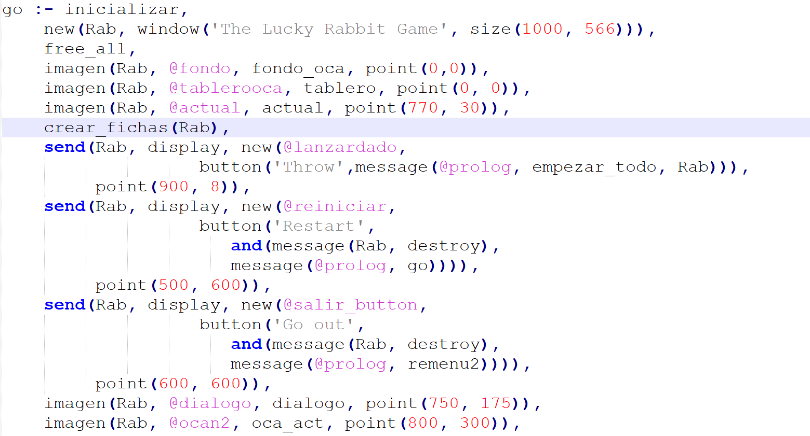
Code

Slide 7
THANK YOU

