Slide 1
Intro to AI Agents
Your AI can do more than just write emails
Pankaj Manoharlal Thakur
Notes:
0:00 to 1:00 (1 min). Walk on, say your name, the tagline. Tagline is still a placeholder.

Slide 2
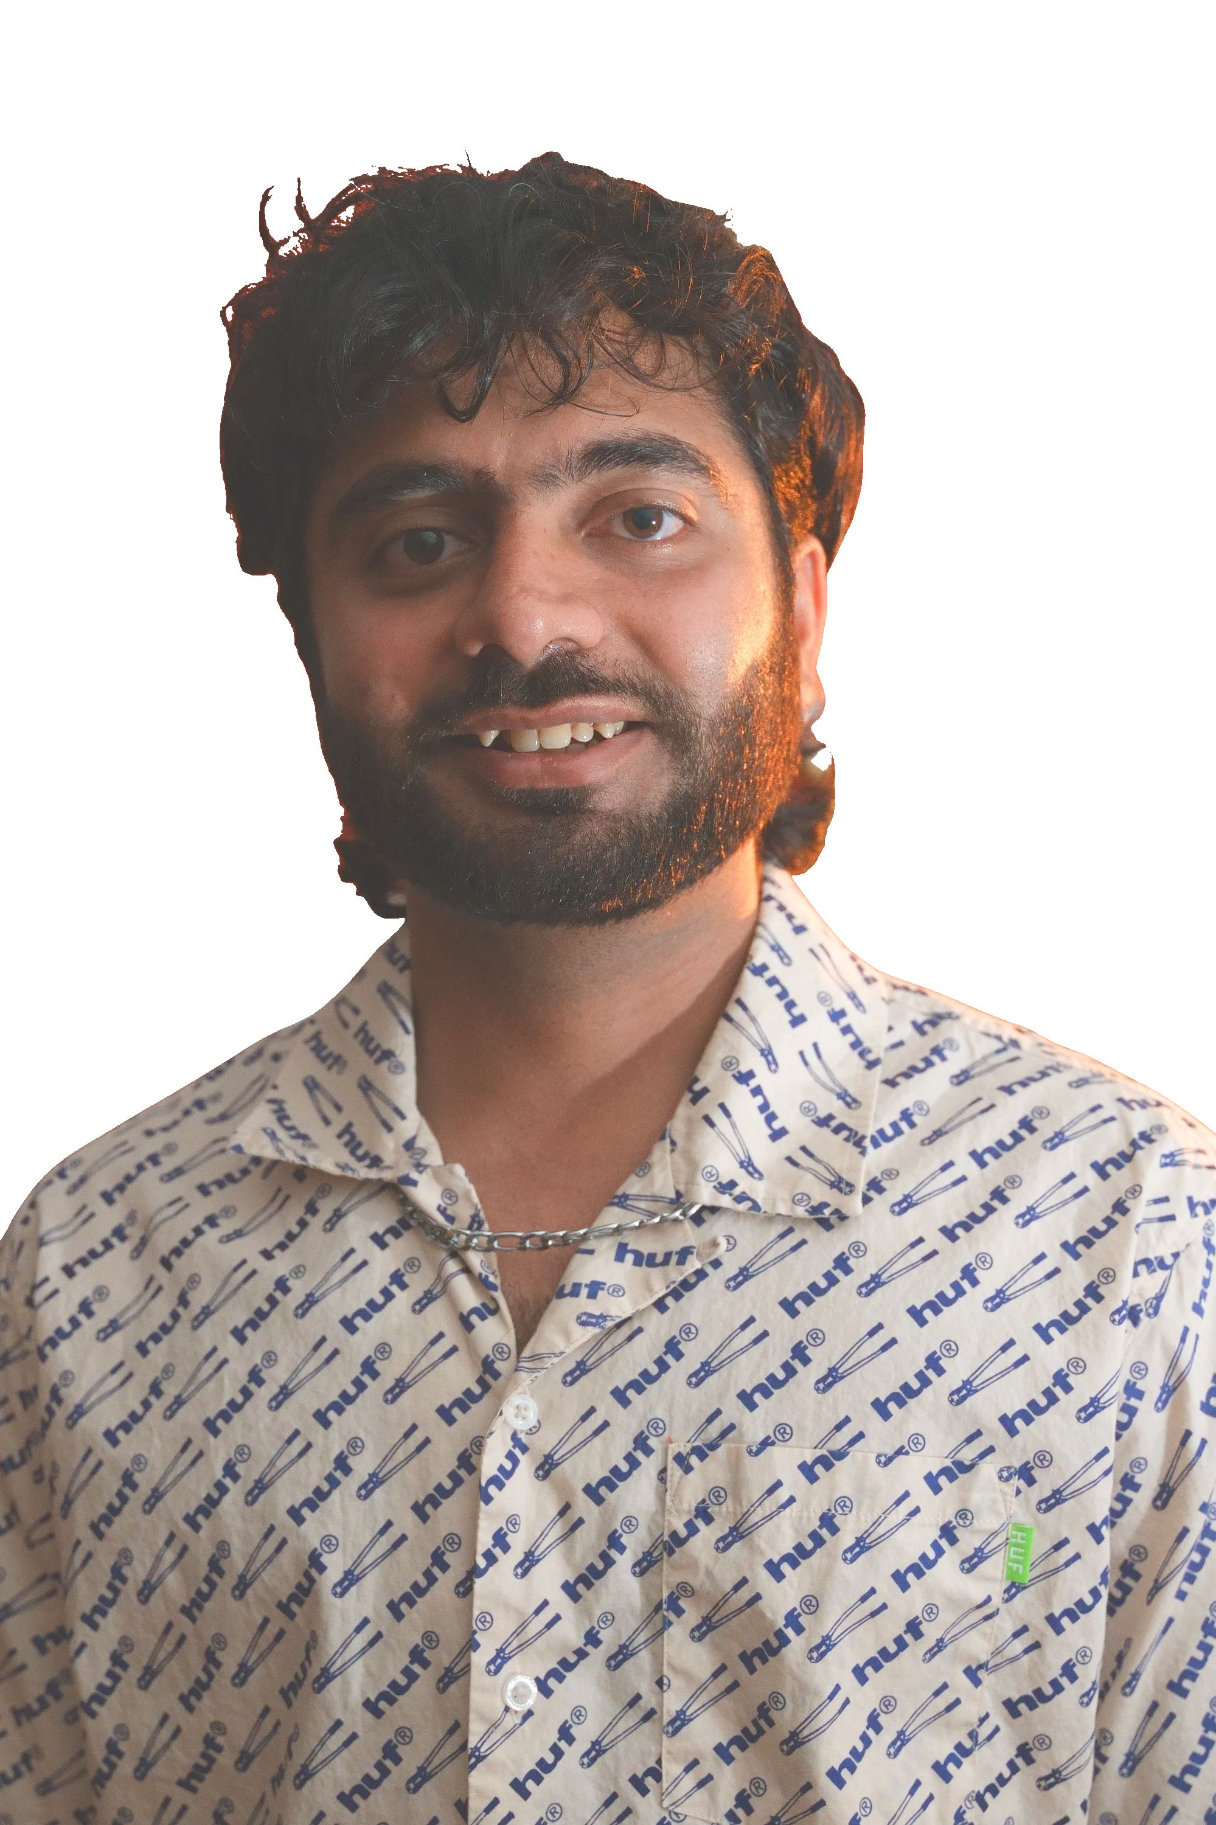
It's me,
Hi, I'm Pankaj Manoharlal Thakur.
and I'm not AI.
Software Engineer in AI at LexisNexis.
I build agents for my own problems.
Off the clock: pickleball.
Notes:
1:00 to 2:00 (about 1 min). Name, then "I'm not AI", then straight into the costume.

Slide 3
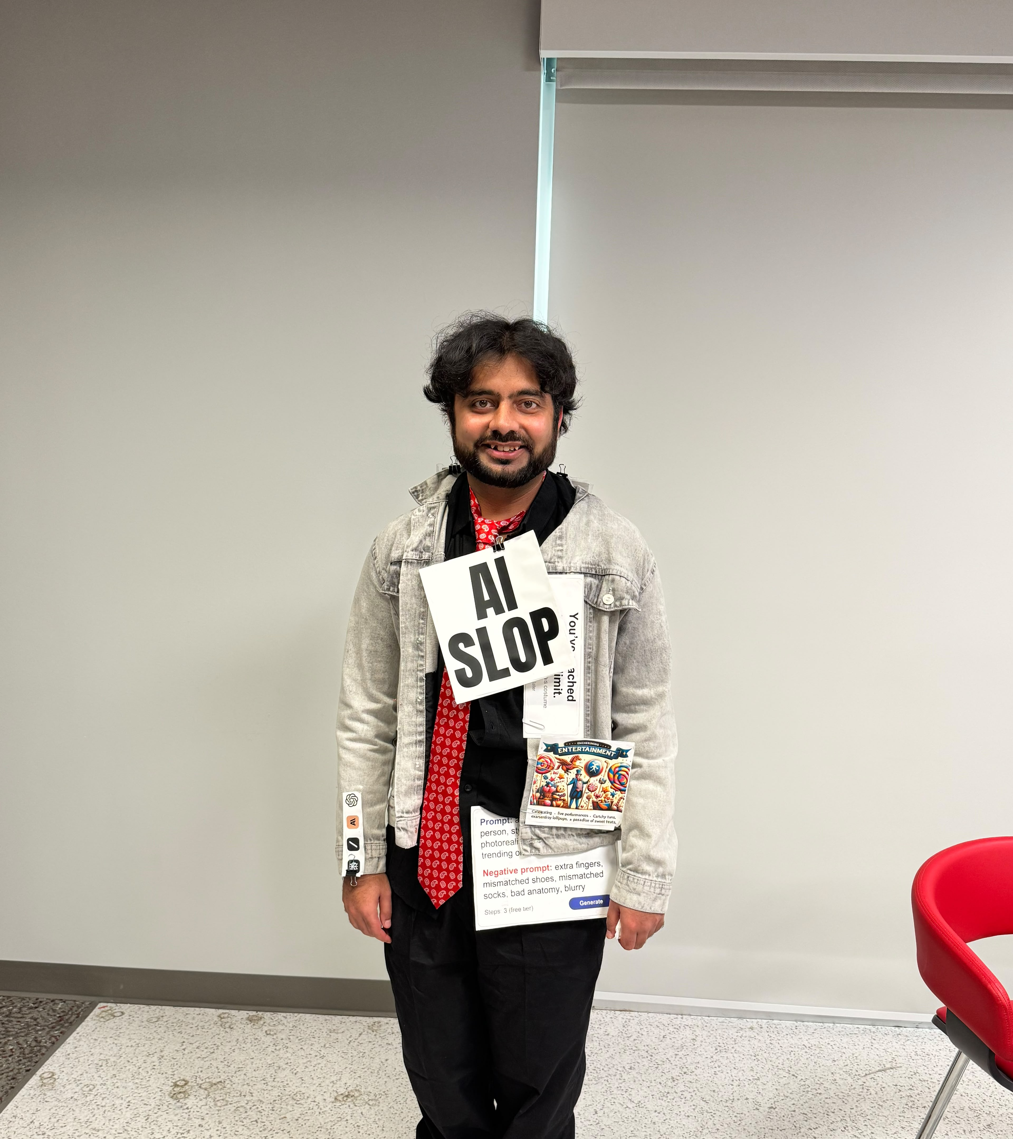
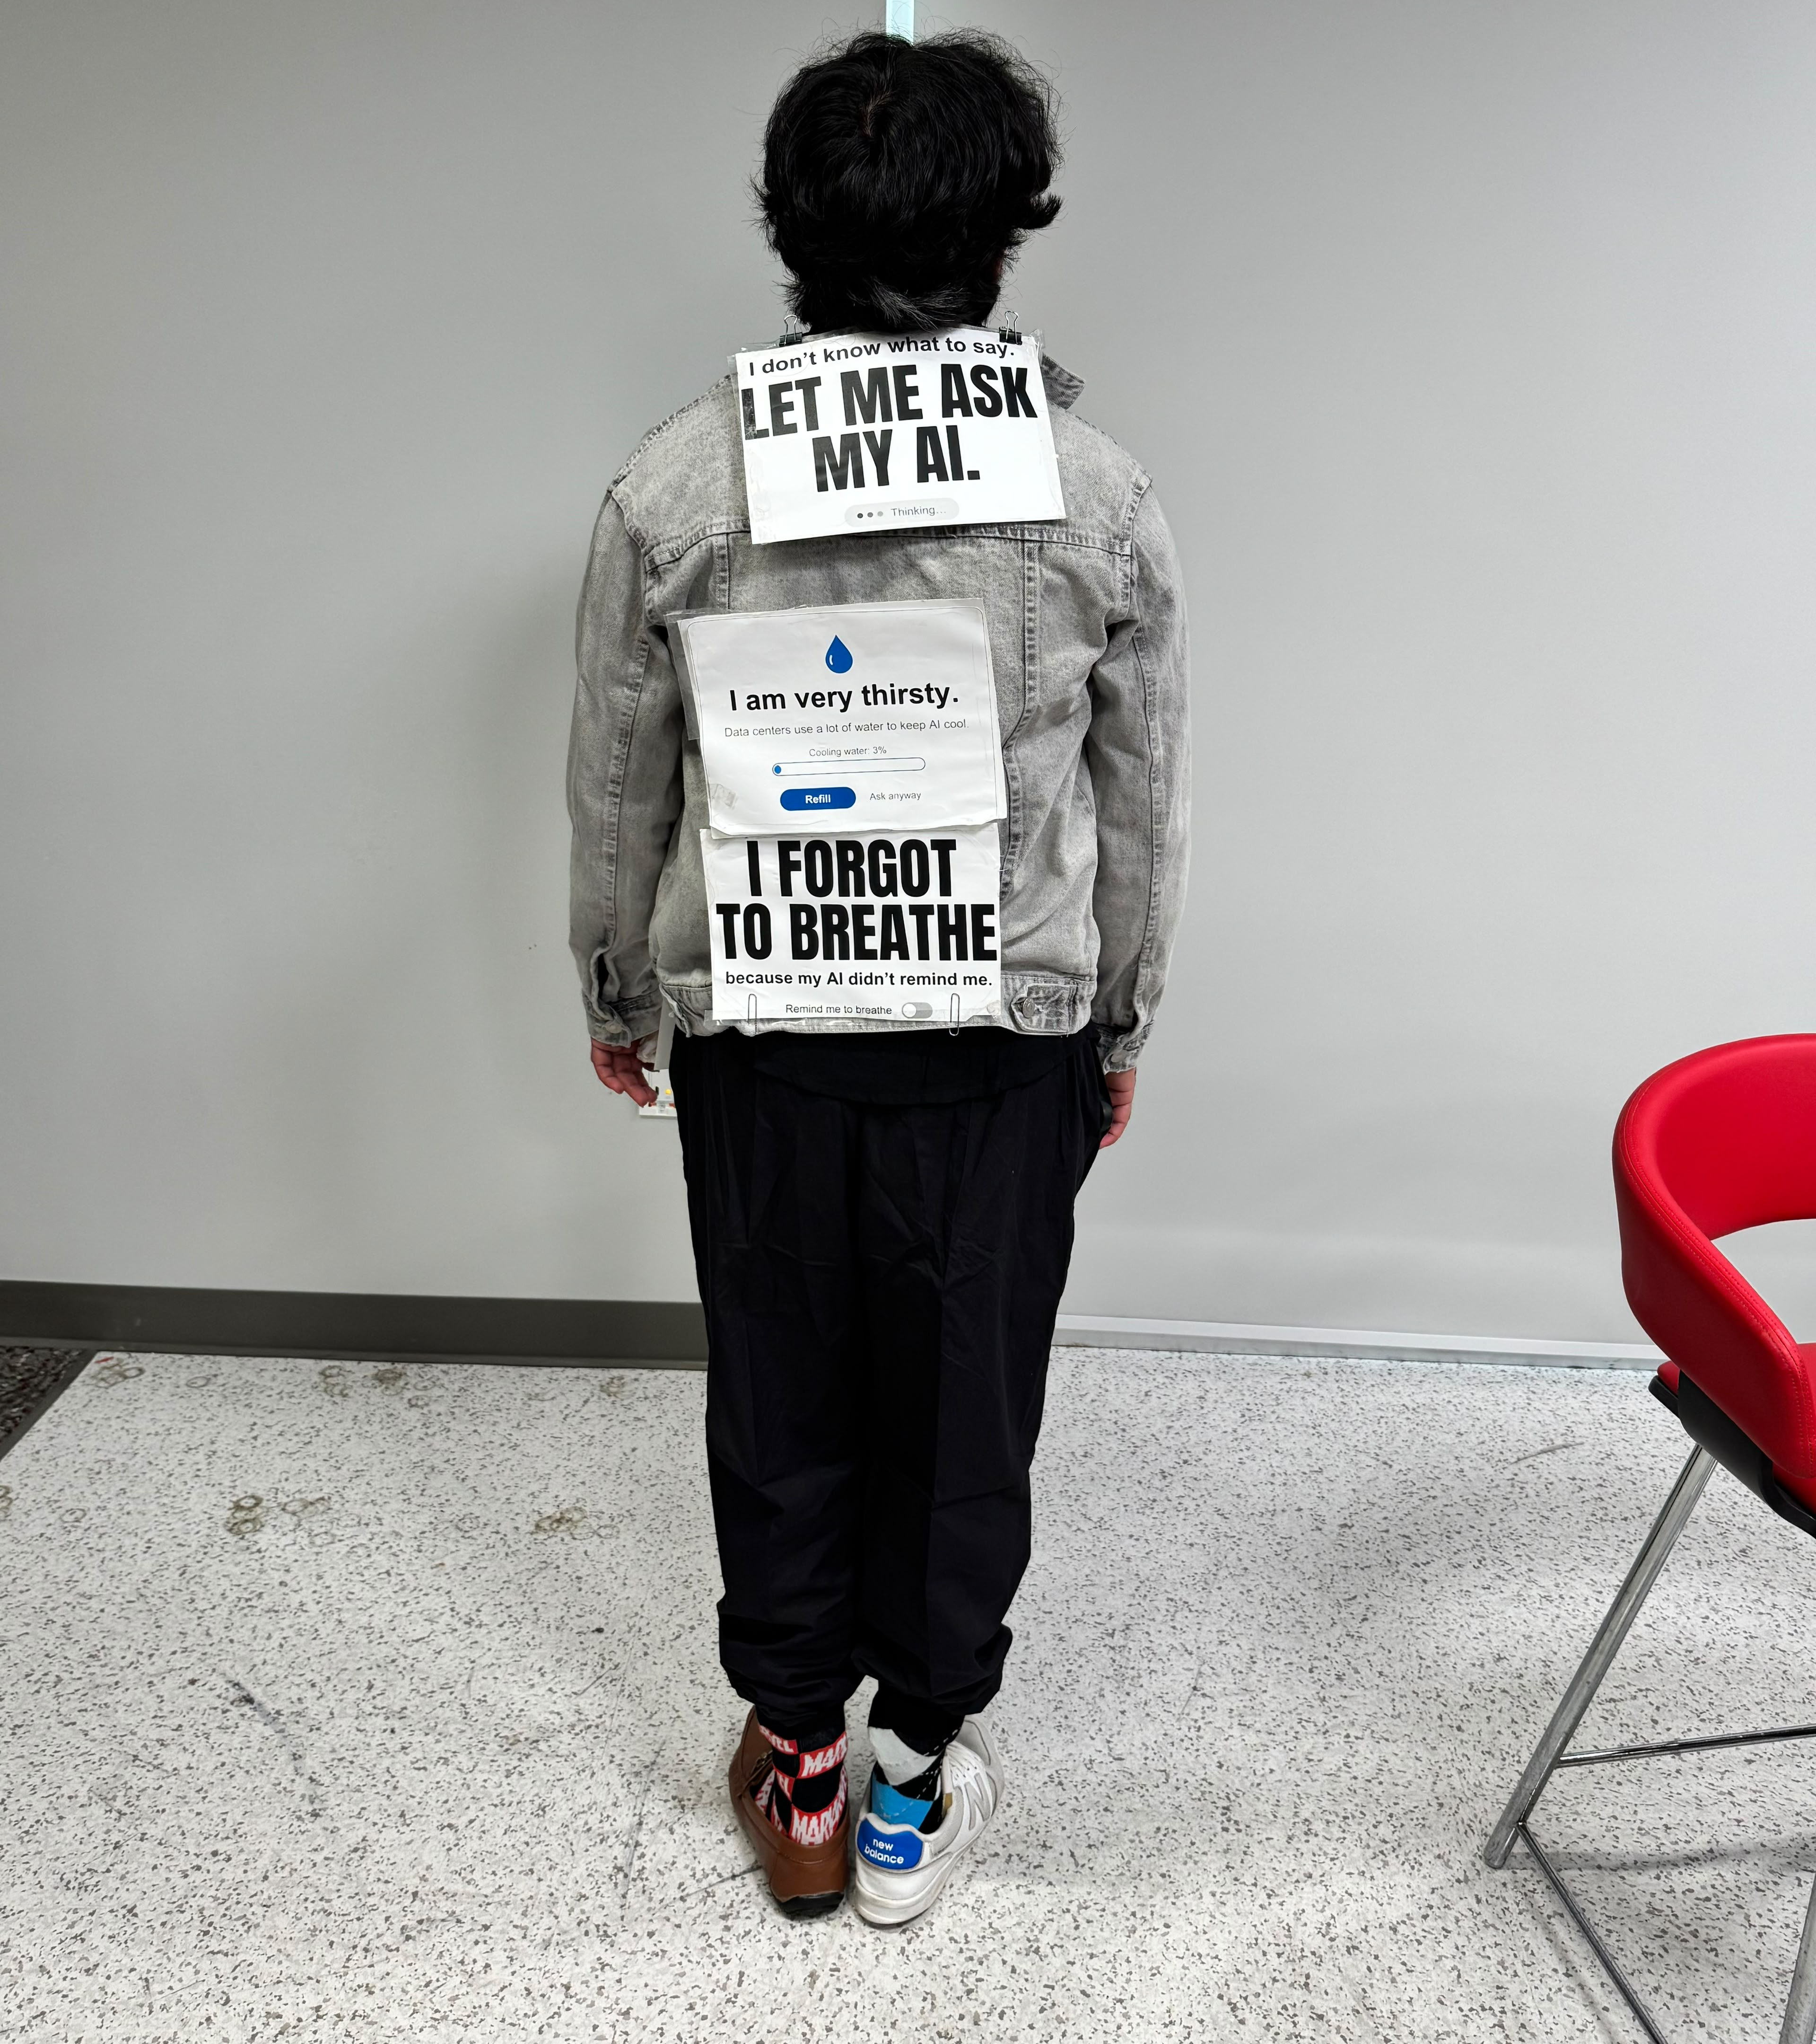
Notes:
2:00 to 3:00 (2 min). Two or three quick gags about the costume. Keep them short, then go to the poll.

Slide 4
Quick poll: raise your hand
1
2
3
Have you used ChatGPT today?
Have you asked AI for advice?
Have you ever planned a week of meals?
Notes:
3:00 to 5:00 (2 min). Ask each question, take the hands, react to what you see. Do not rush this.

Slide 5

Here is what an agent looks like.
Ooh. Wrong agent.
Notes:
5:00 to 6:00 (1 min). Use an image you have the rights to. Let the room laugh, then move on to the definition.

Slide 6
So, what is an agent?
An LLM that decides what to do next, using tools, in a loop.
Decides
Uses tools
Repeats
The model picks the next step. Your code runs the tool.
Notes:
6:00 to 7:00 (1 min). Serious tone. Read the definition slowly, then pause.

Slide 7
Who holds the control?
CHATBOT
AGENT
You hold the control
It holds the control
You ask
It answers
You decide
You set a goal
It gathers data
It picks next step
Next: what the agent needs to gather.
Notes:
7:00 to 9:00 (2 min). The chatbot waits for each question. The agent decides what data it needs and uses tools to get it.

Slide 8
Why I build this
1
2
3
I build things that help me.
I struggle with meal prep.
So that is the problem I solve.
Let's start where most people start: ChatGPT.
Notes:
9:00 to 10:00 (1 min). Keep it personal. This is why the talk exists.

Slide 9
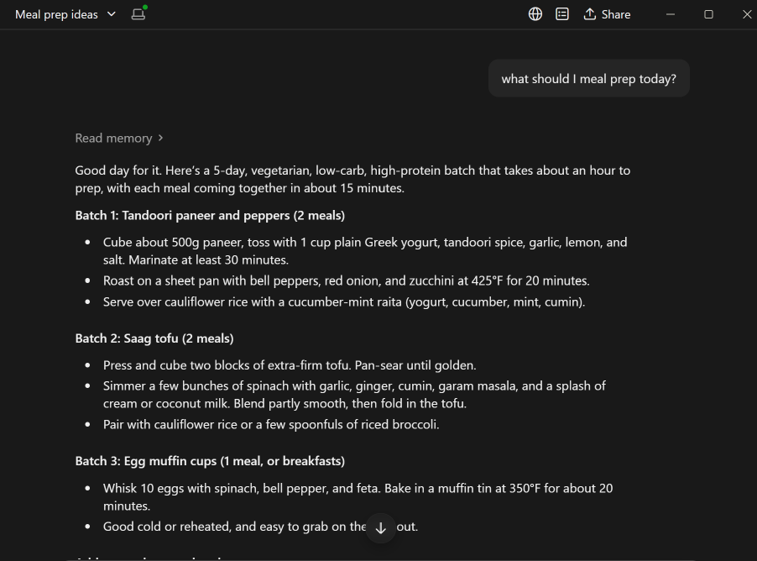
Problem v1: ask Claude [ Claude’ Plan ]
Me: “What should I meal prep?"
Generic. It doesn’t know me
Notes:
10:00 to 12:00 (2 min). Decide: show a screenshot or paste the reply. A screenshot is safer on stage. Read two lines, then point out what is missing.

Slide 10
Problem v2: add goals and pantry
My goals
My pantry
Calories, protein, fiber, restrictions, favorites
What is in my fridge right now
Meal prep that fits my goals and my pantry
Notes:
12:00 to 14:00 (2 min). Refine twice on this slide: first add goals, then add pantry. Ask the room what they would want the agent to know.

Slide 11
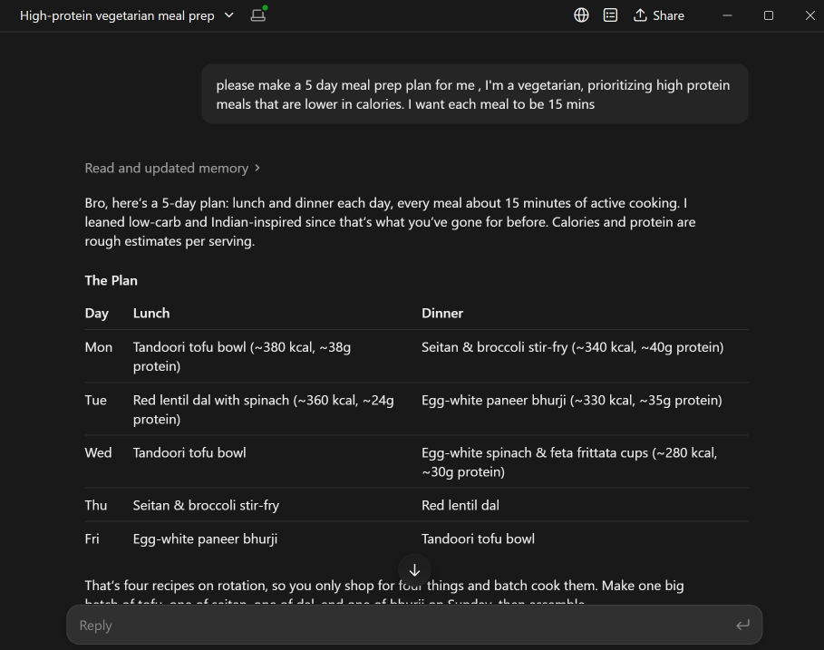
Generic. It kinda knows me, but there is no plan, no access to my calendar

Slide 12
Problem v3: tell me when
My goals
My pantry
My calendar
Targets and restrictions
What is in the fridge
When I am free
A plan that fits what I eat, what I have, and when I am free
Three data sources. That is an agent job.
Notes:
14:00 to 16:00 (2 min). The calendar is where the chatbot runs out of road. It cannot see the week.

Slide 13
That's an agent
Goal in
Gathers goals, pantry, calendar
Proposes meals and free slots
YOU approve
Books the slots
The agent controls the steps. You control the yes.
Human in the loop: the approval step is what makes it safe to trust.
Notes:
16:00 to 18:00 (2 min). This is the core message. Point at the red approval step every time.

Slide 14
The agent loop
Goal
LLM thinks
Picks a tool
Tool runs
Result back
Repeat until done.
The model decides. Your code acts.
Notes:
18:00 to 20:00 (2 min). Walk the loop with the meal prep example: goal, gather, pick a tool, read the result, repeat.

Slide 15
Tool calling
def get_pantry() -> list[str]:
"""Return what is in the fridge."""
return pantry_items
1
Model asks for get_pantry
2
Your code runs it
3
Result goes back to the model
The docstring tells the model when to use it.
Notes:
20:00 to 22:00 (2 min). Show the function, point at the docstring, and say the model reads it to decide.

Slide 16
Context grows every turn
Context limit
Trim
Drop old tool results
Keep only what the next step needs
Summarize long history
Turn 1
Turn 2
Turn 3
Turn 4
Notes:
22:00 to 23:30 (1.5 min). Tell the "it broke because context got messy" story here.

Slide 17
Project folder: meal_prep
meal_prep/
├── __init__.py
├── agent.py
├── .env
├── pantry.json
├── goals.json
└── calendar auth file
agent.py
The agent, its instructions, and its tools.
pantry.json, goals.json
Fixed data to start. Swap for real sources later.
.env
Your API key. Keep it out of git.
Created with adk create meal_prep. Nothing else to set up.
Notes:
25:00 to 26:00 (1 min). Created by adk create meal_prep. The calendar auth file name is a placeholder: check it against your folder before the talk.

Slide 18
Tools: what the agent can do
get_pantry
What is in the fridge
Read
get_goals
Calorie, protein, and fiber targets, plus restrictions
Read
get_calendar
Busy blocks for a date range
Read
find_recipes
Recipes that fit the time limit and the pantry
Read
get_recipe
Full steps for one recipe
Read
get_current_date
Resolves "this Saturday"
Read
book_slot
Writes a meal to the calendar, after your approval
Write
Only book_slot writes, and it runs only after you approve.
Notes:
26:00 to 27:00 (1 min). Presenter only, not on the slide: get_pantry, get_goals, and find_recipes are written. get_calendar is being wired in. get_current_date, get_recipe, and book_slot are next. Only show in the live run what is wired.

Slide 19
What is ADK?
Agent Development Kit: Google's Python toolkit for agents.
Agent
Tools
Runner
The brain. A model plus instructions.
Python functions the agent can call.
Runs the loop: think, act, read, repeat.
Placeholder: a 3-line example of an agent with one tool goes here.
Check the current ADK docs (adk.dev) before the session.
Notes:
23:30 to 25:00 (1.5 min). Agent, tools, runner. Replace the placeholder with a real three-line example later.

Slide 20
The demo: Meal Prep Agent
1
2
3
4
5
Ask
Gather
Propose
Approve
Book
Breakfast and lunch this week
Goals, pantry, calendar, date
Meal options and free slots
You say yes
Calendar events with reminders
Only step 5 writes to the calendar, and only after step 4.
Notes:
25:00 to 27:00 (2 min). Set the scene with the five steps before the live run.

Slide 21
Live run
you > Plan my breakfast and lunch this week
agent > get_goals()
agent > get_pantry()
agent > get_calendar(start, end)
agent > find_recipes(max_minutes=15)
agent > Proposed 5 breakfasts, 4 lunches, 9 free slots. Approve?
you > Approve
agent > book_slot(...) x 9, reminders set
Sample data, for illustration. Replace with the live run if it works.
Notes:
27:00 to 33:00 (6 min). Run it live in adk web if it works, otherwise use this as the mockup. Point at the approve step before booking. get_current_date and get_recipe are not wired yet, so do not show them unless they are ready.

Slide 22
What would you build?
Pick a track. Tell me one problem you would solve.
HEALTH & WELLNESS
FINANCE, ENTERPRISE & TECH
What would help you feel better?
What task wastes your week?
SOCIAL IMPACT & EDUCATION
ENTERTAINMENT, MEDIA & ARTS
What would you teach or fix?
What would you make?
Notes:
33:00 to 34:00 (1 min). Take two or three answers. Do not spend more than a minute here.

Slide 23
Ideas to start with
HEALTH & WELLNESS
FINANCE, ENTERPRISE & TECH
SOCIAL IMPACT & EDUCATION
ENTERTAINMENT, MEDIA & ARTS
Neurodivergent planner
Stock and tech news
Concepts as stories
Script to storyboard
Breaks big tasks into small steps.
Summarizes headlines. No buy or sell advice.
Teaches fractions through a story.
Turns a script into scene cards.
Fitness and meal prep helper
Tax explainer
Bill explainer
Your idea
Plans meals and tracks calories.
Walks through a form, line by line.
Explains a bill and where to ask.
Pick one from the crowd.
Explainers help people understand. They don't give financial, tax, insurance, or medical advice.
Notes:
34:00 to 35:00 (1 min). Point at the track the crowd picked. Then hand off to Q&A.

Slide 24
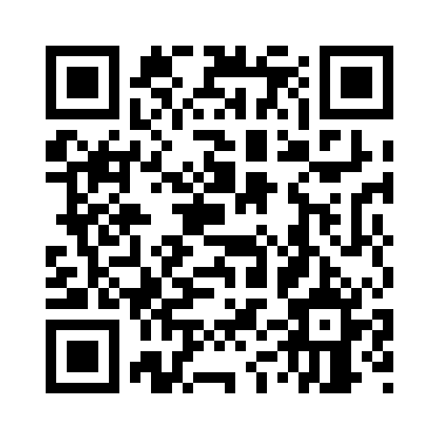
Q&A
Starter kit
1
pip install google-adk
2
adk create my_agent
3
Add GOOGLE_API_KEY to .env
4
adk web
GitHub Repo Link
adk web is for local development only.
Notes:
Q&A only. Show when students ask how to start.

Slide 25
Q&A
MCP: plug in new tools
Your agent
MCP server
Your data
Decides which tool to call
Exposes tools in one format
Files, calendar, GitHub, a database
Local: stdio
Remote: HTTP + auth
Always set tool_filter
MCP is an open standard. Check adk.dev/tools-custom/mcp-tools before the session.
Notes:
Q&A only. Use when students ask how agents connect to their own data.

Slide 26
Q&A
Build agents on other platforms
Google ADK
Claude (Anthropic)
Python framework with a local test UI.
Send tool definitions with the API.
OpenAI Agents SDK
LangGraph
Tools, handoffs between agents, and tracing.
An agent built as a graph of steps.
The loop stays the same. Check each platform's current docs before the session.
Notes:
Q&A only. Use when students ask which platform to pick.

Slide 27
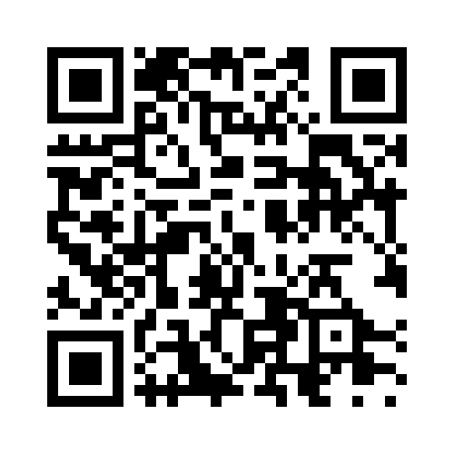
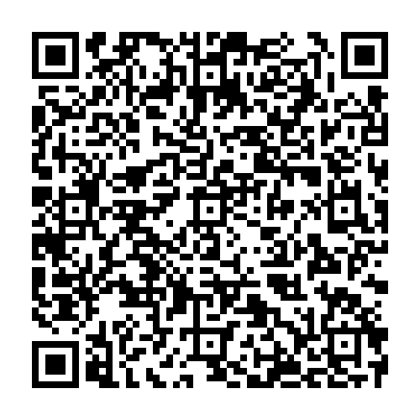
Thank you
Pankaj Manoharlal Thakur
Build one thing this weekend. Tell me what it is.
LinkedIn
Feedback form
Notes:
35:00. Start Q&A. Slides 22 to 24 are for Q&A only.

