Slide 1
Lab2 Exercise 2: Floating Point Find a positive floating point value x, for which x+1.0=x. Verify your result in a MIPS assembly language program, and determine the stored exponent and fraction for your x value (either on the computer or on paper). Note: The provided MIPS program p2.s will allow you to experiment with adding floating point values. It leaves the output in $f12 and also $s0, so you can examine the hex representation of the floating point value by printing out $s0.

Slide 2
Lab2 Exercise 3: Floating Point Next, find the smallest positive floating point value x for which x+1.0=x. Again, determine the stored exponent and fraction for x

Slide 3
Lab2 Exercise 4: Floating Point Associativity Finally, using what you have learned from the last two parts, determine a set of positive floating point numbers such that adding these numbers in a different order can yield a different value. You can do this using only three numbers. (Hint: Experiment with adding up different amounts of the x value you determined in part 3, and the value 1.0). This shows that for three floating point numbers a, b, and c, a+b+c does not necessarily equal c+b+a. If time permits, you should write a program to add these three values in different orders. It should be a straightforward modification of the program from part 2-3.

Slide 4
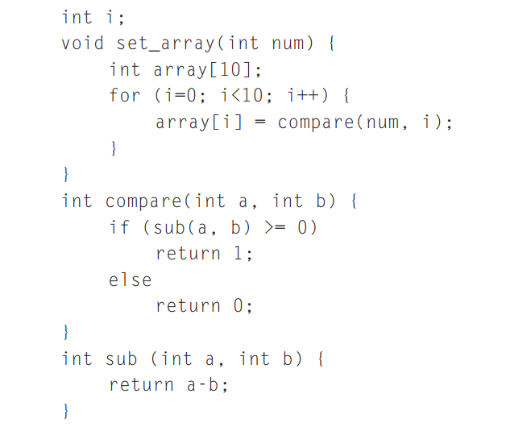
2.15 [25] <§2.7> Implement the following C code in MIPS, assuming that set_array is the first function called:
Be sure to handle the stack and frame pointers appropriately. The variable code font is allocated on the stack, and i corresponds to $s0. Draw the status of the stack before calling set_array and during each function call. Indicate the names of registers and variables stored on the stack and mark the location of $sp and $fp.

Slide 5
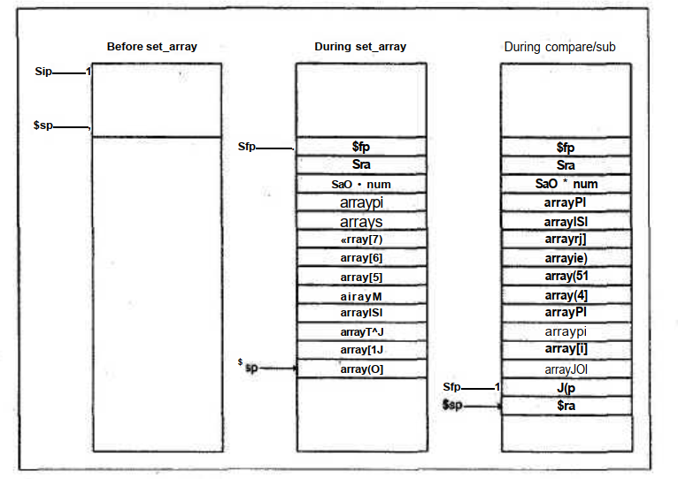

Slide 6
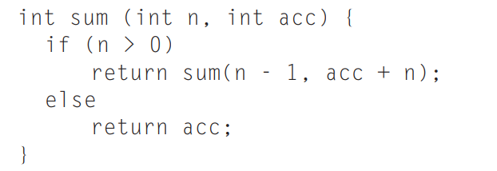
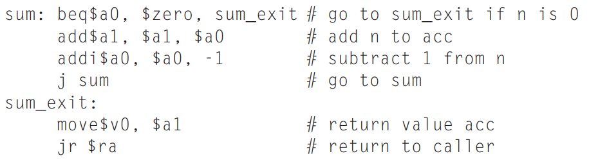
Tail Recursion. Some recursive procedures can be implemented iteratively without using recursion. Iteration can significantly improve performance by removing the overhead associated with procedure calls. For example, consider a procedure used to accumulate a sum:
Consider the procedure call sum(3,0). This will result in recursive calls to sum(2,3), sum(1,5), and sum(0,6), and then the result 6 will be returned four times. This recursive call of sum is referred to as a tail call, and this example use of tail recursion can be implemented very efficiently (assume $a0 = n and $a1 = acc):

Slide 7
2.16 [30] <§2.7> Write a MIPS procedure to compute the nth Fibonacci number F(n) where
F(n) = 0, if n = 0; F(n) = 1, if n = 1; F(n) = F(n-1) + F(n-2), otherwise.
Base your algorithm on the straightforward but hopelessly inefficient procedure below, which generates a recursive process:
int fib(int n){ if (n == 0) return 0; else if (n == 1) return 1; else return fib(n-1) + fib(n-2);
}

Slide 8
2.21 [30] <§§2.7, 2.8> Write a program in MIPS assembly language to convert an ASCII decimal string to an integer. Your program should expect register $a0 to hold the address of a null-terminated string containing some combination of the digits 0 through 9. Your program should compute the integer value equivalent to this string of digits, then place the number in register $v0. Your program need not handle negative numbers. If a nondigit character appears anywhere in the string, your program should stop with the value -1 in register $v0. For example, if register $a0 points to a sequence of three bytes 50ten, 52ten, 0ten (the null-terminated string “24”), then when the program stops, register $v0 should contain the value 24 ten. (The subscript “ten” means base 10.)
0011 0000 | 060 | 48 | 0x30 | 0 | 字符0
0011 0001 | 061 | 49 | 0x31 | 1 | 字符1
0011 0010 | 062 | 50 | 0x32 | 2 | 字符2
0011 0011 | 063 | 51 | 0x33 | 3 | 字符3
0011 0100 | 064 | 52 | 0x34 | 4 | 字符4
0011 0101 | 065 | 53 | 0x35 | 5 | 字符5
0011 0110 | 066 | 54 | 0x36 | 6 | 字符6
0011 0111 | 067 | 55 | 0x37 | 7 | 字符7
0011 1000 | 070 | 56 | 0x38 | 8 | 字符8
0011 1001 | 071 | 57 | 0x39 | 9 | 字符9

Slide 9
5.8 [15] <§5.4> We wish to add the instruction jr (jump register) to the single-cycle datapath described in this chapter. Add any necessary datapaths and control signals to the single-cycle datapath of Figure 5.17 on page 307 and show the necessary additions to Figure 5.18 on page 308. You can photocopy these figures to make it faster to show the additions
5.11 [20] <§5.4> This question is similar to Exercise 5.8 except that we wish to add a variant of the lw (load word) instruction, which increments the index register after loading word from memory. This instruction (l_inc) corresponds to the following two instructions: lw $rs,L($rt) addi $rt,$rt,1

Slide 10
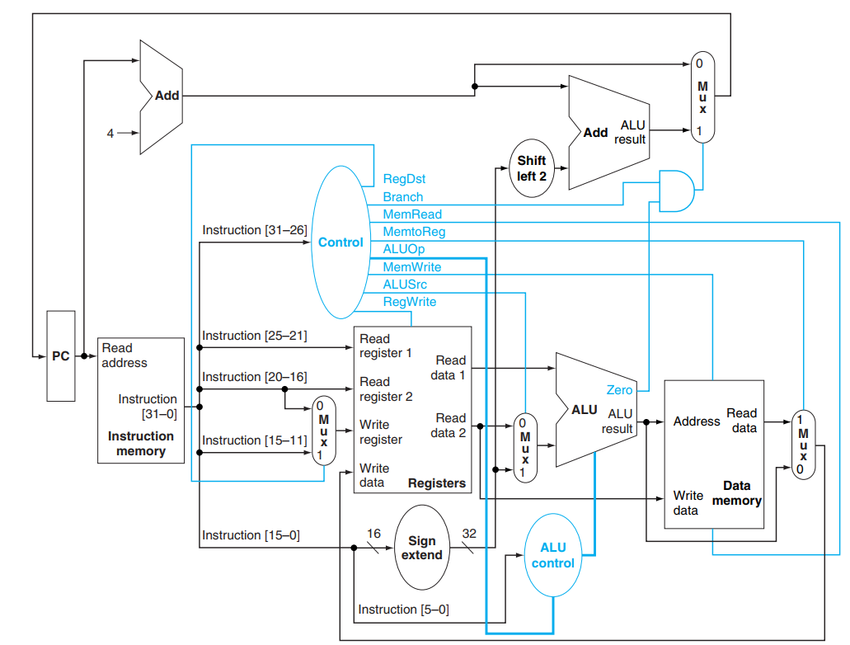
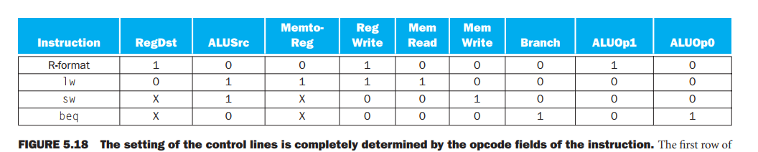

Slide 11
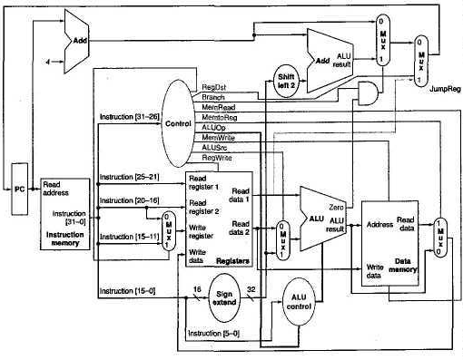
5.8 A modification to the datapath is necessary to allow the new PC to come from a register (Read data 1 port), and a new signal (e.g., JumpReg) to control it through a multiplexor as shown in Figure 5.42. A new line should be added to the truth table in Figure 5.18 on page 308 to implement the jr instruction and a new column to produce the JumpReg signal
Instruction | RegDst | ALUSrc | MemtoReg | RegWrite | MemRead | MemWrite | Branch | ALUOp1 | ALUOp0 | JumpReg
R-format | 1 | 0 | 0 | 1 | 0 | 0 | 0 | 1 | 0 | 0
lw | 0 | 1 | 1 | 1 | 1 | 0 | 0 | 0 | 0 | 0
sw | X | 1 | x | 0 | 0 | 1 | 0 | 0 | 0 | 0
beg | x | 0 | x | 0 | 0 | 0 | 1 | 0 | 1 | 0
jr | 0 | 0 | 0 | 0 | 0 | 0 | 0 | 0 | 0 | 1

Slide 12
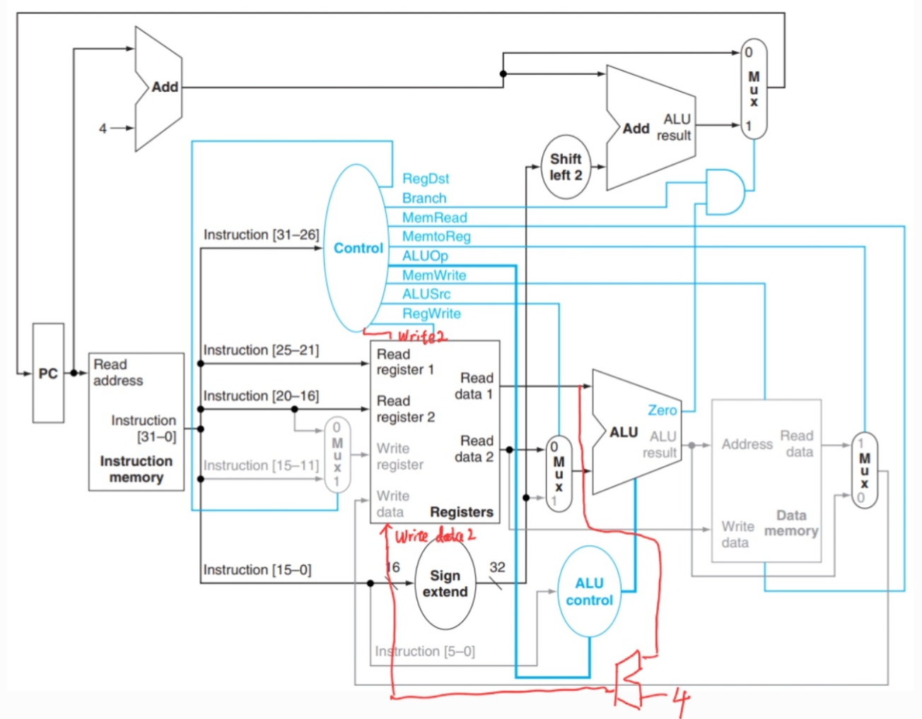
5.11 A modification is required for the datapath of Figure 5.17 to perform the auto increment by adding 4 to the $rs register through an incrementer. Also we need a second write port to the register file because two register writes are required for this instruction. The new write port will be controlled by a new signal, "Write 2", and a data port, "Write data 2." We assume that the Write register 2 identifier is always the same as Read register 1 ($rs). This way "Write 2" indicates that there is second write to register file to the register identified by "Read register 1," and the data is fed through Write data 2.
Instruction | RegDst | ALUSrc | MemtoReg | RegWrite | MemRead | MemWrite | Branch | ALUOp1 | ALUOp0 | Write2
R-format | 1 | 0 | 0 | 1 | 0 | 0 | 0 | 1 | 0 | 0
lw | 0 | 1 | 1 | 1 | 1 | 0 | 0 | 0 | 0 | 0
sw | x | 1 | x | 0 | 0 | 1 | 0 | 0 | 0 | 0
beg | x | 0 | x | 0 | 0 | 0 | 1 | 0 | 1 | 0
l_inc | 0 | 1 | 1 | 1 | 1 | 0 | 0 | 0 | 0 | 1

Slide 13
7.23 [10] <§7.2, B.5> You have been given 18 32K × 16-bit SRAMs to build an instruction cache for a processor with a 32-bit address. What is the largest size (i.e., the largest size of the data storage area in bytes) direct-mapped instruction cache that you can build with one-word (64-bit) blocks? Show the breakdown of the address into its cache access components (for an example, see Figure 7.8) and describe how the various SRAM chips will be used. (Hint: You may not need all of them.)
7.36 [10] <§§7.3, B.5> This exercise is similar to Exercise 7.23, except that this time you decide to build a three-way set-associative cache with blocks. Once again show the breakdown of the address (see Figure 7.17 for an one-word example of a four-way set-associative cache) and describe how the chips are used. Note that each SRAM will only perform a single read per cache access.

Slide 14
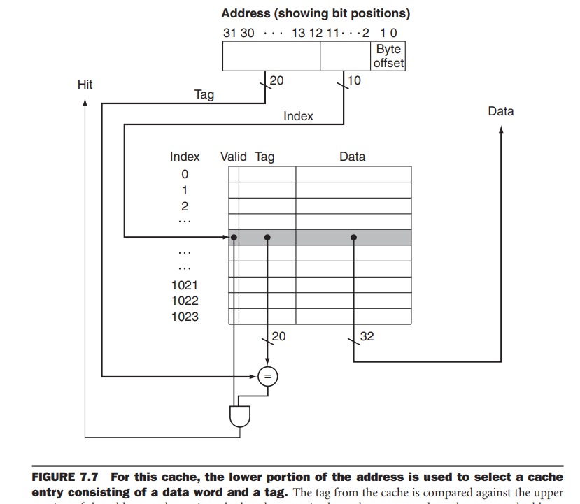

Slide 15
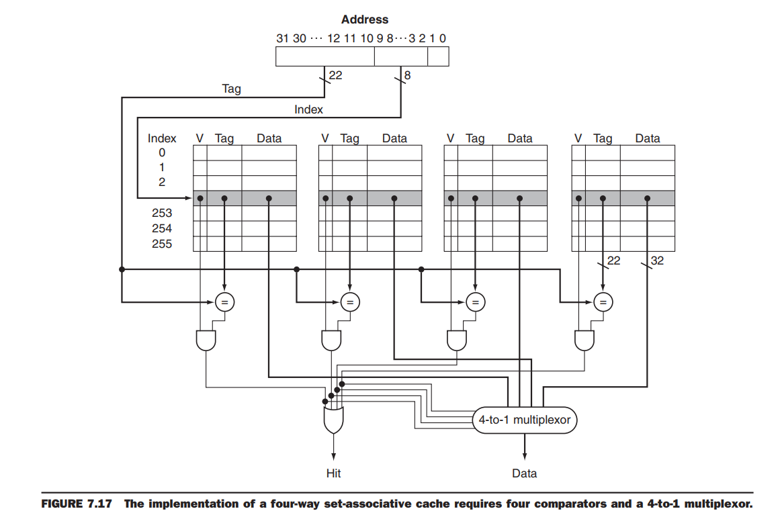

Slide 16
7.23 The largest direct-mapped cache with two-word (64-bit) blocks would be 512 KB in size. The address breakdown is 13 bits for tag, 16 bits for index, 1 bit for block offset and 2 bits for byte offset. The SRAMs will be used such that 8 of them form the data array (2 × 4) and 2 of them form the tag array (2 × 1).
64 bit → 8Byte → 3bit offset
4 * SRAM → 32K * 64bit(data) 每四个一组形成64-bit block
4 8 16 三种方式
16 * SRAM：4 * 32K * 64bit → 128K*8B → 2^17 → 17bit (index)
tag:32-17-3=12 bit
4 * 32K * 12bit → 4*SRAM 4+16 > 18
8* SRAM：2 * 32K * 64bit → 64K*8B → 2^16 → 16bit (index)
tag:32-16-3=13bit
2 * 32K * 13bit → 2*SRAM 8+2 < 18
容量 64K * 8B = 512KB

Slide 17
7.36 We can build a 384 KB cache. The address breakdown is 14 bits for tag, 16 bits for set index, 0 bits for block offset, and 2 bits for byte offset. A total of 18 chips will be required; 6 for overhead
offset 32bit → 2^2 * 1B → 2bit
2 * SRAM → 2 * 32K * 16bit → 32 * 32bit 2个SRAM一组
3 way → 6个SRAM一组
6 12 两种方式
12 * SRAM （3*）2 * 32K * 32 bit → 64K*4B → 2^16 → 16bit (index)
tag:32-16-2=14 bit
3 * 2 * 32K * 14bit → 6*SRAM
12 + 6 <= 18
容量3 * 2 * 32K * 4B = 768KB

