Slide 1



Ontario Rental Market Data Analysis Using Machine Learning MODELLING and deployment
Ontario
.

Slide 2

Problem Statement
"Developing an accurate housing price prediction model tailored for Canadian small communities through regression and classification techniques. The project focuses on implementing cross-validation and hyperparameter tuning to optimize model performance. The resulting application provides real-time price estimates and actionable insights, empowering community members to make informed decisions and address local housing needs effectively."
2

Slide 3
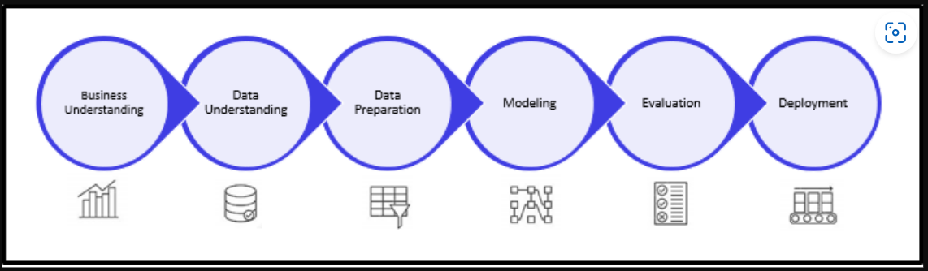

Steps Involved:
3

Slide 4
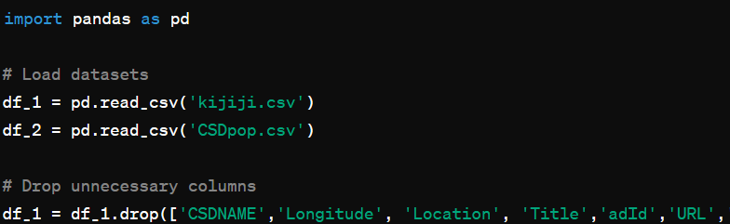
DATA preparation
In the process of preparing the dataset for accurate modeling in our project, we began by loading two crucial datasets: "kijiji.csv," which contains housing listings, and "CSDpop.csv," which provides population data. Subsequently, we filtered out unnecessary columns from the housing listings dataset and performed essential data type conversions to ensure compatibility with our analysis tools. This initial step sets the foundation for a streamlined and efficient data preparation process, laying the groundwork for subsequent modeling efforts.
4

Slide 5
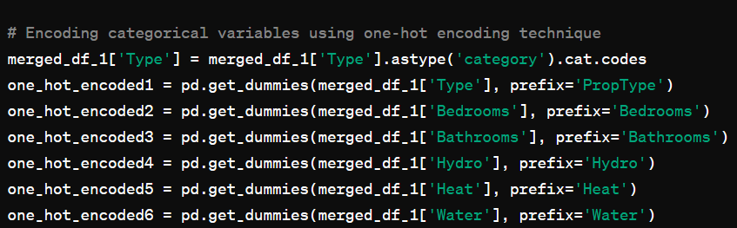
DATA preparation
20,585 samples (rows)
37 features (columns),
Handled missing values by replacing outliers and filling NaN values.
Formatted price data by removing special characters and converting to numeric format.
Merged datasets based on a common identifier and encoded categorical variables using a one-hot encoding technique.
Ensured the dataset was cleaned, formatted, and ready for machine learning model training.
5

Slide 6

ML MODELING
List of Models Used:
RandomForestRegressor
GradientBoostingRegressor
Linear Regression
DecisionTreeRegressor
KNeighborsRegressor.

Slide 7


Model Performance Overview
RandomForestRegressor achieved the highest mean R^2 score of 0.6823 and the lowest mean MSE of 186,565.40, indicating superior overall performance.
Linear Regression performed well but had a slightly lower mean R^2 score and higher mean MSE compared to RandomForestRegressor and GradientBoostingRegressor.
DecisionTreeRegressor showed lower performance compared to RandomForestRegressor and GradientBoostingRegressor, with a lower mean R^2 score and higher mean MSE.
KNeighborsRegressor performed the poorest among the models, exhibiting the lowest mean R^2 score and highest mean MSE.
GradientBoostingRegressor also demonstrated strong performance with a mean R^2 score of 0.6453 and a mean MSE of 208,269.18.

Slide 8
Among the models evaluated in the analysis, the Random Forest model emerged as the most effective for predicting rental prices in the Ontario market
Random Forest model achieved the lowest mean squared error (MSE) and highest R-squared value post cross-validation.
It consistently provided accurate predictions and explained a significant portion of rental price variance.
The model offered valuable insights into feature importances, aiding in understanding key factors influencing rental prices.
Known for its robustness, it effectively handled complex data relationships.
Overall, the Random Forest model emerged as the top performer for predicting rental prices in the Ontario market.

Slide 9
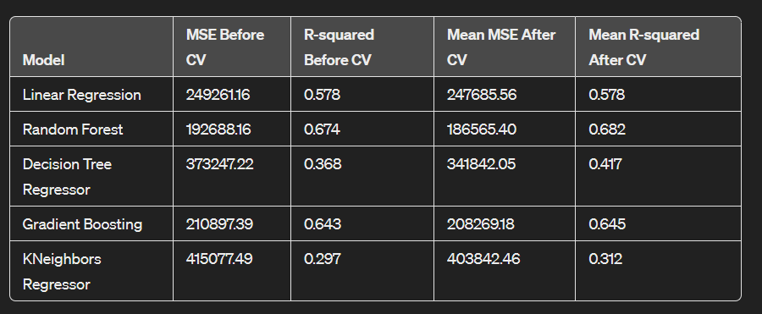
Model’s Report:
9

Slide 10
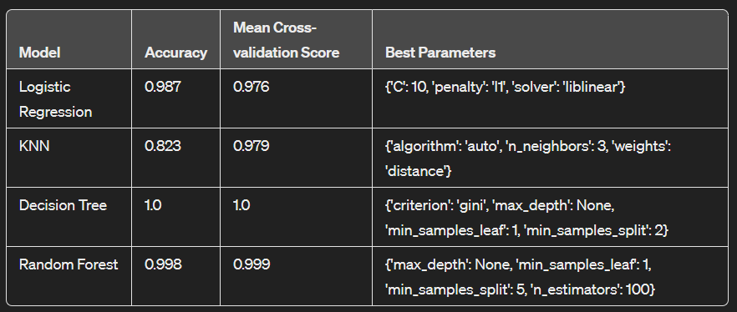
Classification REPORT:
The Decision Tree model achieved perfect accuracy and a perfect mean cross-validation score, making it the best model for this classification task. It doesn't just perform well on the training data but also generalizes effectively to unseen data, making it reliable for future predictions.

Slide 11

CONCLUSION:
Model Deploy:
https://silver-icons-boil.loca.lt
Password 34.121.177.15
Random Forest stood out as the top model for both predicting rental prices and classifying rental properties, even after parameter tuning, underscore its effectiveness in predicting rental prices and classifying properties. Its performance highlights its suitability for practical applications in the Ontario rental market.
https://go.screenpal.com/watch/cZfF37VsWBe
https://lookerstudio.google.com/reporting/9758bc61-0c8d-4759-8632-5facb0db2cf5
Dashboard view

Slide 12
Learning Outcomes:
Despite facing various obstacles, such as managing missing data and dealing with a limited dataset size, we successfully conducted machine learning analysis on the small community dataset.
This course has proven to be an invaluable resource, offering us essential insights that have deepened our understanding of machine learning principles.
Overcoming these challenges has not only been gratifying but has also strengthened our skills and knowledge in the field.
Looking ahead, we are eager to apply the lessons learned from this experience to future projects.
Our journey in machine learning continues, and we are committed to ongoing growth and exploration in this dynamic domain.

Slide 13
UPDATED TIMELINE
25–26 Jan. 2024
PREPARATION PHASE
28 Jan. – 3 Feb. 2024
EXPLORATORY ANALYSIS
6 Feb. – 15 Mar. 2024
FEATURE ENGINEERING
29 Mar. – 18 Apr. 2024
MODEL DEPLOY

Slide 14

Thank You
Khushi
Anureet Kaur
Kawaldeep Kaur

