Slide 1
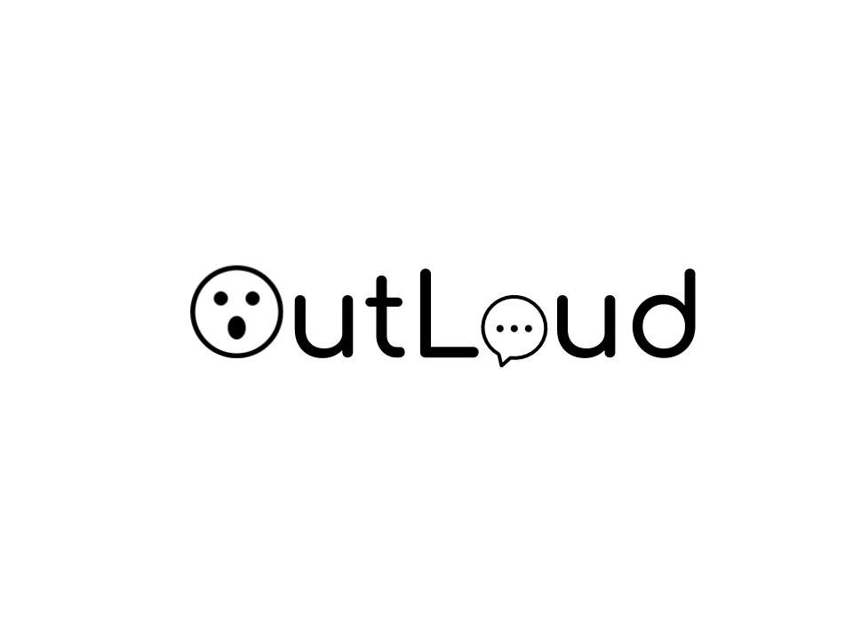

provide a simple yet powerful voice
to disabled people unable to communicate

Slide 2
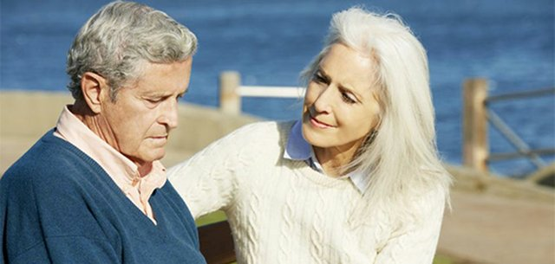
Meet John Doe who has Aphasia
Aphasia affects about 2 million Americans and is more common than Parkinson's Disease, cerebral palsy or muscular dystrophy. Nearly 180,000 Americans acquire the disorder each year.
Aphasia refers to a family of language disorders that usually stem from injury, lesion, or atrophy to the left side of the brain that result in reception, perception, and recall of language; in addition, language formation and expressive capacities may be inhibited.
• Inability to comprehend language
• Inability to pronounce, not due to muscle paralysis or weakness
• Inability to speak spontaneously
• Inability to form words
• Inability to name objects (anomia)
• Poor enunciation
Source: National Aphasia Association,https://www.aphasia.org

Slide 3
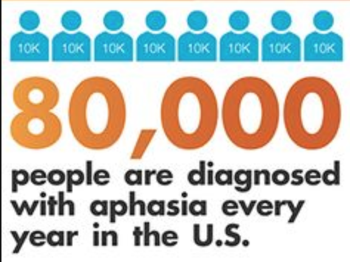
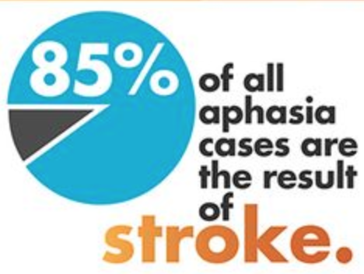
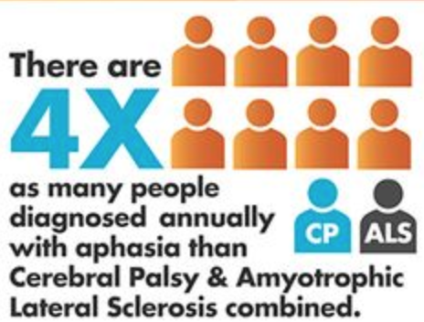
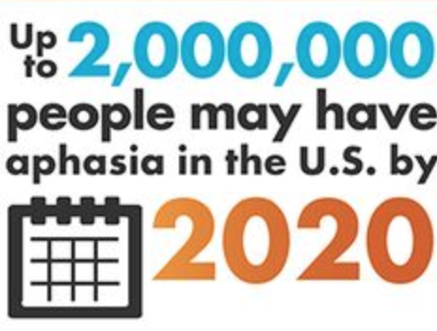
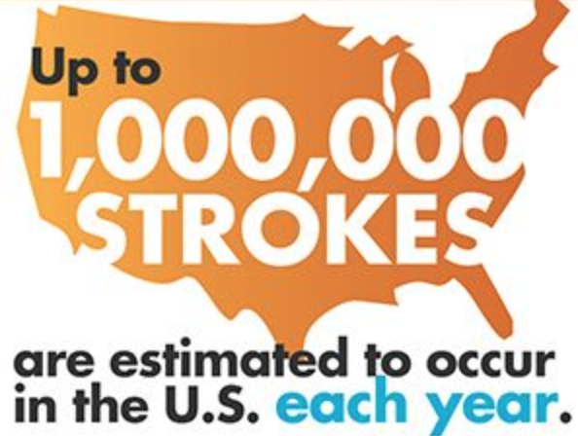
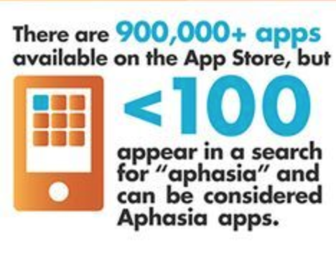
Aphasia is most often caused by stroke, but any disease or damage to the parts of the brain that control language can cause aphasia. Some of these can include brain tumors, traumatic brain injury, and progressive neurological disorders.
Source: Aphasia Awareness Week, Aphasia Institute, https://www.aphasia.ca/aphasia-awareness-week

Slide 4
Problem
Wearable EEG communication players do not have a simple communication method for people with Aphasia nor the 7.5 million people in the United States who have trouble using their voices https://www.nidcd.nih.gov/health/statistics/quick-statistics-voice-speech-language
EyeControl - Wearable eye-tracking continuous communication tool
NeuroSky - Wearable EEG communication tool which detects “yes”, “no”, “happy”, “sad”
ControlBionics - Wearable EMG tool for single button communication
Eyegaze Edge - Eye-tracking camera observes eyes (60x / second). Nothing attached

Slide 5
Why current solutions are subpar?
37.7% of nurse-patient communication sessions in ICU unsuccessful
62% of patients in ICU reported a high level of frustration
Need for alternative
Speed
Accuracy
Reliability
Communication Board
Patak, Applied Nursing Research, 2006

Slide 6
Recent advances with EEG/Eye Tracking?
NextMind: Brain-sensing wearable for real-time device control
CTRL-Labs: Wearable EMG system for single button communication
Not able to creatively produce communication, needs to increase accuracy
Ineffective for paralyzed, LiS patients

Slide 7
Outloud Solution
An electronic communication board that consists of emojis (rather than letters)
A system that will monitor brain signals for motionless communication
Brain-Computer Interface that allows users to "visually select" an emoji of their choice
Artificial Intelligence to track most frequently used emojis and increase efficiency

Slide 8

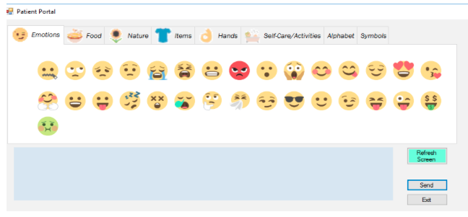
The right Emojis with AI engine
Emojis that personify Facial Expressions
Punctuation, Emphasis, Replacement for Words with expressions that cross language barriers.
Emoji Communication Board
Artificial Intelligence
Convolutional Neural Networks (CNNs) for Video Parsing which increase accuracy of eye-tracking system

Slide 9
Our Research
Generating & Decoding in a Patient-Caregiver setting
Tested hypothesis by designing board and recruiting able-bodied participants
Comparative: standard board and computerized emoji board
Number correct and speed recorded
Skiba, Nursing Education Perspectives, 2016 and Kraus, Basic and Applied Social Psychology,1983
Validation
Designed Emoji communication board with JoyPixels (https://www.joypixels.com)
Developed with Microsoft Visual Basic
8 categories: Emotions, Food, Nature, Items, Hands, Self-Care, Alphabet, Symbols
Click to select emojis. 7 emojis max/message
7 based on Miller’s Law on human memory span
Able to refresh the screen. Also able to send and receive messages.

Slide 10
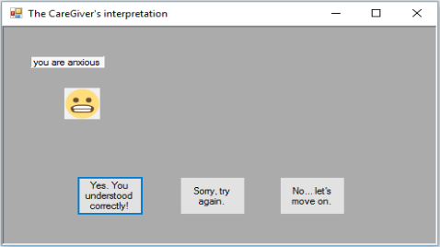
Outloud Simple Process Methodology
Given message by experimenter
Generates “phrase”
Send
PATIENT:
CAREGIVER:
Reads message
Interprets
Send
PATIENT:
1) Correct
2) Incorrect
3) Let’s move on
Send
Caregiver interpretation
1) Correct
2) Incorrect
3) Let’s move on
Patient decides
What patient sent

Slide 11
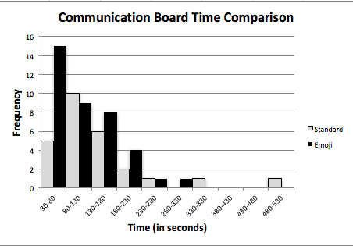
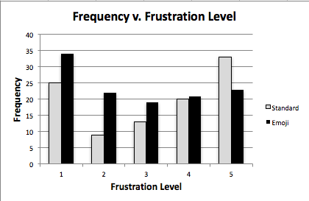
N=12 | Emoji | Standard (picture-based)
% correct | 63.33% | 43.33%
Mean time to correct interpretation | 112.45+/- 67.93 s | 146.62 +/- 103.01 s
Average frustration level | 2.81+/-1.50 | 3.27 +/- 1.60
Our
Results

Slide 12
Takeaways from our research
Goal: More accurate, less frustrating, less time
Need a system that addresses inadequacies of modern communication board
Better communication → Fewer medical errors
Optimize time using health-specific emojis
No time difference as of now
Will not be using a custom EEG setup
Research shows lack of speed
Will be redesigning the emoji board (Visual Basic —> Python )

Slide 13
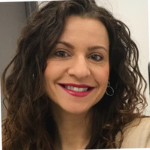
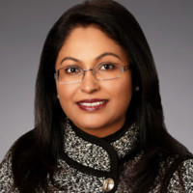
Team
Karishma Muthukumar
CEO/ co founder
2nd year, UCI Cognitive Sciences
https://www.linkedin.com/in/karishma-muthukumar/
Pratyush Muthukumar CTO/ co founder
2nd year, CSULA Computer Science and Math
https://pratyushmuthukumar.ml
Board of Directors and Advisors
Steve Ardire
AI startup advisor & 'Merchant of Light'
sardire@gmail.com
https://www.forcemultipliersteveardire.com/
http://www.linkedin.com/in/sardire
Marinela Gombosev
President, CEO at Evoke Neuroscience | Early Alzheimer's Diagnosis and Prevention Advocate
https://www.linkedin.com/in/marinelagombosev/
Arlen Meyers, MD, MBA
President and CEO, Society of Physician Entrepreneurs
https://sopenet.org/
https://www.linkedin.com/in/ameyers/
Denver, Colorado
Melina Padayachy
Innovation Strategy Consultant
http://nextcurveglobal.com/
https://www.linkedin.com/in/melinapadayachy/
Veena Somareddy
Co-Founder at Neuro Rehab VR | Merging healthcare & technology to enhance patient care
https://www.linkedin.com/in/veenasomareddy/
Aly Abayazeed, MD
Assistant Professor of Neuroradiology UMass Medical Center and Chief Medical Officer Neosoma, Inc.
https://www.linkedin.com/in/aly-abayazeed-894ab0180/
Madhu Bhattacharyya
Practice Leader, Advanced Analytics, Technology Consulting at Protiviti
https://www.linkedin.com/in/madhumita-bhattacharyya-aa39b214/
Anthony Chang, MD, MBA, MPH, MS
Founder of AIMed and Global Convener of Passionate People for Transformation
https://www.linkedin.com/in/anthonychangmd/

