Slide 1
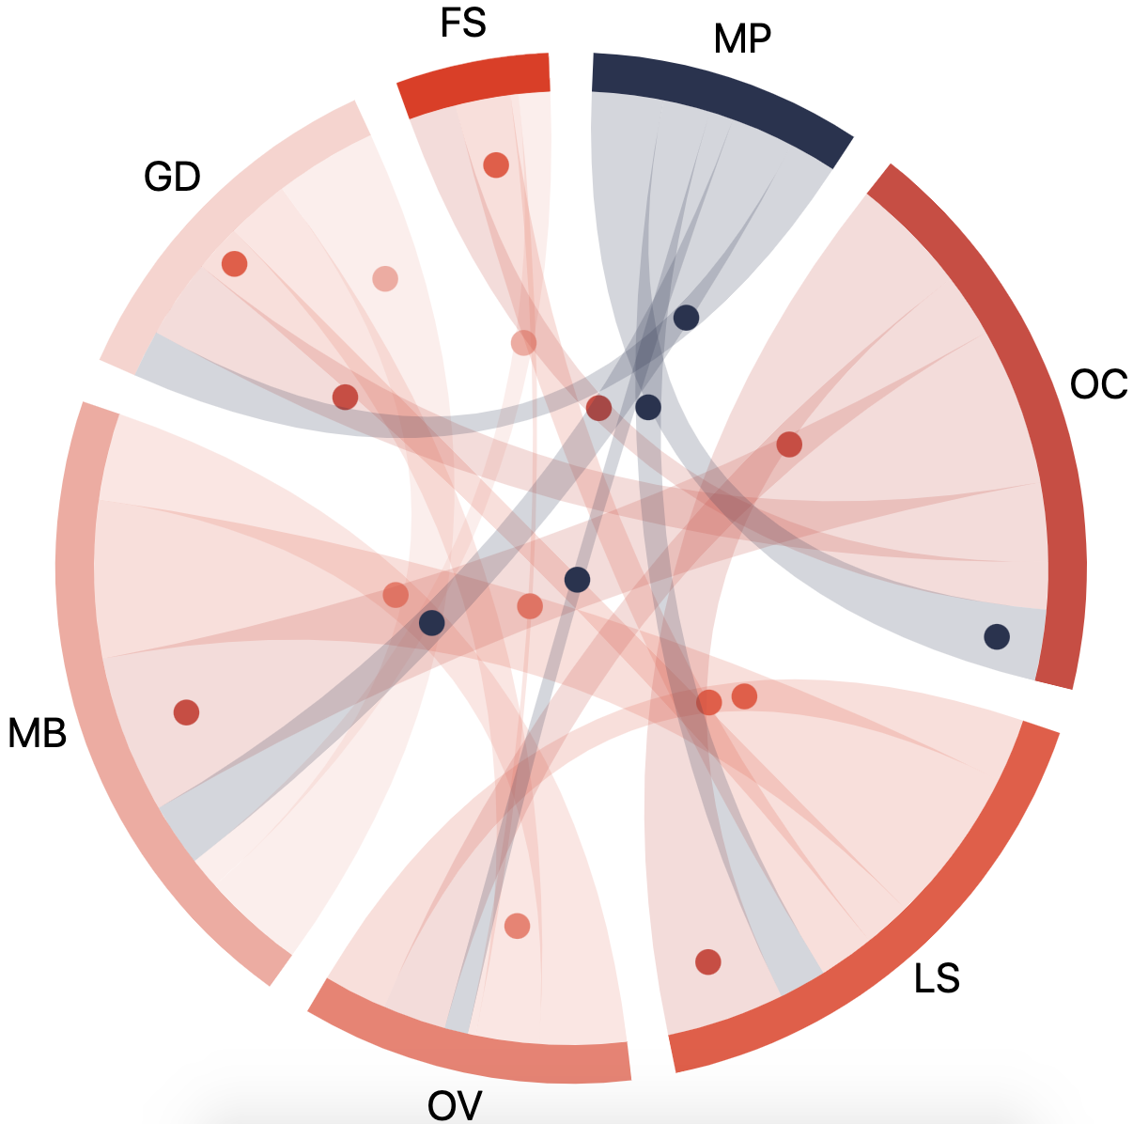
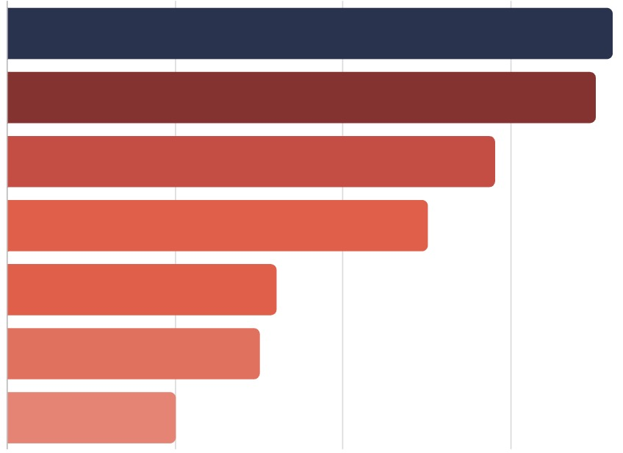
FS
MP
GD
OC
MB
OC
LS
GD
MB
OV
MP
LS
FS
OV
10
20
30
(a)
(b)

