Slide 1
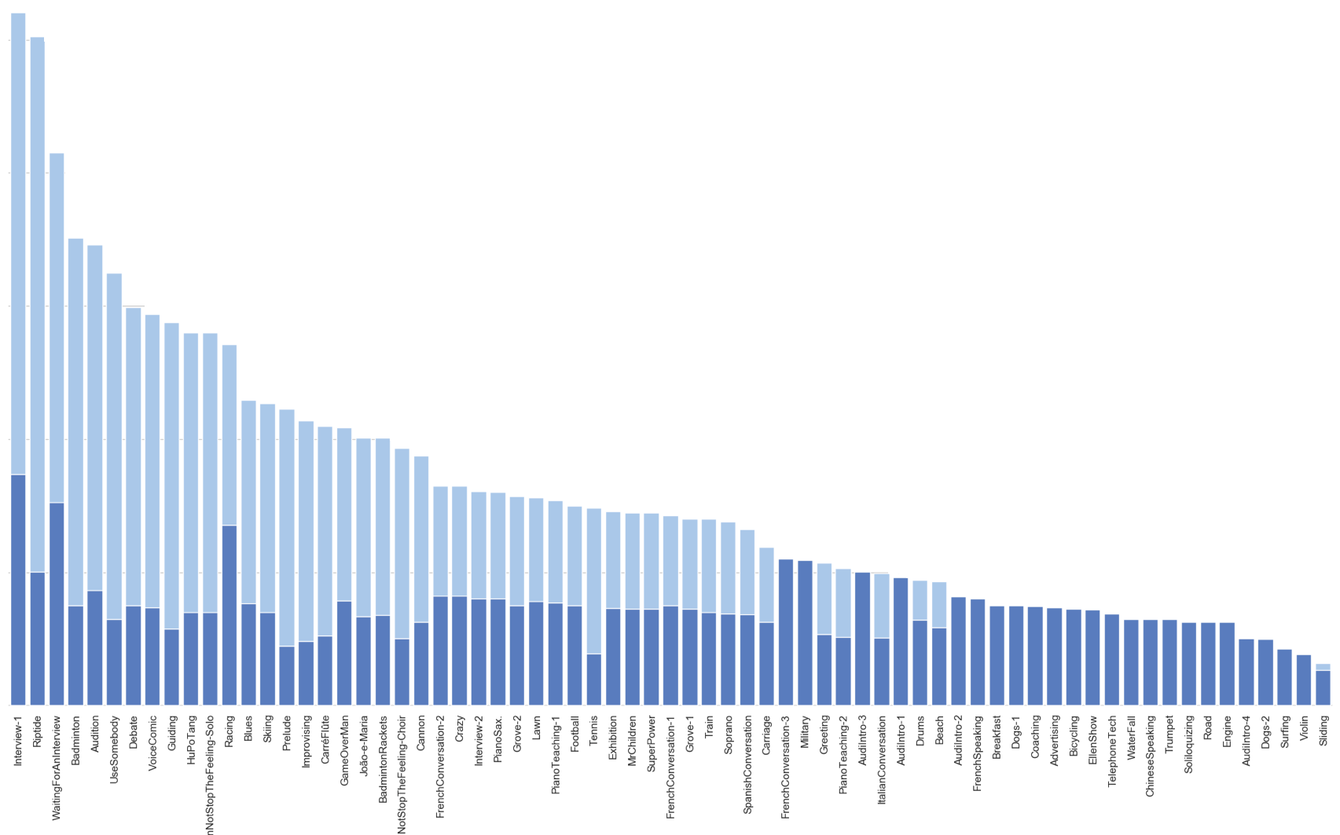





1000
Object-level human masks
Instance-level human masks
800
600
400
200

