Slide 1
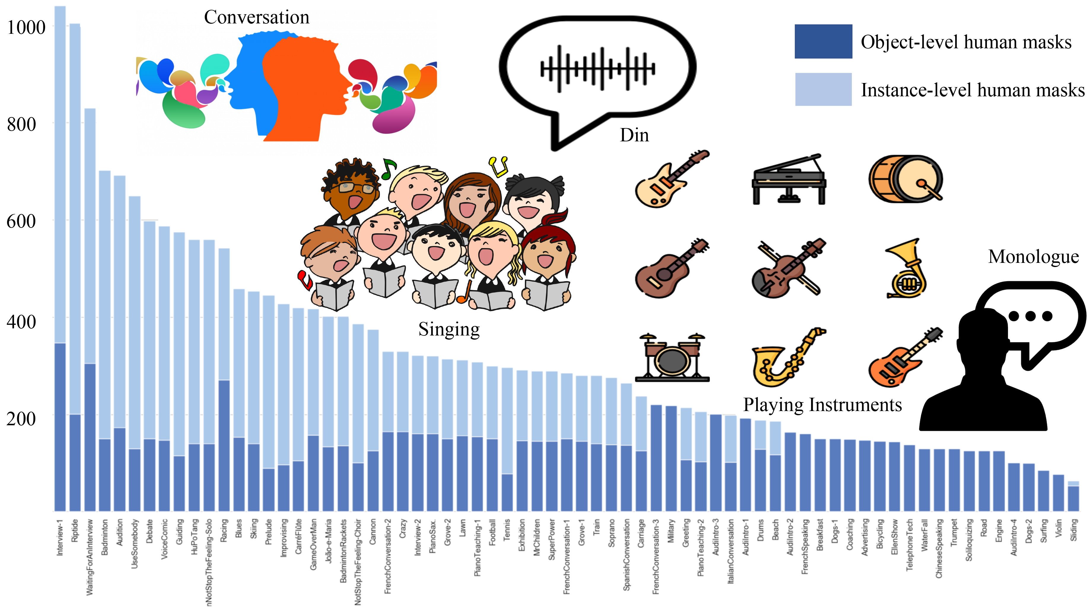
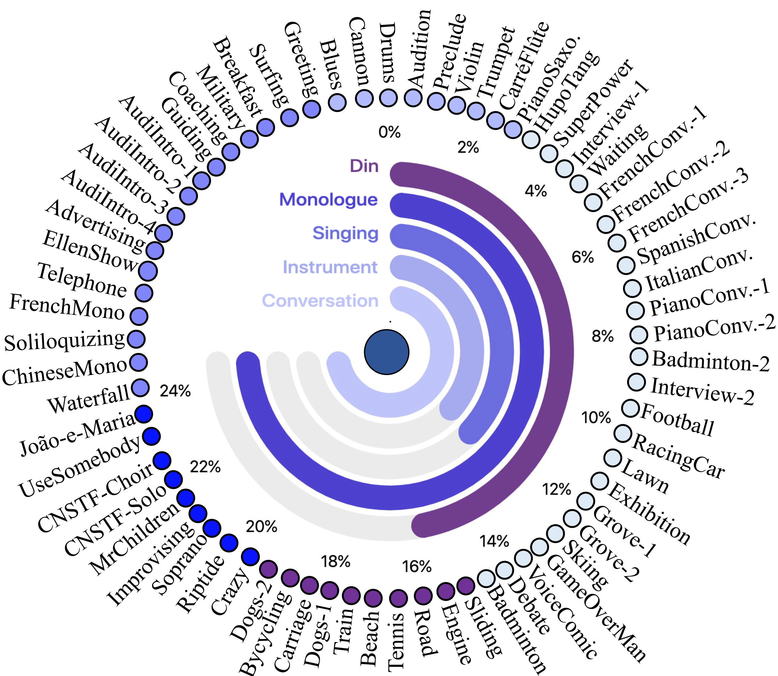
(a) Scene categories
(b) Number of object-/instance-level human masks in each video.

