Slide 1
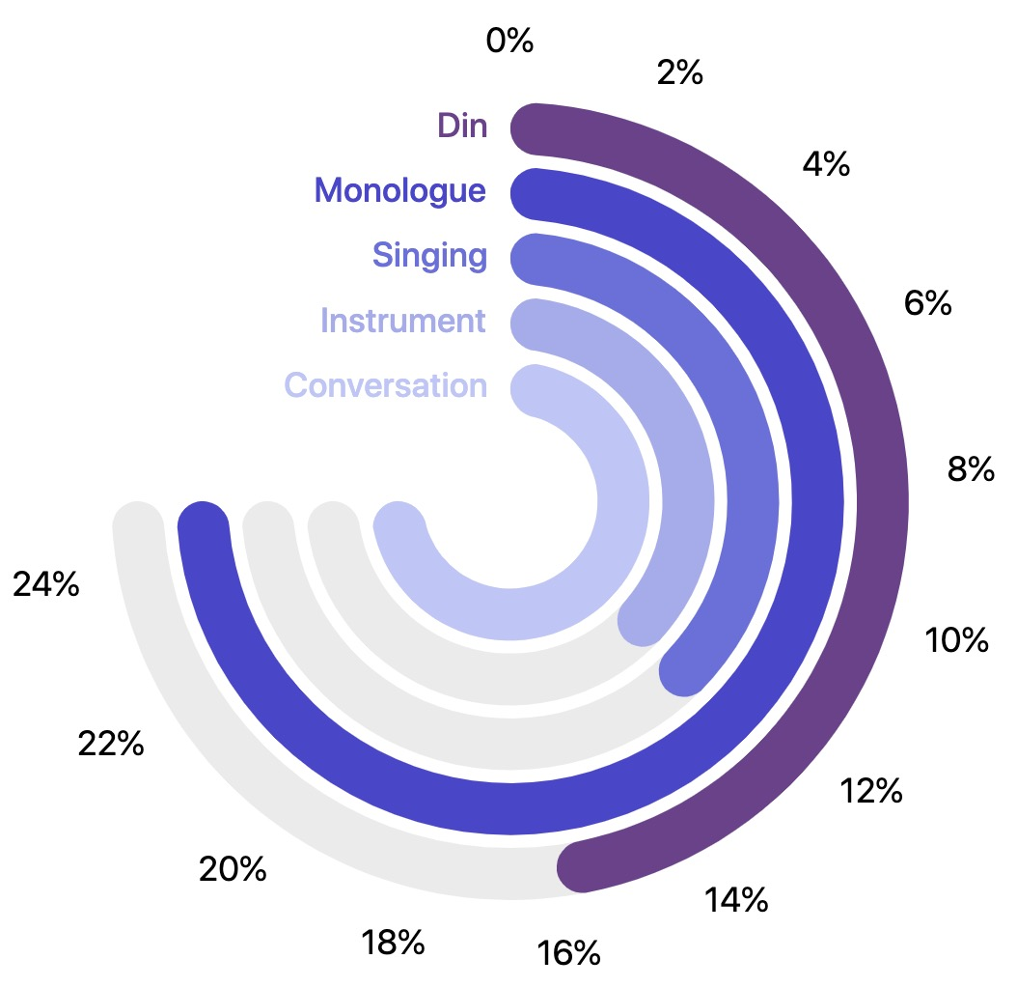
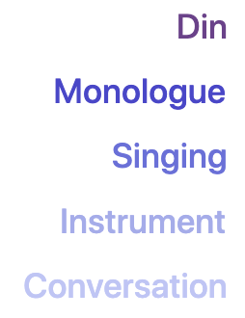
Audition
Cannon
Preclude
Greeting
Drums
Trumpet
Blues
CarréFlûte
Surfing
Violin
PianoSaxo.
Breakfast
HupoTang
Military
SuperPower
Coaching
Guiding
Interview-1
AudiIntro-1
Waiting
AudiIntro-2
FrenchConv.-1
AudiIntro-3
FrenchConv.-2
AudiIntro-4
FrenchConv.-3
Advertising
SpanishConv.
EllenShow
Telephone
ItalianConv.
FrenchMono
PianoConv.-1
Soliloquizing
PianoConv.-2
ChineseMono
Badminton-2
Waterfall
Interview-2
João-e-Maria
Football
UseSomebody
RacingCar
Lawn
CNSTF-Choir
CNSTF-Solo
Exhibition
MrChildren
Grove-1
Improvising
Grove-2
Soprano
Skiing
Riptide
Crazy
Debate
Dogs-2
GameOverMan
VoiceComic
Train
Sliding
Bycycling
Road
Badminton
Dogs-1
Engine
Carriage
Beach
Tennis
Notes:
There are totally 72 objects classes, which belong to 7 broader categories.

