Slide 1
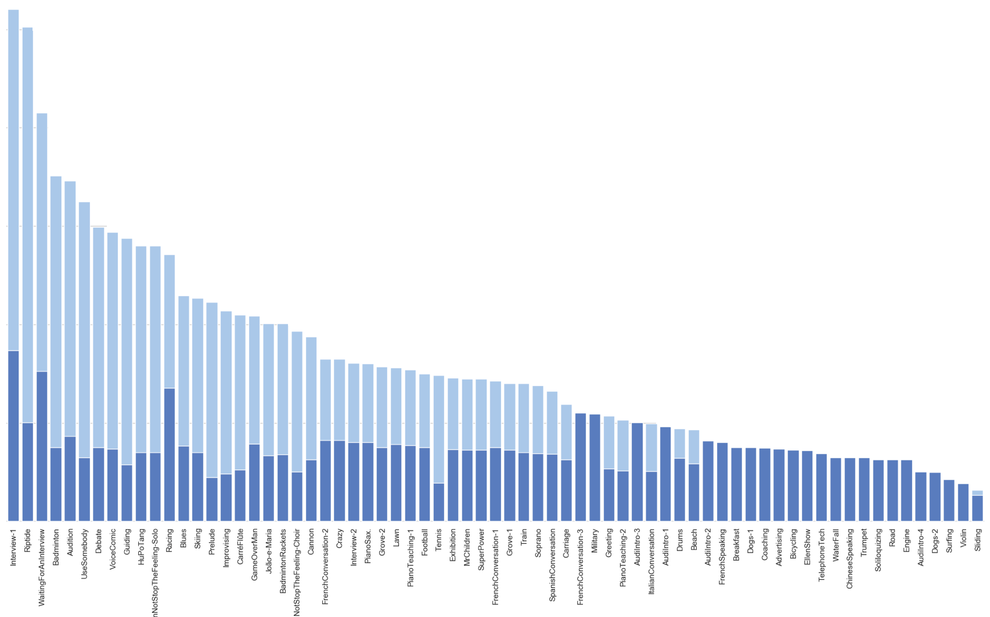
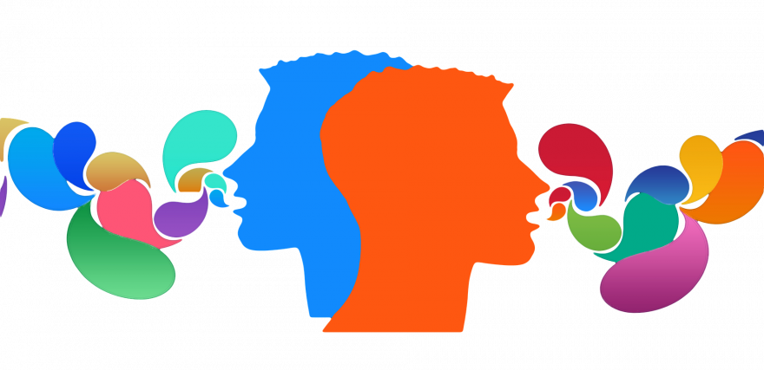

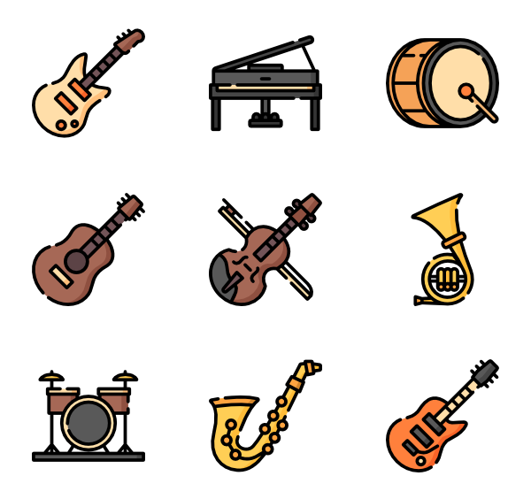


1000
Conversation
Object-level human masks
Instance-level human masks
800
Din
600
Monologue
400
Singing
Playing Instruments
200

