Slide 1
New AWS account
Ondrej Toffolet

Slide 2
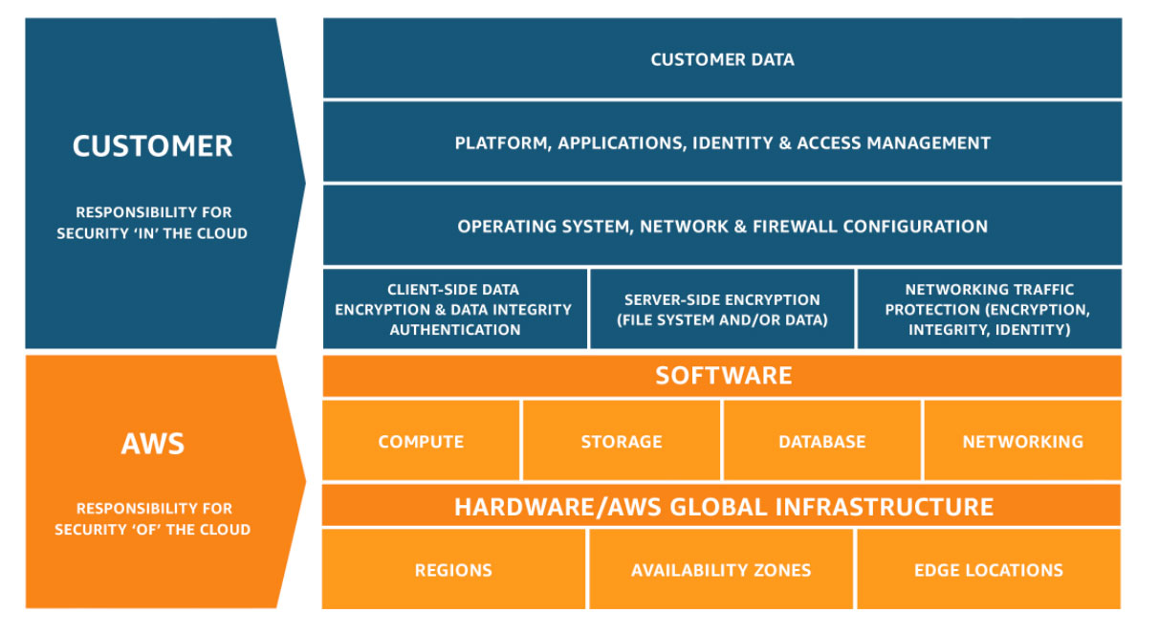
AWS Tips 101
Shared Responsibility Model

Slide 3
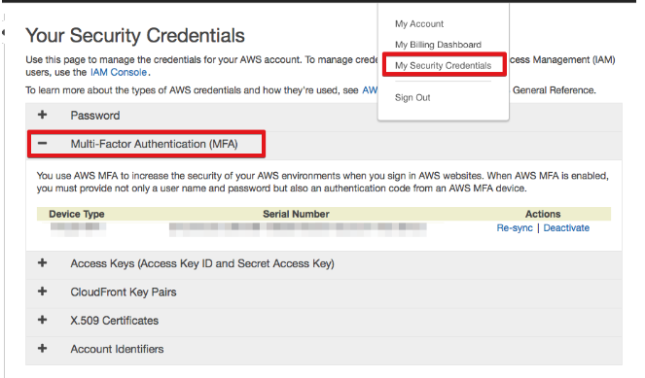
AWS Tips 101
Enable MFA
Authy
yubikey

Slide 4
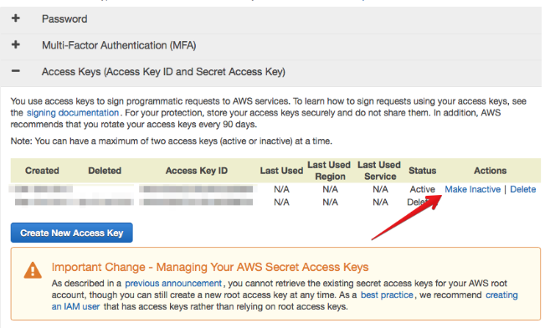
AWS Tips 101
Delete Root Access Key and Secret Key

Slide 5
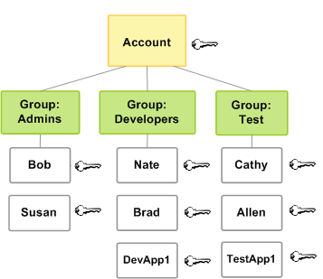
AWS Tips 101
Create IAM User & Role for yourself, your instances and other account users
(aka the principle of least privilege)

Slide 6
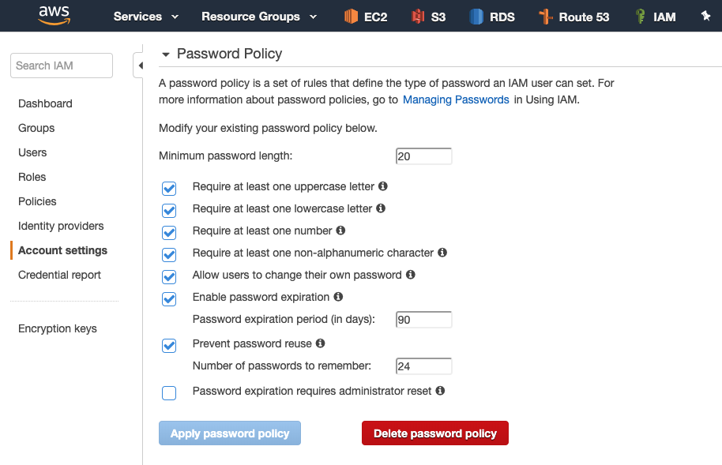
AWS Tips 101
Enforce Passwords Policy
&
Configure Security Challenge Questions

Slide 7
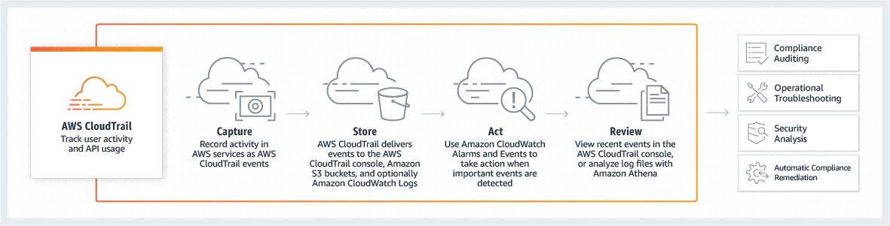
AWS Tips 101
Enable Cloudtrail

Slide 8
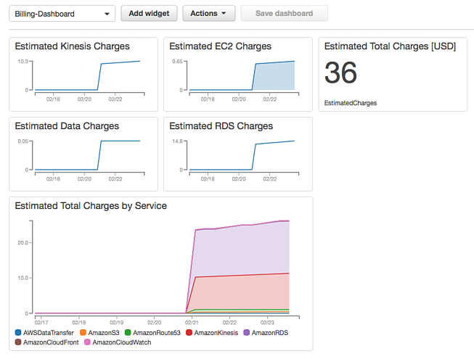
AWS Tips 101
Add Cloudwatch Alarms & Custom Billing Dashboard

Slide 9
AWS Tips 101
What to Do If You Inadvertently Expose an AWS Access Key
Determine what resources those credentials have access to
Invalidate the credentials so they can no longer be used to access your account
Consider invalidating any temporary security credentials that might have been issued using the credentials
Restore appropriate access
Review access to your AWS account
-------------------------------------------------------------------------------------------------------- git-secrets - Prevents you from committing sensitive information to a git repository.

