Slide 1



Introduction to python
LECTURE 1: Setting up Python
By panagiotis herodotou
Notes:
Let’s see how to setup python

Slide 2
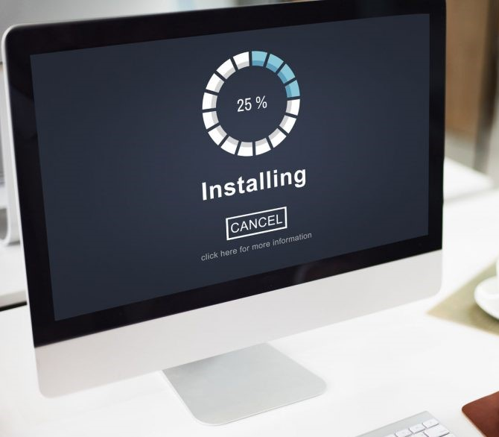
Installing Python
There are many ways to run python!
Install Anaconda Distribution
Run Jupyter Notebook
Explore “no install” options
Python is FREE!
Notes:
If you have your own laptops, you can install Anaconda Distribution

Slide 3
Install Anaconda Distribution
https://www.anaconda.com/download
Anaconda has many python libraries & applications, not just the python progr. language
Documentation page:
https://docs.anaconda.com/
Notes:
Those working on the Uni PCs, I think there is no need to install Anaconda, but I put the instructions on how to do it.

Slide 4
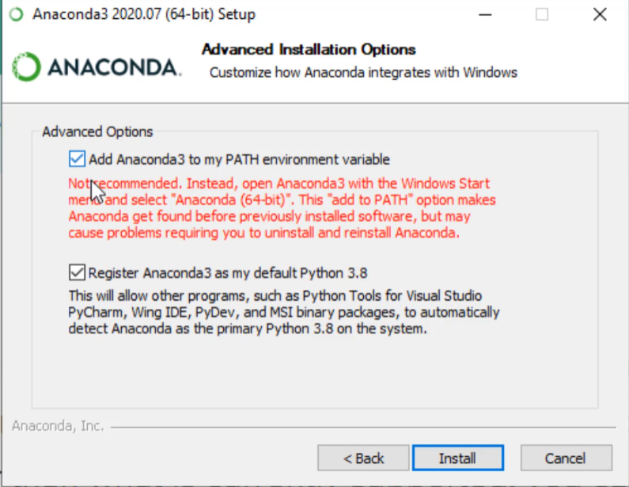
Anaconda installation
Run the installation steps
I recommend to add to path, so you can always run programs from terminal
PATH: a system environment variable that tells the operating system where to look for executable files when a command is entered in the terminal or command prompt
Notes:
Anaconda Navigator is a graphical user interface (GUI) that simplifies the management of Python environments and packages

Slide 5
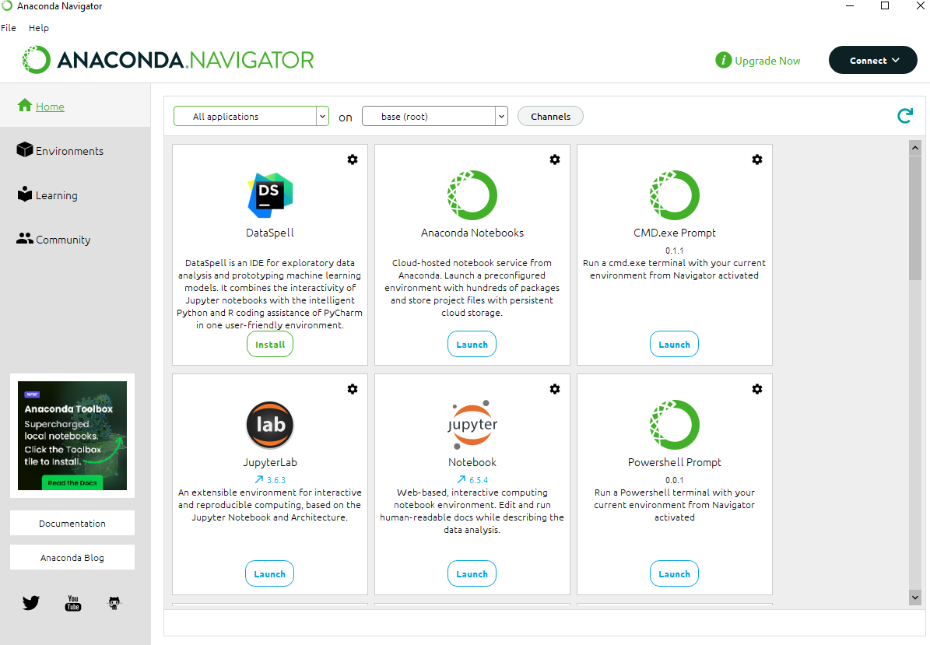
Anaconda Navigator
What are all these icons?
Home Page:
  Displays all available tools and applications.
  Allows you to launch or install popular tools
Environment Management
  helps manage Python environments, allowing you to create, clone, and delete environments.
  Facilitates installing and updating Python packages.
Learning Resources
  Provides links to tutorials, documentation, and blog posts to help you get started

Slide 6

Jupyter Lab / Notebook
Open Jyputer Lab / Notebook.
  An interactive development environment (IDE) with individual cells, where you can write and execute interactive python code
  It launches on the C drive. It does not need Internet connection.
  It just uses your browser interface (check Help)
Let’s Create new Python 3 Notebook
This is the main way we are going to learn how to program throughout the course
Keep in mind Notebook saves jpynb files, not py files! But we can convert them

Slide 7
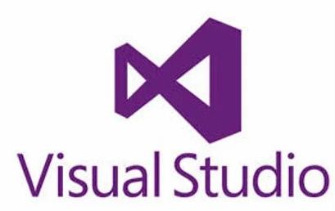



Visual Studio / Spyder etc.
We can run python in Many IDEs,
  MS Visual Studio
  MS VS code: (my favourite buts needs some time to setup properly)
  Spyder → IDE similar to MATLAB workspace
  PyCharm → Designed for python specifically
Each one has advantages and disadvantages
We can use any of these!
Notes:
Sho VS code environment, terminal etc

Slide 8
“No Install” options
Notebooks
https://jupyter.org/try
https://colab.research.google.com/
(My personal favourite, because of Gemini!)
https://replit.com/
Python code interpreters
https://www.online-python.com/
https://pythononline.net/
https://www.tutorialspoint.com/online_python_compiler.php
Notes:
Open and show these tools.
Use the online jupyter if they cannot install anaconda

Slide 9



Text editors
They can open any text (or code) file and edit.
We can modify code in text editors.
They cannot run python! (usually)
  Notepad
  Notepad ++
  Sublime text
  Atom
  https://www.sublimetext.com/
  https://notepad-plus-plus.org/downloads/
Notes:
Show the Notepad++

Slide 10


Git & Github Repository
Git: free and open source distributed code version control system used to track changes in files and coordinate work among multiple people on a project.
https://git-scm.com/
Github = a cloud-based platform for hosting Git repositories, enabling collaboration, sharing, and project management. a remote repository where your code can be stored, accessed, and reviewed by team members or the public.
Open the Github link
https://github.com/Panos1992/Intro_to_python_2025
Download the Lectures
Notes:
lectures on github

Slide 11

OK Let’s code!
Open Jyputer Notebook, Lecture 2

Slide 12
THANK YOU!
Panagiotis Herodotou
Special Scientist
pherod01@ucy.ac.cy
94055169

