Slide 1
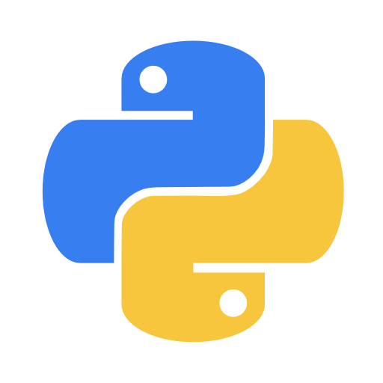


Introduction to python
February 2025
By panagiotis herodotou
Notes:
Hello everyone and welcome to this introductory course.
In this course, you'll learn the fundamentals of Python, one of the most versatile and beginner-friendly programming languages.

Slide 2
Why Learn Python?
Easy to learn and widely used in various fields such as:
Data Science & Statistics
Web Development
Automation
Machine Learning
Game Development
High demand in the job market.
Data Analysts
Software engineers
Robotics, IoT
Bioinformatics
Finance
Notes:
Python is one of the most popular programming languages ​​used today in areas such as
data analysis, web development, automation, and more.
Python's simple and easy-to-use syntax makes it an ideal choice for both beginners and experienced programmers.

Slide 3
Course Objectives:
Understand Python syntax and structure.
Learn core programming concepts like variables, loops, and functions.
Explore real-world applications of Python.
Notes:
This crash course aims to teach the basics of Python, helping you solve problems and write clean, efficient code.
You will learn programming syntax and concepts like variables, loops, functions etc

Slide 4
Who is This Course For?
Beginners with no prior programming experience.
Professionals looking to learn Python for career advancement.
Students interested in computer science and programming.
Notes:
This course is for absolute beginners, perhaps never coded before.
Any engineering student will benefit from this, as we use python everywhere

Slide 5
Structure of the Course:
Interactive lectures with live coding examples.
Hands-on exercises and assignments.
Quizzes to test your knowledge.
Notes:
The lectures will be interactive, meaning you can code with me, and I will add small tests for you and some assignments

Slide 6


Course Curriculum Overview
Python Setup: Installation, environment, Notebooks
Object and Data Structure Basics
Comparison Operators
Python Statements
Methods and functions
Modules and Packages
Object-oriented Programming
Errors and Exception Handing
Built-in Functions

Slide 7
Resources
Documentation
Python 3.13.1 documentation, https://docs.python.org/3/
Anaconda documentation, https://docs.anaconda.com/
Online Courses
https://www.codecademy.com/catalog/language/python
Portilla J, Pierian Training - Udemy: The Complete Python Bootcamp From Zero to Hero in Python. https://www.udemy.com/course/complete-python-bootcamp/?couponCode=ACCAGE0923
Youtube Videos
https://www.youtube.com/watch?v=_uQrJ0TkZlc
https://www.youtube.com/watch?v=H2EJuAcrZYU
Other
OpenAI. (2025). ChatGPT (o1 version) [Large language model]. https://chatgpt.com
Notes:
The course is based on this course in Udemy, but I modified it to fit in the 6 hours, filtering the most important stuff and I also added examples.
You can try the full 22 hour course here.

Slide 8
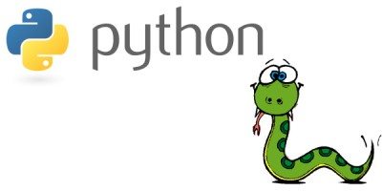
Fun Fact
Python is named after the British comedy series "Monty Python," not the snake!

Slide 9
THANK YOU!
Panagiotis Herodotou
Special Scientist
PhD Student MME
pherod01@ucy.ac.cy

Slide 10
Schedule
Time | Content
10.00 – 10.30 | L0, L1
10.30 – 13.00 | L2 - L3
13.00 – 14.00 | Break
14.00 – 16.00 | L4 - L5
16.00 – 17.00 | L6 ? Bonus

