Slide 1
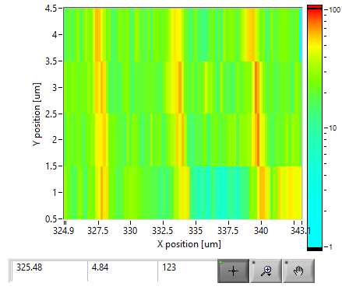
Scan parameters (Cariage):
Xaxis =18 mm
Step size 0.2 mm
Yaxis=3mm
Step size 1 mm
Acquisition time 1sec ( 0.1 sec)
Total points 346

Slide 2
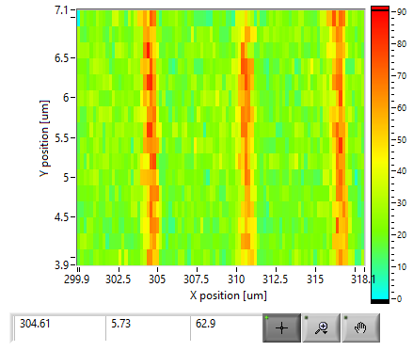
Scan parameters (Snake):
Xaxis =18 mm
Step size 0.2 mm
Yaxis=3mm
Step size 0.2 mm
Acquisition time 1sec ( 0.1 sec)
Total points 1456
Total time 35 min

Slide 3
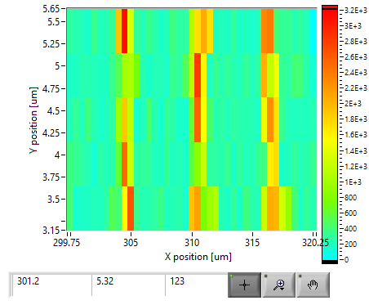
Scan parameters (Carriage):
Xaxis =20 mm
Step size 0.5 mm
Yaxis=2 mm
Step size 0.5 mm
Acquisition time 1sec ( 0.1 sec)
Total points 205
Total time 4:27 min

Slide 4
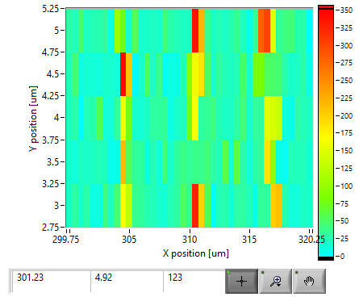
Scan parameters (Carriage):
Xaxis =20 mm
Step size 0.5 mm
Yaxis=2 mm
Step size 0.5 mm
Acquisition time 0.1sec ( 0.01 sec ?)
Total points 205
Total time 4:15 min

Slide 5
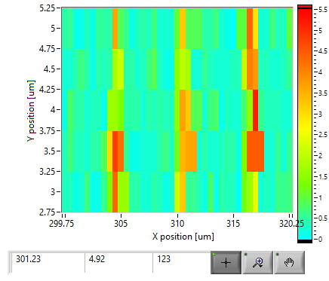
Scan parameters (Carriage):
Xaxis =20 mm
Step size 0.5 mm
Yaxis=2 mm
Step size 0.5 mm
Acquisition time 0.1sec ( 0.01 sec ?)
Total points 205
Total time 4:15 min
Time preset 10 sec

Slide 6
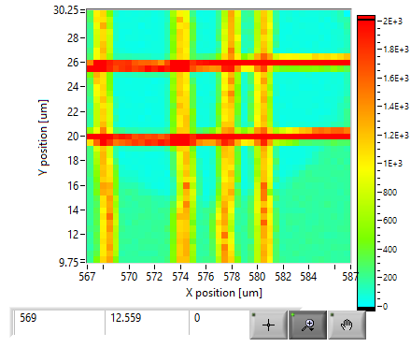
Scan parameters (Carriage):
Xaxis=20 mm
Step size 0.5 mm
Yaxis=20 mm
Step size 0.5 mm
Acquisition time 5sec ( 0.5 sec ?)
Total points 1681
Total time 30:150 min
Presicion 0.2 mm

Slide 7
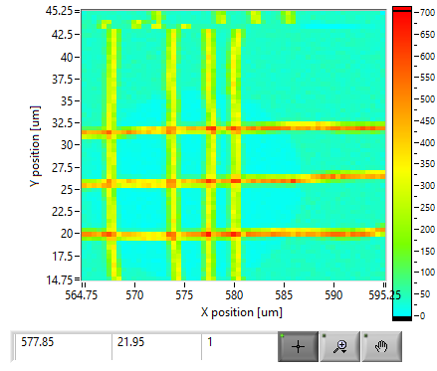
Scan parameters (Snake):
Xaxis =30 mm
Step size 0.5 mm
Yaxis=30 mm
Step size 0.5 mm
Acquisition time 1sec ( 0.1 sec ? 0.2 real time)
Total points 3721
Total time 46:48 min
Precision 0.2 mm
Proximity sensor: 71 mm
!! Αρκετά ομαλή κίνιση με επιτάχυνση 10mm/sec^2 και ταχύτητα 61 mm/sec
!! Τελευταίες γραμμές μετακινήθηκε με το χέρι γιατί ήταν πολύ κοντά στην πλαστελίνη το παράθυρο του ανιχνευτή

Slide 8
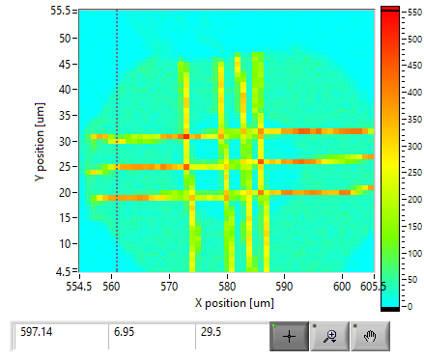
Scan parameters (Snake):
Xaxis=50 mm
Step size 1 mm
Yaxis=50 mm
Step size 1 mm
Acquisition time 1sec ( 0.1 sec ? 0.2 real time)
Total points 2601
Total time 39:12 min
Presicion 0.3 mm
Proximity sensor: 73 mm
!! Αρκετά ομαλή κίνηση με επιτάχυνση 10mm/sec^2 και ταχύτητα 61 mm/sec
!! Στις τελευταίες γραμμές μέτραγε πλαστελίνη

Slide 9
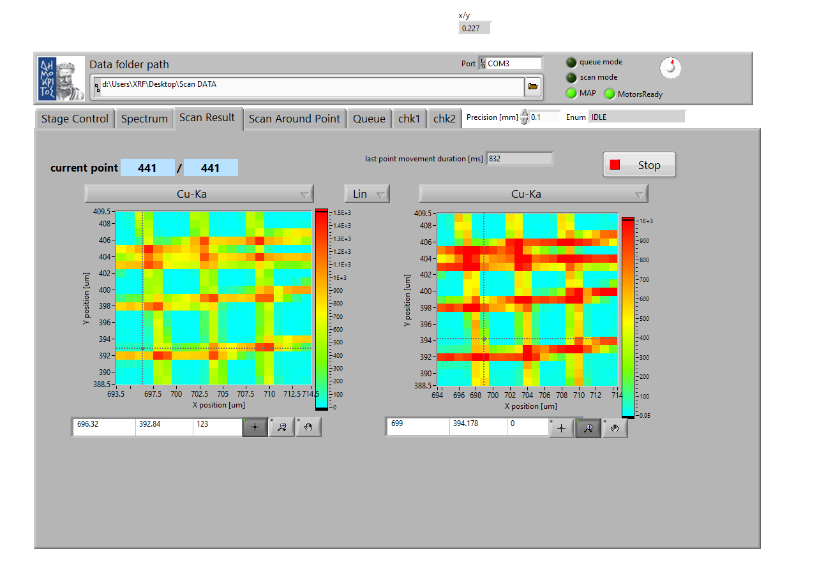
Scan parameters (Snake):
Xaxis=20 mm
Step size 1 mm
Yaxis=20 mm
Step size 1 mm
Acquisition time 1sec ( 0.1 sec ? 0.2 real time)
Total points 441
Precision 0.1 mm
Proximity sensor: 71.5 mm
Roi: 860-900
Point movement duration 832 msec
Acquisition time: 0.24 msec

Slide 10
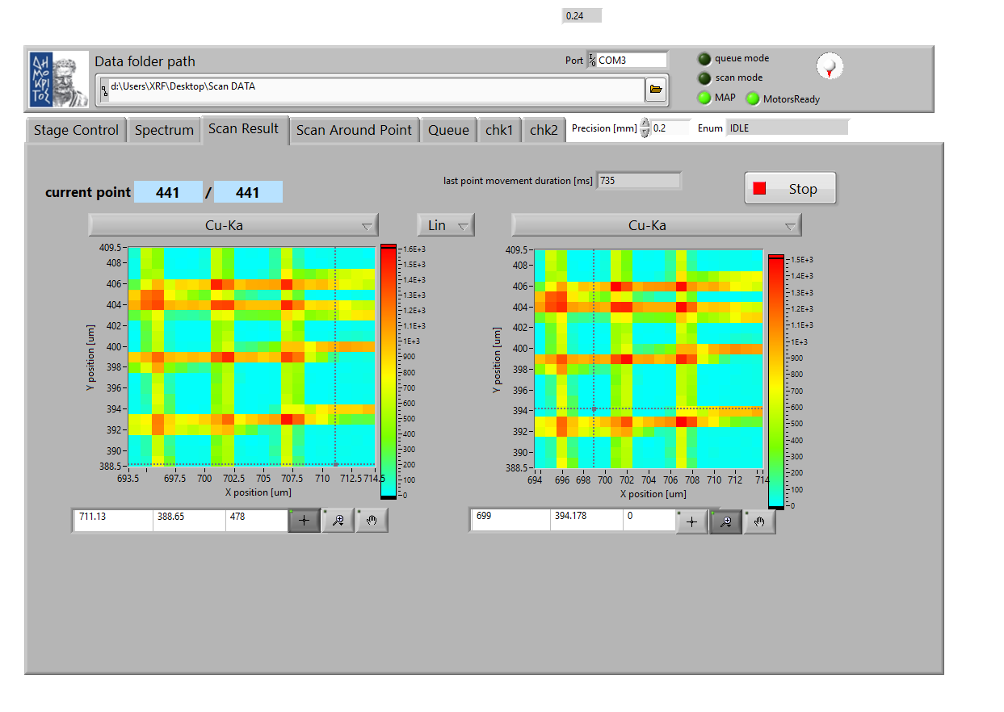
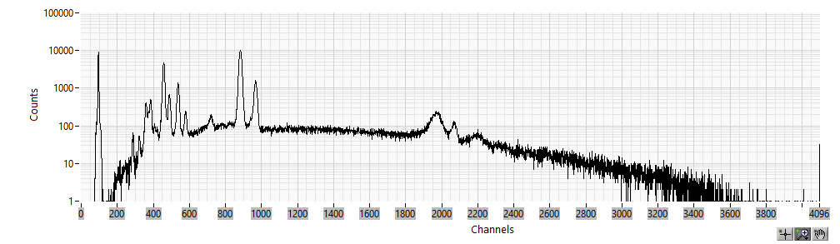
Scan parameters (Snake):
Xaxis=20 mm
Step size 1 mm
Yaxis=20 mm
Step size 1 mm
Acquisition time 1sec ( 0.1 sec ? 0.2 real time)
Total points 441
Precision 0.2 mm
Proximity sensor: 69.3 mm
Roi: 860-900
Point movement duration: 735 msec
Acquisition time: 0.24 msec
Total time: 08:17

Slide 11
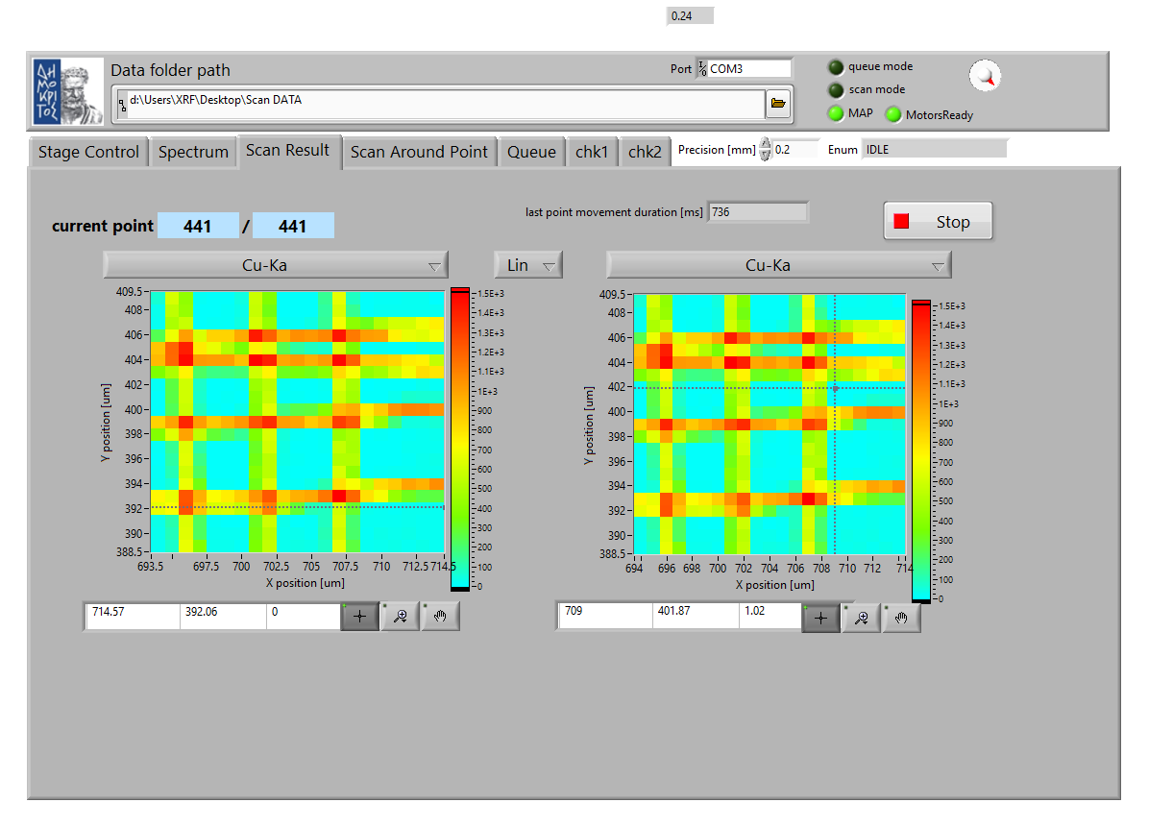

Scan parameters (Carriage):
Xaxis=20 mm
Step size 1 mm
Yaxis=20 mm
Step size 1 mm
Acquisition time 1sec ( 0.1 sec ? 0.2 real time)
Total points 441
Precision 0.2 mm
Proximity sensor: 69.3 mm
Roi: 860-900
Point movement duration 736 msec
Acquisition time: 0.24 msec
Total time 12:02

Slide 12
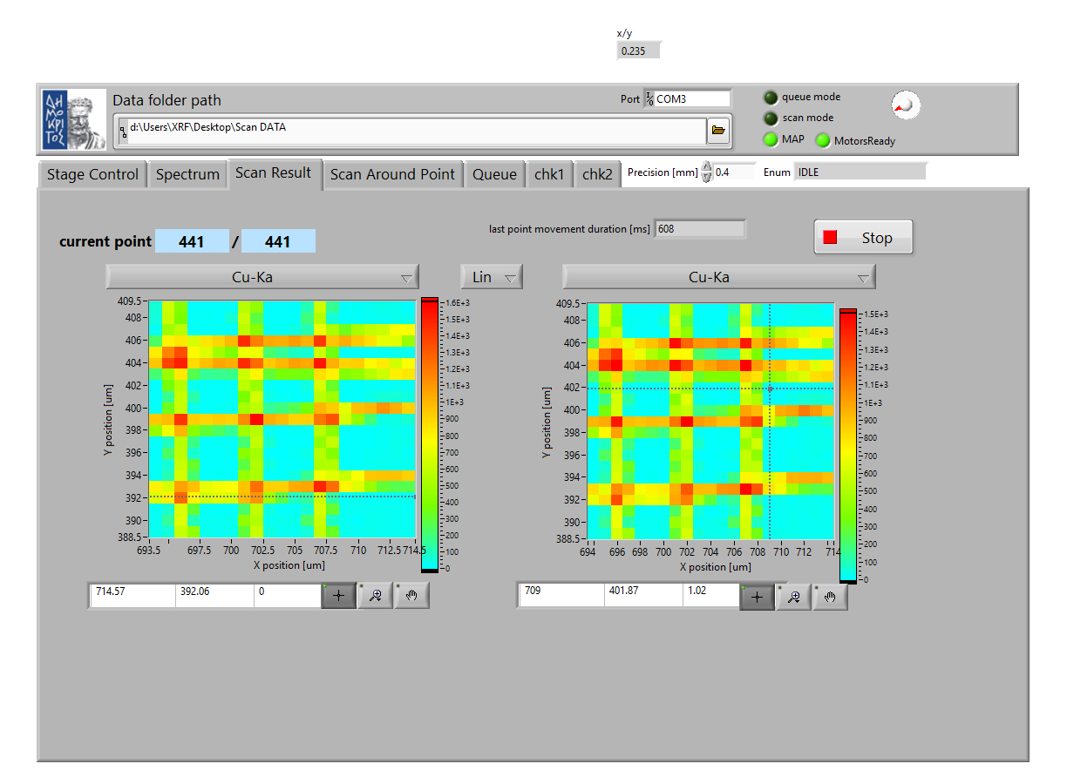
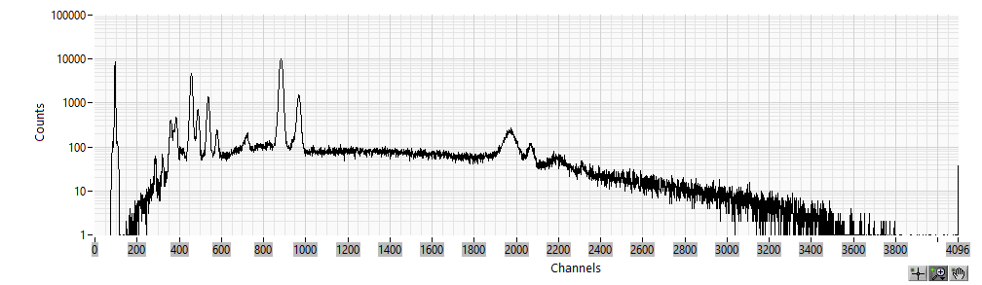
Scan parameters (Snake):
Xaxis=20 mm
Step size 1 mm
Yaxis=20 mm
Step size 1 mm
Acquisition time 1sec ( 0.1 sec ? 0.2 real time)
Total points 441
Precision 0.4 mm
Proximity sensor: 69.3 mm
Roi: 860-900
Point movement duration 608 msec
Acquisition time: 0.24 msec
Total time 07:33

Slide 13
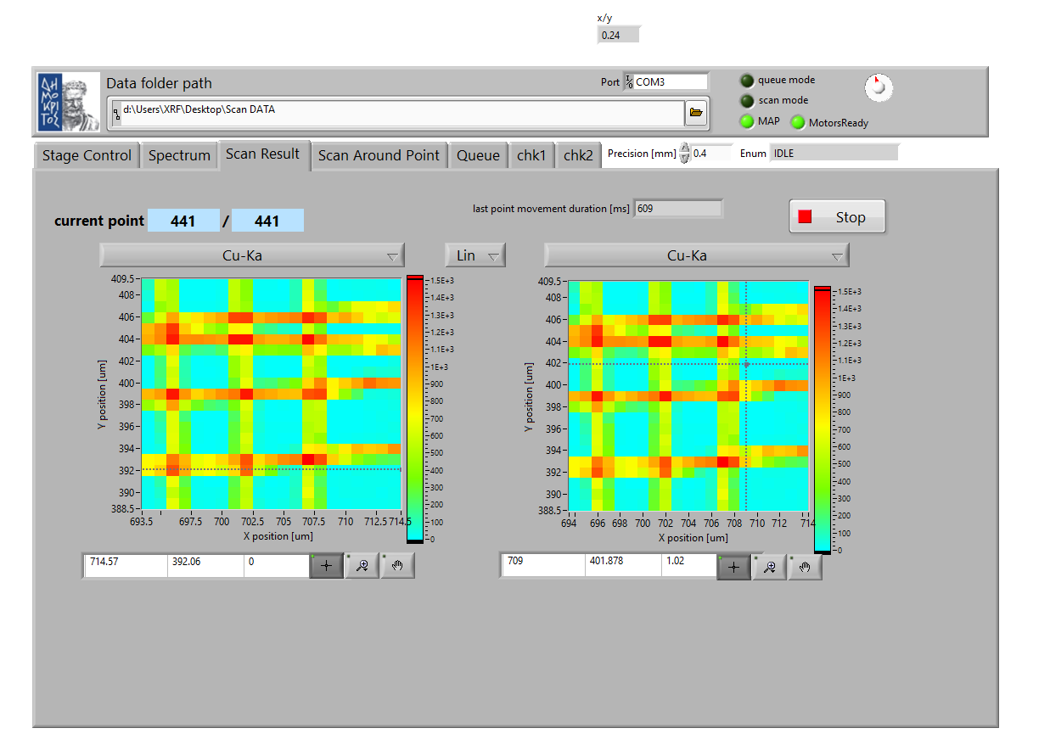

Scan parameters (Carriage):
Xaxis=20 mm
Step size 1 mm
Yaxis=20 mm
Step size 1 mm
Acquisition time 1sec ( 0.1 sec ? 0.2 real time)
Total points 441
Precision 0.4 mm
Proximity sensor: 69.3 mm
Roi: 860-900
Point movement duration 608 msec
Acquisition time: 0.24 msec
Total time 10:56

Slide 14
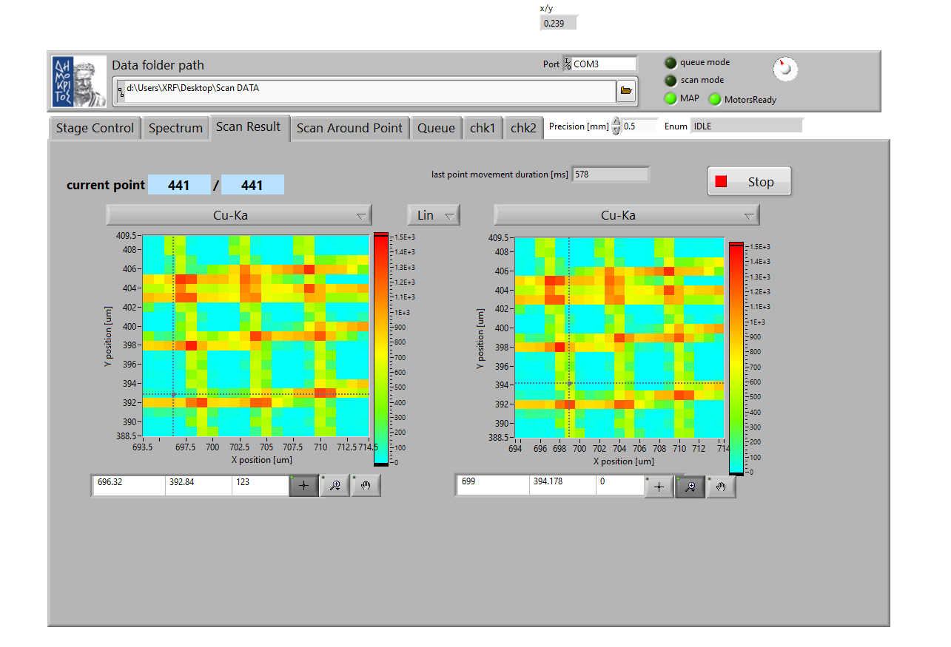
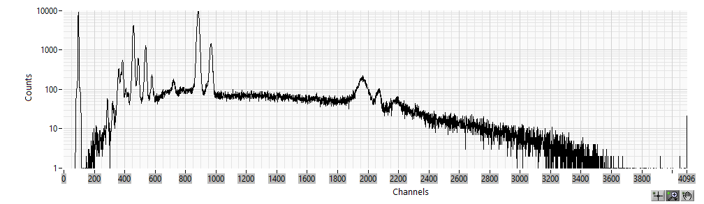
Scan parameters (Snake):
Xaxis=20 mm
Step size 1 mm
Yaxis=20 mm
Step size 1 mm
Acquisition time 1sec ( 0.1 sec ? 0.2 real time)
Total points 441
Precision 0.5 mm
Proximity sensor: 71.5 mm
Roi: 860-900
Point movement duration 578 msec
Acquisition time: 0.24 msec
Total time 06:02

Slide 15
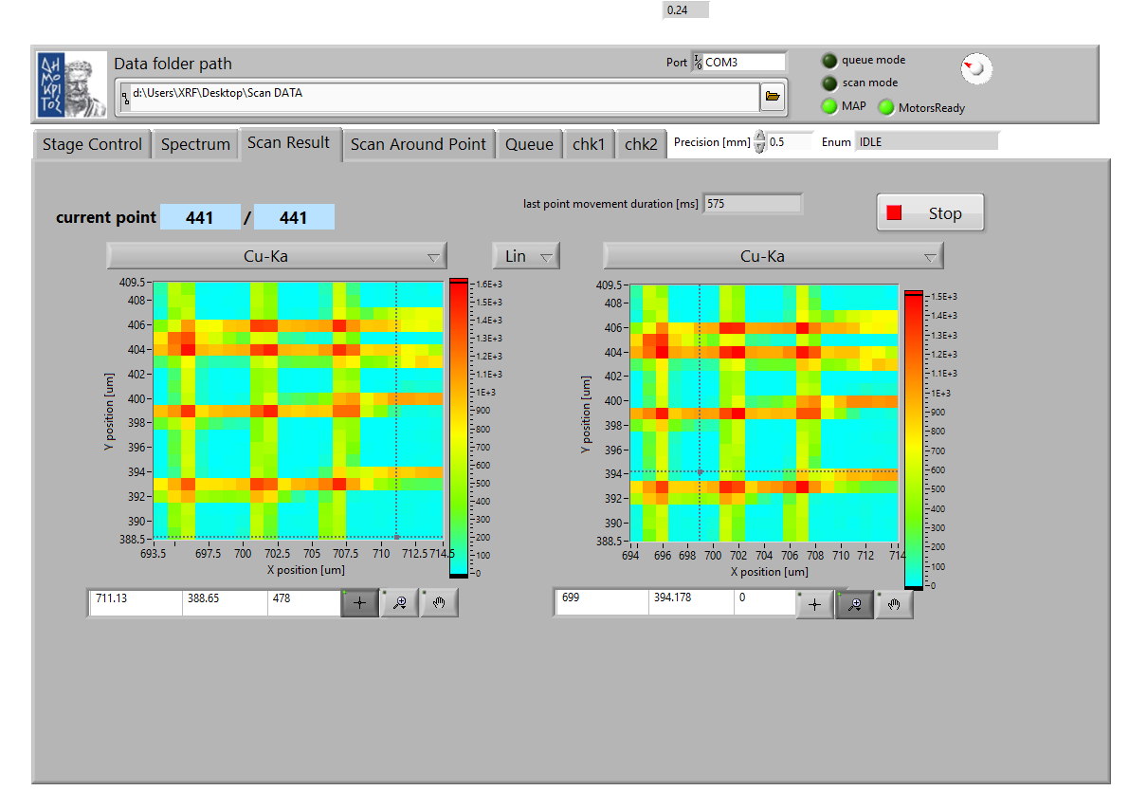

Scan parameters (Carriage):
Xaxis=20 mm
Step size 1 mm
Yaxis=20 mm
Step size 1 mm
Acquisition time 1sec ( 0.1 sec ? 0.2 real time)
Total points 441
Precision 0.5 mm
Proximity sensor: 69.3 mm
Roi: 860-900
Point movement duration 575 msec
Acquisition time: 0.24 msec
Total time 10:23

Slide 16
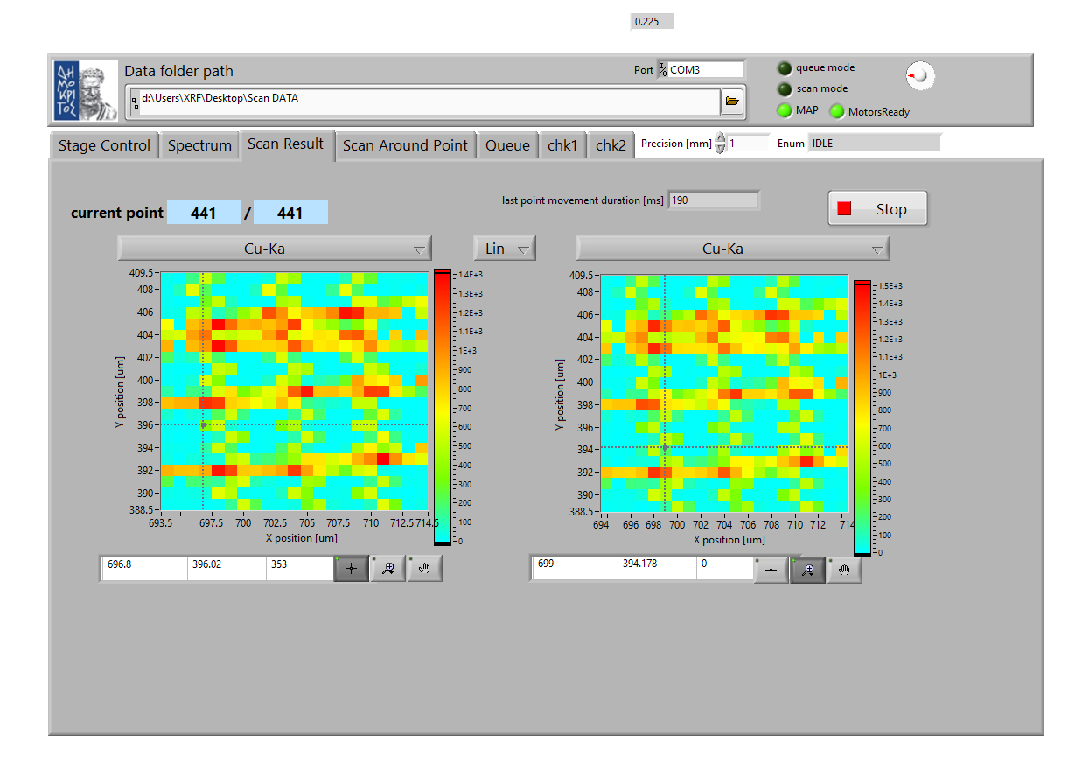

Scan parameters (Snake):
Xaxis=20 mm
Step size 1 mm
Yaxis=20 mm
Step size 1 mm
Acquisition time 1sec ( 0.1 sec ? 0.2 real time)
Total points 441
Precision 1.0 mm
Proximity sensor: 71.5 mm
Roi: 860-900
Point movement duration 190 msec
Acquisition time: 0.22 msec
Total time 04:02

Slide 17
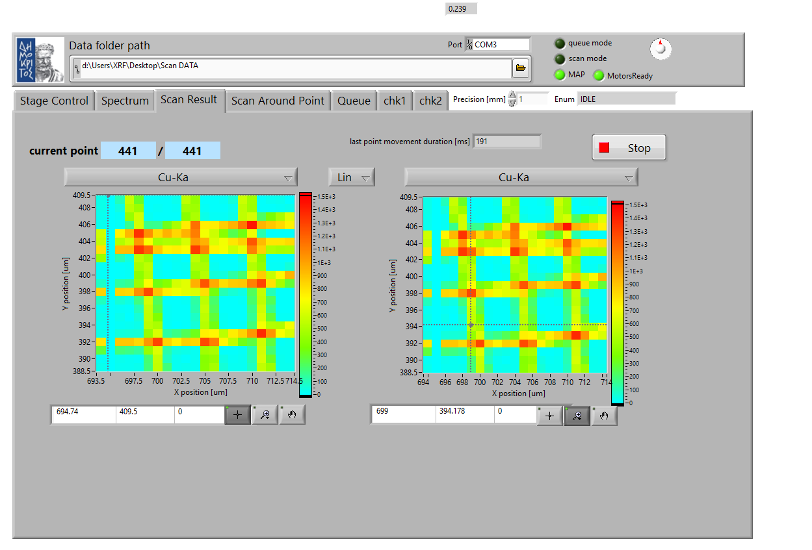

Scan parameters (Carriage):
Xaxis=20 mm
Step size 1 mm
Yaxis=20 mm
Step size 1 mm
Acquisition time 1sec ( 0.1 sec ? 0.2 real time)
Total points 441
Precision 1.0 mm
Proximity sensor: 71.5 mm
Roi: 860-900
Point movement duration 190 msec
Acquisition time: 0.22 msec
Total time 08:02

Slide 18
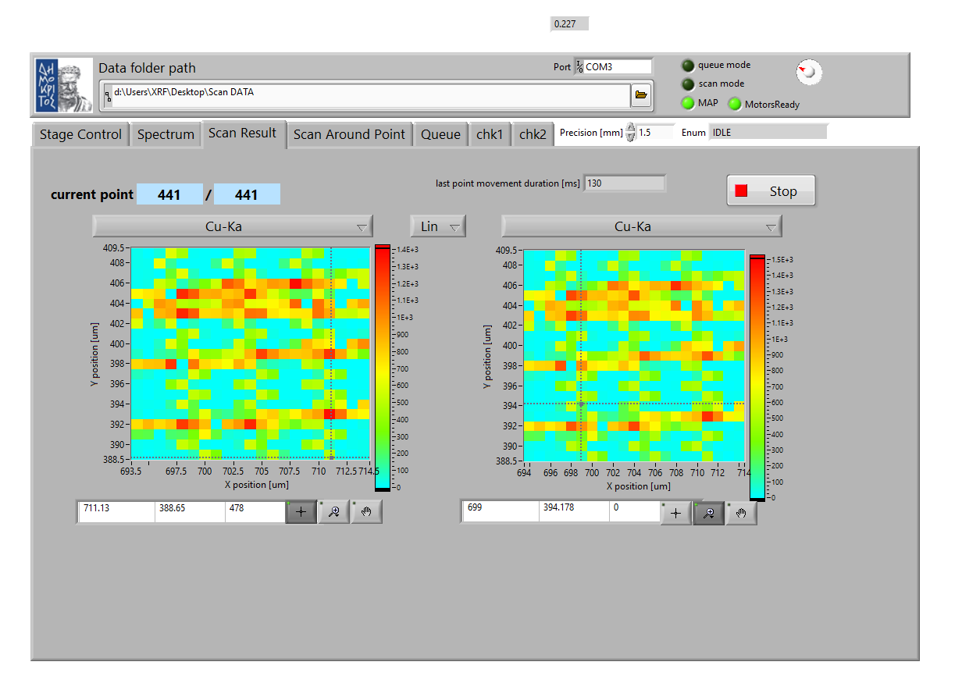

Scan parameters (Snake):
Xaxis=20 mm
Step size 1 mm
Yaxis=20 mm
Step size 1 mm
Acquisition time 1sec ( 0.1 sec ? 0.2 real time)
Total points 441
Precision 1.5 mm
Proximity sensor: 71.5 mm
Roi: 860-900
Point movement duration 130 msec
Acquisition time: 0.22 msec
Total time 04:03

Slide 19
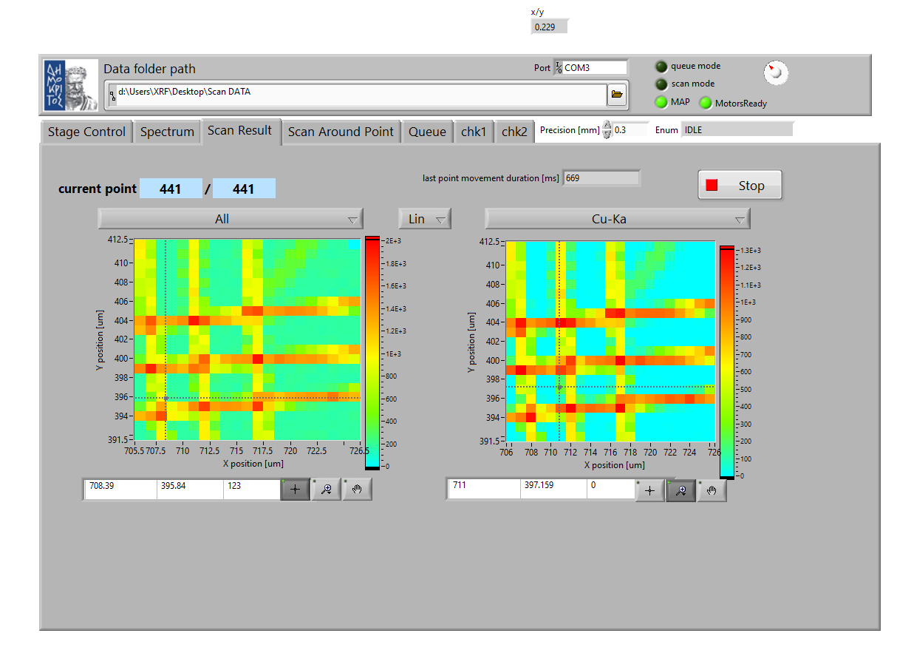
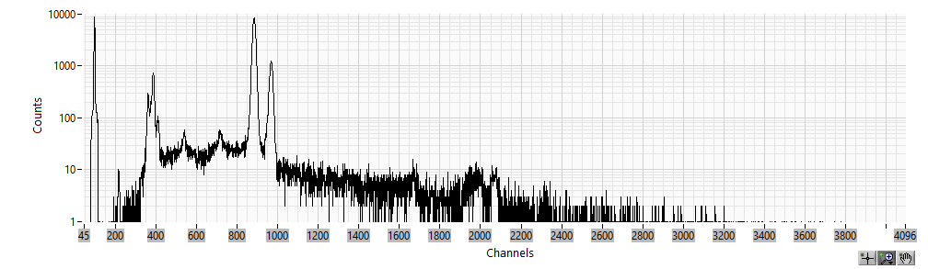
New patern !!
Scan parameters (Snake):
Xaxis=20 mm
Step size 1 mm
Yaxis=20 mm
Step size 1 mm
Acquisition time 1sec ( 0.1 sec ? 0.2 real time)
Total points 441
Precision 0.3 mm
Proximity sensor: 69.3 mm
Roi: 860-900
Point movement duration 669 msec
Acquisition time: 0.24 msec
Total time 08:30

Slide 20
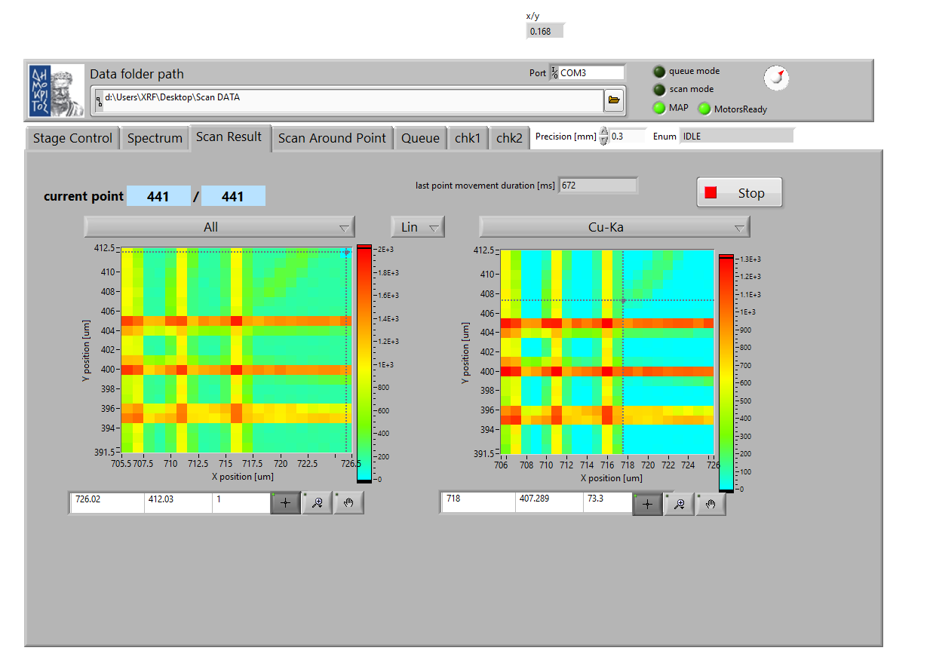

New patern !!
Scan parameters (Carriage):
Xaxis=20 mm
Step size 1 mm
Yaxis=20 mm
Step size 1 mm
Acquisition time 1sec ( 0.1 sec ? 0.2 real time)
Total points 441
Precision 0.2 mm
Proximity sensor: 69.3 mm
Roi: 860-900
Point movement duration 672 msec
Acquisition time: 0.24 msec
Total time 10:40

