Slide 1
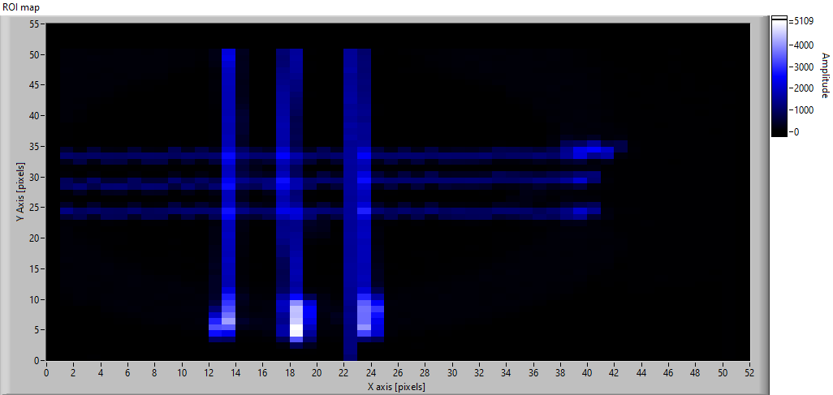
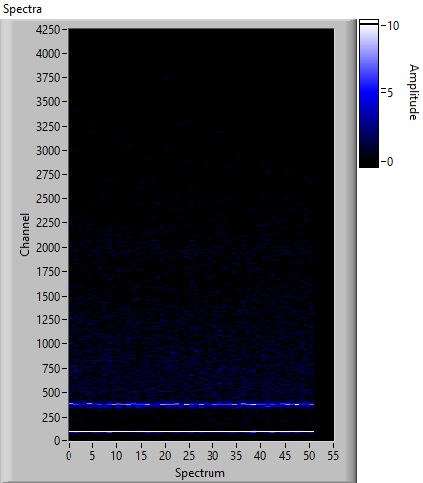
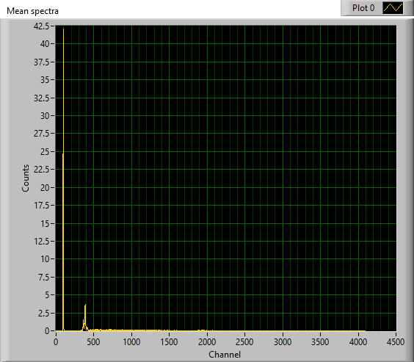
Scan parameters (Carriage)
X_axis = 50 mm
Step size = 1 mm
Y_axis = 50 mm
Step size = 1 mm
ROI: 853-917
Scan Velocity = 5 mm/sec
Acceleration = 10 mm/sec^2
Return Velocity = 50 mm/sec
Total line time = 11 sec
Total scan time 613.5 sec
Acq distance = 1.25 mm
Acc time = 0.5 sec

Slide 2
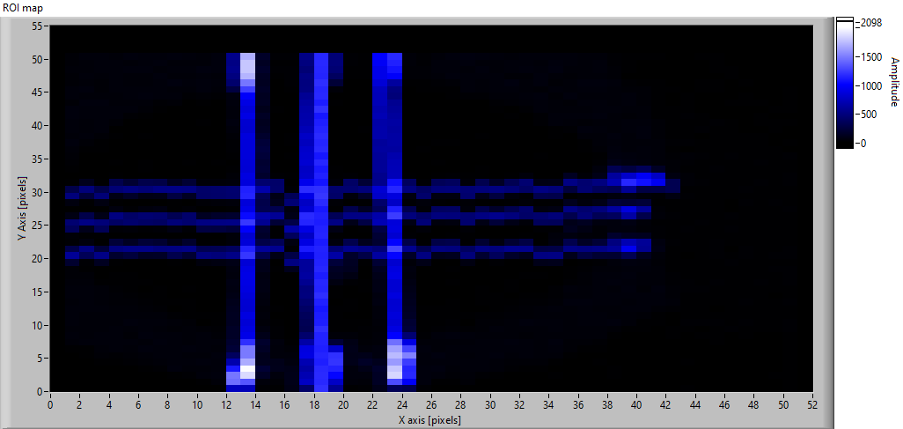
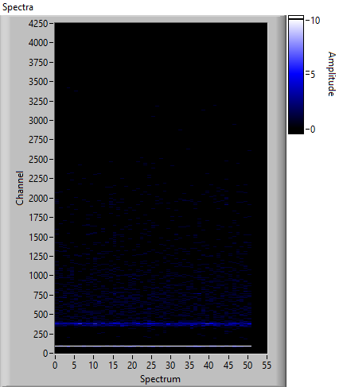
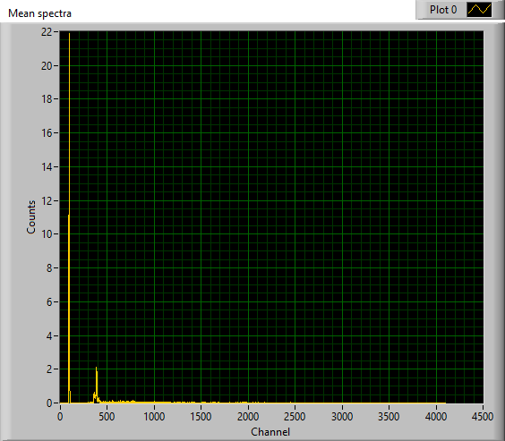
Scan parameters (Carriage)
X_axis = 50 mm
Step size = 1 mm
Y_axis = 50 mm
Step size = 1 mm
ROI: 853-917
Scan Velocity = 10 mm/sec
Acceleration = 20 mm/sec^2
Return Velocity = 50 mm/sec
Total line time = 6 sec
Total scan time 6316 sec
Acc distance = 2.5 mm
Acc time = 0.5 sec
Acq time = 5 sec
Total time measured with timer: 13 min

Slide 3
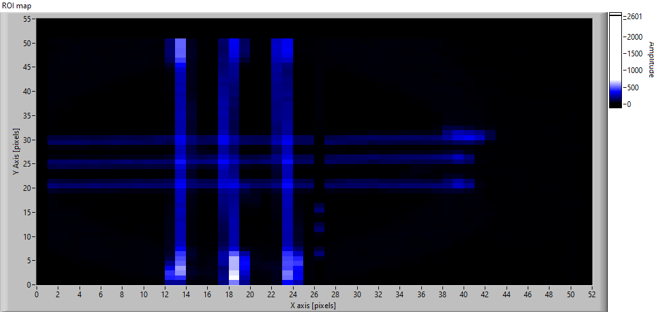


Scan parameters (Carriage)
X_axis = 50 mm
Step size = 1 mm
Y_axis = 50 mm
Step size = 1 mm
ROI: 853-917
Scan Velocity = 10 mm/sec
Acceleration = 20 mm/sec^2
Return Velocity = 100 mm/sec
Total line time = 6 sec
Total scan time 333 sec
Acc distance = 2.5 mm
Acc time = 0.5 sec
Acq time = 5 sec
Total time measured with timer: 14:16

Slide 4
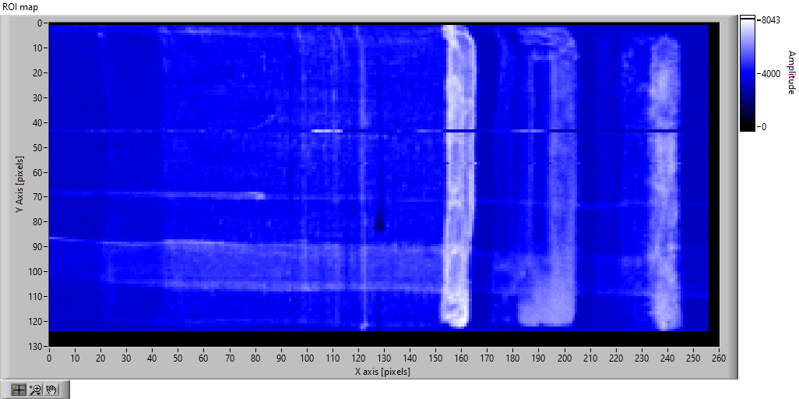
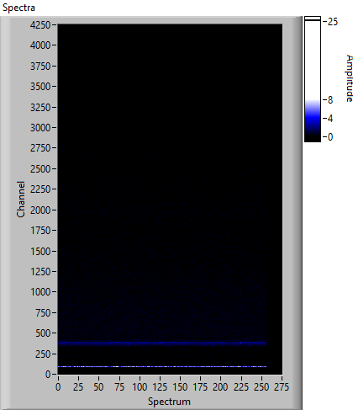
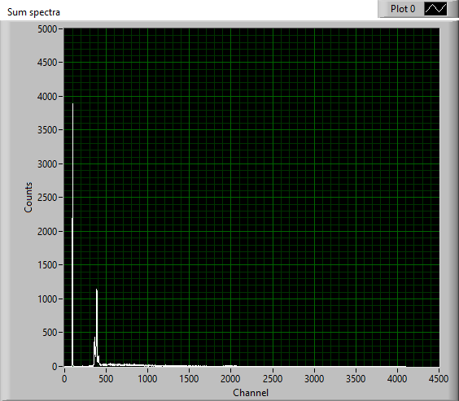
Scan parameters (Carriage)
X_axis = 255 mm
Step size = 1 mm
Y_axis = 123 mm
Step size = 1 mm
ROI: Full spectrum
Scan Velocity = 10 mm/sec
Acceleration = 20 mm/sec^2
Return Velocity = 20 mm/sec
Acc distance = 2.5 mm
Acc time = 0.5 sec
Acq time = 25.5 sec
Total line time = 26.5 sec
Total scan time = 5122 sec
Total time measured with timer: 01:34 hours:minutes

Slide 5
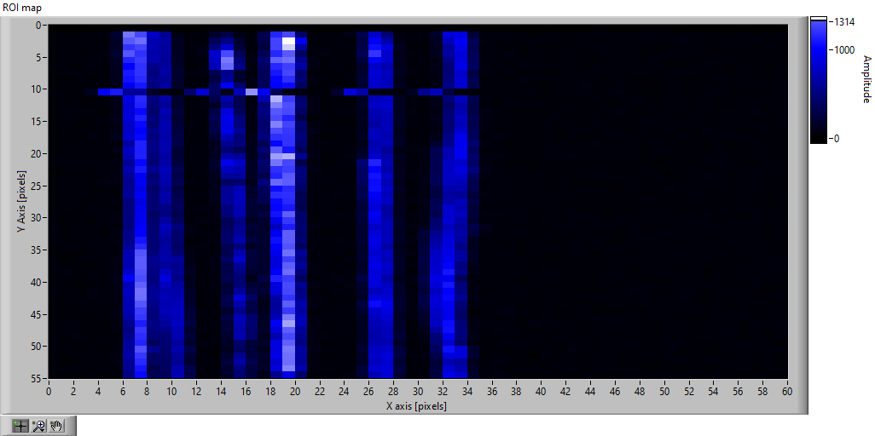

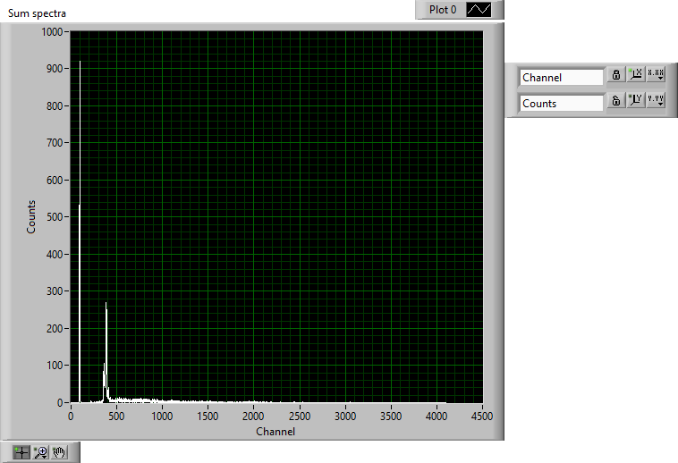
Scan parameters (Carriage)
X_axis = 59 mm
Step size = 1 mm
Y_axis = 54 mm
Step size = 1 mm
ROI: Full spectrum
Scan Velocity = 10 mm/sec
Acceleration = 20 mm/sec^2
Return Velocity = 30 mm/sec
Acc distance = 2.5 mm
Acc time = 0.5 sec
Acq time = 25.5 sec
Total line time = 26.5 sec
Total scan time = 494.7 sec
Total time measured with timer: 20 minutes

Slide 6
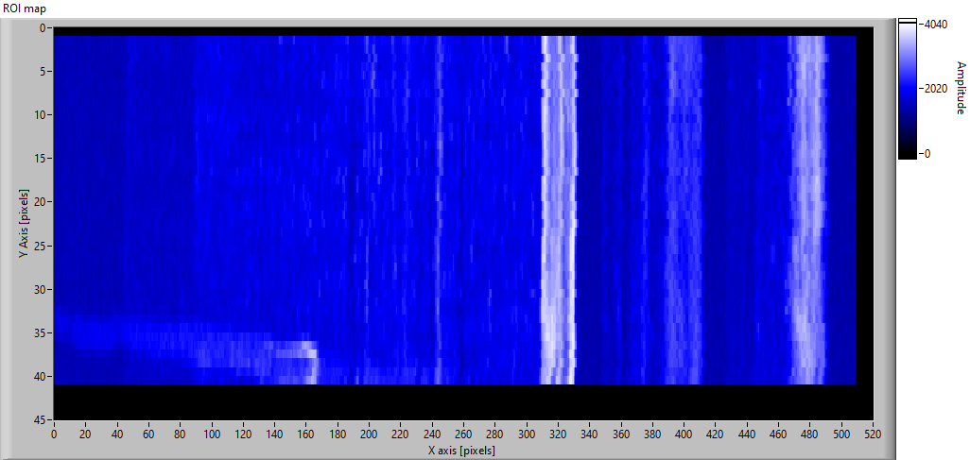
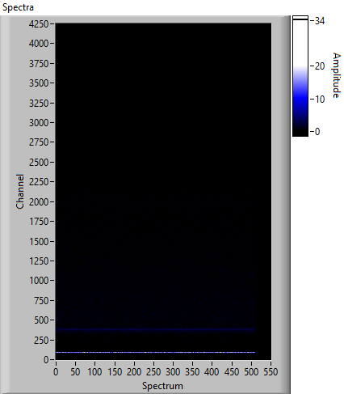
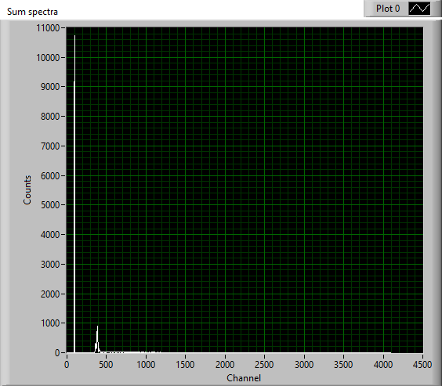
Scan parameters (Carriage)
X_axis = 254 mm
Step size = 0.5 mm
Y_axis = 20 mm
Step size = 0.5 mm
ROI: Full spectrum
Scan Velocity = 5 mm/sec
Acceleration = 20 mm/sec^2
Return Velocity = 30 mm/sec
Acc distance = 0.625 mm
Acc time = 0.25 sec
Acq time = 50.8 sec
Total line time = 51.3 sec
Total scan time = 2443.63 sec
Total time measured with timer: 48 minutes

Slide 7
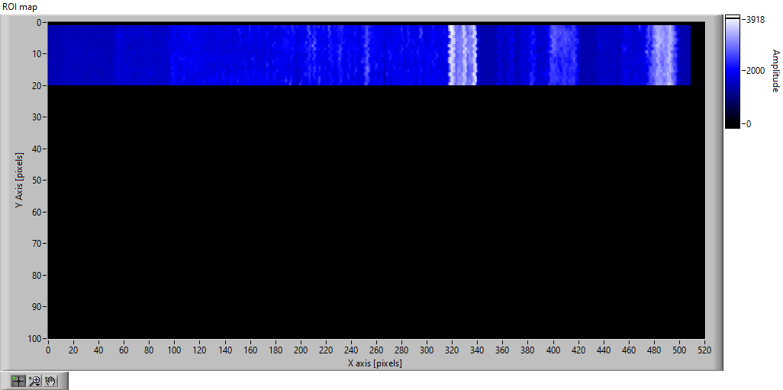
Scan parameters (Carriage)
X_axis = 254 mm
Step size = 0.5 mm
Y_axis = 20 mm
Step size = 0.5 mm
ROI: Full spectrum
Scan Velocity = 5 mm/sec
Acceleration = 5 mm/sec^2
Return Velocity = 5 mm/sec
Acc distance = 2.5 mm
Acc time = 1 sec
Acq time = 50.8 sec
Total line time = 52.8 sec
Total scan time = 10512.8sec

Slide 8
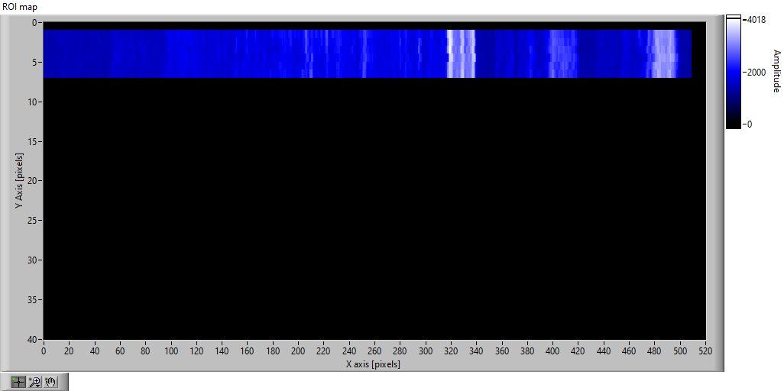
Scan parameters (Carriage)
X_axis = 254 mm
Step size = 0.5 mm
Y_axis = 20 mm
Step size = 0.5 mm
ROI: Full spectrum
Scan Velocity = 5 mm/sec
Acceleration = 10 mm/sec^2
Return Velocity = 5 mm/sec
Acc distance = 1.25 mm
Acc time = 0.5 sec
Acq time = 50.8 sec
Total line time = 52.8 sec
Total scan time = 10512.8sec

Slide 9
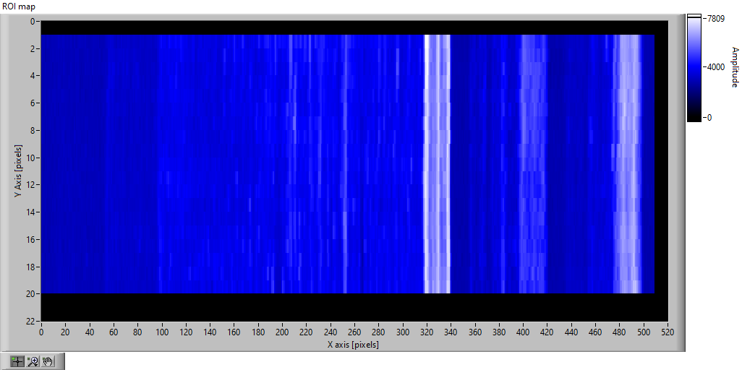
Scan parameters (Carriage)
X_axis = 254 mm
Step size = 0.5 mm
Y_axis = 10 mm
Step size = 0.5 mm
ROI: Full spectrum
Scan Velocity = 2.5 mm/sec
Acceleration = 10 mm/sec^2
Return Velocity (Μεταβλητή)= 2.5, 10 , 50, 20 mm/sec
Acc distance = 0.3125 mm
Acc time = 0.25 sec
Acq time = 101.6 sec
Total line time = 102.1sec
Total scan time = 4695.35 sec

Slide 10
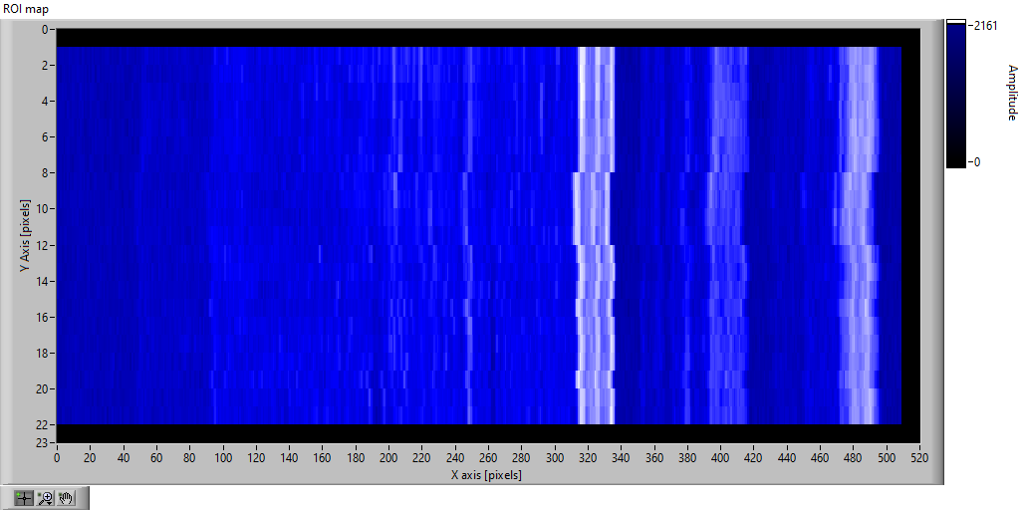
Scan parameters (Carriage)
X_axis = 254 mm
Step size = 0.5 mm
Y_axis = 10 mm
Step size = 0.5 mm
ROI: Full spectrum
Scan Velocity = 10 mm/sec
Acceleration = 10 mm/sec^2
Return Velocity = 10
Acc distance = 5 mm
Acc time = 1 sec
Acq time = 25.4sec
Total line time = 27.4sec
Total scan time = 1103.4sec

Slide 11
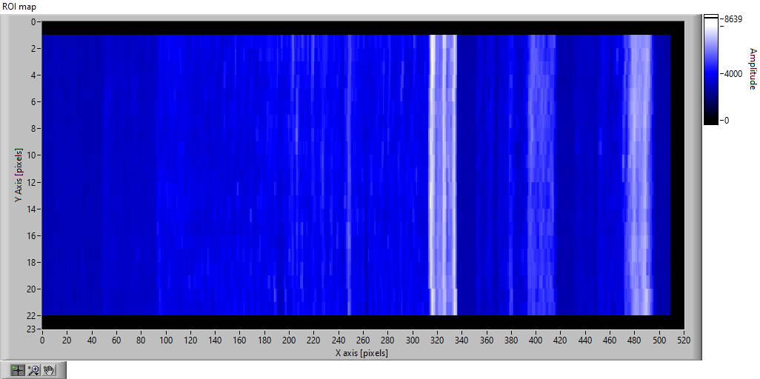
Scan parameters (Carriage)
X_axis = 254 mm
Step size = 0.5 mm
Y_axis = 10 mm
Step size = 0.5 mm
ROI: Full spectrum
Scan Velocity = 2.5 mm/sec
Acceleration = 10 mm/sec^2
Return Velocity = 10
Acc distance = 0.4 mm
Acc time = 0.25 sec
Acq time = 101.6sec
Total line time = 102.1sec
Total scan time = 2653.35sec

Slide 12
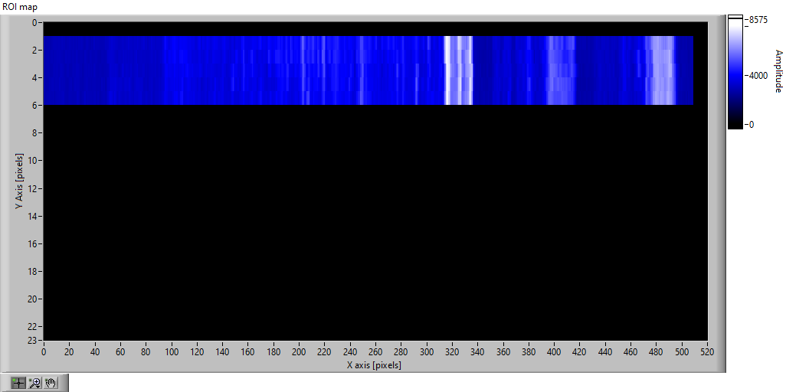
Scan parameters (Carriage)
X_axis = 254 mm
Step size = 0.5 mm
Y_axis = 10 mm
Step size = 0.5 mm
ROI: Full spectrum
Scan Velocity = 2.5 mm/sec
Acceleration = 20 mm/sec^2
Return Velocity = 20
Acc distance = 0.27 mm
Acc time = 0.16 sec
Acq time = 76.2sec
Total line time = 76.53sec
Total scan time = 2116.31sec

Slide 13
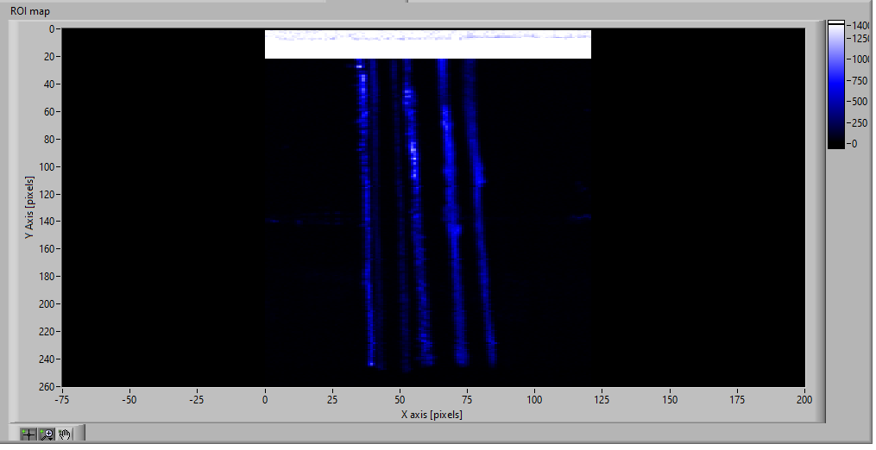
Scan parameters (Carriage)
X_axis = 60 mm
Step size = 0.5 mm
Y_axis = 129 mm
Step size = 0.5 mm
ROI: On Fe (700-750) after 20 row
Scan Velocity = 5 mm/sec
Acceleration = 10 mm/sec^2
Return Velocity = 30 mm/sec
Acc distance = 1.25 mm
Acc time = 0.5 sec
Acq time = 12 sec
Total line time = 13sec
Total scan time = 3904.31sec

Slide 14
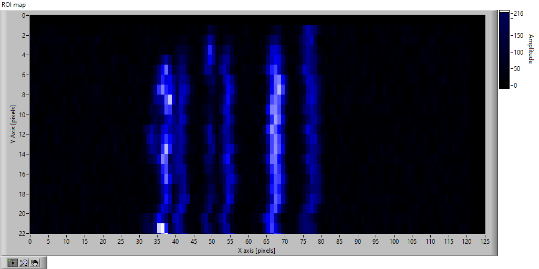
Scan parameters (Carriage)
X_axis = 60 mm
Step size = 0.5 mm
Y_axis = 130 mm
Step size = 0.5 mm
ROI: On Fe (700-750)
Scan Velocity = 10 mm/sec
Acceleration = 2.5 mm/sec^2
Return Velocity = 20 mm/sec
Time per pixel 50 msec
Acc distance = 20 mm
Acc time = 4.5 sec
Acq time = 6 sec
Total line time = 14 sec
Total scan time = 3869 sec
Additional acceleration distance = 0 mm
Stopped after line 23. Bad alignment

Slide 15
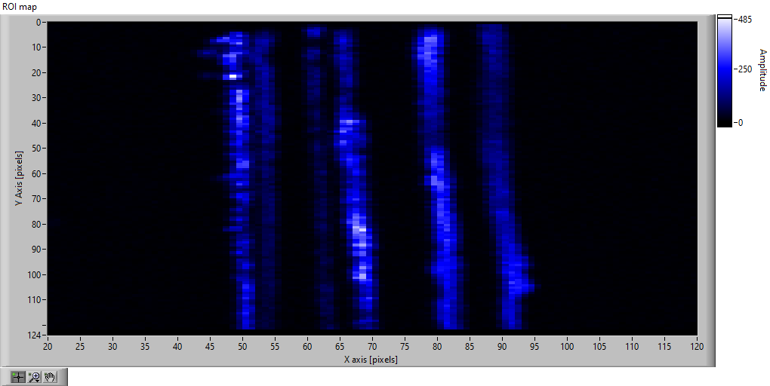
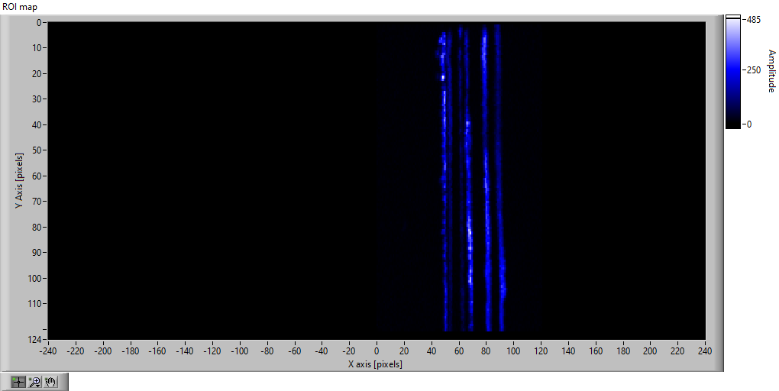
Scan parameters (Carriage)
X_axis = 60 mm
Step size = 0.5 mm
Y_axis = 60 mm
Step size = 0.5 mm
ROI: On Fe (700-750)
Scan Velocity = 5 mm/sec
Acceleration = 2.5 mm/sec^2
Return Velocity = 50 mm/sec
Time per pixel 100 msec
Acc distance = 10 mm
Acc time = 2 sec
Acq time = 20 sec
Total line time = 24 sec
Total scan time = 3869 sec
Additional acceleration distance = 5 mm

Slide 16
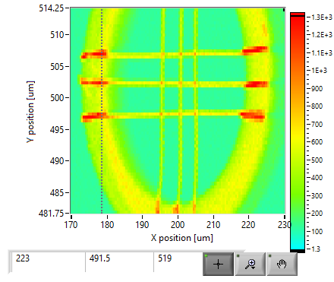
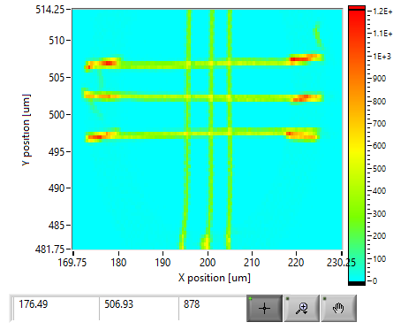
Scan parameters (Snake with Stepper mode)
X_axis = 60 mm
Step size = 0.5 mm
Y_axis = 32 mm
Step size = 0.5 mm
ROI: On Cu (850-9000) and on Full spectrum
Scan Velocity = 5 mm/sec
Acceleration = 2.5 mm/sec^2
Time per pixel 100 msec (0.220 sec acq time+ 0.500 sec mov. time)
Total points 7865
Total scan time measured with timer = 2 hours and 11min

Slide 17
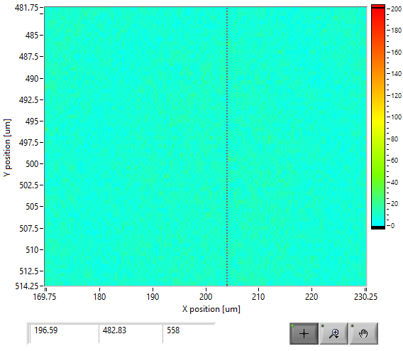
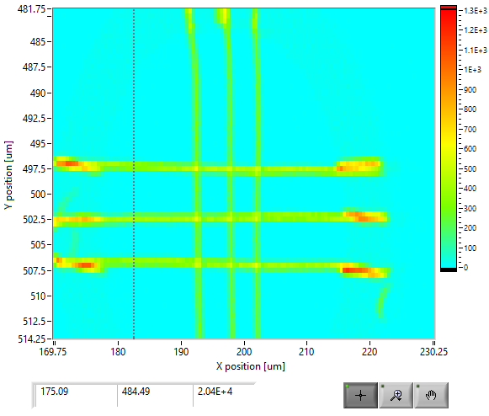
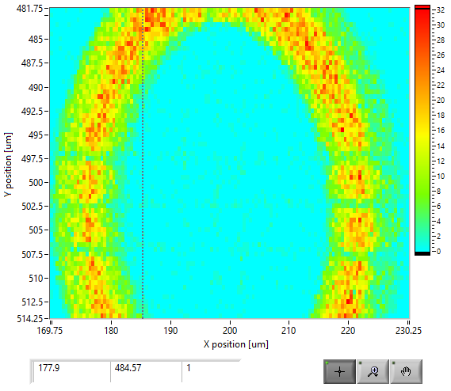
Ar-Ka
Scan parameters (Carriage with Free runing mode)
X_axis = 60 mm
Step size = 0.5 mm
Y_axis = 32 mm
Step size = 0.5 mm
ROI: Cu-Ka(850-900), Ar-Ka (327-425), Rh-Ka (2039-2113)
Scan Velocity = 5 mm/sec
Acceleration = 2.5 mm/sec^2
Time per pixel 100 msec
Total points 7865
Total scan time measured with timer = 26 min
Cu-Ka
Rh-Ka

