Slide 1
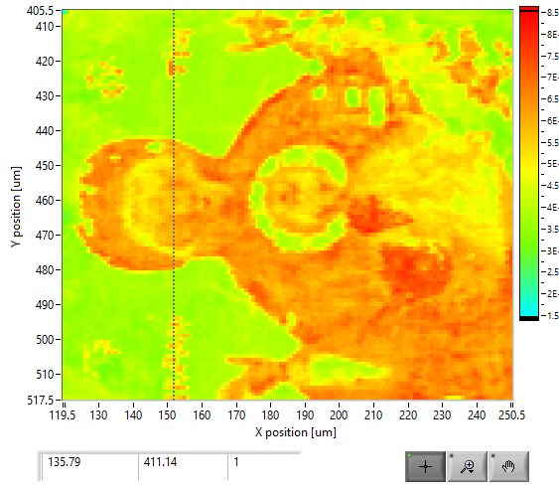
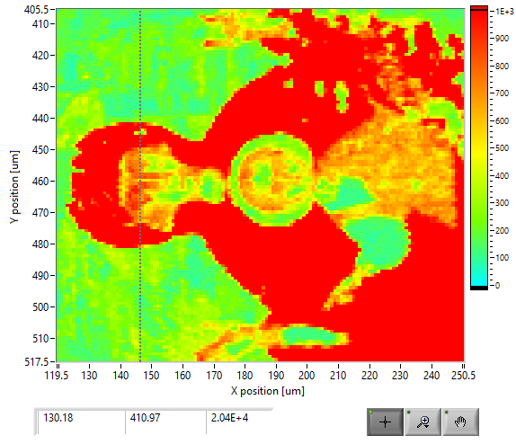
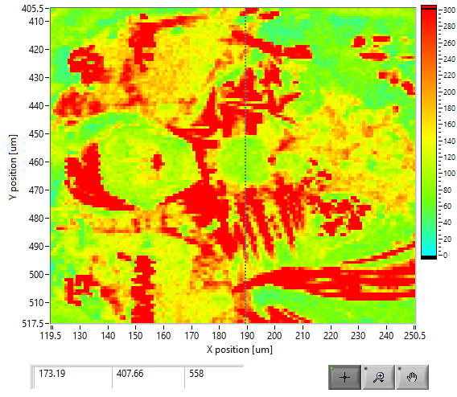
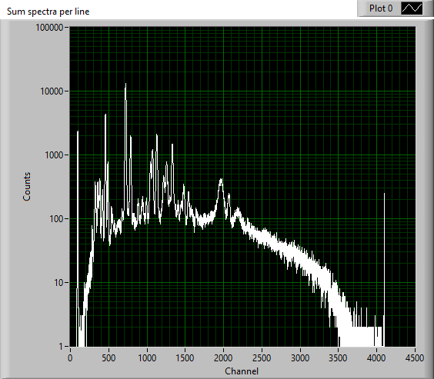
Scan parameters (Carriage Free Running )
X_axis = 120 mm
Step size = 1.0 mm
Y_axis = 406 mm
Step size = 0.5 mm
ROI: Fe(690-751), Au(1047-1098), Full
Scan Velocity = 10 mm/sec
Acceleration = 5 mm/sec^2
Return Velocity = 30 mm/sec
Time per pixel = 100 msec
Acc distance = 20 mm
Acc time = 2.82 sec
Acq time = 13 sec
Total line time = 18.65 sec
Total scan time = 2718.57sec
Total time measured with timer: 1:00:14
Additional acceleration distance added = 10 mm
X-ray tube: 40kV, 200 uA
Full spectrum
Fe spectrum
Au spectrum

