Slide 1

Presentation for the Business Intelligence Analyst role
Panagiotis Evripiotis

Slide 2

1) Exploratory Analysis:
Table of Contents
Evolution of Orders
Orders per Class and Cuisine
Top Cities
Returning Users
Evolution of Metrics
Metrics per Class
Metrics per Class for the Breakfast Cuisine
2) Main analysis Goal:

Slide 3
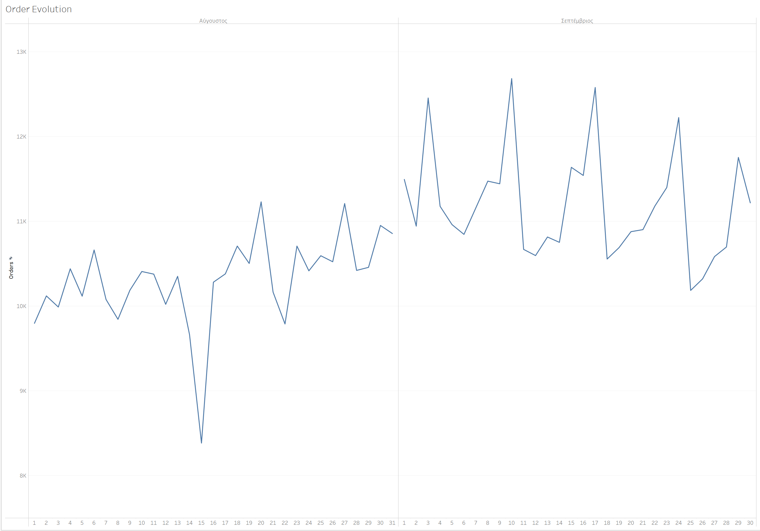
September is a better month than August in regards to orders.
Evolution of Orders
It is evident that orders are affected by seasonality. For example the 15th of August which is national holiday and the days before and after show a big drop in orders.
September shows peaks and valleys with a slightly downward trend to overall orders. It is not clear from the data why but it is worthy of understanding the reason.

Slide 4
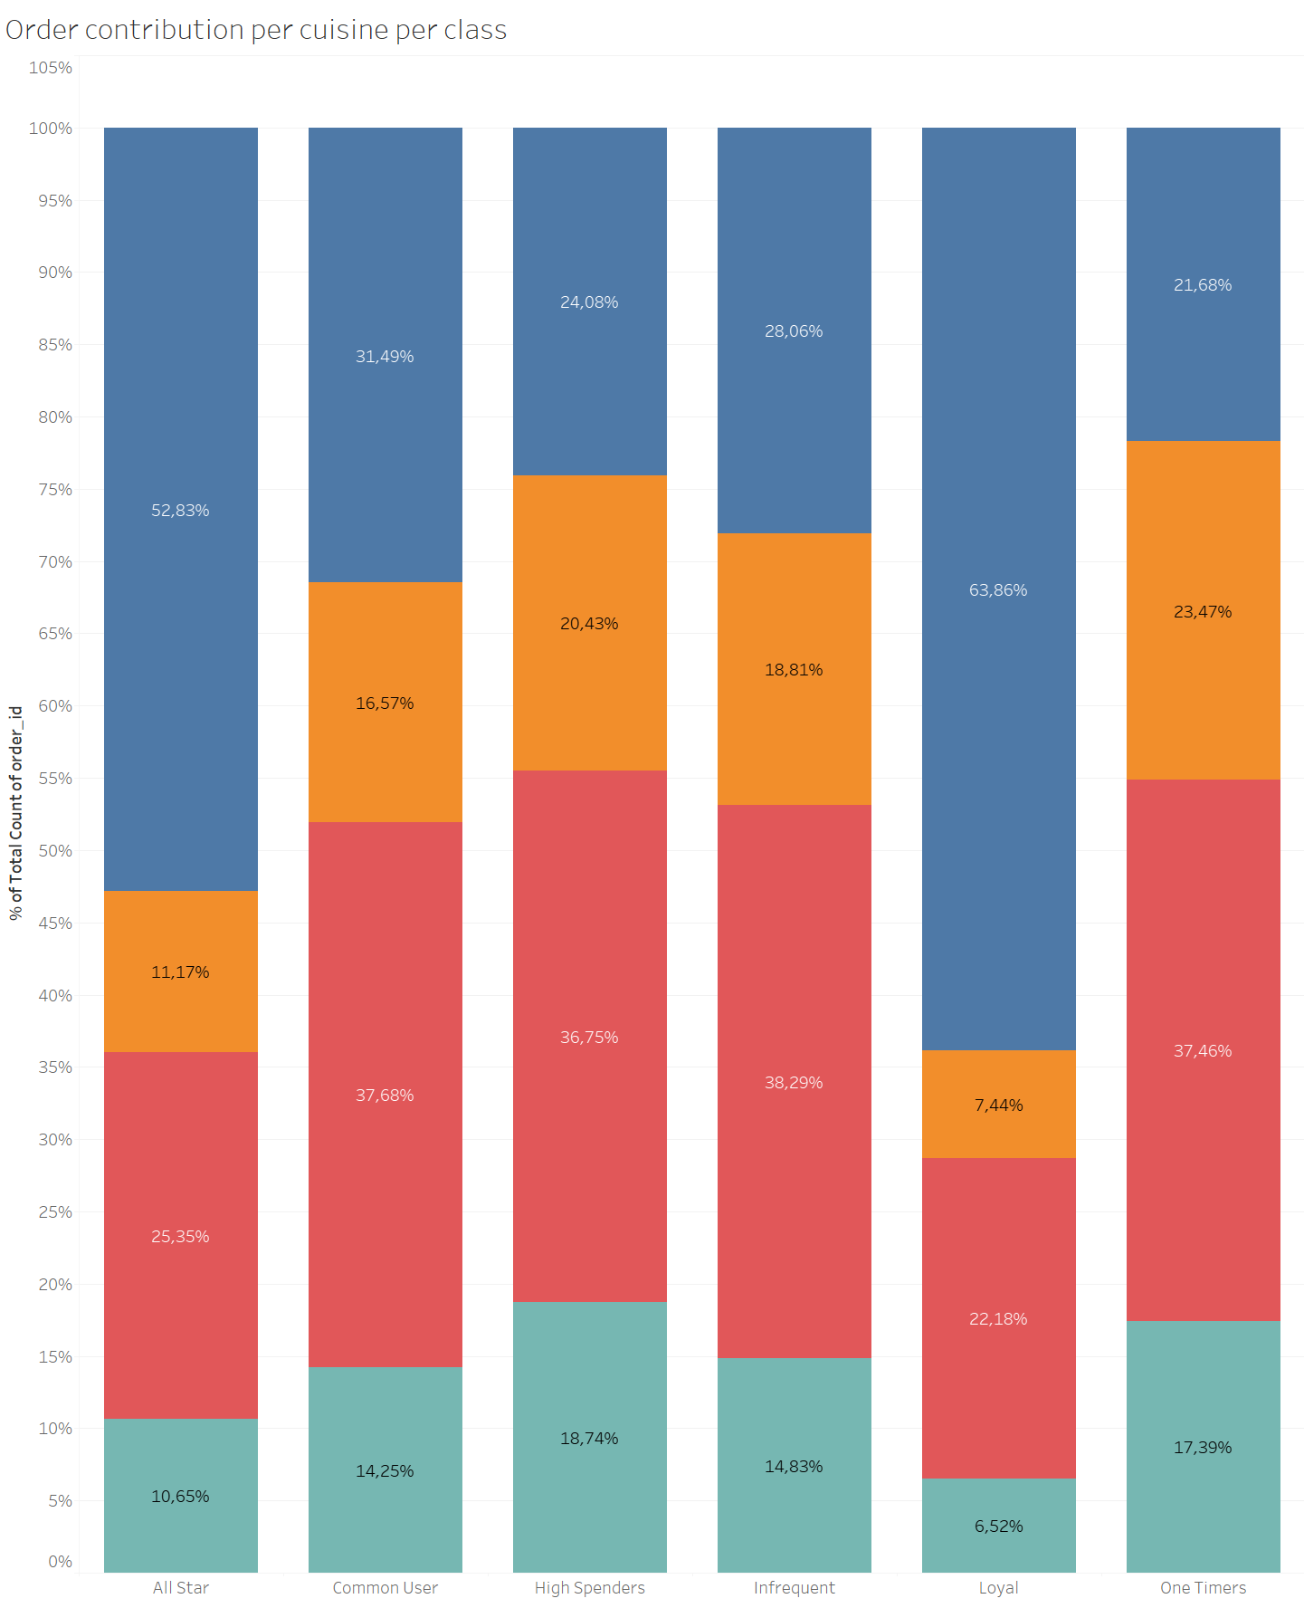
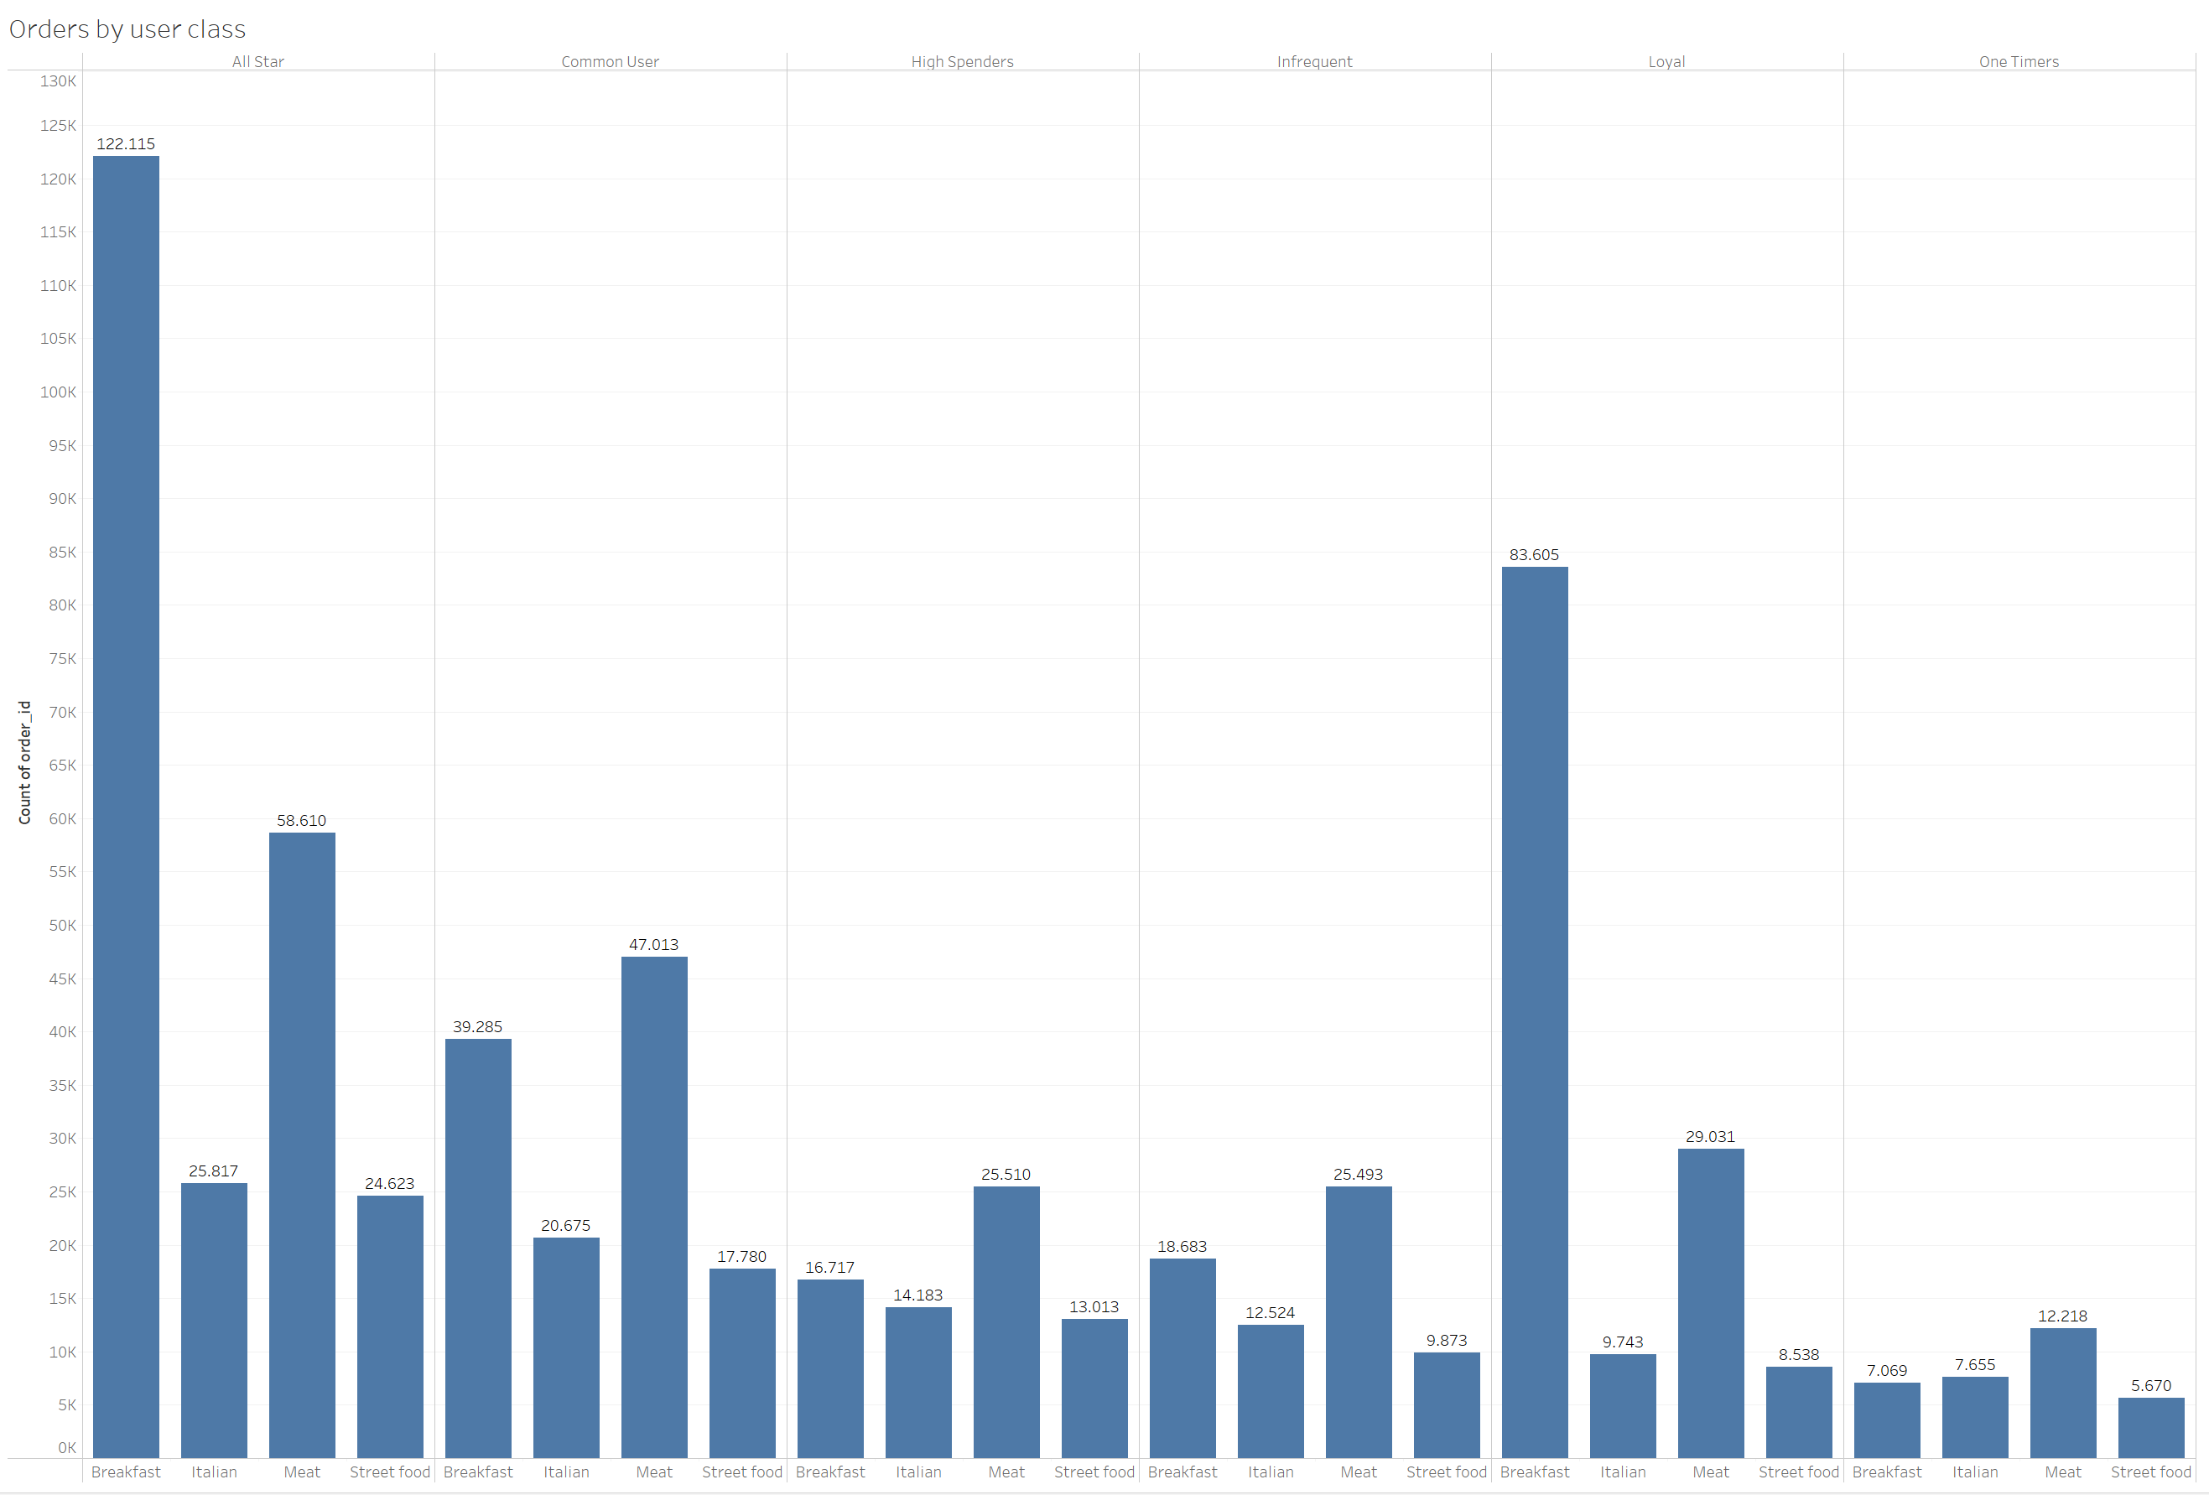
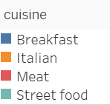
Breakfast has the highest contribution compared to other cuisines over total orders for ‘All Star’ and ‘Loyal Classes’
Orders per Class and Cuisine
All other classes have more equally distributed orders over all cuisines with the biggest contributor shifting from ‘Breakfast’ to ‘Meat’
‘High Spenders’ and ‘One Timers’ have a higher preference in ‘Italian’ and ‘Street Food’

Slide 5
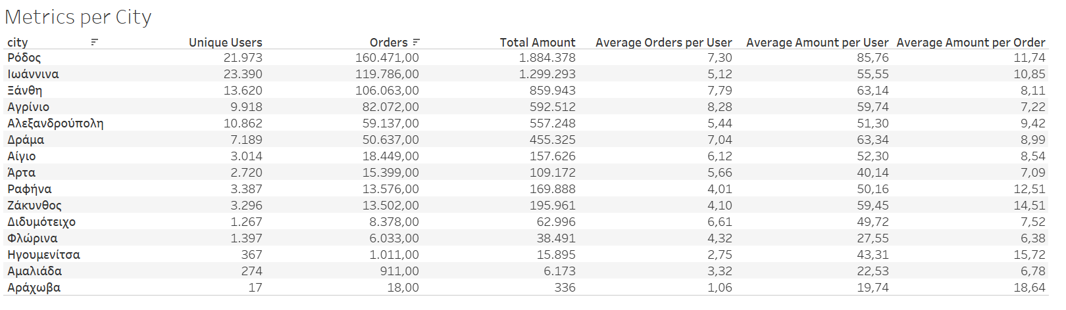
Top Cities
The top performing cities as all metrics besides the average amount per order are Rhodes, Ioannina, Ksanthi and Agrinio
Average amount per order shows fluctuations between cities with some correlation to the rest of the metrics. That could also be affected by number of restaurants and cost of living
2nd Assignment on Business Intelligence

Slide 6
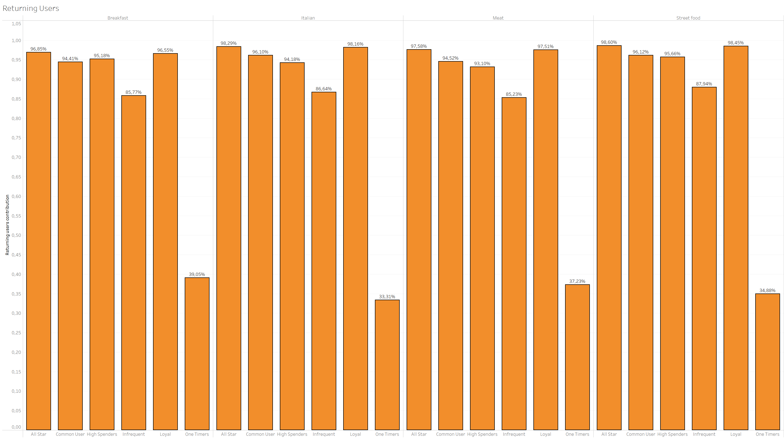
Returning Users
As returning customers we define those who have made more than one order in the given period
The distribution does not show any major fluctuations per group between different cuisines
As expected ‘one timers’ and ‘infrequent’ have the lowest percentages across all data
What’s worthy of investigating is the definition of a ‘one timer’ since even that category has returning users

Slide 7
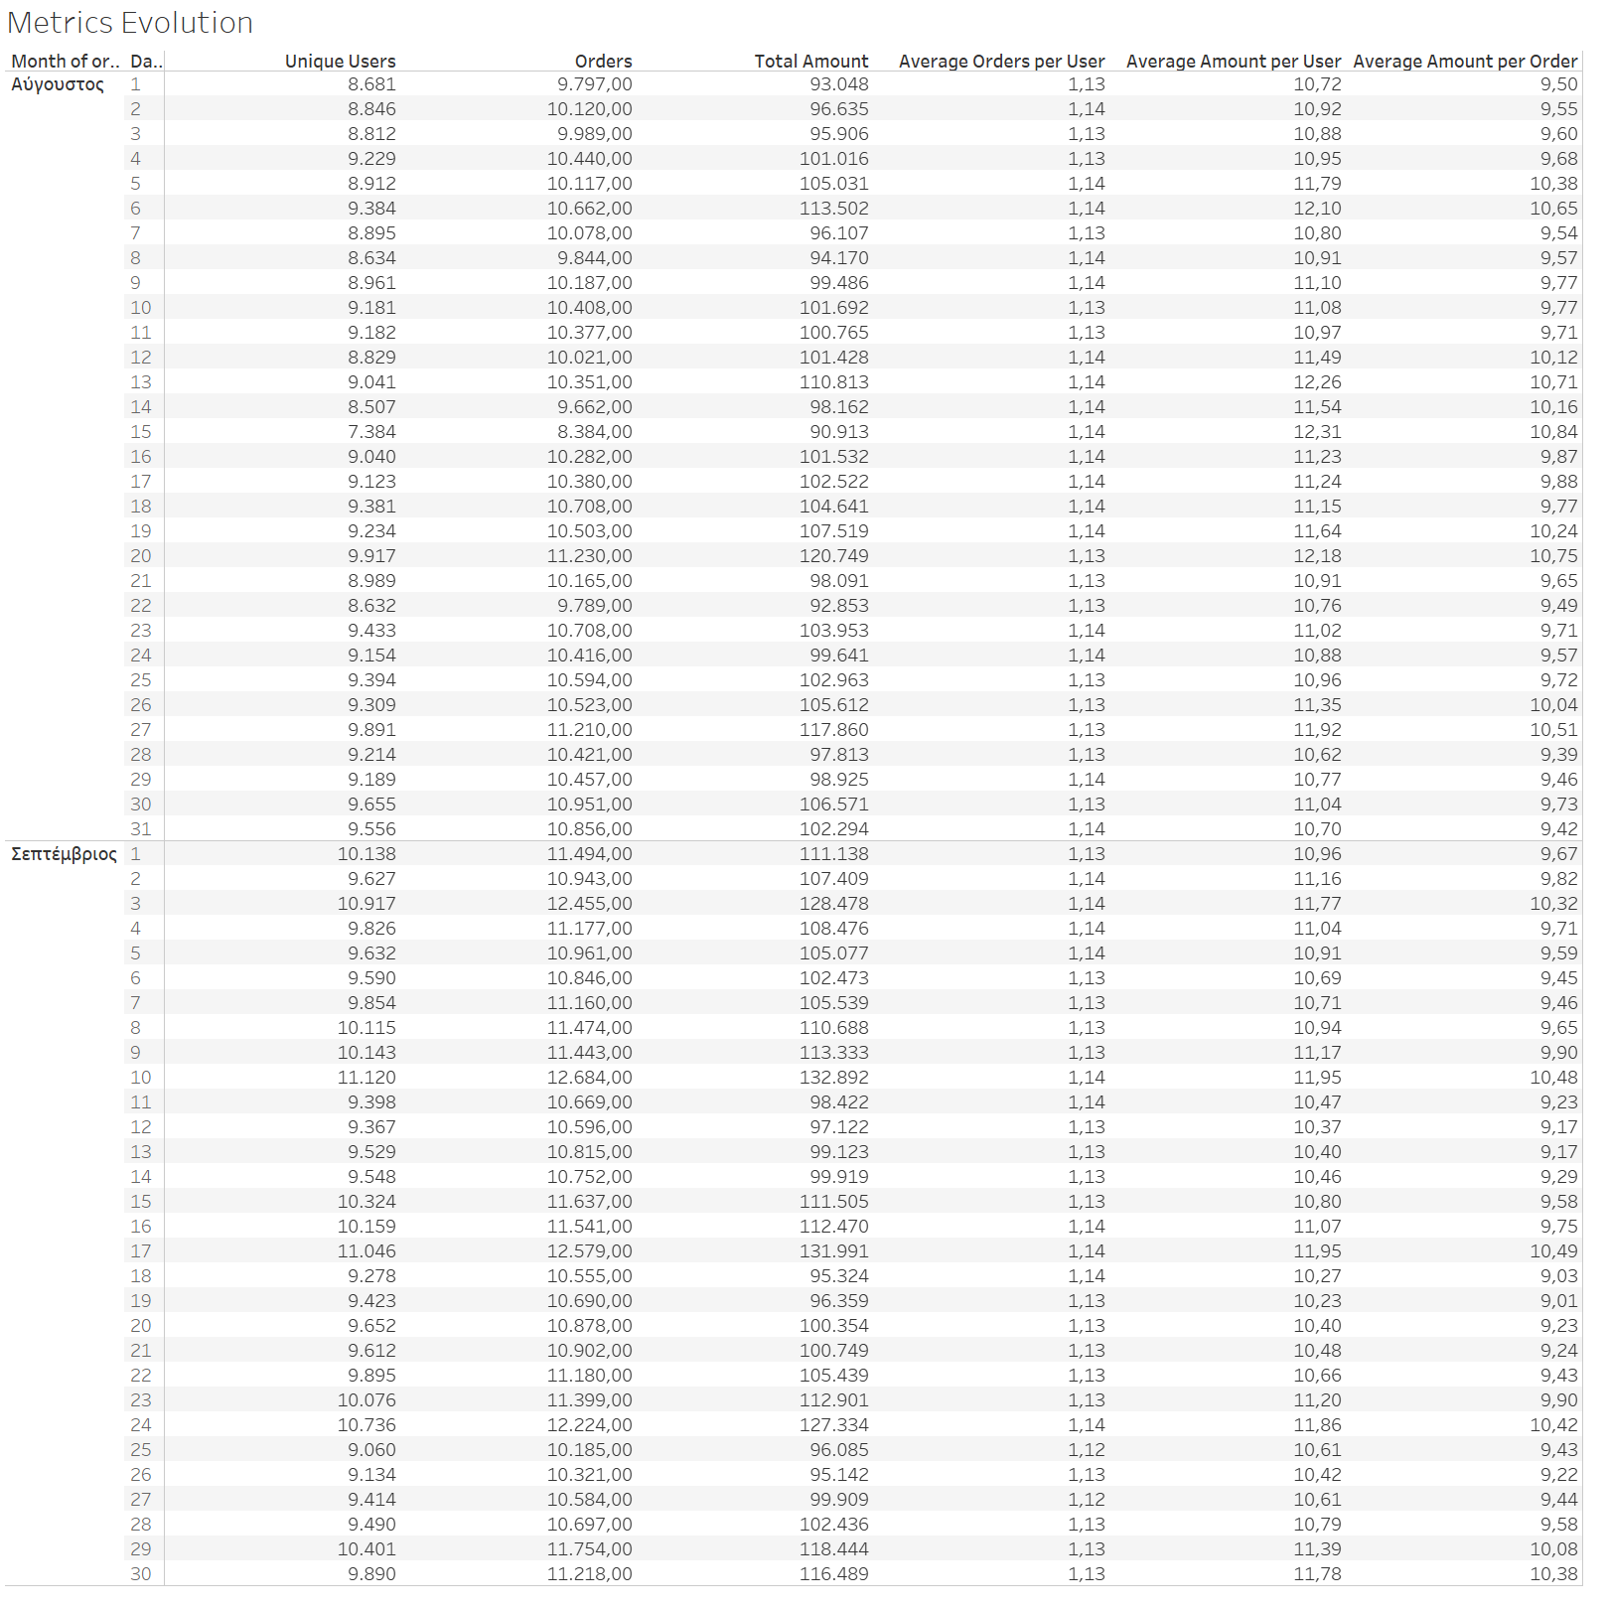
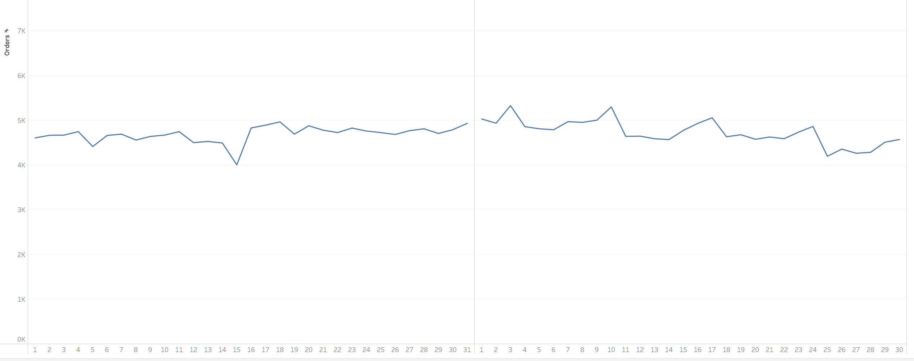
Most metrics show a slight upward trend after the first half of August until the middle of September. Besides that very slight increase they are steady from day to day
Evolution of Metrics
We notice the same thing specifically for ‘Breakfast’ in the upper left corner where the above mentioned increase is even smaller.
2nd Assignment on Business Intelligence

Slide 8
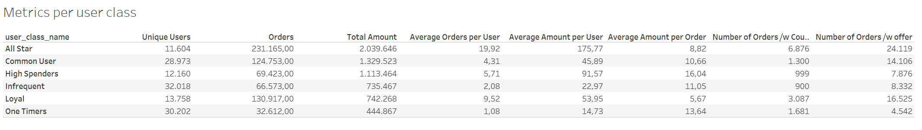
Metrics per Class
Based on users its seems that there are two main categories. One with All star, High Spenders and Loyal and one with the rest of the three. Besides users these main categories are based in similar behaviours in the average amount per user.
One timers although they represent a very small percent of the total orders and revenue have a tendency to make expensive orders which are surpassed only by high spenders. Similar behaviour is seen by the infrequent and the common users.
All stars, common users and loyal are the top three classes in regards to the use of coupons and ordering with offers.
One timers seem to user coupons often, even more than the common users but don’t order with offers.
2nd Assignment on Business Intelligence

Slide 9
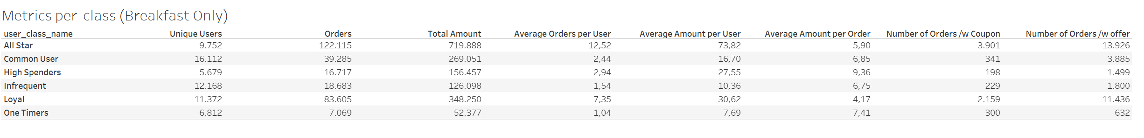
Metrics per Class for the Breakfast Cuisine
One timers seem to be open to the use of coupons and not offers if we take into account the fact that they have a very low percent of breakfast contribution.
It is also evident that classes besides all stars and loyal do not usually buy breakfast with coupons or orders which is justified by the breakfast contribution compared to the other cuisines.
For Breakfast we notice a similar behaviour like the previous slide about all cuisines with the difference that comes from the higher penetration of breakfast compared to other cuisines in Loyal and All stars.
2nd Assignment on Business Intelligence

Slide 10

Discussion
Question:
Which users would you recommend to target in an upcoming coupon campaign dedicated to Breakfast cuisine?
Recommendation:
My recommendation would be to target the ‘one timers’ with a coupon campaign that could even reward them for doing consecutive orders. The reasons are the following:
It would motivate one timers to order more times shifting the towards the infrequent and ultimately to common users.
It would raise the breakfast cuisine contribution percentage over the other cuisines with a potential of increasing the overall breakfast percent across classes since one timers are a lot of users.
From the last to slides we can notice that one timers like to use coupons in general but don’t order a lot of breakfast in order to see a similar behaviour with coupons. The campaign could possibly incentivise them to order more breakfast through the coupons.
It is also evident from the previous slides that one timers make expensive orders which are only surpassed by high spenders. If the campaign is successful that could raise the overall revenue significantly and that could also be an indicator that if we engage with the successfully they could shift towards the more profitable classes like the high spenders or even the all stars.

