Slide 1
Regression Trees

Slide 2
Tree Depth
The tree depth of a tree is the length of the longest path from the root node to a leaf.
Overfitting: perfect classification on the training data results in high variance of the model -> need to define maximum depth of tree
To find optimal depth: Run cross validation with different values for depth and plot the results of accuracy, i.e. percentage of correctly

Slide 3
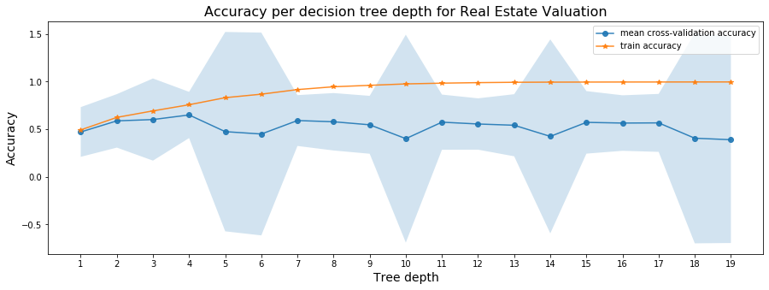
Cross-Validation Accuracy
The Real Estate dataset has a low number of samples and attributes (414x8)
-> train accuracy gets high very soon, but the cross-validation accuracy does not reach a high score for any depth

Slide 4
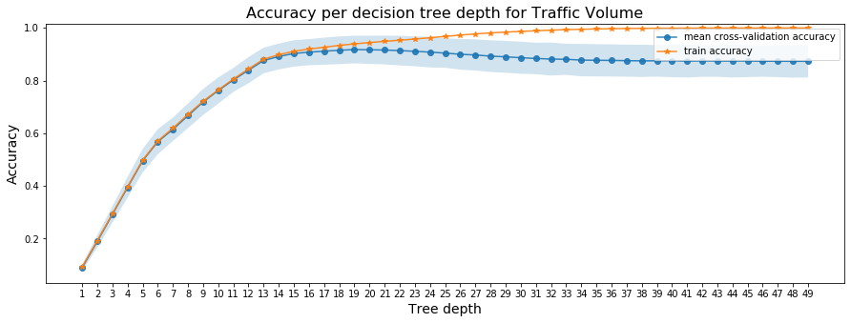
Cross-Validation Accuracy
The Traffic Volume dataset consists of 48204 samples
-> results are much better: Optimal tree depth: 19 gives average accuracy of 0.92 and the confidence interval is still quite narrow

Slide 5
kNN-Regression

Slide 6
Number of neighbours
The k-NN algorithm searches for the k nearest neighbours of a value and computes the average of their values

