Slide 1
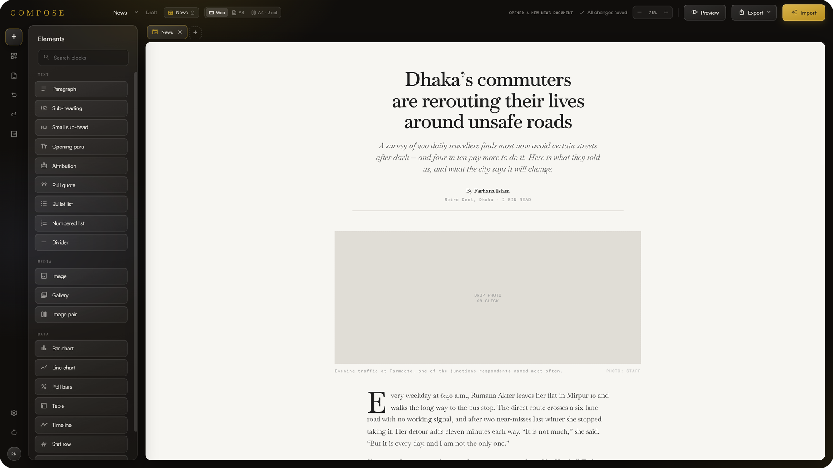
Compose
Turn any article into a finished visual feature, in minutes.
Built for Nutshell Today
Notes:
PERSON 1 · 27 words, about 11 s
Hi, we're the Compose team. Compose turns any article into a finished visual feature in minutes. We built it for Nutshell Today, a real Bangladeshi news publication.

Slide 2



Small newsrooms have the stories, but no designers and no time
Hours per feature
Charts, pull quotes and layouts are rebuilt by hand for every story.
No design budget
A small publication can't hire a designer or an infographics desk.
Too many tools
Write in Docs, chart in Flourish, lay out in Canva, then paste it all back.
Great reporting, published as a wall of text.
Notes:
PERSON 1 · 25 words, about 10 s
Small newsrooms have great stories but no designers and no time. Every chart and pull quote gets rebuilt by hand, across three or four tools.

Slide 3

Compose: import it, let AI structure it, edit it on the page
1
Import
Paste text, or drop in a Word doc or PDF.
2
AI structures it
Headings, pull quotes, charts and tables, in your template's style.
3
Edit on the page
Click any text to change it. Export when you're done.
Notes:
PERSON 1 · 32 words, about 13 s
Compose fixes that. Import a Word doc or PDF, and AI structures it into headings, quotes, charts and tables. Then you edit it right on the page. Person 2 will show you.

Slide 4


See it in action
30-second demo
Notes:
PERSON 2 · 16 words, about 6 s
Here's thirty seconds of Compose in action. [Clip plays, about 30 seconds] That was one article, from upload to finished feature.
To add the clip: select the dark frame, then Insert > Video > This Device and pick the clip. Drag it over the frame, then on the Playback tab set Start: Automatically. Keep the clip to about 30 seconds.

Slide 5

Three steps. No learning curve.
1
Drop in a file
2
Drag in a chart
3
AI fills it in
A PDF, a Word doc, or pasted text.
A gold line shows exactly where it will land.
The numbers come straight from the paragraph above.
Notes:
PERSON 2 · 33 words, about 13 s
It really is three steps. Drop in a file. Drag a chart beside any paragraph. AI reads that paragraph and builds the chart from its numbers. No prompts, no settings, no design skills.

Slide 6




Why now: AI is finally cheap enough to disappear into the tool
Models got cheap and fast
Newsrooms got smaller
Readers went visual
AI fades into the tool
Structuring a whole article now takes seconds and costs cents.
Fewer people publish more stories, with no design desk.
Charts, quotes and clean layouts keep readers on the page.
No prompts to write. Drag, drop, done.
Notes:
PERSON 2 · 30 words, about 12 s
Why now? Models got cheap and fast, newsrooms keep shrinking, and readers expect visuals. The best AI disappears into the tool, and that's what we built. Over to Person 3.

Slide 7
A big market, and a clear place to start
$18.9B
TAM
TAM · Global digital content-creation market, 2024
426
SAM
SAM · Registered news portals in Bangladesh, 2024
SOM
20
SOM · Independent publishers like Nutshell Today, our year-one goal
Sources: IMARC Group, Digital Content Creation Market report (2024); The Business Standard, April 2024, citing the Information Ministry.
Notes:
PERSON 3 · 27 words, about 11 s
Content-creation tools are a nineteen-billion-dollar market. We start with Bangladesh's four hundred plus registered news portals, and our year-one goal is twenty independent publishers like Nutshell Today.

Slide 8



Others help you design or write. Compose does both, in one editor
NEWS-READY
Story-aware AI
WordPress
Compose
Charts and quotes are built from your own paragraphs.
Shorthand
Flourish
Web and print from one file
A web page, A4 pages and LaTeX from the same document.
MANUAL
AI-NATIVE
Ceros
Any AI provider
Canva
Anthropic, OpenAI, Gemini, or a local model with Ollama.
Google Docs
GENERIC
Notes:
PERSON 3 · 24 words, about 10 s
Canva and Flourish help you design. WordPress and Docs help you write. None of them read your story. Compose does both, in one editor.

Slide 9
Free to start, and almost free for us to run
Free
Pro
Newsroom
$0
$8 / month
Custom
For writers trying it out
For small publications
For larger publishers
All five templates
Web layout and HTML export
Bring your own AI key
A4 print layouts
LaTeX export
Shared team workspace
House-style templates
AI included, no key needed
Priority support
Bring your own key: users pay their AI provider directly, so serving them costs us almost nothing.
Notes:
PERSON 3 · 31 words, about 12 s
The model is simple: free to start, Pro for small publications, and custom plans for newsrooms. Users bring their own AI key, so serving them costs us almost nothing. Person 4?

Slide 10
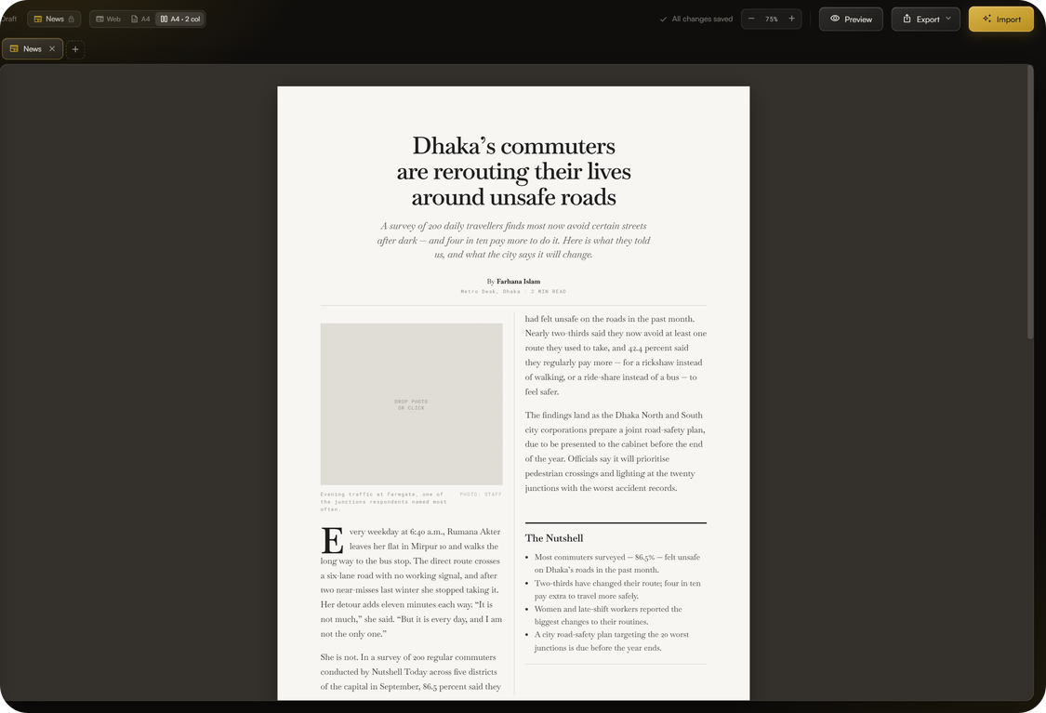
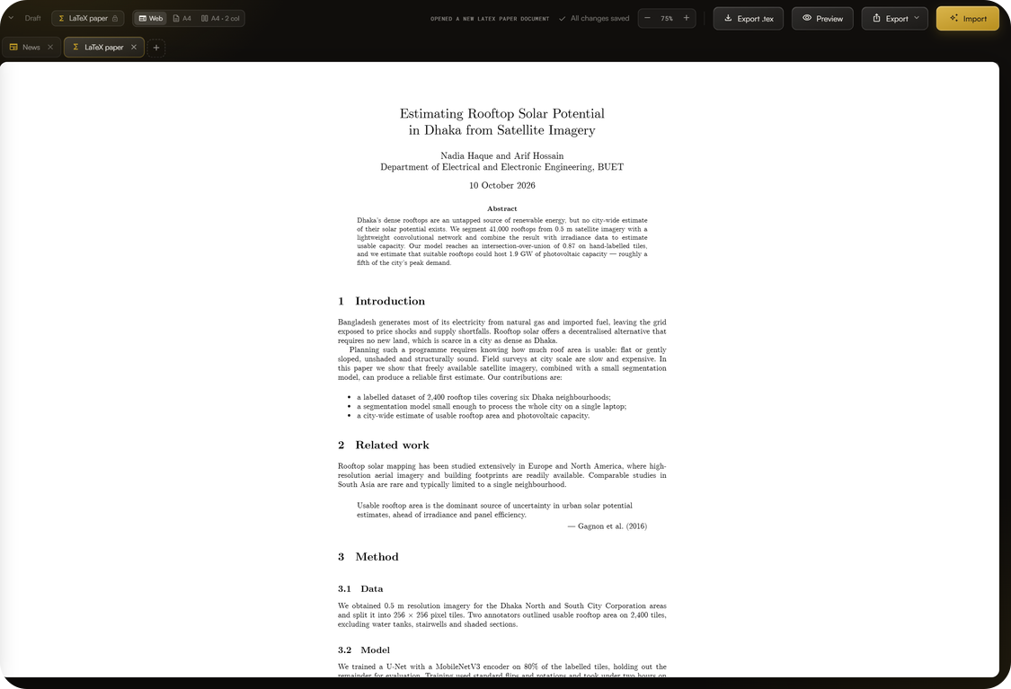
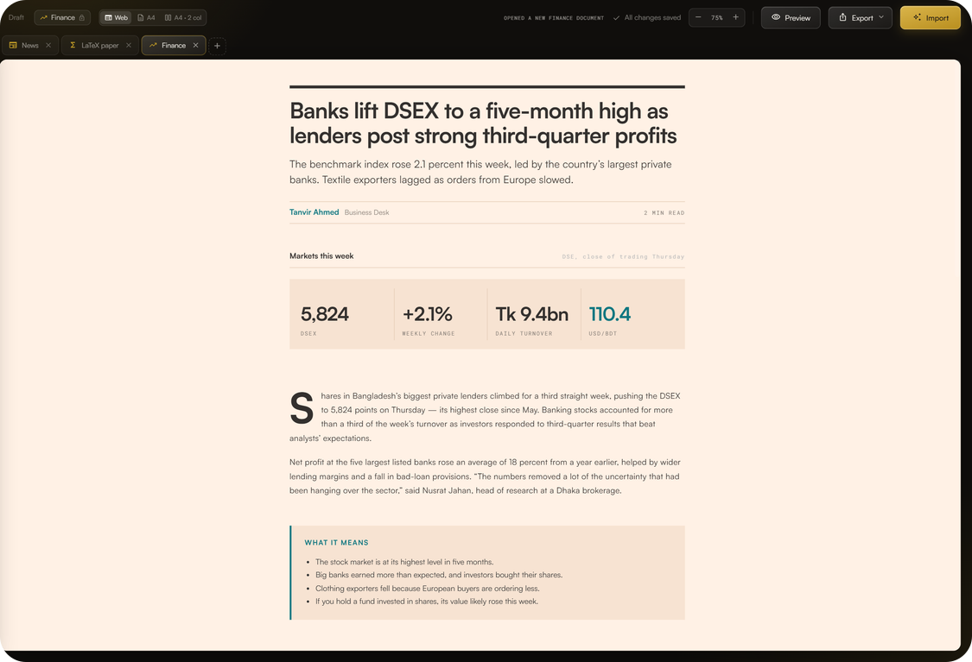
Built in five days, for a real publication
36
5
19
4
3
commits in 5 days
templates
element types
AI providers
export formats
A4 print, two columns
LaTeX paper, with .tex export
Finance template
Notes:
PERSON 4 · 24 words, about 10 s
We built all of this in five days: thirty-six commits, five templates, nineteen element types, four AI providers, and web, print and LaTeX output.

Slide 11

Four people, and one of us runs Nutshell Today
Person 1
Person 2
Person 3
Person 4
Runs Nutshell Today, the publication Compose is built for
Editor and print layout engine
AI import and drag-to-fill
Templates, export and design
Notes:
PERSON 4 · 28 words, about 11 s
We're a team of four, and one of us runs Nutshell Today. So every feature was built around a real newsroom's needs from day one, not guessed at.

Slide 12
What we'd build next, with your support
1
2
3
Pilot with Nutshell Today
One-click publishing
Bangla support
Publish real features every week and measure the time saved.
Send features straight to WordPress and newsletters.
Bangla templates, fonts and AI prompts for local newsrooms.
Compose. From article to feature, in minutes.
Thank you
Notes:
PERSON 4 · 27 words, about 11 s
With support, we'd pilot Compose at Nutshell Today, add one-click publishing, and build Bangla templates for local newsrooms. Compose: from article to feature, in minutes. Thank you.

