Slide 1
humor-me
Can a robot learn to read the room?
Supriya Kotturu · Tingyu Zhang · RL course final project, Nov 2026
Notes:
LLMs can plan a trip, write code and reason through a proof. So here's a harder question: can one do stand-up? Not tell a joke, do stand-up. This project is a voice-only robot comedian that performs a set, listens for laughter, and learns from it. I'll tell you what we built, what worked, and the places it failed.
Q&A notes
Answer in one breath: in simulation, a director that adapts to the room gets 97% of the laughs of one that knows the room's taste (about 95% of the true best), and 18% more than always performing as Neurotic. No joke has been generated or performed yet.
- Q: What exists today? The simulator, the director policies, the rJokes analysis and 16 notebook experiments, plus a first voice slice: three hand-written lines spoken by Kokoro on the CPU, with a browser frequency display and session logs. The trained joke model, laugh detection, safety filter and the director in the live loop are not built yet.
- Q: Who did what? Decide this with Tingyu before the talk. Every commit in the repo is under Supriya's name, and the docs don't record a split. Claude's part is on slides 35 and 39.
- Q: Is there a demo? Not a full one yet: the voice slice speaks fixed lines only. The plan is the agent on screen with its waveform and audio, speaking jokes from a model we trained, by Dec 8. If it slips, the RL results still stand on the simulator.

Slide 2
Act 1: Why a Joke Needs a Room
Notes:
Q&A notes
This act says: LLM humor has no audience, and a comedian's craft is a feedback loop, so RL is a fair frame.

Slide 3
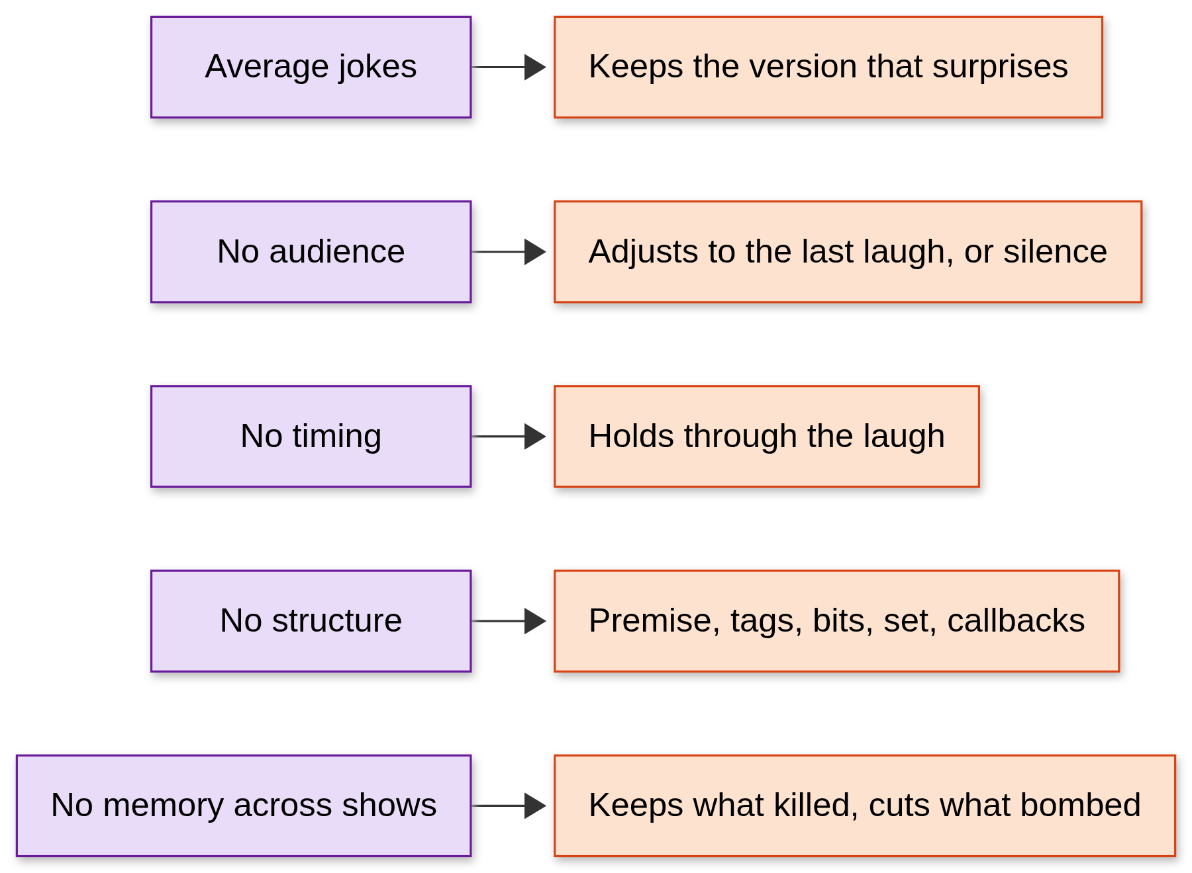
What LLM Jokes Miss
LLM lacks taste. Humor needs it.
Notes:
I believe LLMs can't do stand-up, at least not good stand-up. I'm trying to find evidence of how bad it can get. Ask a model for a joke and you often get retrieval: the same dad jokes, falling flat. The left column is what's missing. The jokes are average, because decoding favors likely text and humor lives in surprise. There's no audience, no timing, no structure, and every prompt starts fresh. The right column is what a comedian does about each one. Papers like HumorGen and LoL work on the first gap. Neither has an audience, timing or set structure. That gap is this project.
Q&A notes
- Q: Did you measure how bad LLM jokes are? No. This slide is reasoning plus the papers. "How bad it gets" is still the open question, because the generator isn't built.
- Q: Why "average jokes"? Decoding favors likely text. HumorGen calls this mode collapse: the model keeps producing the same safe region of jokes.
- HumorGen vs LoL (common mix-up). HumorGen: six personas, candidate generation, LLM judge, distillation. LoL: thought-leap reasoning plus a frozen pairwise judge. LoL doesn't classify personas.
- How noisy is humor? In HumorGen's human check (3 evaluators, 180 judgments on 60 pairs), evaluators agreed on 31.7% of pairs. Its judge matched the human consensus on 58.3% of pairs and individual votes on 52.4%.

Slide 4
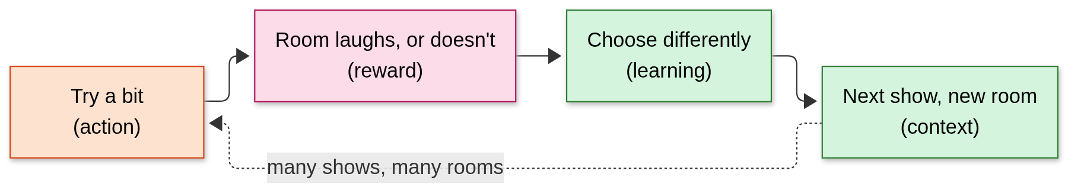
The Comedian's Loop Is RL
Try a bit, hear the room, change the next show
Notes:
A new comedian isn't a writer telling a long story. They write short bits, try them in different rooms, and keep what works. That is reinforcement learning: the bit is an action, the laugh is a reward, and the next show is the update. It takes many rooms to learn that the cynical material kills at a bar and dies at a company party. Taste, at least part of it, is what that loop leaves behind. So my question is: does adapting to the room beat performing one fixed persona?
Q&A notes
Comedian | RL term | In the project
Picks an attitude for the next bit | Action (arm) | One of 6 modes
Hears the room | Reward | Mean laugh level of the bit ÷ 3, from 0 to 1
Knows the venue and crowd | Context | Venue, energy, age, last mode and how it landed
Next show | Update | Weights carry across shows
- Q: Is this really RL? Today it's a contextual bandit: see context, pick an arm, see only that arm's reward. That's the simplest form of RL, and it assumes actions don't change the future. Fatigue already bends that, and callbacks would break it.
- Q: Taste is what the loop leaves behind? That's the thesis, not a result. The loop picks an attitude. It doesn't learn what makes a joke funny.
- Hypothesis H1: adapting beats the best fixed mode and random, live. Only the simulated version is tested.

Slide 5
The Target System
A voice-only loop where laughter trains the director
Notes:
Here's where we're heading. A mic hears the room, a laugh detector turns that into a signal, with an operator button as a fallback. A director picks the attitude for the next bit, a joke model we train writes candidates, a safety filter checks them, and the robot speaks. Be clear on status: solid means built. The director is, in simulation, and so is a first slice of speech and waveform, speaking fixed lines. Everything dashed isn't built yet.
Q&A notes
Part | State
Director | Built, in simulation only
Mic, laugh detector, operator button | Not started; the detector is planned for Nov 17 to 23
Trained joke model, safety filter | Not built; model track Nov 1 to 22 (latest SFT Nov 15, DPO Nov 22), with Gemini as the fallback. Judge rerank is optional
Speech, waveform | First slice built: fixed lines, Kokoro on the CPU, browser audio and a frequency display, with session logs. Not yet connected to a generator or the director
- Q: How fast must it be? Target is 1 s or less from the end of a laugh to the next line. Measured so far: about 0.6 s to the first token on Gemini flash-lite. That's one piece, not the whole loop. Kokoro takes 1.9 to 3.7 s to render 5 to 8 s of audio, faster than real time but over the target, so the next line must be rendered while the current one plays.
- Q: What if the detector fails? A person presses a laugh button, and that becomes the reward.
- Q: Does it learn during the show? The director's weights update between bits. No model gradients run during a show.

Slide 6
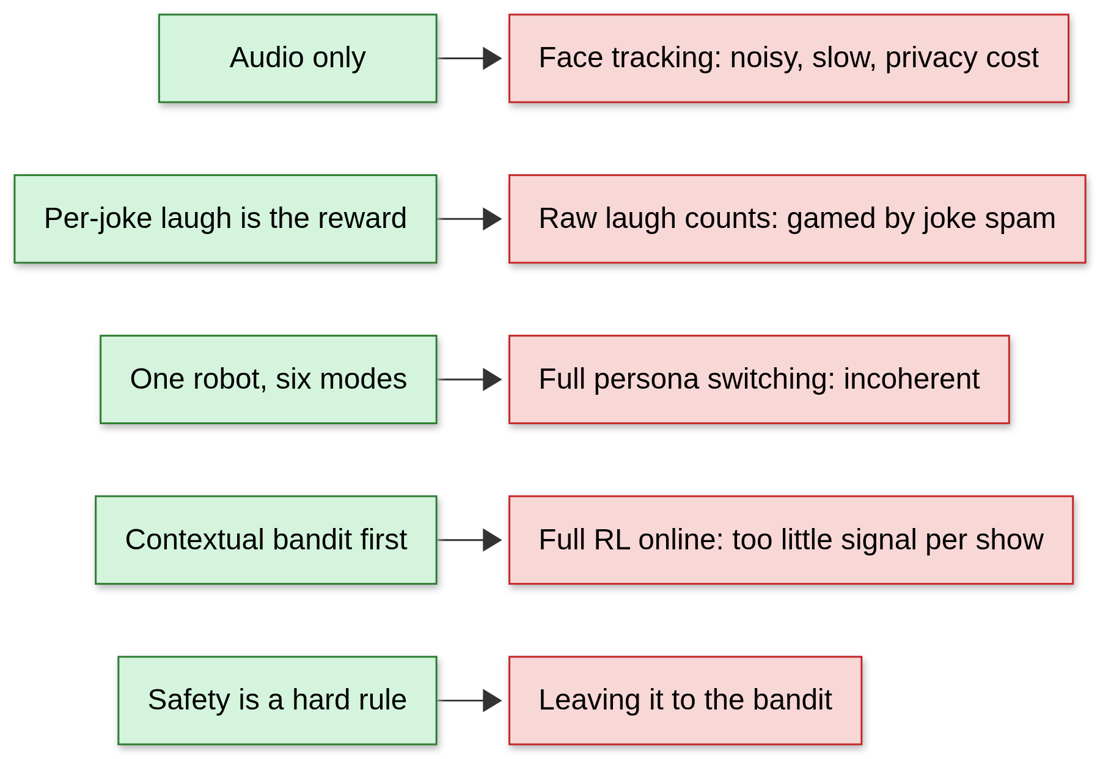
Day-One Decisions
Each rule rejected a tempting alternative
Notes:
These were fixed on day one. Audio only, since face tracking is noisy and slow, and without video the robot can't joke about how anyone looks. The per-joke laugh is the reward, because raw laugh counts can be gamed by spamming jokes. One robot with six modes, because switching whole personas is incoherent. A bandit first, because one show gives too little signal for full RL. And safety is a hard rule, never something the bandit gets to learn: no jokes about bodies or protected attributes, and a stricter filter for teens.
Q&A notes
- Why not an end-of-show rating as the reward? One number per show is sparse and biased toward the peak and ending. The rating is the reported outcome; the per-joke laugh is the training reward.
- Why not raw laugh counts? More jokes means more laughs, and a bigger room is louder. The live signal gets normalized to the room's baseline. That normalization isn't built.
- How does it know age, if it's audio only? It doesn't. An operator sets venue, energy and age. The optional camera snapshot is cut from M1.
- Q: Why a bandit first? An 8-bit show gives too little signal for full RL online.
- Careful: the safety rule is a design decision. The filter isn't built, and slide 29 shows rJokes' safety labels can't help. Teens get no alcohol or sexual content, as a hard rule outside the bandit.

Slide 7
Act 2: How a Comedian Builds a Set
Notes:
Q&A notes
This act says: comedy has units, and each maps to a decision. Mining them from transcripts worked for bits, failed for callbacks, and got paused.

Slide 8
The Units of Comedy
A joke sits inside a bit, a bit inside a set
Notes:
Before modeling comedians, I had to learn their units. A joke is a setup, a punch and maybe some tags. A bit is one premise worked through, the smallest stretch that stands on its own. Bits on the same topic form a thread, threads and bits form a set, and one set in front of one audience is a show. Two of these matter most: the joke is my unit of reward, and the bit is my unit of decision. In my hand labels of Nate Bargatze's *Hello World*, a median bit runs 118 words and earns 4 laughs.
Q&A notes
Numbers (hand labels, Bargatze *Hello World*): 52 bits, median 118 words (about 17 lines), median 4 laughs per bit, middle half 2 to 7 laughs. 3 callbacks. Bits form 37 threads in the metrics file (a decision entry says 38).
- Q: Is one special enough? Not for general claims. It set definitions and scale, nothing more.
- Q: The sim uses 5 jokes per bit. Why not 4? 5 is a round design value close to the median, not fitted.
- Laugh levels: the sim uses 0 to 3. The transcript pipeline also has a level 4, which is an applause break that includes a laugh.

Slide 9
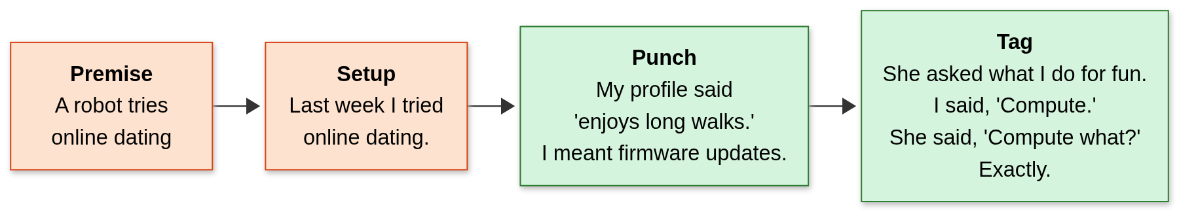
Anatomy of a Bit
Setup makes an expectation, punch breaks it, a tag reuses the setup
Lines invented by Claude (the AI assistant) to illustrate the format; not generated by humor-me and not from any special.
Notes:
Here's a bit in the robot's voice. The premise: a robot tries online dating. Setup: "Last week I tried online dating." Punch: "My profile said 'enjoys long walks.' I meant firmware updates." Then a tag, another laugh off the same setup: "She asked what I do for fun. I said, 'Compute.' She said, 'Compute what?' Exactly." These lines are illustrations written by the AI. The system isn't generating jokes yet.
Q&A notes
- Q: Did your system write this? No. Claude wrote it by hand to show the format. No generator exists.
- Definitions: a setup creates an expectation, a punch breaks it, and a tag is another punch on the same setup with no new setup.

Slide 10
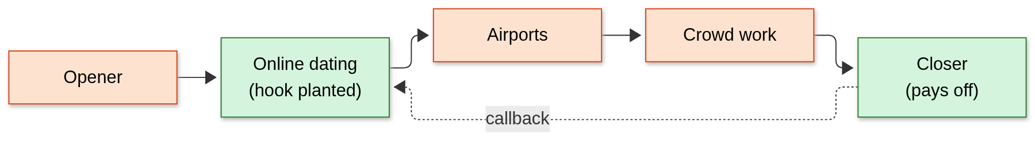
How a Set Holds Together
A callback pays off an earlier bit: a delayed reward
Same invented example set, written by Claude.
Notes:
A set is ordered bits, and this arrow is why the problem is interesting. Much later, the closer goes back: "And my date? She's still waiting for me to compute something." That's a callback. Planting the hook earned nothing at the time, and it only pays off if the hook landed. A one-step bandit can't plan for a reward that arrives later. This is where the problem stops being a bandit and becomes sequential.
Q&A notes
- A callback must return to an earlier bit at least 2 bits later, or it counts as continuing the same bit.
- Important: callbacks aren't in the simulator. The only choice in the sim that affects later bits is fatigue. Slides 10 and 11 explain the motivation, not something tested.
- Q: How common are they? 3 in Bargatze's 52 bits. That's one special.
- Status: deferred to step C2, after the demo and DPO. They need a model that can write them and would add more made-up rewards to the sim.
- Planned rule, not built: a hook must have landed at level 2 or more, with at most 2 uses and diminishing returns.

Slide 11
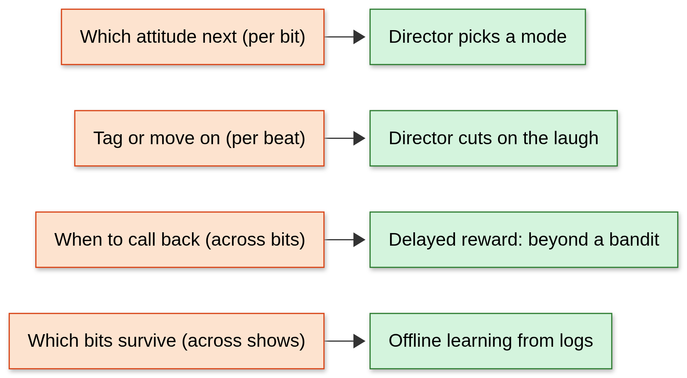
Comedian's Choices, Agent's Decisions
Four decisions, four timescales
Notes:
Every choice a comedian makes maps to something the agent has to learn. Which attitude next is a per-bit choice, and that's the director picking a mode. Tagging or moving on is the director reacting to a laugh. When to call back is the delayed reward. And which bits survive to the next show is offline learning from logged sessions. So far I've focused on the first of these.
Q&A notes
Decision | Timescale | State
Which attitude next | Per bit | Built, in sim
Tag or move on | Per beat | Not built
When to call back | Across bits | Deferred (C2)
Which bits survive | Across shows | Not built; needs real logs

Slide 12
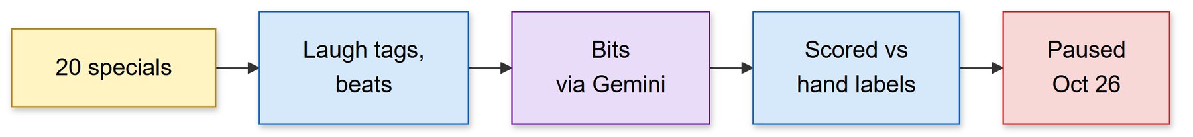
Mining Transcripts, Then Pausing
Bit boundaries worked, callbacks did not, and the simulator was behind
Notes:
My first idea was to learn structure from real specials. I built a pipeline over 20 transcripts: laugh tags become levels, text splits into beats, and Gemini marks the bits. Scored against my hand labels on the tuning set, bit boundaries reached F1 0.80 against a 0.21 baseline. But it found 0 of 3 callbacks. On October 26 I paused it: it was never on the path to the demo, the simulator was behind, and copyrighted specials were the weakest legal point. I kept aggregate statistics only. We copy structure, never a comedian's voice.
Q&A notes
Bargatze (tuning set) | Gemini | Even-spacing baseline
Bits (52 by hand) | 48 found, F1 0.796, precision 0.83, recall 0.765, Pk 0.146 | F1 0.204, Pk 0.505
Threads (37 by hand) | 22 found, F1 0.632, recall 0.50 | F1 0.07
Callbacks (3 by hand) | 0 found | n/a
F1 balances precision (found boundaries that are real) and recall (real boundaries that were found). Pk is the chance that two nearby lines are wrongly split or joined, so lower is better.
- Q: Is 0.80 a fair score? It's optimistic. Bargatze is the tuning set: the prompt was improved from 0.75 on it. The held-out set (Birbiglia) was never run, so there is no held-out score.
- Q: Why did callbacks fail? Asking for them inside the segmentation call didn't work. A hint pass found 1 of 3, and the other two are thematic. A separate pass was the next idea, then the pipeline paused.
- Q: Why pause? Not on the path to M1, the simulator was behind, and copyrighted specials were the weakest legal point.
- Q: Is transcript text in the repo? No. It stays local and only aggregate statistics are kept.
- Laugh data: only 11 of 20 sets are tagged densely enough (at most 150 words per laugh) to use for laugh labels.

Slide 13
Act 3: Can a Director Learn a Room?
Notes:
Q&A notes
This act says: in a simulated room, a director that shares learning across rooms nearly matches a perfect-information one, and any fixed persona falls well behind.

Slide 14
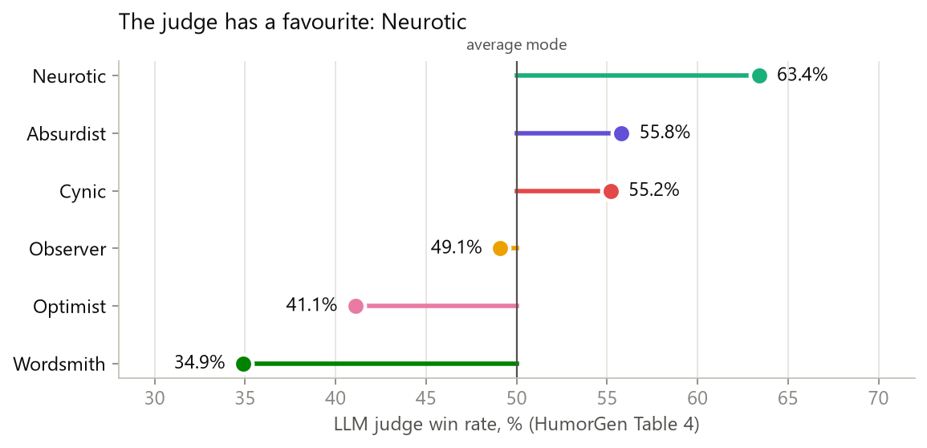
Six Modes, One Robot
The director picks an attitude; the identity stays fixed
Modes and win rates: HumorGen, Table 4. The identity is a self-aware, slightly anxious robot.
Notes:
The robot has one identity. What changes is its attitude, one of six modes from the HumorGen paper: Neurotic is anxiety and overthinking, Absurdist is dream logic, Cynic is sarcasm and hypocrisy, Observer is awkward everyday norms, Optimist finds the wholesome side of something bad, and Wordsmith is puns. This is how often an LLM judge preferred each mode. Neurotic wins. So the baseline to beat is obvious: always be Neurotic.
Q&A notes
Mode | LLM judge win rate | Sim base
Neurotic | 63.4% | 0.57
Absurdist | 55.8% | 0.42
Cynic | 55.2% | 0.40
Observer | 49.1% | 0.28
Optimist | 41.1% | 0.12
Wordsmith | 34.9% | 0.00
base = 0.3 + 2 × (win rate − 0.5). Claude picked this mapping by hand when writing PR #1, and you approved it. No options were compared then, and the entry was recorded later (decisions.md 2026-10-31).
- Q: Who judged? Llama 3.3-70B, not people. Slide 31 tests this against people.
- Q: Why that slope? A spread of 0.57 is about the size of the venue offsets, so a venue can flip the best mode. A slope of 10 makes Neurotic best everywhere and leaves nothing to learn. That choice favors learning.
- Q: Isn't "always Neurotic" a weak baseline? Averaged over rooms it's the best single fixed mode under the judge's taste. Per room it isn't: at a bar, cynic gets 46.7 and Neurotic 39.0.

Slide 15
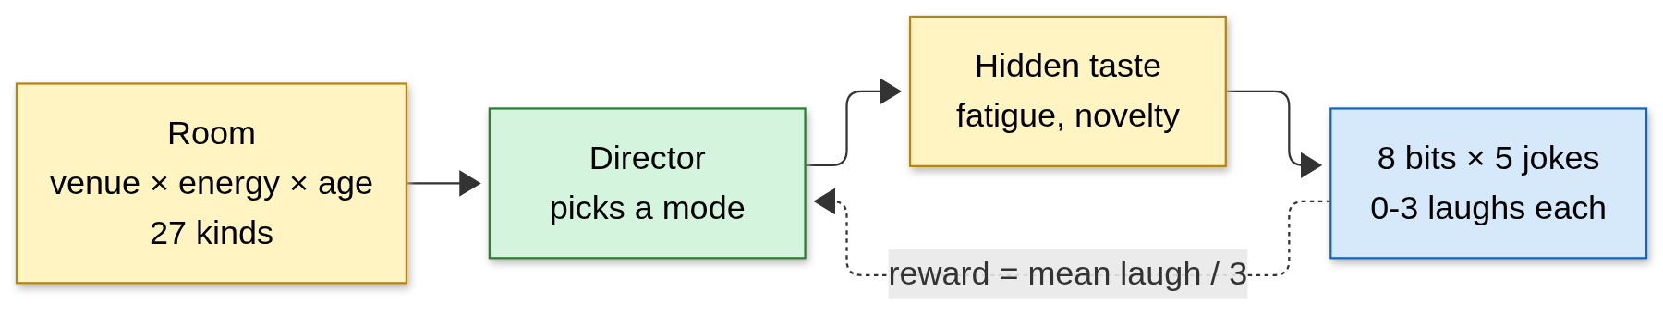
A Simulated Room
Thousands of shows in seconds, because real shows are too few
Notes:
I can't run thousands of shows on real people, so I built a room. There are 27 kinds of room: venue, energy and age. Each has a hidden taste, plus fatigue if you repeat yourself and novelty early on. A show is 8 bits of 5 jokes, each earning 0 to 3 laughs, and the reward is the bit's mean laugh level divided by 3. I also have an oracle that knows the room exactly and picks the best next bit, which is my yardstick. The most important sentence on this slide: the room's tastes are made up. This tests whether the algorithm adapts, not whether any joke is funny.
Q&A notes
Setting | Value (sim/audience.yaml)
Rooms | 3 venues × 3 energies × 3 ages = 27
Venue offsets | At most ±0.4; each venue has a different best mode
Energy | Low −0.4, normal 0, high +0.3
Noise | Standard deviation 1.0 on the hidden funniness scale
Laugh levels | Hidden funniness above 0, 1, 2 gives level 1, 2, 3
Novelty | +0.4 at the start, fading over about 5 jokes
Fatigue | −0.15 per use of a mode in the last 2 bits
Show | 8 bits × 5 jokes = 40 jokes, about 10 min
- "Laughs" means summed levels. A show's score adds each joke's level from 0 to 3, so the maximum is 120. "48 laughs a show" is 48 of 120, not 48 separate laughs from 40 jokes. Expect this one.
- Q: What's made up? Everything except base. Venue offsets were chosen so that each venue has a different best mode, because otherwise nothing is learned. Say this before someone else does: the sim was built so adapting can pay off. It tests whether an algorithm can adapt, not whether adapting pays in real rooms.
- Q: Is the oracle the ceiling? No, not strictly. It knows the truth but picks the best *next* bit, without planning around fatigue. Exp 16 finds the exact best sequence for each of the 27 rooms: 50.03 expected laughs a show, against 49.20 for the oracle. Planning wins in all 27 rooms, by 1.7% on average and at most 5.6%. Call the oracle a yardstick. Against the true best, LinUCB is 95.4%, not 97%. No bar was set for this check, and it covers steady shows only.
- Q: Is it validated against real audiences? No.

Slide 16
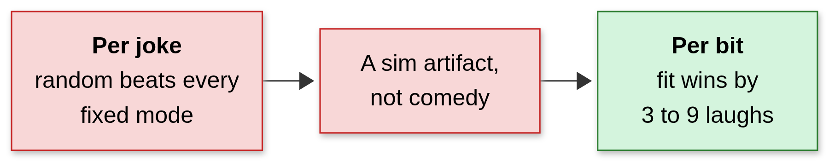
Per Joke or Per Bit?
Deciding per joke rewarded rotation, so the director decides per bit
Notes:
My first version picked a mode for every joke, and random beat every fixed mode. That was a sim artifact: fatigue outweighed fit, so the best strategy was to keep rotating, and that isn't comedy. A comedian commits to one attitude for a whole bit. Once the director chose per bit, fitting the room beat random by 3 to 9 laughs a show. The cost is only 8 decisions a show. Telling the top two modes apart takes 14 to 177 shows, so learning has to span many shows.
Q&A notes
| Per joke (v1, rejected) | Per bit (v2, chosen)
Bar: oracle / best fixed / random | 45.4 / 32.4 / 35.8 | 50.4 / 46.7 / 38.1
Company event | 41.9 / 28.9 / 35.5 | 46.9 / 42.6 / 37.7
Showcase | 43.6 / 30.0 / 38.6 | 49.1 / 43.9 / 40.8
Fatigue on a fixed mode | −0.75 | −0.3
To tell the top two modes apart | 551 to 7,063 jokes | 111 to 1,414 bits (14 to 177 shows)
Numbers are for <venue>, normal energy, mixed age, 1,000 episodes per cell (Exp 3).
- Q: Didn't you change the sim until learning looked good? Partly, and say so. After seeing random win, both the decision unit and the fatigue window changed, which cut fixed-mode fatigue from −0.75 to −0.3. The reason was comedy (a comedian commits for a bit), and it's logged. But no bar was set in advance, and results depend on this choice.
- Why a bit helps: each reward averages 5 jokes, which is less noisy, and coherence comes for free.
- Cost: 8 decisions a show, so learning has to span shows.

Slide 17
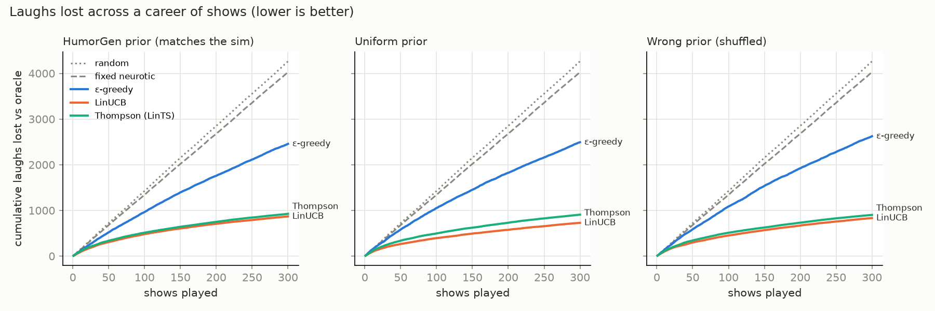
Reinforcement Learning via LinUCB
Adapting to Dynamic Audience State
Evaluated director agent performance across 27 simulated room contexts.
LinUCB achieved 97% of the oracle's reward (about 95% of the true best), 18% above always-Neurotic.
Notes:
Here's the main result. Each line is laughs lost against the oracle over a career of 300 shows, so lower is better. Random and always-Neurotic keep losing at a steady rate. The learners flatten out. LinUCB estimates each mode's payoff from features of the room and adds a bonus for uncertainty. Once experienced, it gets 48.0 laughs a show, against 49.4 for the oracle and 40.8 for always-Neurotic. So in this room, adapting beats any fixed persona.
Q&A notes
Policy (uniform prior) | First 10 shows | Last 50 shows | Laughs lost, 300 shows
Oracle | 50.8 ± 1.9 | 49.4 ± 1.0 | 0
Planning optimum (Exp 16) | not comparable here | 50.3 ± 1.1 | 196 ± 5
LinUCB | 44.7 ± 1.8 | 48.0 ± 1.1 | 728 ± 64
Thompson (LinTS) | 43.5 ± 2.4 | 48.2 ± 1.0 | 907 ± 58
ε-greedy | 40.3 ± 2.2 | 44.6 ± 1.1 | 2,493 ± 143
Always Neurotic | 41.7 ± 2.1 | 40.8 ± 0.9 | 4,026 ± 52
Random | 40.5 ± 2.1 | 39.2 ± 1.0 | 4,264 ± 59
± is a 95% confidence interval over 10 careers of 300 shows, with the same rooms in the same order for every policy. 97% = 48.0 ÷ 49.4; 95.4% = 48.0 ÷ 50.3; 18% = 48.0 ÷ 40.8 − 1.
How LinUCB works: one ridge regression per mode (a linear fit that stays stable with little data) on 12 features: bias, venue, energy, age, same-mode-as-last-bit, last reward. Score = predicted reward + bonus, where the bonus is large when the model is unsure about this mode in this context. It picks the highest score. That's 72 weights in total. The bonus scale α = 0.15 is the measured per-bit noise (0.14), not tuned.
How fast it learns (LinUCB's cumulative laughs lost): 89 by show 10, 266 by 50, 393 by 100, 576 by 200, 728 by 300. In the last 50 shows it loses 1.5 a show, against 13.4 for always Neurotic.
- Q: Does it help early? Only weakly shown. First 10 shows are 44.7 vs 41.7, and those CIs overlap. A live demo has far fewer shows than 300, so don't imply the demo reaches 97%.
- Q: Why 4,026 lost when 8.6 a show × 300 is about 2,600? "Laughs lost" isn't oracle minus policy. Per bit, it compares the chosen mode with the best mode *from the policy's own position*. A fixed mode is always fatigued while the others are fresh, so its losses count for more than the gap in total laughs. Even the planning optimum "loses" 196, because it sometimes gives up the best next bit to avoid fatigue.
- Q: Why not Thompson, if its last 50 is higher? 48.2 and 48.0 are inside each other's CIs. LinUCB's total loss is lower with no overlap under judge taste, but under human taste they overlap (886 ± 80 vs 947 ± 58). It's also deterministic, which is easier to debug.
- Q: Weakness in the features? "Same mode" sees only the last bit, but fatigue lasts 2 bits.
- Q: Only 10 seeds? Yes. Big gaps are clear; small ones aren't. That's why overlapping CIs aren't read as differences.

Slide 18
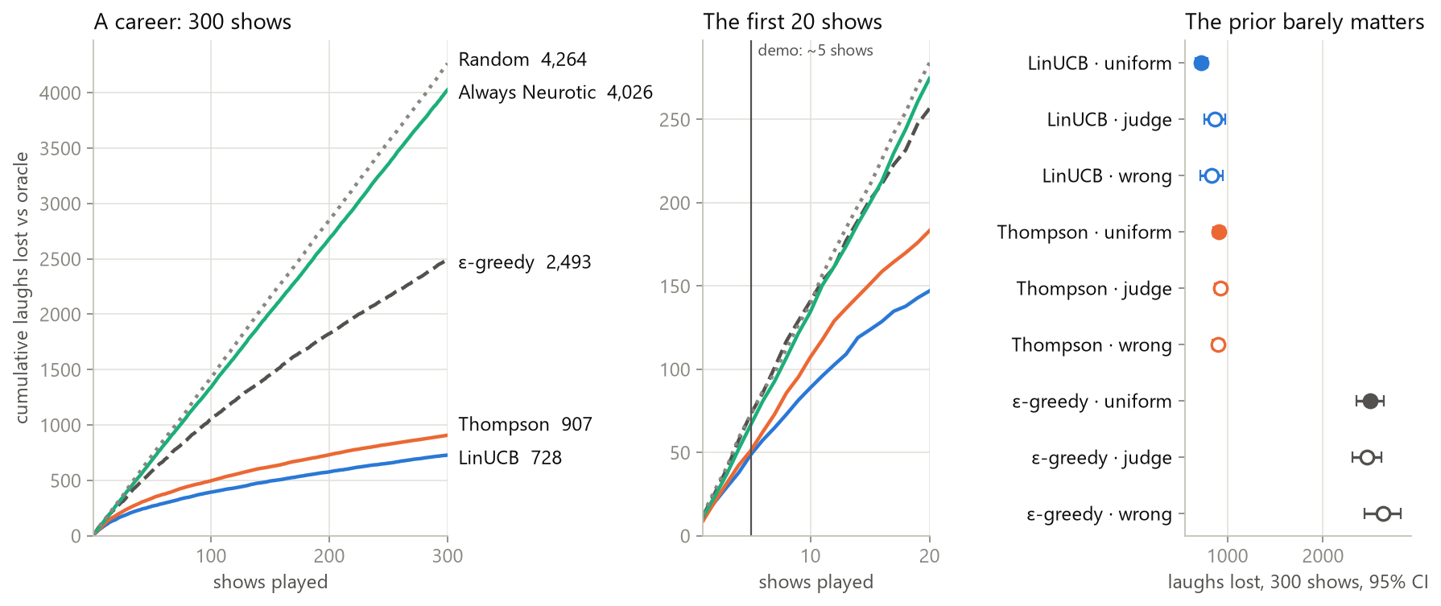
Sharing Beats the Starting Guess
Pooling across rooms matters; the prior barely does
Notes:
Why does it work? ε-greedy keeps a separate table for each of the 27 rooms and loses 3.4 times more than LinUCB, which shares what one bar teaches with every other bar. The starting guess barely matters: a prior from the LLM judge, a uniform prior and a deliberately wrong one land within each other's confidence intervals for LinUCB and Thompson. So I chose LinUCB with a uniform prior, which keeps the LLM judge's taste out of the agent.
Q&A notes
Laughs lost, 300 shows | Judge prior | Uniform prior | Wrong prior
LinUCB | 868 ± 111 | 728 ± 64 | 832 ± 116
Thompson | 926 ± 59 | 907 ± 58 | 902 ± 55
ε-greedy | 2,457 ± 151 | 2,493 ± 143 | 2,624 ± 192
- Q: The chart marks the demo at about 5 shows. What happens there? Laughs lost after 5 shows: LinUCB 49, Thompson 51, Always Neurotic 66, ε-greedy 73, Random 73. Over the first 10 shows, LinUCB's CI overlaps Always Neurotic's (44.7 ± 1.8 vs 41.7 ± 2.1, unpaired), so don't promise that the demo will show the learning.
- Pooling: ε-greedy keeps 27 × 6 = 162 separate averages. LinUCB's 72 weights mean a lesson from one bar applies to every bar, and a lesson from a low-energy room to every low-energy room. 2,493 ÷ 728 = 3.4×.
- Q: Why does the prior barely matter? Prior weight is 1, about one bit of evidence, so data overrides it within a few shows. Even the judge prior that matches the sim's base doesn't help, because venue offsets decide the best mode.
- Q: So priors never matter? Only tested at weight 1. A strength sweep is in the backlog, not run.
- Q: Was ε-greedy treated fairly? ε is fixed at 0.1 and wasn't tuned or decayed, so a tuned version could lose less. It still can't pool.
- Q: Isn't uniform just lucky? Its CI overlaps LinUCB's other priors. It wins on keeping the LLM judge's taste out, not on the small gap.

Slide 19
Act 4: When the Room Turns Mid-Set
Notes:
Q&A notes
This act says: the director reads rooms but not a room changing. Longer sets and two memory designs didn't fix it, and the root cause points to sequential decisions.

Slide 20
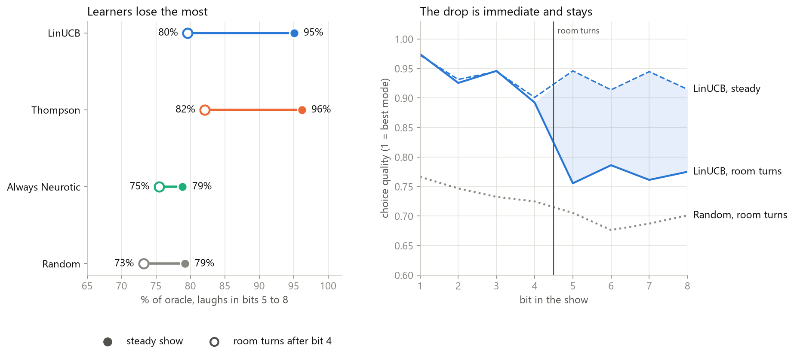
When the Room Turns
It reads rooms, not a room turning
Notes:
Then I tried to break it. Halfway through a set, unannounced, the room's taste changes. In steady shows LinUCB gets 95% of the oracle. After a shift it falls to 80%, and it takes about as long as random to land on a good mode again. Its estimates average hundreds of shows, so one bombed bit barely moves them. It knows this mode just bombed. It doesn't know this room has turned. Adding a reaction feature gained under half a laugh, inside the confidence intervals, so I didn't adopt it.
Q&A notes
Bits 5 to 8, last 100 of 400 shows | Shifted shows | % of oracle | Bits to recover | Steady shows | % of oracle
Oracle | 24.0 ± 0.4 | 100% | 0 | 23.7 ± 0.6 | 100%
LinUCB | 19.1 ± 0.6 | 80% | 2.46 ± 0.22 | 22.6 ± 0.7 | 95%
LinUCB + reaction | 19.5 ± 0.4 | 81% | 2.26 ± 0.28 | 22.6 ± 0.6 | 95%
LinTS | 19.7 ± 0.4 | 82% | 2.12 ± 0.13 | 22.8 ± 0.6 | 96%
Always Neurotic | 18.1 ± 0.4 | 75% | 3.69 ± 0.09 | 18.7 ± 0.6 | 79%
Random | 17.6 ± 0.6 | 73% | 2.33 ± 0.10 | 18.8 ± 0.6 | 79%
The shift: after bit 4, unannounced, in a random half of shows: cynic and observer −0.5, absurdist −0.4, optimist +0.6, wordsmith +0.5. The best mode changes in every venue (bar: cynic to neurotic; company event: observer to optimist; showcase: absurdist to wordsmith).
- Q: Why 95% here and 97% on slide 17? Different measure: only bits 5 to 8, a 400-show career in which half the shows shift, and the last 100 shows.
- Q: Does this happen in real rooms? Unknown. The shift, like the tastes, is invented.
- Q: Why not LinTS, if it does better after a shift? 19.7 vs 19.1, with overlapping CIs.
- Why it fails: estimates average hundreds of shows, so one bad bit barely moves them. Its features can say "this mode just bombed" but not "this room has turned".

Slide 21
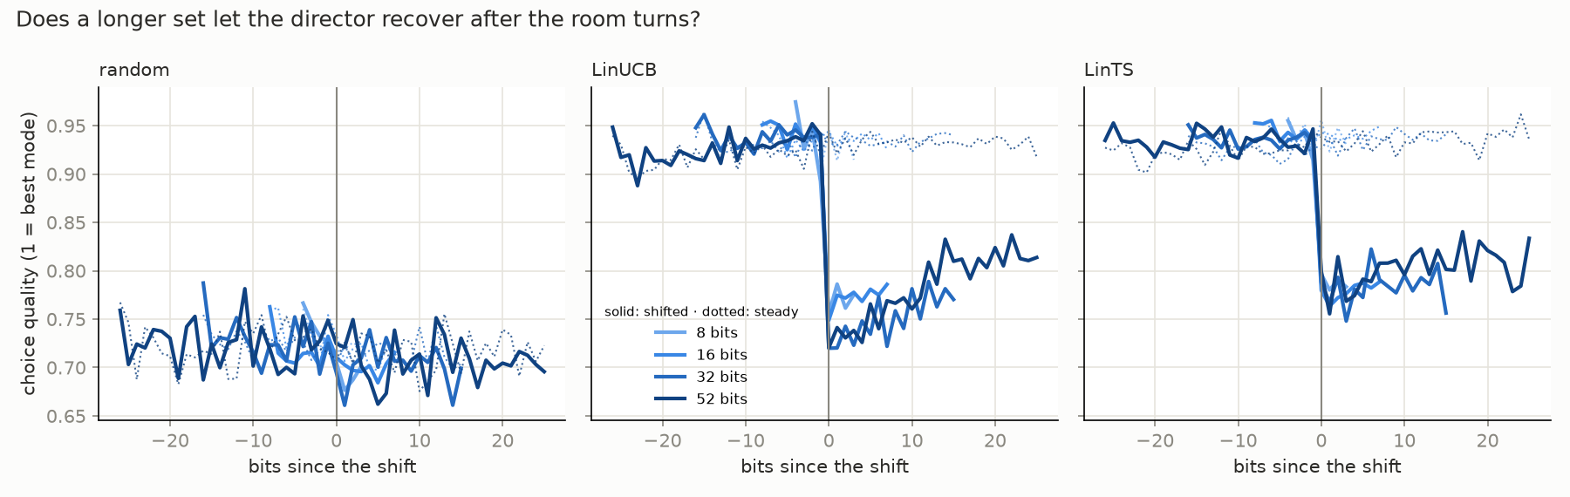
Longer Sets Don't Help
Quality stays 0.12 to 0.17 below steady at every length
Notes:
I wondered whether longer sets would give it time to recover, so I tested 8, 16, 32 and 52 bits with the same total experience. Choice quality is the expected reward of the chosen mode divided by the best mode's. Quality drops off a cliff at the shift and barely climbs. I kept 8-bit sets. This also changed how I measure recovery: "bits to recover" rewarded luck, because random scored well just by wandering. These curves are the honest measure.
Q&A notes
Set | Shows | LinUCB after shift, % of oracle | Quality, last quarter after shift | Quality, steady | Gap | Bits to recover (of)
8 | 400 | 80% | 0.768 | 0.930 | 0.162 | 2.5 (4)
16 | 200 | 81% | 0.778 | 0.936 | 0.158 | 4.6 (8)
32 | 100 | 80% | 0.767 | 0.936 | 0.169 | 10.1 (16)
52 | 61 | 82% | 0.812 | 0.931 | 0.119 | 14.1 (26)
All runs use 3,200 bits of experience, 10 seeds. Random's quality is about 0.69 to 0.72.
- Choice quality: expected reward of the chosen mode ÷ the best mode's. It has no joke noise, so it shows decisions.
- Q: No recovery at all? A slow drift: 0.73 to 0.81 over 26 bits in a 52-bit set, about 10× too slow for a show.
- Q: Why drop "bits to recover"? Random "recovers" in 4 bits at 52 by luck, while LinUCB sticks with its favorite and takes 14. The metric rewarded wandering.
- Why 8 bits: it's the demo's length, about 10 min.

Slide 22
Giving the Director a Memory
Three designs failed criteria we fixed before running them
Notes:
The director has no memory of tonight, so I added it in steps. Before running anything, I fixed the bar: gain at least 0.05 in choice quality after a shift, and lose no more than 0.01 when the room is steady. Steps A, B and C all failed that bar, and they failed in useful ways.
Q&A notes
The bar, the same for every step: at both 8 and 16 bits, gain at least +0.05 in choice quality after the shift, and lose no more than 0.01 over the same bits in steady shows.
Step | Idea | Result
A | Tonight's record as extra features | Failed in all 4 cells
B | Career model + a per-show correction | No κ passed
C | Linear Q-learning across the show | Failed, in both runs
- Q: Why 0.05 and 0.01? They were fixed before running, but the docs don't record a derivation. For scale, the shift costs about 0.16 in quality. Call them judgment calls.
- Q: What's left? Callbacks (C2) come after the demo and DPO. Anything further on reading a turn, PPO included, needs a new decision.

Slide 23
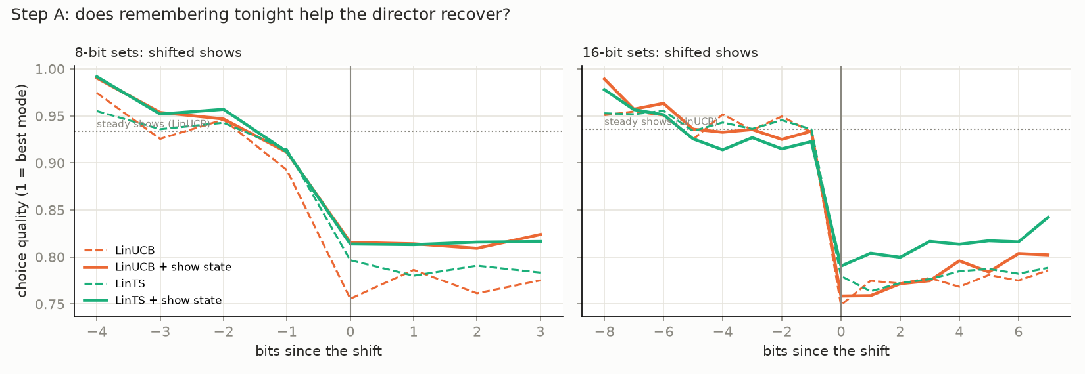
Step A: It Hedges
Higher at the shift, then it stops climbing
Notes:
Step A adds tonight's record as extra features. Quality is a bit higher at the moment of the shift, but it doesn't climb afterwards, and steady shows pay for it. It isn't reading the turn. It's just less committed all show, because one learned weight has to serve shifted and steady rooms alike.
Q&A notes
Set | Algorithm | Quality after shift | Gain (need +0.05) | Steady | Change (need −0.01 or better)
8 | LinUCB | 0.770 → 0.816 | +0.046 | 0.930 → 0.908 | −0.022
8 | LinTS | 0.788 → 0.815 | +0.027 | 0.939 → 0.910 | −0.030
16 | LinUCB | 0.773 → 0.781 | +0.008 | 0.936 → 0.925 | −0.011
16 | LinTS | 0.779 → 0.812 | +0.033 | 0.941 → 0.923 | −0.017
- Q: +0.046 is almost 0.05. Why reject? It also fails the steady-show limit (−0.022), and the bar was set in advance. Moving it afterwards would make the bar pointless.
- Why it hedges: one learned weight on "tonight's mean" must serve shifted and steady rooms, so it settles on a compromise.

Slide 24
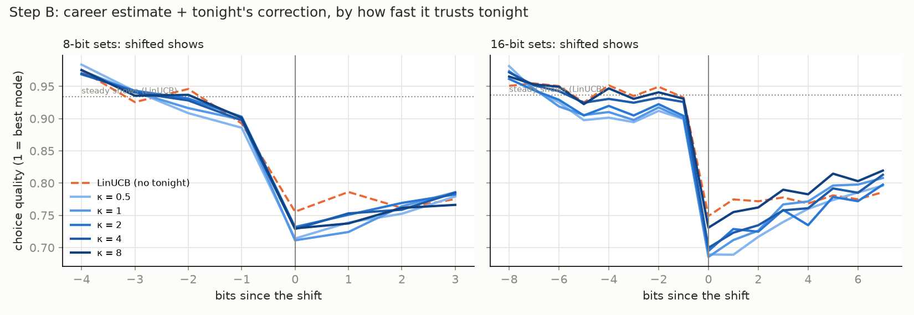
Step B: Fatigue, No Exploration
Repeats rise from 29% to 54%, and untried modes are never tested
Notes:
Step B keeps the career estimate and adds an explicit correction for tonight, with a setting κ for how quickly to trust it. No κ passed, and I tracked down why. Trusting tonight nearly doubles repeats of the last mode, from 29% to 54%, and the room tires of repeats. And untried modes get no correction, so it learns what bombed, not what's now good. So the next step had to value trying something new within a show and plan around fatigue. That's sequential decision-making, the same step callbacks need.
Q&A notes
Formula: correction for a mode = tonight's total surprise ÷ (bits tonight + κ), where surprise = reward − career prediction. It resets each show. Small κ trusts tonight quickly.
Set | κ = 0.5 / 1 / 2 / 4 / 8 |
8 bits | −0.023 / −0.023 / −0.011 / −0.013 / −0.021 | Shifted gain
8 bits | −0.029 / −0.030 / −0.015 / −0.012 / +0.005 | Steady change
16 bits | −0.029 / −0.015 / −0.024 / −0.015 / +0.009 | Shifted gain
16 bits | −0.043 / −0.043 / −0.024 / −0.010 / −0.005 | Steady change
Behavior, 3 careers | Repeats last mode | After a shift, picks a hurt mode
LinUCB | 29% | 51%
B, κ = 1 | 54% | 48%
B, κ = 8 | 40% | 55%
- Q: Why did more memory make it worse? Trusting tonight means repeating what just worked, and the sim's fatigue punishes repeats. Untried modes also get no correction, so it still can't discover what's good now.
- Q: Is fatigue doing this by design? Yes, and fatigue is made up. The diagnosis holds in this sim, not necessarily in a room.
- Evidence: behavior was tracked, not guessed (notebook Exp 8).

Slide 25
Step C: Planning Didn't Beat It
Fixing the lock-on exposed a new problem, so the demo keeps LinUCB
Notes:
Step C makes the director plan across the show, using linear Q-learning. The first run locked on, repeating the last mode 77% of the time. The cause was a scale error in the design: modes started at one bit's reward, but Q-values estimate the rest of the show. So we allowed one corrected run, and a bug found in it was fixed and re-run once. Repeats fell to 39%, so the diagnosis held, but choice quality now falls through the show even with no turn, from 0.95 to 0.72. Every run failed the same bar. So a linear model on these inputs hasn't beaten LinUCB at reading a turn. That says nothing about planning in general.
Q&A notes
Against LinUCB | First run (C1) | Corrected run (C1b) | Need
Quality after shift, 8 bits | −0.023 | +0.029 | +0.05
Quality after shift, 16 bits | −0.114 | −0.013 | +0.05
Steady shows, 8 bits | −0.198 | −0.164 | −0.01 or better
Steady shows, 16 bits | −0.255 | −0.189 | −0.01 or better
Repeats the last mode (LinUCB 29%) | 77% | 39% |
After a shift, picks a hurt mode (LinUCB 51%) | 16% | 33% |
The method: LinQ is LinUCB's ridge model and bonus, with target = reward + the next bit's best value, no discount. Inputs are LinUCB's, plus the reaction feature, step A's show state and five for planning. Known-model planning was rejected because it would read the room's hidden truth. PPO was rejected as more to tune and debug for an 8-step problem.
- The fix (C1b): each mode starts at its one-bit prior × the bits left, the bonus grows with √(bits left), and past targets are recomputed after each show.
- The bug: A grew after each bit but b only at the show's end, so values dropped mid-show with no new evidence. The table shows the fixed run.
- In laughs: after the shift at 8 bits it gets 19.8 vs LinUCB's 19.1, with overlapping CIs. In steady shows it loses, 19.9 vs 22.6.
- Q: Why stop there? The rule, set in advance, was one run with no tuning, then one corrected run, plus one re-run to fix its bug. Anything more needs a new decision and would risk tuning until something passes.
- Q: So is an MDP wrong here? Not shown. It rejects this linear model on these inputs. The likely causes of the fall in quality were measured once, not tested separately.
- Q: How much could planning gain? In a steady room, not much: perfect planning around fatigue adds 0.83 laughs a show on average, at most 2.47 (Exp 16). The value of planning after a turn wasn't measured.
- Evidence: notebook Exp 14 and 15. The simulator's fatigue and shift are made up.

Slide 26
Act 5: Do People Agree with the Judge?
Notes:
Q&A notes
This act says: the LLM judge is only a partial stand-in for people, but the choice of LinUCB holds under either taste.

Slide 27
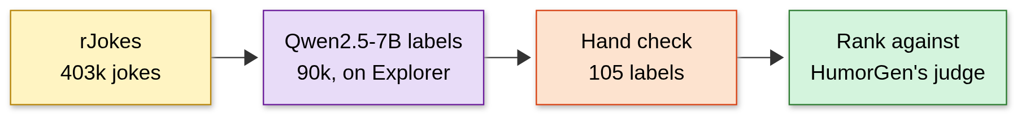
Checking Against Real Upvotes
The sim's taste came from an LLM judge, so we tested it
Notes:
There's a weak spot in everything so far: the room's base taste came from an LLM judge. So I checked it against people, using rJokes, about 403,000 Reddit jokes with upvote scores, as percentiles within each year. A local Qwen model labels jokes by mode on the university's GPU cluster, I check a sample by hand, then I rank the modes against the judge.
Q&A notes
rJokes prep | Count
Rows in the official splits | 432,457
After removing duplicates | 419,446
After the 4 to 200 word filter (the "403k") | 402,981
Train / dev / test | 323,573 / 39,764 / 39,644
Labeled: uniform random sample of train, seed 0 | 90,000
Used in the ranking (no parse failures or none, year known) | 89,200
- pct: the share of jokes from the same year that this joke beat on upvotes. r/Jokes grew about 1,000× from 2008 to 2019, so raw scores can't be compared across years. Scores 0 to 11 are roughly ln(upvotes).
- Noise ceiling: 6,971 texts were posted more than once, and the same text's scores differ by a median of 2, about 7× in upvotes. No model can predict upvotes much better than that.
- Q: Why upvotes? There's no public dataset of (venue, joke, live reaction). Upvotes aren't laughter, and Reddit isn't a room.
- Q: Why Qwen2.5-7B? It's local and free of API limits, with greedy decoding on a V100 at 5.2 jokes/s. vLLM couldn't run on Explorer's driver, so it uses transformers.
- Q: Legal? Reddit's terms: local use, never redistribute the dataset. A few rows are quoted in docs with credit.

Slide 28
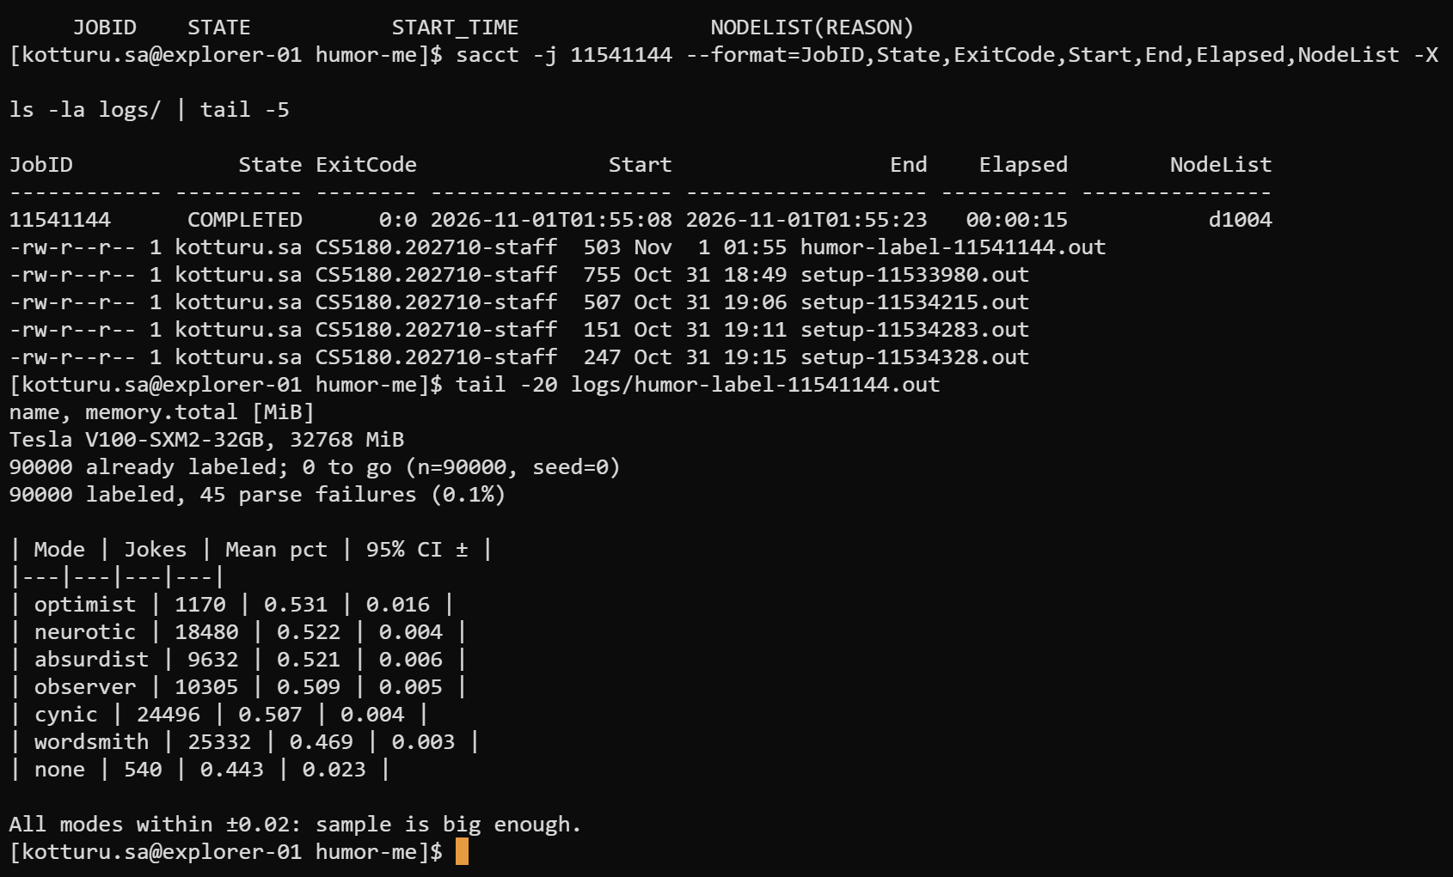
Labeling 90k Jokes on Explorer
The precision rule forced 30k up to 90k: every mode within ±0.02
Notes:
This is the real run. I set a precision rule first: every mode's confidence interval within ±0.02. At 30,000 jokes, optimist missed it at ±0.029, because only 1.3% of jokes are optimist. So the sample grew to 90,000, and optimist came in at ±0.016. The last line says what I needed: all modes within ±0.02.
Q&A notes
Mode | Jokes | Share | Mean pct (raw) | 95% CI ±
Optimist | 1,170 | 1.3% | 0.531 | 0.016
Neurotic | 18,480 | 20.5% | 0.522 | 0.004
Absurdist | 9,632 | 10.7% | 0.521 | 0.006
Observer | 10,305 | 11.5% | 0.509 | 0.005
Cynic | 24,496 | 27.2% | 0.507 | 0.004
Wordsmith | 25,332 | 28.2% | 0.469 | 0.003
None | 540 | 0.6% | 0.443 | 0.023
- The rule, fixed before the run: if any mode's CI is wider than ±0.02, add 30k more. At 30k optimist had 399 jokes and ±0.029. It needs about 840, from (1.96 × 0.296 ÷ 0.02)². none is excluded from the rule.
- Don't read this table as a ranking. These are raw means, confounded by length (slide 30).
- Run facts: about 5 h of GPU at about 5.2 jokes/s (estimated from that rate). 45 parse failures (0.05%). An out-of-memory crash on old code was resumed after a fix; the first 30k came out identical, with 90,000 unique ids.
- This screenshot: job 11541144 ran for 15 s and printed the summary of finished labels. It isn't the labeling job itself.

Slide 29
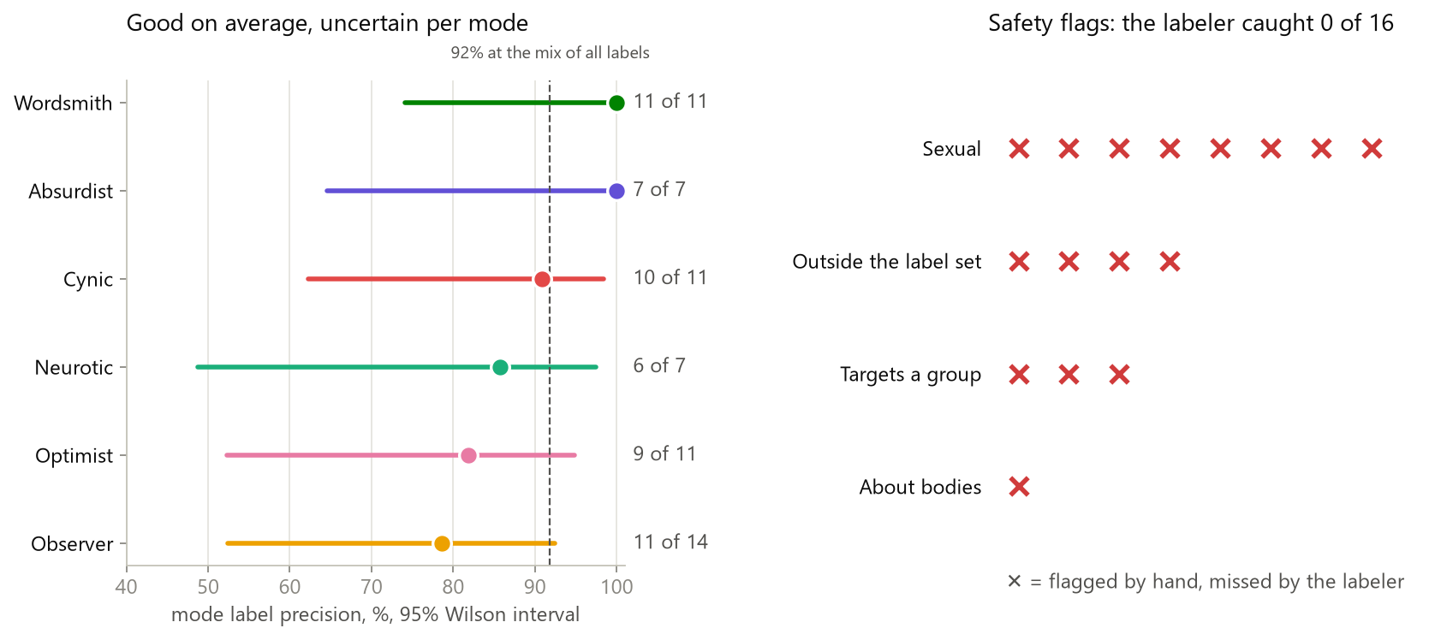
The Hand Check
Mode labels hold at 92%; safety flags caught 0 of 16
7 to 14 judged jokes per mode, so each estimate is uncertain. 92% is weighted to the mix of all 90k labels.
Notes:
I checked 105 labels by hand. Mode labels are 92% precise, and the misses lean toward puns filed elsewhere: "Wanna hear a joke about ghosts? That's the spirit." The judge said no mode; I said wordsmith. Safety was a different story: I flagged 16 jokes, and the model's safety labels caught none of them. So I made a decision: rJokes is for mode statistics only, never joke material. Safety stays a hard filter in the live loop.
Q&A notes
Qwen's mode | Share of 90k | Yes | No | ? | Skipped | Precision | 95% CI (Wilson)
Wordsmith | 28.2% | 11 | 0 | 1 | 3 | 100% | 74 to 100%
Cynic | 27.2% | 10 | 1 | 1 | 3 | 91% | 62 to 98%
Neurotic | 20.5% | 6 | 1 | 2 | 6 | 86% | 49 to 97%
Observer | 11.5% | 11 | 3 | 0 | 1 | 79% | 52 to 92%
Absurdist | 10.7% | 7 | 0 | 6 | 2 | 100% | 65 to 100%
Optimist | 1.3% | 9 | 2 | 1 | 3 | 82% | 52 to 95%
None | 0.6% | 14 | 1 | 0 | 0 | 93% | 70 to 99%
A Wilson interval is a confidence interval that stays sensible with small samples. ? means the joke didn't land, so no mode could be assigned.
- 89% vs 92%: 89% (CI 81 to 95%) is the plain average over judged rows. 92% re-weights to the mode mix of all 90k labels.
- Q: Was this rigorous? It's a sanity check: one annotator (you), 105 jokes from the first 30k, and no pass criterion set in advance. If you saw Qwen's label while marking, say so, since that can bias you toward agreeing.
- Absurdist's 100% is misleading: 6 of its 13 judged jokes couldn't be given any mode. The label may be a bin for jokes that don't land.
- Safety: you flagged 16 (sexual 8, targets a group 3, about bodies 1, outside the schema 4). Qwen flagged none. Notes were opportunistic, so this measures misses, not false alarms.
- Decision: rJokes is for statistics, never joke material (and, since Nov 1, for testing judges). Safety belongs in the live filter.

Slide 30
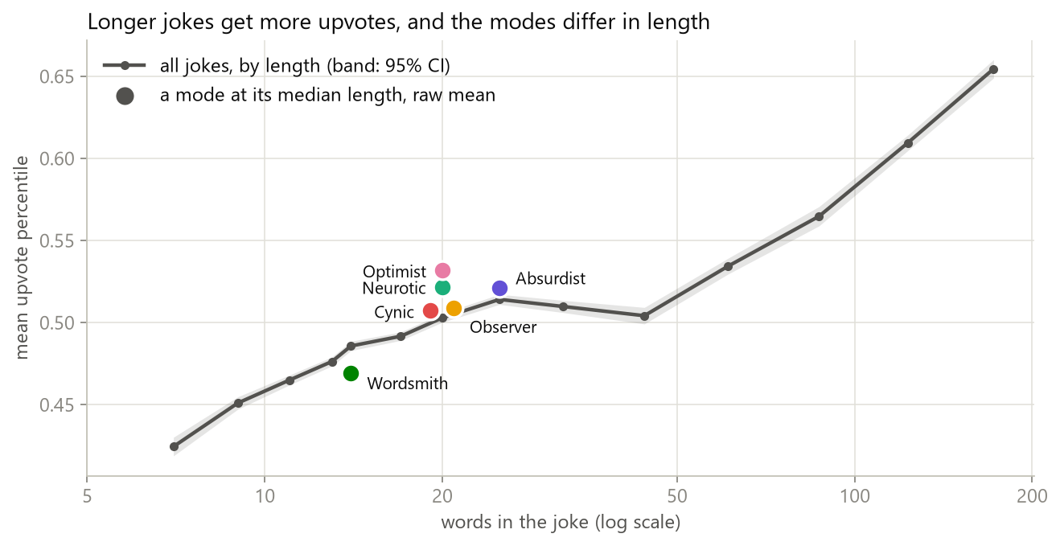
The Length Confound
Joke length moves upvotes about twice as much as mode does
Notes:
Before comparing modes I found a confound. Longer jokes get more upvotes, and modes differ in length: a median wordsmith joke is 14 words, an absurdist one 26. Length alone moves the upvote percentile about twice as much as mode does. Absurdist drops from third to fifth once length is held fixed. So I only compare same-year, similar-length jokes. The correlation is weak, Spearman ρ +0.13, and it doesn't show that length causes upvotes, but mode effects are smaller still.
Q&A notes
Words | Mean pct
13 or fewer | 0.46
19 to 50 | 0.51
51 to 100 | 0.55
101 to 200 | 0.63
The chart plots 14 length bins, 4 to 200 words (reports/metrics/length_curve.json), and each mode sits at its median length and raw mean. It rises overall but plateaus from about 25 to 50 words, so don't call it steady. The table's bins come from the one-off check and skip 14 to 18 words. Quartiles (≤13, 14 to 18, 19 to 28, >28) go from 0.465 to 0.550: a 0.085 spread, against about 0.04 for mode. That's the "about twice".
- Spearman ρ +0.13 (0.127) on 322,731 jokes with a known year; +0.09 to +0.28 within single years; Pearson +0.15. Spearman uses ranks, so huge upvote counts don't dominate.
- Q: ρ is weak, so why care? Mode effects are smaller still, and modes differ in length, so even a weak link can reorder them.
- Absurdist: raw third (0.521). Fifth with deciles (0.493), but third with quartiles (0.505). The coarse bins leave more length in, which is why deciles were chosen. It's the longest mode.
- Limits: this doesn't show that length causes upvotes. Length still leaks through the groups (+0.033). This check ran outside the notebook.

Slide 31
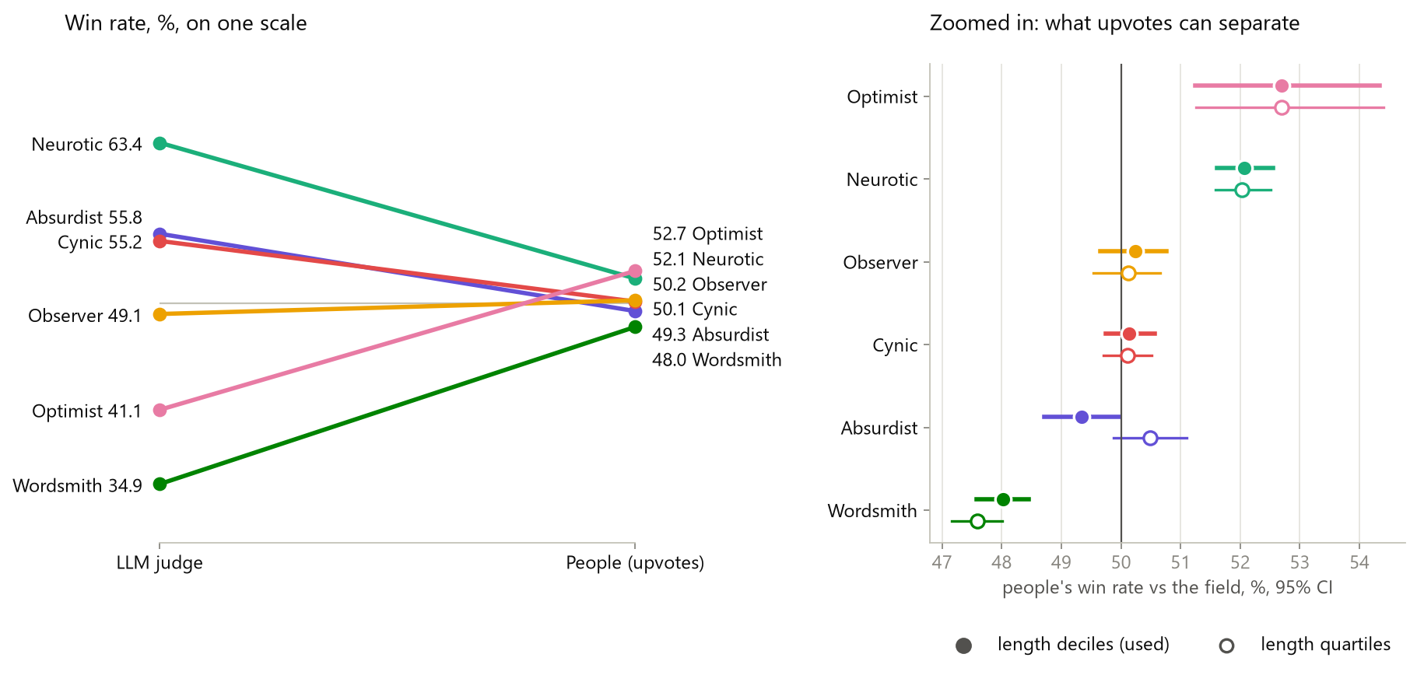
People vs the LLM Judge
Weak agreement: neurotic and wordsmith match, optimist doesn't
Left: judge and people on the same scale. Right: people only, zoomed in, with 95% CIs.
Notes:
Same scale, on 89,200 jokes. The judge's preferences are steep; people's are almost flat. They agree on neurotic above average and wordsmith last. They clearly disagree on optimist: the judge dislikes it and people like it. Spearman ρ runs from +0.20 to +0.37: agreement, but weak. Careful with the flat line. It doesn't show people care less about mode. Upvotes are noisy, these jokes were labeled afterward rather than written per mode, and about 8% of labels are wrong.
Q&A notes
Mode | LLM judge | People: win rate, deciles [95% CI] | Regression effect | Side, people vs judge
Optimist | 41.1% | 0.527 [0.512, 0.543] | +0.022 | Above vs below: disagree
Neurotic | 63.4% | 0.521 [0.516, 0.526] | +0.012 | Above vs above: match
Observer | 49.1% | 0.502 [0.497, 0.508] | −0.001 | Too close to tell
Cynic | 55.2% | 0.501 [0.497, 0.506] | −0.003 | Depends on the estimator
Absurdist | 55.8% | 0.493 [0.487, 0.500] | −0.010 | Depends on the estimator
Wordsmith | 34.9% | 0.480 [0.476, 0.484] | −0.020 | Below vs below: match
Criteria, fixed in advance, on 4 variants (win rate or regression × quartiles or deciles), 1,000 bootstrap resamples:
- C1 Spearman ρ: +0.37 with quartiles, +0.20 with deciles. "Agree" by the rule (the CI's lower end is above 0). CIs run from +0.20 up to +0.66.
- C2 sides: 2 of 6 match in every variant, with optimist clearly disagreeing.
- C3 wordsmith last: in at least 99.7% of resamples, in all variants.
A bootstrap redraws the jokes with repeats, many times, to see how much a number moves.
- Q: Is ρ +0.20 meaningful? Barely. With only 6 modes, ρ needs about 0.89 to be significant by itself. The CI covers only uncertainty on the human side; the judge's isn't modeled. Say "weak, partial agreement", and lean on the sides and wordsmith.
- Q: So people don't care about mode? Not shown. The judge's spread is about 6× wider (0.285 vs 0.047), but upvotes are noisy, HumorGen wrote its jokes per persona while ours were labeled afterward, about 8% of labels are wrong, and upvotes aren't a room's laughter.
- Q: Why trust optimist? Be careful: it has the fewest jokes (1,170) and the widest CI, though the CI is still clearly above 0.5.

Slide 32
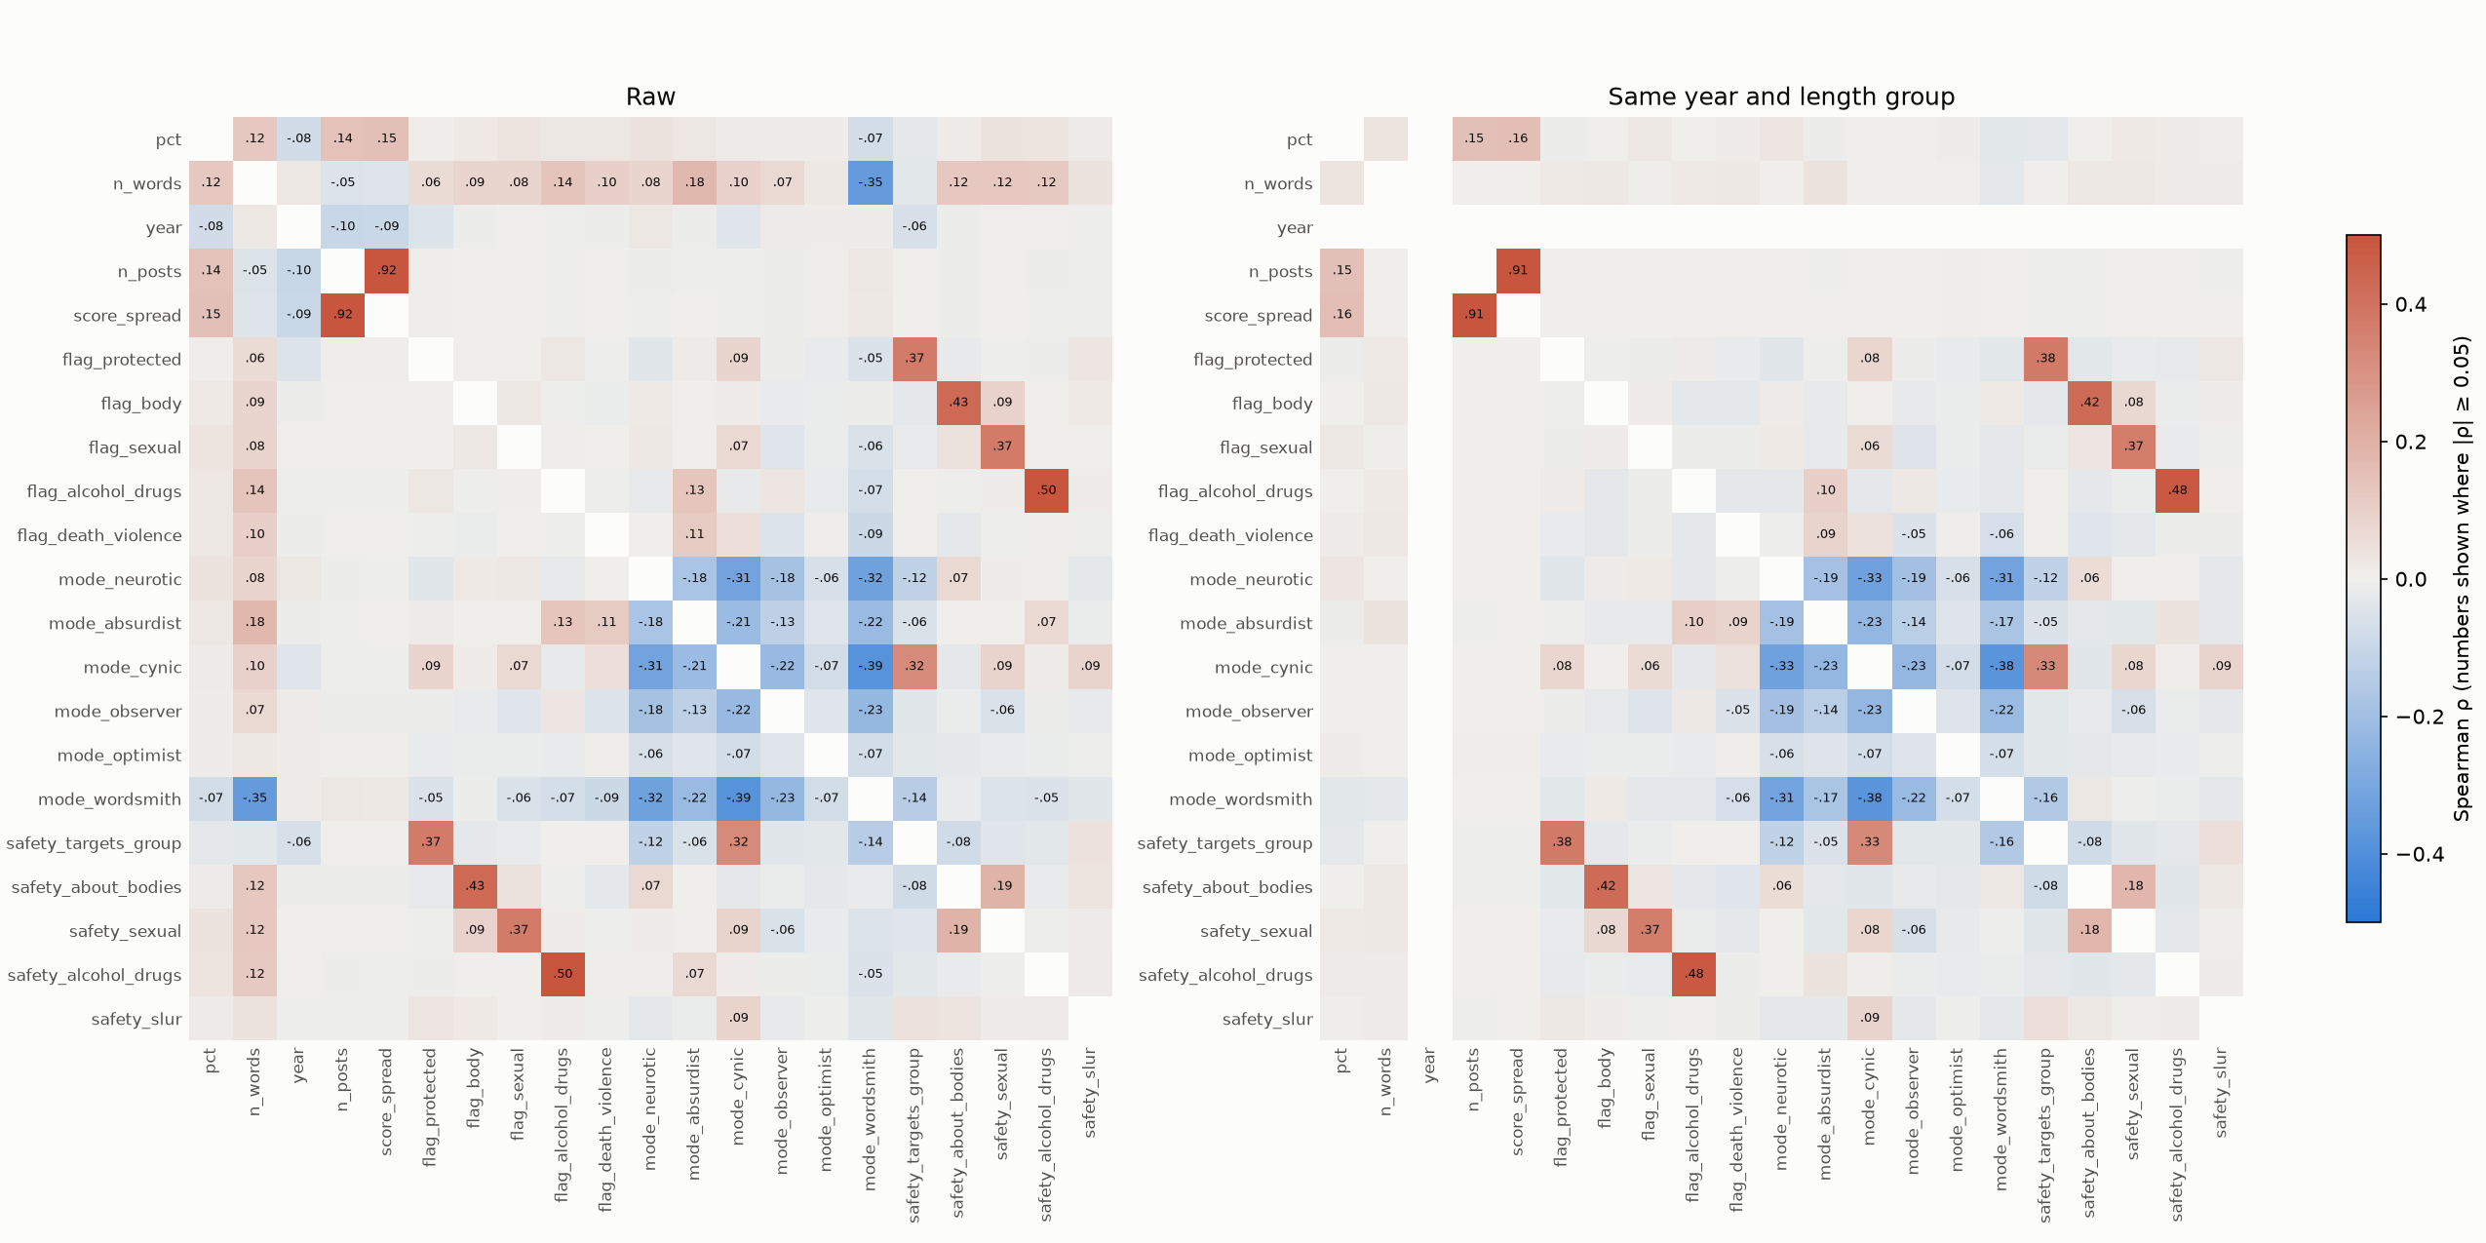
The Correlation Map
Nothing else we measured changes the main findings
Notes:
Did I adjust for the right things? Here's every feature against every other, raw on the left and within year and length groups on the right. My pre-set rule found nothing needing an extra adjustment. Then, asked why the threshold was 0.05, I found the rule misses a weak link paired with a strong one. The outcome stood, and a separate check, also fixed in advance, re-ran the ranking with that feature. The main findings held, but cynic passed observer, so the order of the middle modes is unsettled.
Q&A notes
Feature | Raw ρ with pct | Same year and length group
Length (n_words) | +0.123 | +0.033
Year | −0.076 | n/a
Wordsmith | −0.073 | −0.032
Neurotic | +0.035 | +0.031
Sexual flag | +0.035 | +0.022
Safety label: targets a group | −0.024 | −0.026
Other modes, flags, safety labels | under 0.04 | under 0.02
n_posts (+0.142) and score_spread (+0.151) are computed from the score, so they don't count.
- The rule: re-run with an extra adjustment only if a feature reaches |ρ| ≥ 0.05 with both pct and some mode. Nothing did.
- The flaw: a feature shifts a result by about (link to pct) × (link to mode), but the rule tests each link separately. "Targets a group" has −0.026 with pct and +0.325 with cynic. The threshold 0.05 was also a judgment call.
- Handling it: the rule's outcome stood, because changing a rule after seeing results would fit it to them. A separate check, fixed in advance, moved cynic from 0.501 to 0.510, past observer (0.499). The human base keeps the original values, because that safety label is unreliable.
- Q: Does this rule out other confounders? No. It covers only what was measured. Topic and joke format aren't.
- Reading the map: red rises together, blue moves opposite, pale is little or no link. It's too dense to read from the room, so point at the pattern.

Slide 33
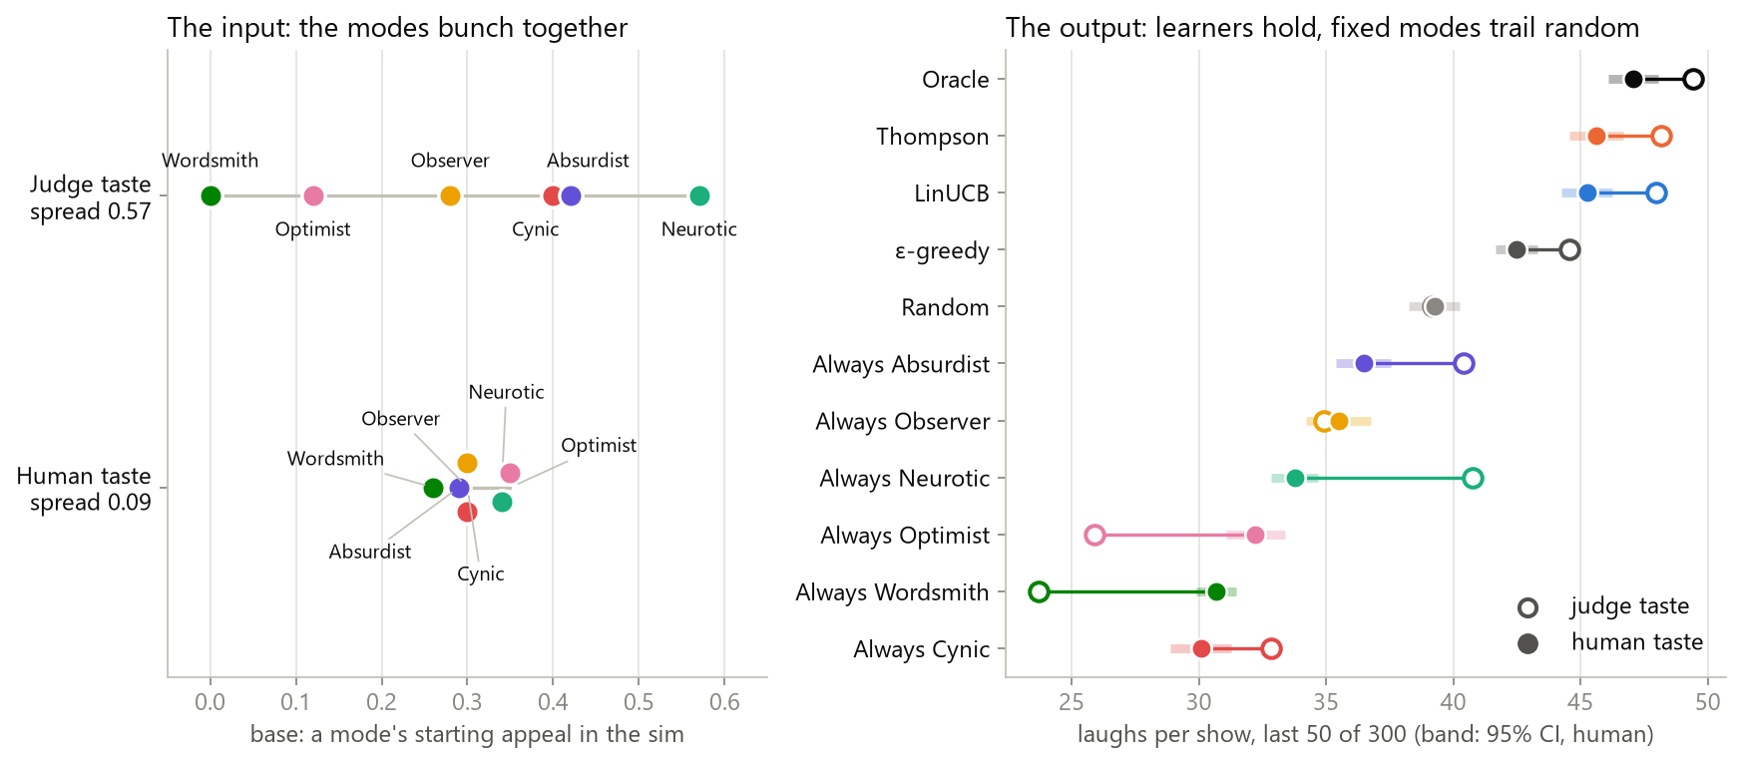
Two Tastes
The director choice holds under the human taste: 96.2% of the oracle
Notes:
So does the result survive? I re-ran the policy experiment with the human taste instead of the judge's. LinUCB reaches 96.2% of the oracle, clearly above the best fixed mode. Sticking to one mode gets worse: random now beats every fixed mode, probably because no mode has much of a head start, though I didn't test that explanation. The limit: venue and age offsets are still made up, so this shows the choice doesn't depend on the base taste, not how much learning would help in a real room.
Q&A notes
Last 50 shows | Judge taste | Laughs lost | Human taste | Laughs lost
Oracle | 49.4 ± 1.0 | 0 | 47.1 ± 1.0 | 0
LinUCB, uniform | 48.0 ± 1.1 | 728 ± 64 | 45.3 ± 1.0 | 886 ± 80
Thompson, uniform | 48.2 ± 1.0 | 907 ± 58 | 45.6 ± 1.1 | 947 ± 58
LinUCB, judge prior | 47.9 ± 1.1 | 868 ± 111 | 45.0 ± 1.0 | 917 ± 95
ε-greedy, uniform | 44.6 ± 1.1 | 2,493 ± 143 | 42.5 ± 0.8 | 2,187 ± 117
Random | 39.2 ± 1.0 | 4,264 ± 59 | 39.3 ± 1.0 | 3,448 ± 53
Best fixed mode | 40.8 ± 0.9 (neurotic) | 4,026 ± 52 | 36.5 ± 1.1 (absurdist) | 4,006 ± 96
Criteria, fixed in advance: P1 at least 95% of the oracle (got 96.2%). P2 beat the best fixed mode with no CI overlap (45.3 vs 36.5). P3 not lose to ε-greedy or Thompson with no CI overlap (passed; Thompson's 45.6 is within the CI).
- What changes: only base, from judge values to Exp 10's decile win rates. Its spread drops from 0.57 to 0.09.
- Q: Why does learning still pay if people barely differ on mode? Because the made-up venue and age offsets now mostly decide the best mode. That's the main limit. Part of the advantage comes from those made-up values.
- Q: Which taste is right? Neither end. The judge's is steep and upvote noise flattens the human one, so a real room probably sits between. Holding at both ends is good evidence for the middle, not proof.
- Q: Why keep the judge's base as the default? The choice didn't depend on it, and both are reported.

Slide 34
Act 6: How We Decide, and What Comes Next
Notes:
Q&A notes
This act says: how decisions were made, what's still unproven, and the plan.

Slide 35
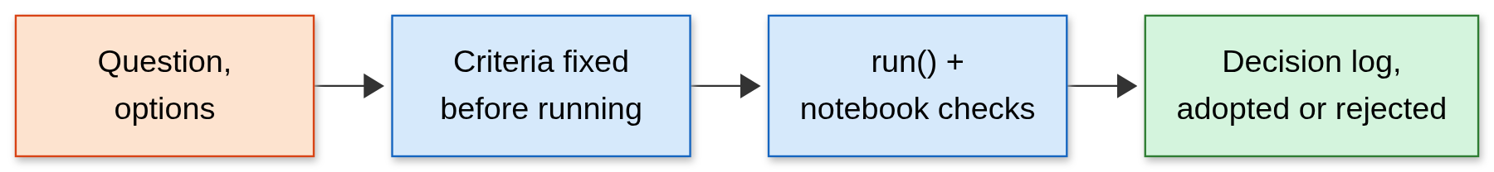
How We Decide
Re-runnable checks throughout, pre-set bars for most decisions since step A
Notes:
Comedy data is noisy, so it's easy to fool yourself. Experiments follow one path: a question with options, a cached run(), and a notebook section with claim checks. From step A on, most decisions get criteria fixed before running. The checks assert rejections too, so re-running the notebook tests every decision. There are 16 experiments so far. I make the calls; Claude, the AI assistant, builds and drafts, and that's recorded.
Q&A notes
- Mechanics: every experiment is a run() cached by its parameters, with a notebook section whose claim checks assert the decision, including rejections. python scripts/run_notebook.py re-runs it. 150 tests pass.
- Be exact about pre-set criteria: Exp 7, 8, 10, 12, 13, 14, 15 and the Exp 11 precision rule had them. Exp 3 to 6, the hand check (Exp 9) and Exp 16 didn't. The base mapping was recorded after the fact. The length check and C1's value check were one-off scripts.
- Q: How much did AI do? You make the calls. Claude builds code, drafts docs, ran the diagnoses, wrote the invented jokes, and drafted these slides. Report sections are marked as yours or as AI-drafted.
- Q: Did it ever fail you? Good examples: the 0.05 rule flaw (slide 32) and C1's scale error (slide 25), both Claude's own designs, and both logged.
- Q: Reproducible? The sim is, from seeds. rJokes and transcripts are local, so others need to fetch rJokes themselves. Explorer runs need the pinned cluster setup.

Slide 36
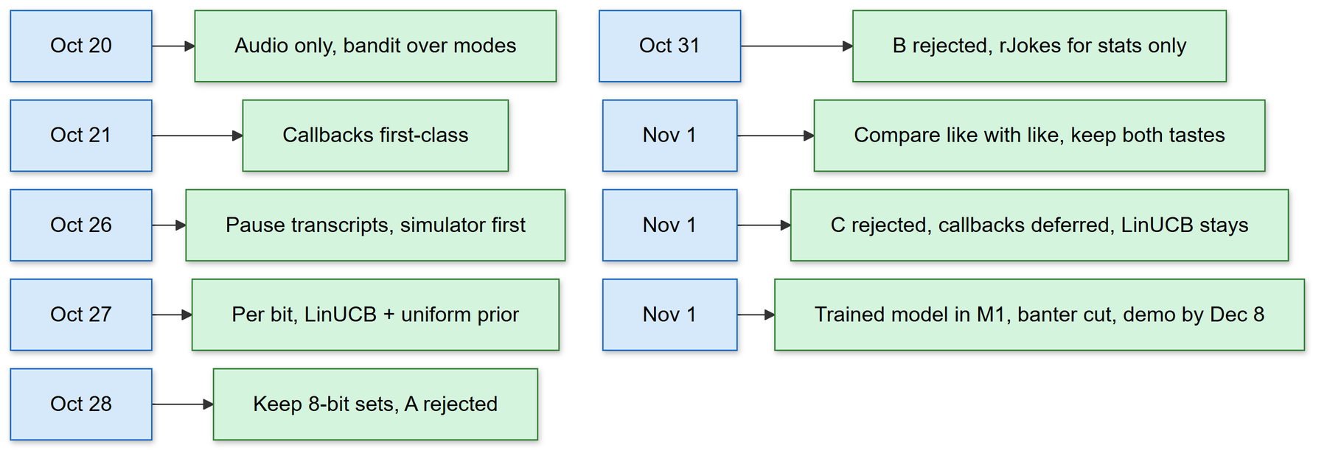
The Decisions So Far
Two weeks, one pivot, three rejected designs
Notes:
Here's the whole path in two weeks. Audio only and a bandit on day one. Callbacks as a first-class idea. The pivot on October 26, away from transcripts. Per-bit decisions and LinUCB. Then comparing like with like and keeping both tastes in the simulator. Then the three rejected designs, A, B and C. And finally, a trained joke model moved into the plan. I'm as proud of the rejections as the adoptions, because each told me what the next design needed.
Q&A notes
Oct 20 to Nov 1 is 12 days.
- Q: Why pivot on Oct 26? See slide 12.
- Q: Favorite rejection? Step B: more memory made things worse, and the diagnosis named what C had to do.
- Q: Why move a trained model into M1 so late? You decided the Dec 8 demo should speak jokes from a model we trained. Banter and roast handling were cut to make room.
- Also on Nov 1: rJokes may also test judges, still never joke material. The oracle stays the yardstick, with the true best reported beside it (Exp 16). The demo voice is Kokoro, local on the CPU, so the 8 GB GPU stays free for the joke model.

Slide 37
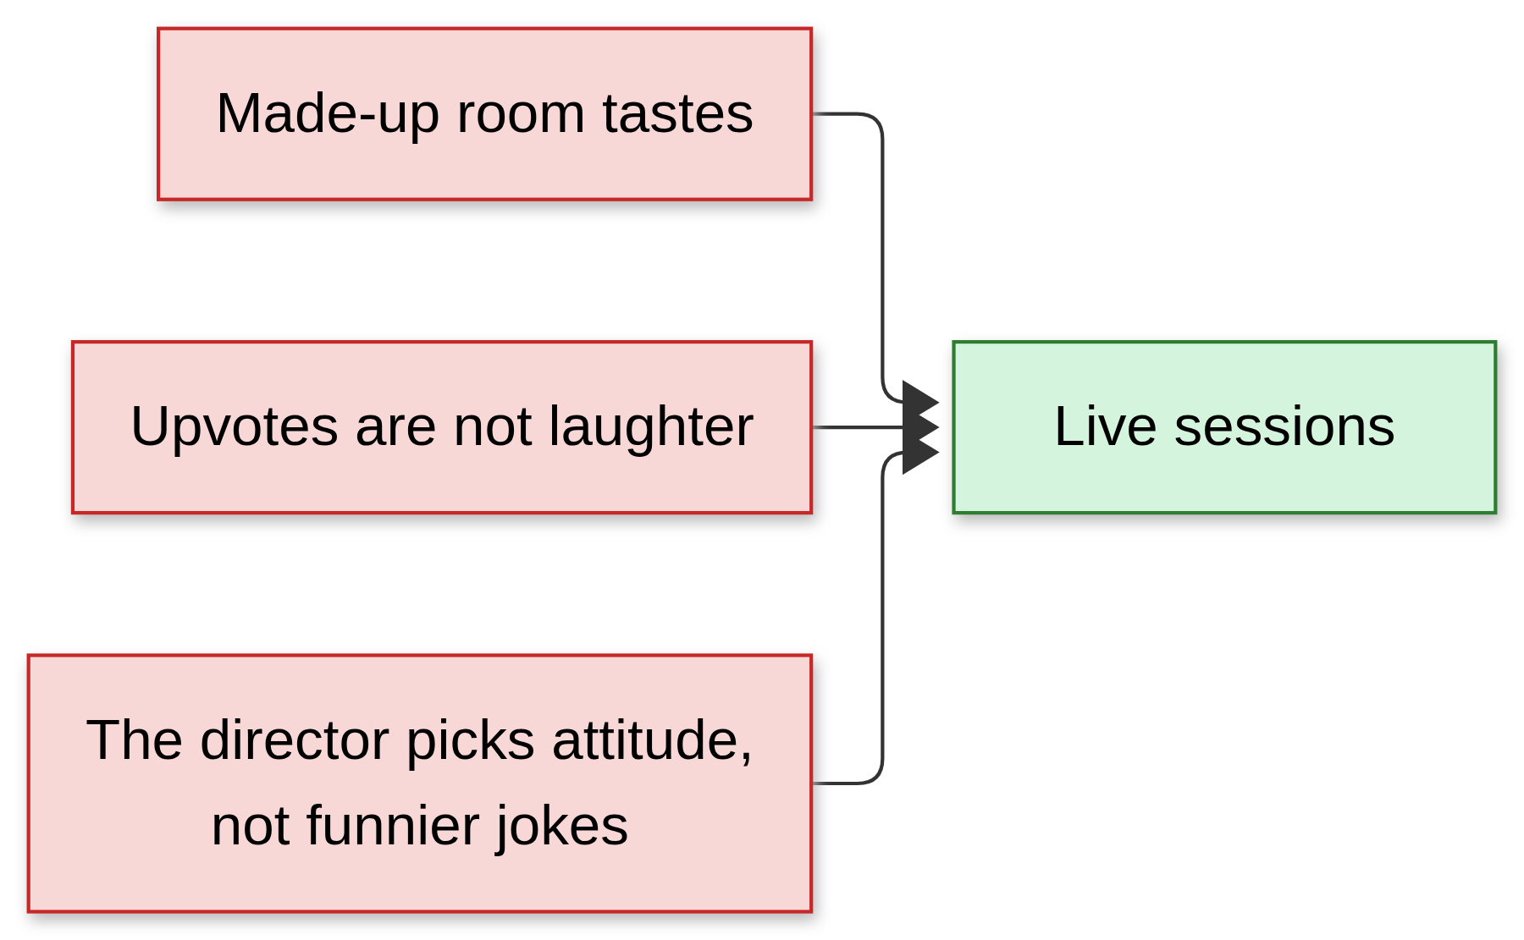
Still Unproven
Nothing here has faced a real room
Notes:
Let me be plain about the limits. The room's tastes are made up. Upvotes are not laughter. And the director picks an attitude; it doesn't make any joke funnier. What I've shown is that the comedian's loop, the part that builds taste, can be learned. Whether the jokes underneath are any good, and how bad it gets in front of people, is what the live sessions are for.
Q&A notes
Unproven | What would answer it
Real rooms differ the way the sim assumes | Logged live sessions across venues
Upvotes track laughter | Compare mode rewards in live logs with rJokes
The mode choice improves real laughs | H1: bandit vs best fixed vs random, live. Cut from M1
The jokes themselves are any good | Generator, then a rated show
- Q: How many sessions would H1 need? Unknown. The plan is a power estimate after the first 10 sessions. M1 aims for at least 3 logged pilots, which can't test H1.
- Live biases to control: room size, "a robot is talking!" novelty, peak-end bias in ratings, drunk audiences, and delayed laughs credited to the wrong line.
- Q: What would prove you wrong? Live: no gain over a fixed mode across enough sessions. In the sim, Exp 13 was already a chance for the choice to fail.

Slide 38
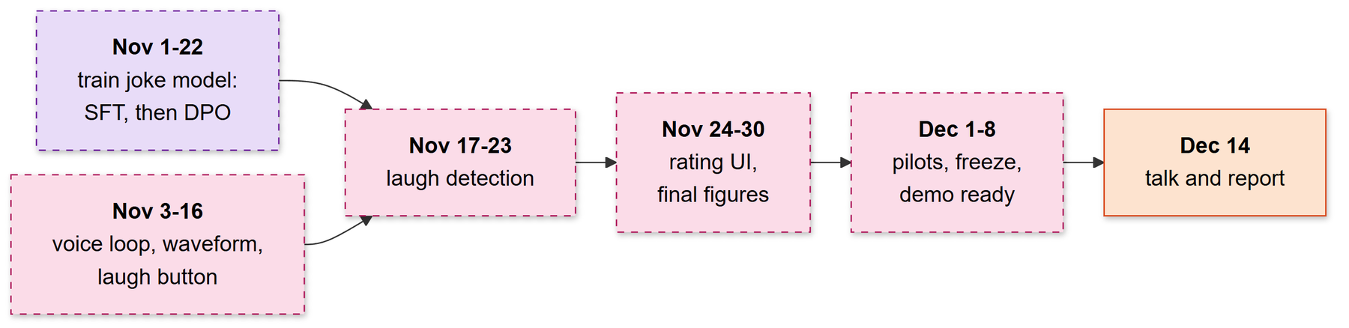
What Comes Next
A trained joke model and a live voice demo by Dec 8
Notes:
Next is the demo: the robot on screen with its waveform and voice, speaking jokes from a model we trained. Two tracks run side by side: training the joke model, SFT and then DPO, by November 22, and the voice loop, waveform and laugh button by November 16. Then laugh detection, final figures and pilot shows, with everything finished by December 8. The biggest risk is that most of the live system isn't built yet: only a first voice slice runs, speaking fixed lines. If the detector isn't reliable, an operator button becomes the reward, and the RL results still stand on the simulator. On the RL side, the demo runs LinUCB, since nothing has beaten it yet. Thank you.
Q&A notes
When | What
Nov 1 to 22 | Model track on Explorer: own premises, 6-mode candidates, judges compared, SFT (latest Nov 15), DPO (latest Nov 22)
Nov 3 to 16 | Voice loop (first slice done: fixed lines, Kokoro, frequency display), waveform, operator panel with laugh button, mode-conditioned generation, safety filter
Nov 17 to 23 | Voice activity detection, laugh detector, hold during laughs, bandit wired to live reward
Nov 24 to 30 | Episode rating UI, final sim figures
Dec 1 to 8 | Pilot sessions, then feature freeze: report and slides done, demo rehearsed in a noisy room
Dec 9 to 12 | Spillover only
Dec 14 | Final presentation (15 min at most, team) and final report due
Cut from M1: banter and roast handling, callbacks (C2), camera snapshot, commute venue, the reward model from logged shows, the live H1 experiment.
The joke model: HumorGen's order, SFT then DPO. HumorGen found DPO about equal to SFT, so SFT is the safe checkpoint. Exit test: it beats the base model on a human vote and runs within the latency budget, or Gemini is the fallback.
- Q: Where do preference pairs come from? No logged shows exist and rJokes isn't joke material, so a judge scores jokes generated per mode, plus a small human vote. The judge is chosen by how often it picks the joke with more upvotes among same-year, similar-length rJokes pairs.
- Q: So the model learns a judge's taste? Yes, and Exp 10 shows that matches people only in part. The report must say so.
- Q: Why your own premises? SemEval's prompts had no license or download link we could find, and news can be sensitive. Own premises give control over the data, but results can't be compared directly with HumorGen.
- Q: Why does an RL project end on a bandit? The bandit is the adopted result, and that's RL. Sequential planning is what the failures point to, and its attempt failed (slide 25).
- Q: What does the live demo run? LinUCB.
- Fallbacks: detector unreliable, so an operator button is the reward. Bandit wiring slips, so an operator chooses the mode, and RL results stand on the sim.
- Biggest risk: most of the live system does not exist yet, and about a week of slack went when the target moved up.

Slide 39
Sources and Credits
Papers: HumorGen (anonymous ACL submission); LoL, Wang et al., ICLR 2025; The rJokes Dataset, LREC 2020.
Data: r/Jokes via rJokes; a few rows quoted for illustration only. Transcripts stay local.
Compute: Northeastern's Explorer cluster (NURC).
AI use: Claude, the AI assistant, drafted these slides and this monologue from the repo's docs, and wrote the invented example set.
Evidence for every number: docs/metrics.md and notebooks/decisions.ipynb.
Notes:
Q&A notes
- Full references: HumorGen is an anonymous ACL submission under review, so its dataset isn't used, only the method and the published win rates. LoL: Wang et al., ICLR 2025. rJokes: Weller and Seppi, LREC 2020. LinUCB: Li et al. 2010.
- Compute: Explorer through CS5180, V100-SXM2-32GB. Sim and analysis run on the laptop.
- Also say if asked: whole transcript sets went to Gemini's free tier, your call given the small, non-commercial corpus. It returned only line indices and paraphrases, never quotes. Exposure to the provider is the trade-off.

