Slide 1
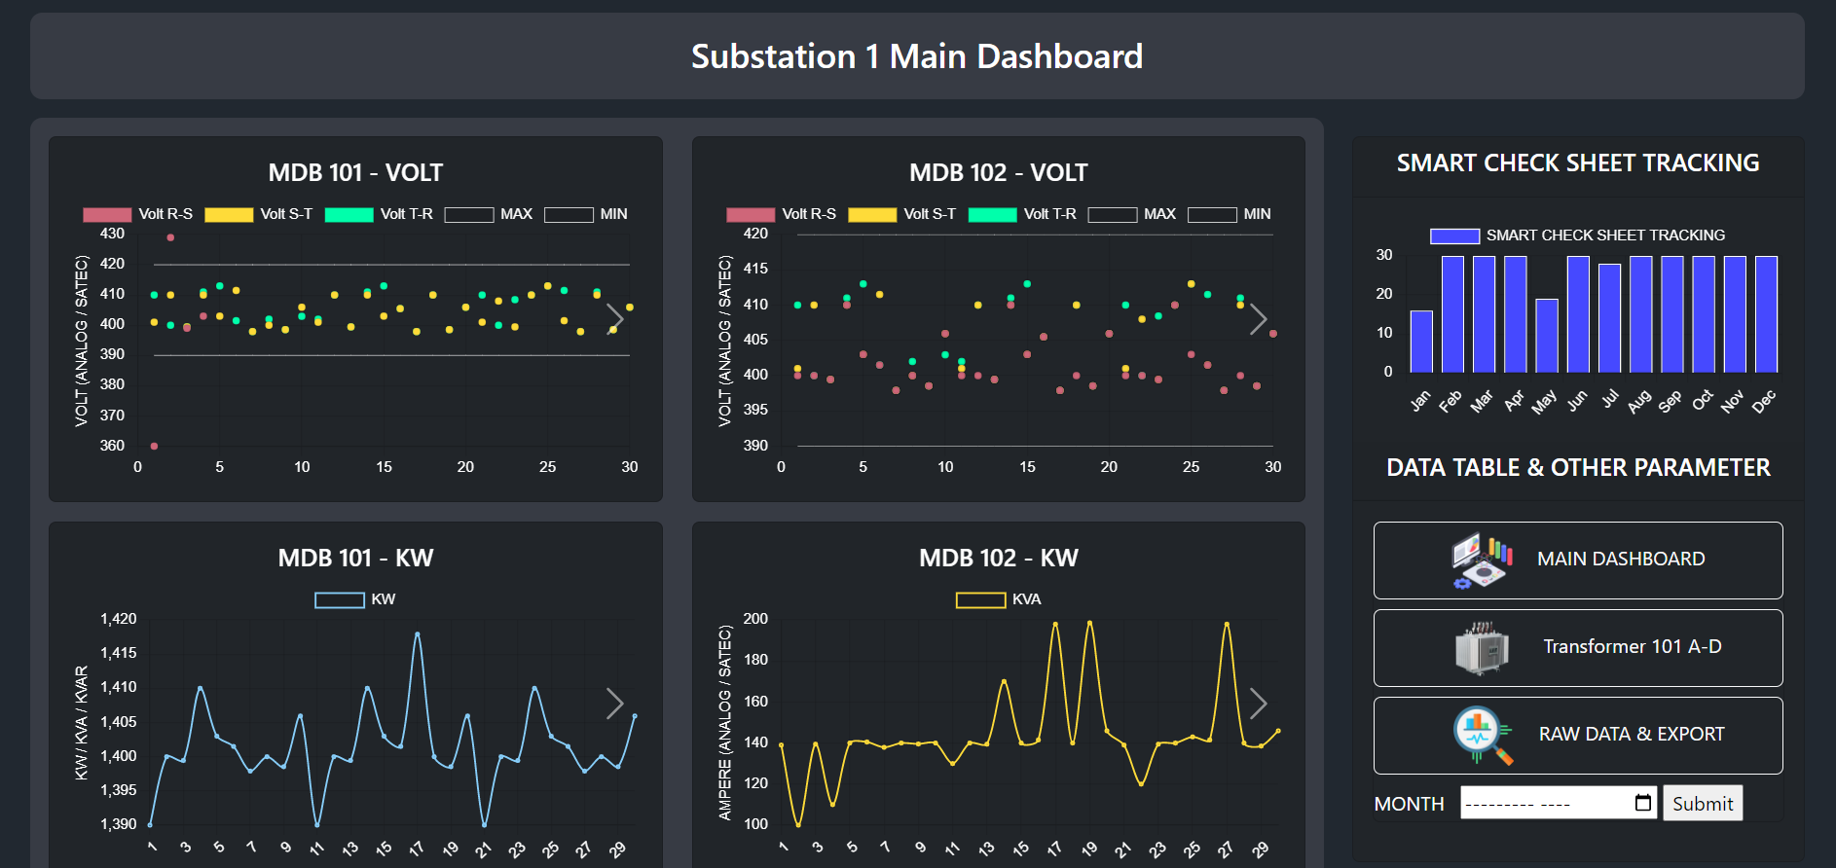
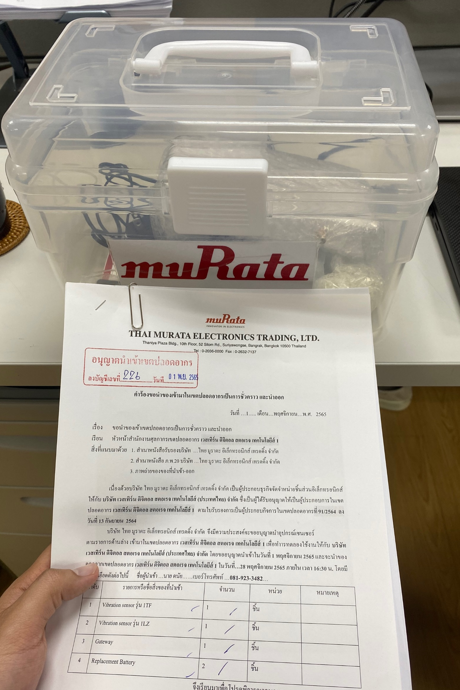
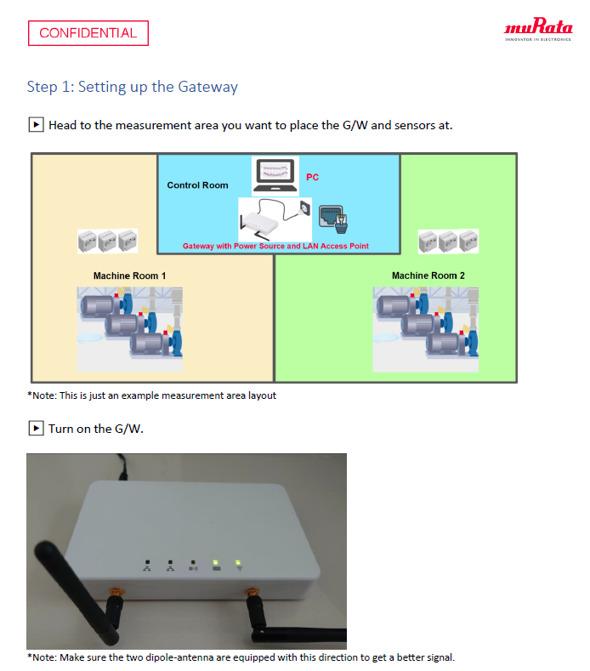
Smart Check Sheet for Electrical System
Status : Test vibration sensor and study sensor
Substation 1 Summary Dashboard
Schedule : Kick-off substation 2 smart check sheet / On Plan
Activities | Sep | Oct | Nov | Dec
Get Requirement for EE Smart Check Sheet | Done
Review current check sheet and substation survey | Done
Develop EE Smart check sheet on iPad for Sub#1 | Done
Training & User Acceptance Test |  | Done
Kick off substation2 smart check sheet |  |  | Ongoing | Plan
Study sensor / MS SQL [BMS DB] / JMP [Analytics Tool] |  |  | Ongoing | Plan
CSR and SSL Process |  |  | Ongoing
Get vibration sensors from Murata and study sensor
Progress Status :
Completed to design and create database for EE smart check sheet and deploy to WD server
Completed to create data validation function : show result immediately
Completed develop dashboard function for EE smart check sheet
Training smart check sheet and user acceptance test at MR1
Under SSL & CSR process
Get vibration sensors from Murata and study sensor
Next Follow up :
Under SSL & CSR process
Kick off substation 2 smart check sheet

