Slide 1
Real Estate Operations, Manufacturing Operations
PRB REO Weekly Report
Facility Engineering
WW16 FY23 (Oct 17’22)
Real Estate Operations, Manufacturing Operations

Slide 2
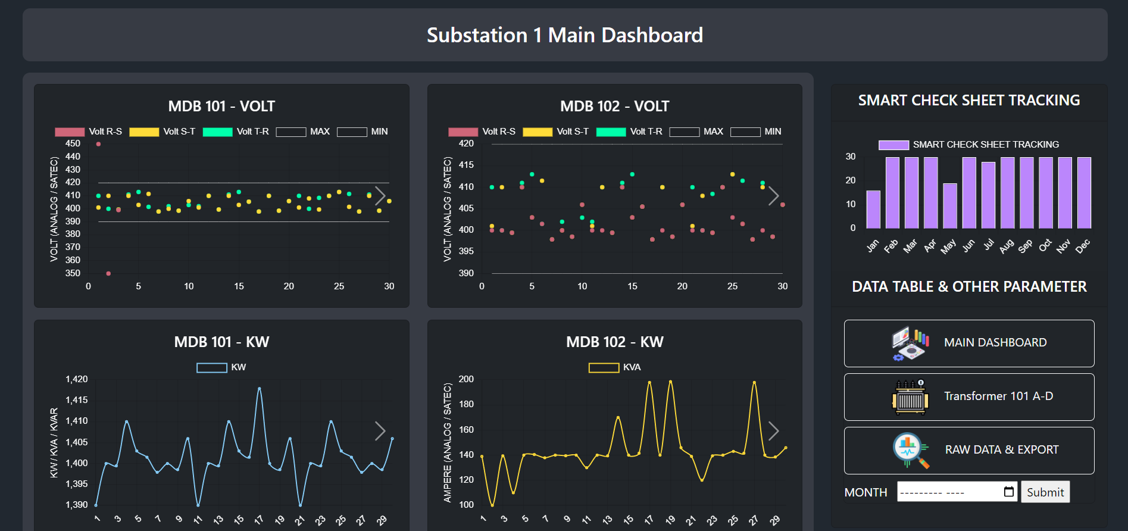
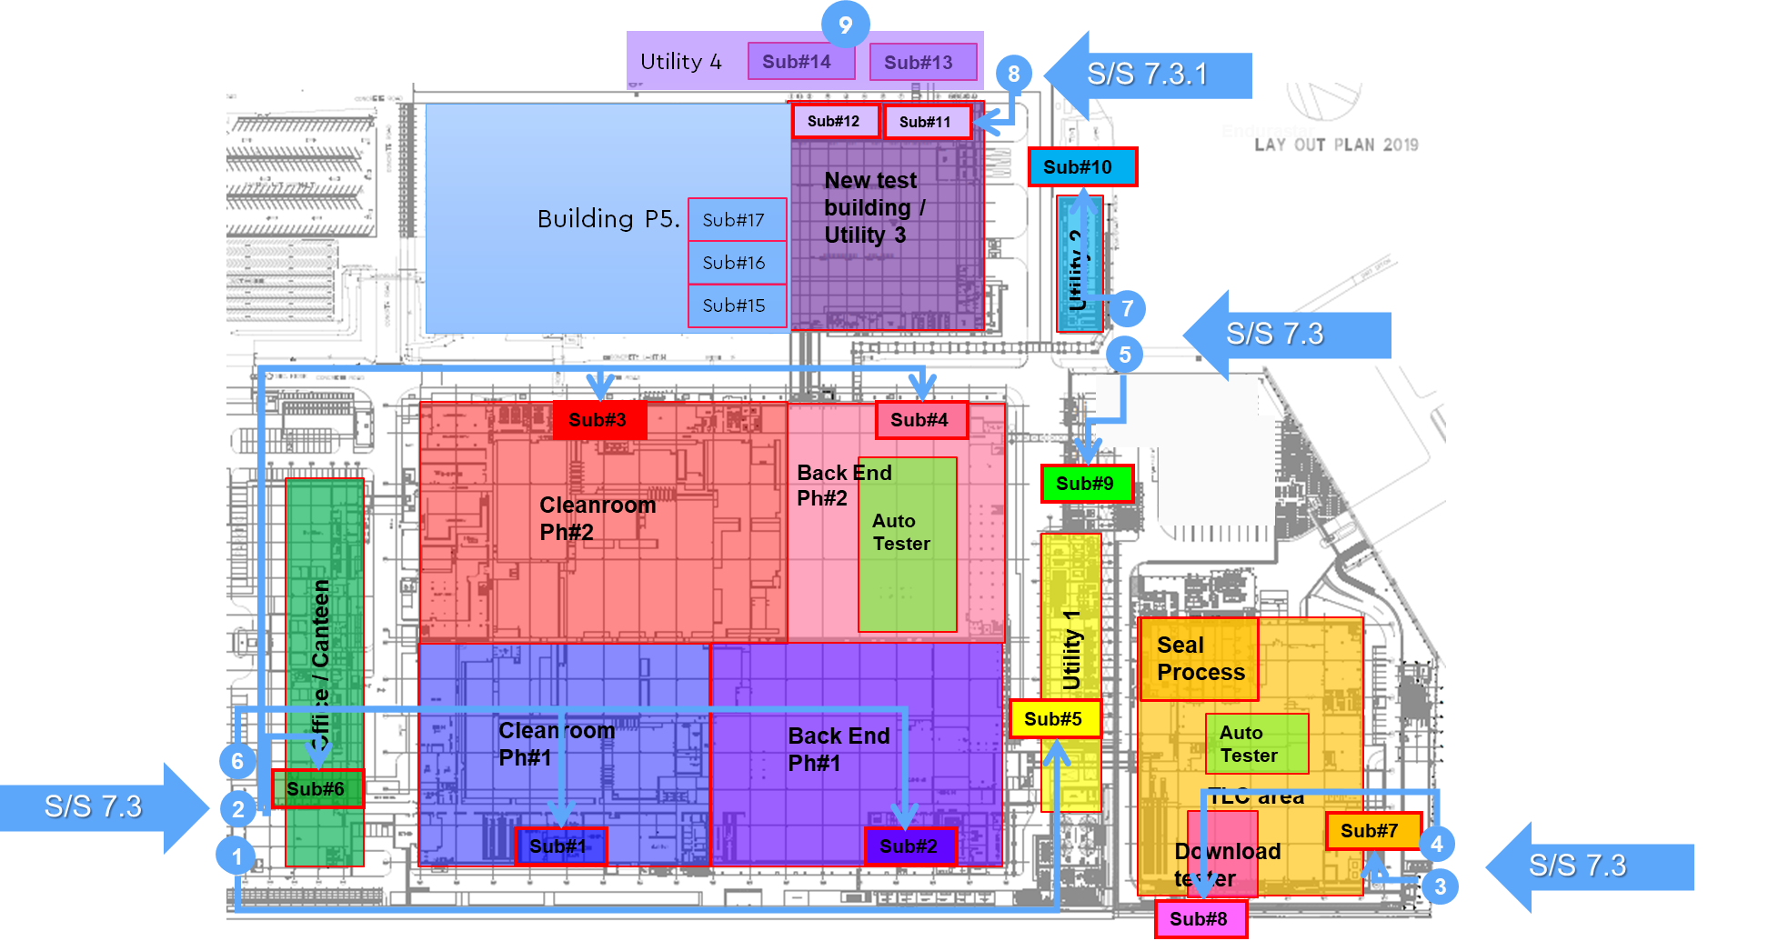
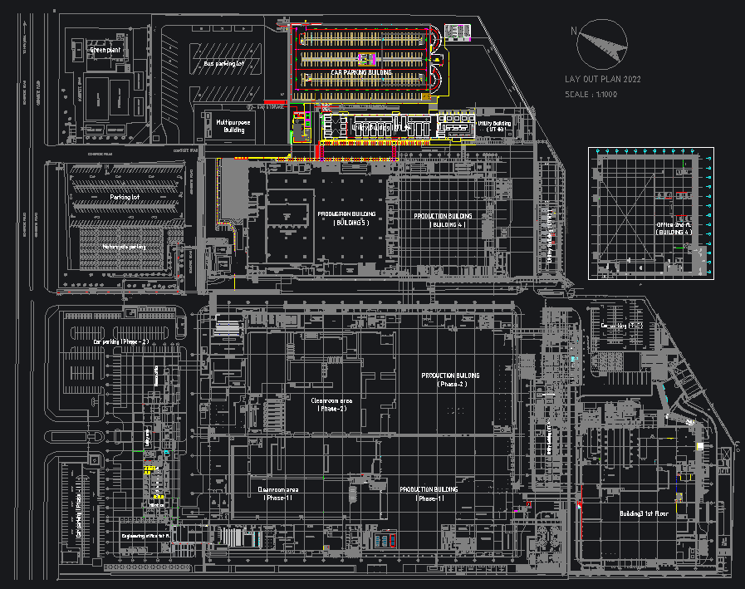
Smart Check Sheet For Electrical System
Status : Under SSL & SSO process and additional ways for requesting authorization
Schedule : Discuss to IT Security about SSL & SSO / On Plan
Substation 1 Monitoring Dashboard
Activities | Sep | Oct | Nov
Get Requirement for EE Smart Check Sheet | Done
Review current check sheet and substation survey | Done
Design and develop EE Smart check sheet on iPad for Sub#1 | Done
Design and develop EE Smart check sheet Dashboard for Sub#1 | Done
SSL & SSO process |  | on plan
User Acceptance Test |  |  | Plan
Progress Status :
Completed to develop EE smart check sheet for Sub #1 on iPad
Completed to design and create database for EE smart check sheet and deploy to WD server
Completed to create data center for validate data
Completed to create data validation function : show result immediately
Completed develop dashboard function for EE smart check sheet
Under SSL & SSO process and additional ways for requesting authorization
Add substation layout to dashboard
Next Follow up :
Under SSL & SSO process and additional ways for requesting authorization ➔ CP. FW16

