Slide 1


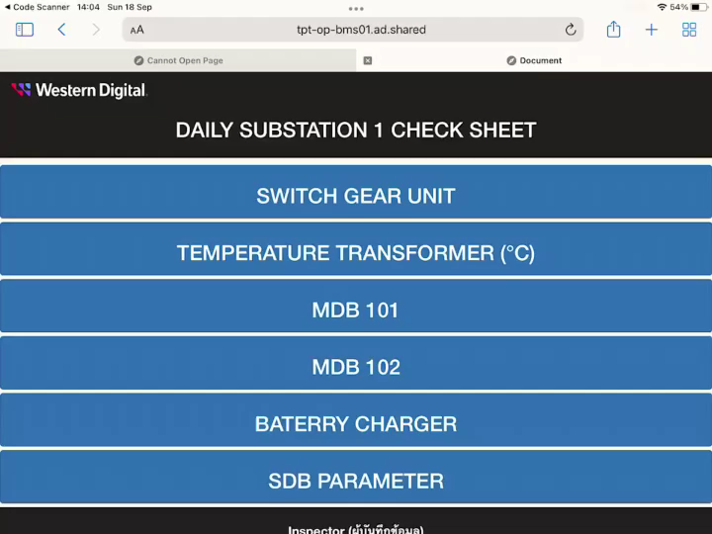
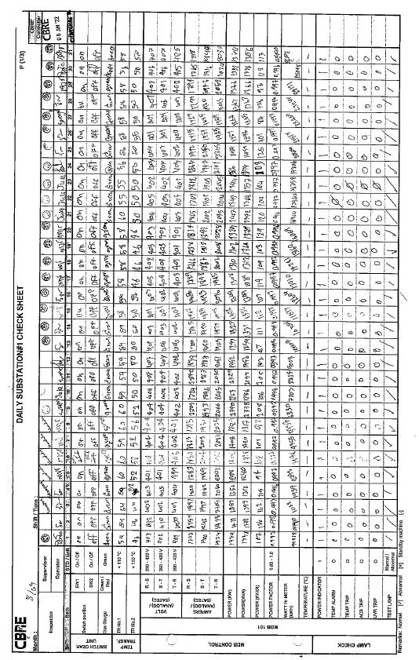
Smart Check Sheet For Electrical System
Status : Completed to develop EE smart check sheet for Sub #1 on iPad
Smart Check Sheet for electrical system on iPad
Schedule : Develop Dashboard to display Sub #1 status / On Plan
Activities | Sep | Oct | Nov
Get Requirement for EE Smart Check Sheet | Done
Review current check sheet and substation survey | Done
Design and develop EE Smart check sheet on iPad for Sub#1 | Done
Design and develop EE Smart check sheet Dashboard for Sub#1 | on going
User Acceptance Test for Sub#1 |  | Plan
Expand to next substation [ Sub #2 – Sub #17 ] |  |  | Plan
Progress Status :
Completed to get requirement ,review current check sheet with team and completed to substation survey
Completed to develop EE smart check sheet for Sub #1 on iPad
Completed to design and create database for EE smart check sheet and deploy to WD server
Design dashboard for display result and make an automatic reports
Current Check Sheet for electrical system
Next Follow up :
Design dashboard for display result and make an automatic reports
User Acceptance Test for Sub#1

