Slide 1

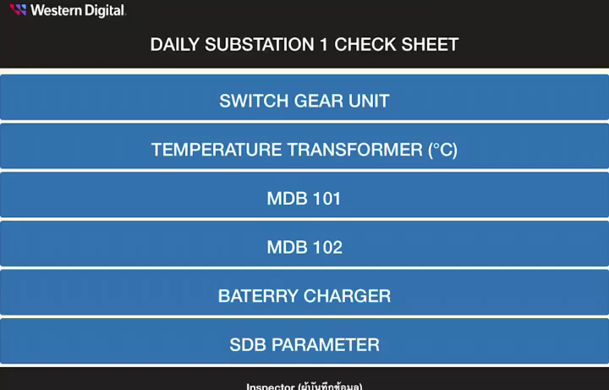
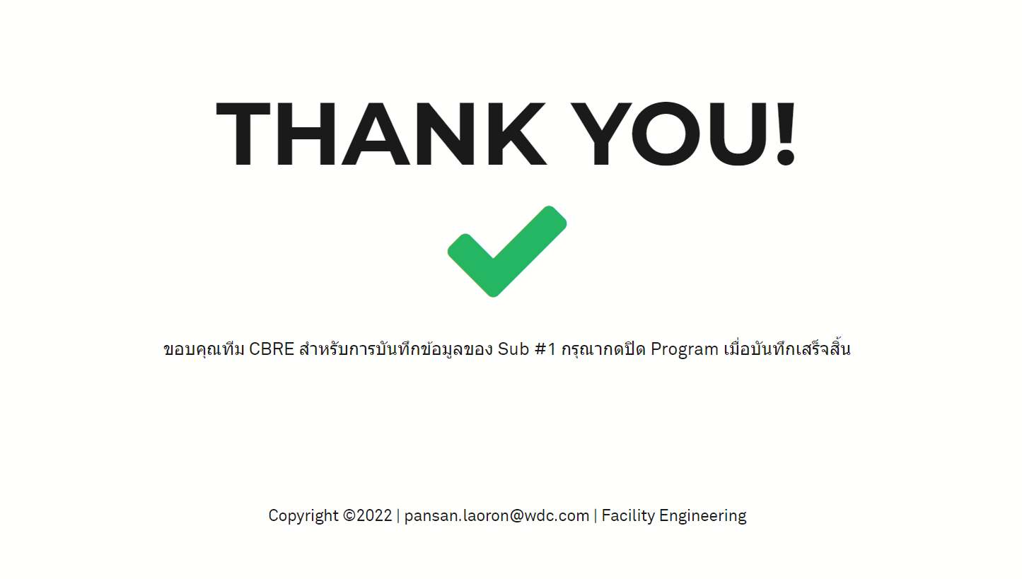
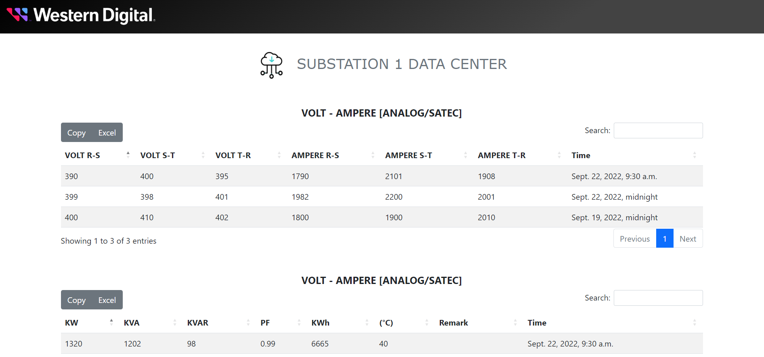



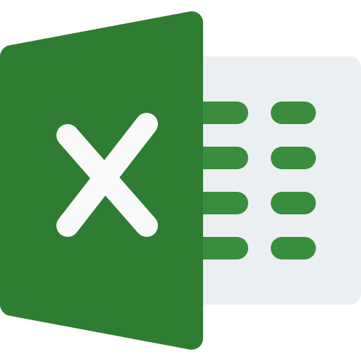
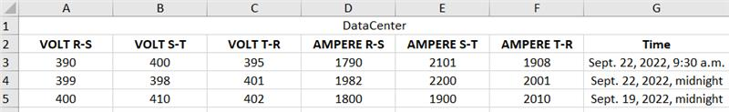
Smart Check Sheet For Electrical System
Status : Completed to develop EE smart check sheet for Sub #1 on iPad
Schedule : Develop Dashboard to display Sub #1 status / On Plan
Smart Check Sheet For EE System on iPad
After CBRE team submit to system
Activities | Sep | Oct | Nov
Get Requirement for EE Smart Check Sheet | Done
Review current check sheet and substation survey | Done
Design and develop EE Smart check sheet on iPad for Sub#1 | Done
Design and develop EE Smart check sheet Dashboard for Sub#1 | on going
User Acceptance Test for Sub#1 |  | Plan
Expand to next substation [ Sub #2 – Sub #17 ] |  |  | Plan
Progress Status :
Completed to get requirement ,review current check sheet with team and completed to substation survey
Completed to develop EE smart check sheet for Sub #1 on iPad
Completed to design and create database for EE smart check sheet and deploy to WD server
Completed to create data center for validate data
Continue develop dashboard function for EE smart check sheet
PRB Factory Metrics
Next Follow up :
Design dashboard for display result and make an automatic reports
User Acceptance Test for Sub#1
Copy
Excel File

