Slide 1
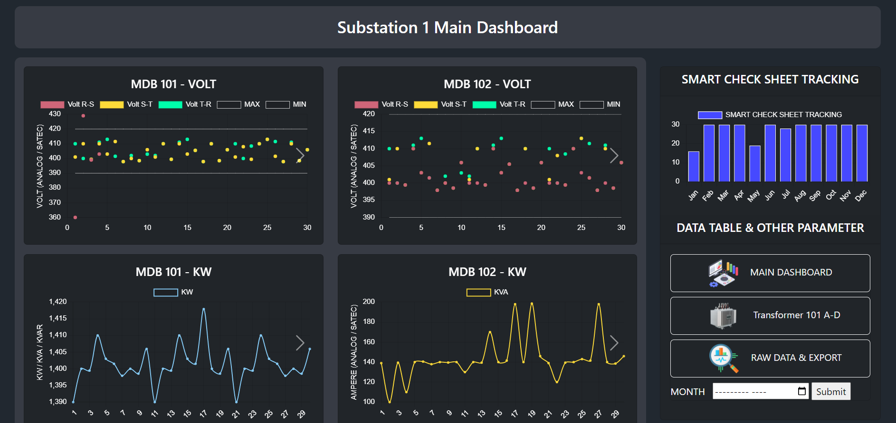
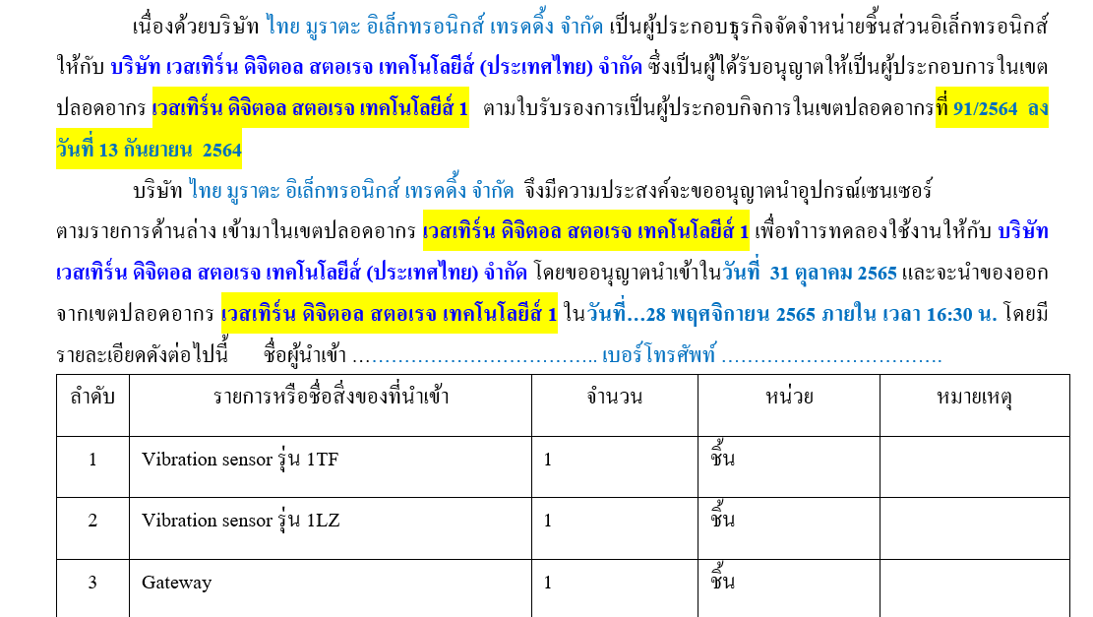
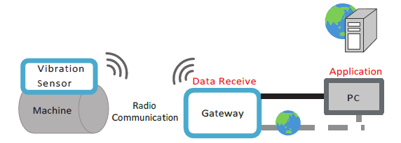
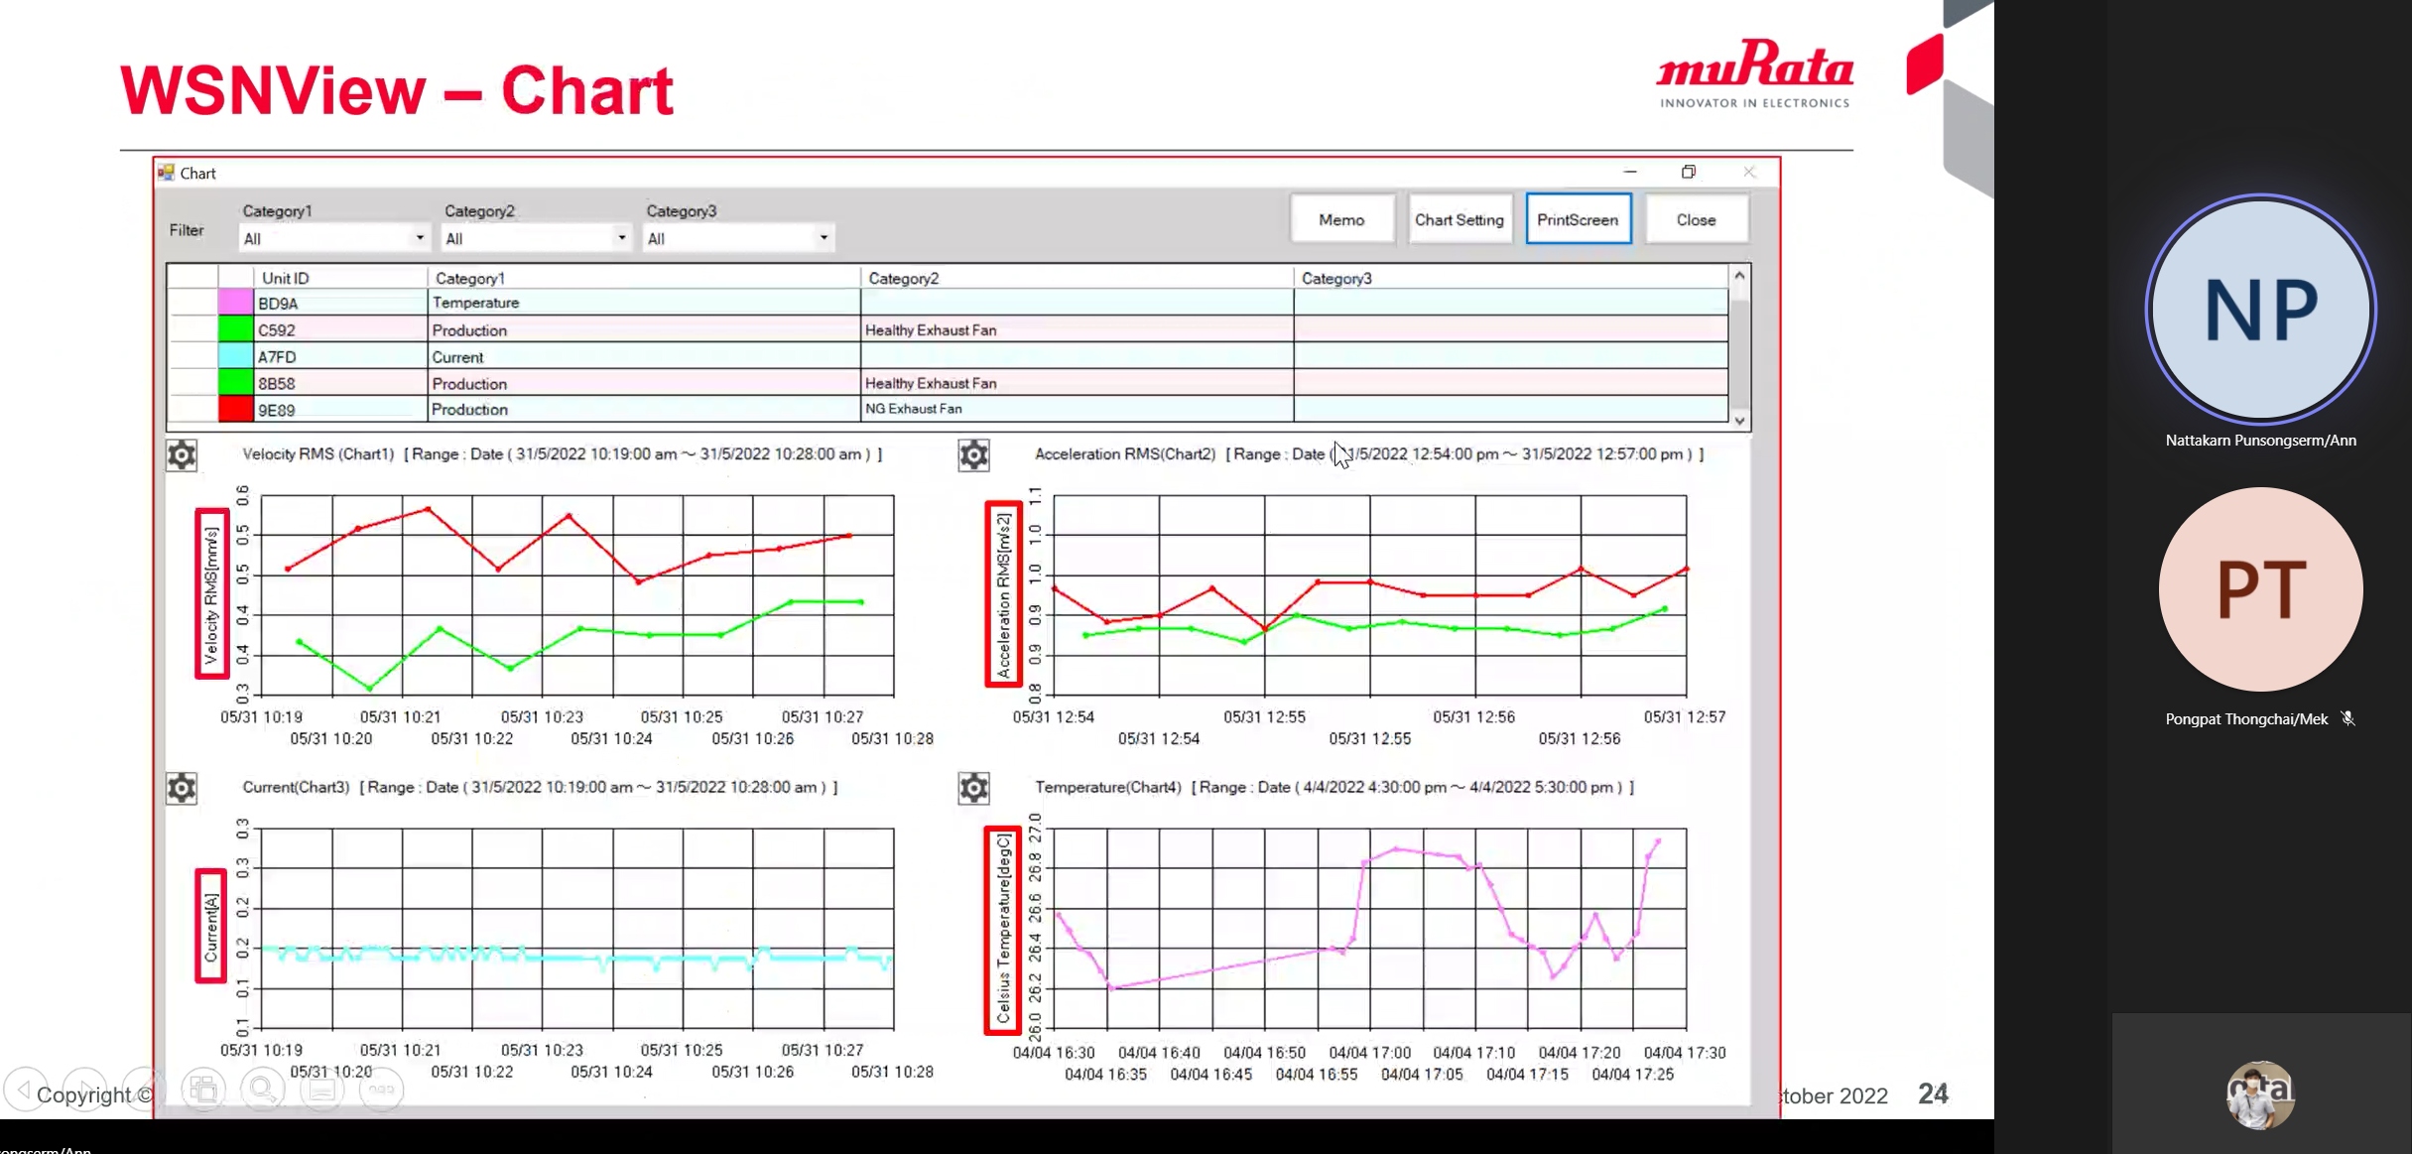
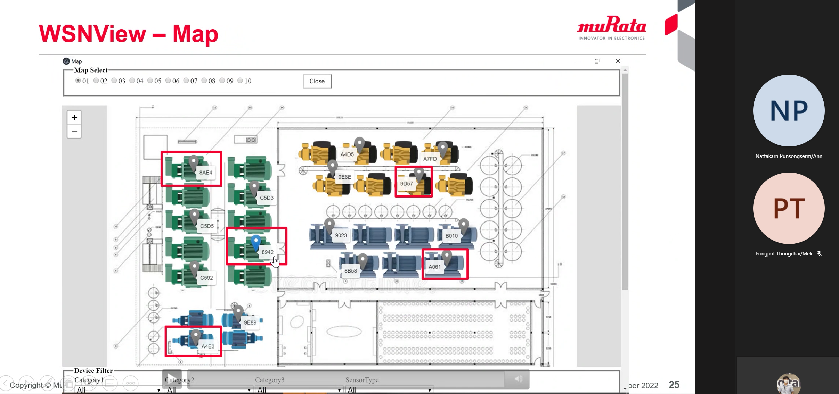
Smart Check Sheet for Electrical System
Status : Contact to supplier for borrowing sensors (Data Analytics)
Schedule : Discuss to IT Security about SSL & SSO / On Plan
Activities | Sep | Oct | Nov
Get Requirement for EE Smart Check Sheet | Done
Review current check sheet and substation survey | Done
Design and develop EE Smart check sheet on iPad for Sub#1 | Done
Design and develop EE Smart check sheet Dashboard for Sub#1 | Done
Training & User Acceptance Test |  | Done
SSL and SSO Process |  | on plan | Plan
Progress Status :
Completed to design and create database for EE smart check sheet and deploy to WD server
Completed to create data validation function : show result immediately
Completed develop dashboard function for EE smart check sheet
Training smart check sheet and user acceptance test at MR1
Under SSL & SSO process and additional ways for requesting authorization
Contact to supplier for borrowing sensors (Data Analytics)
Next Follow up :
Under SSL & SSO process and additional ways for requesting authorization

