Slide 1

Sharing Session

Slide 2
Profile
Hello! My name is Pansie
I majored got my Bachelor ‘s degree in aerospace engineering
My interests are modeling dynamical systems and
developing control algorithms, and parameter estimation
Japanese studies
I started learning Japanese when I learned about the chance to work in Japan.
After that I started taking Japanese classes with AtoJ.
I tried to balance the Japanese classes and my normal studies by attending as much as possible.
After a year, I received an email that I can start applying for jobs

Slide 3
Job Application
I submitted the required documents for my FYP, along with a self-introductory video.
With the support of AtoJ representatives, I attended three interviews across different periods: one in February, one in May, and one in July.
Before each interview, I consistently received guidance from the representatives, including one-on-one meetings.
I also had individual sessions with a Japanese mentor and practiced through mock interviews.

Slide 4

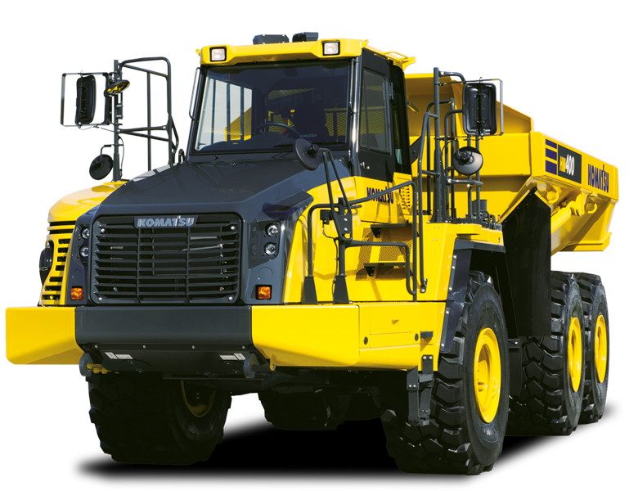
Job Offer
I passed the first interview for Komatsu on 15th July and then the next day I had to do one more interview finally I received the offer on 17th July!
Location: Kanagawa Prefecture.
Position: Embedded software engineer, vehicle control system development group
Role:
I will develop and verify controllers for autonomous dump trucks
Komatsu is a well- known international company oriented towards automating construction equipments and developing controllers for different machinery

Slide 5
Thank you!
Notes:
Feel free to contact me:
LinkedIn profile: https://www.linkedin.com/in/pansyhelmy/.

Slide 6
ALTERNATIVE RESOURCES
Here’s an assortment of alternative resources whose style fits the one of this template:
Hand drawn airplane outline illustration

