Slide 1
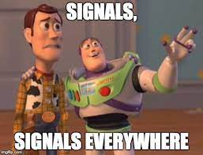
SDR
Par rj45

Slide 2
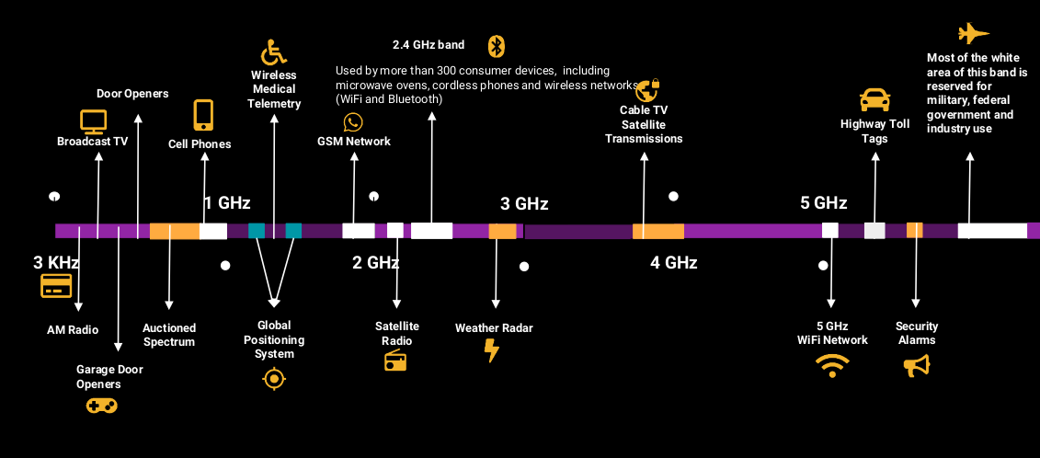

Slide 3
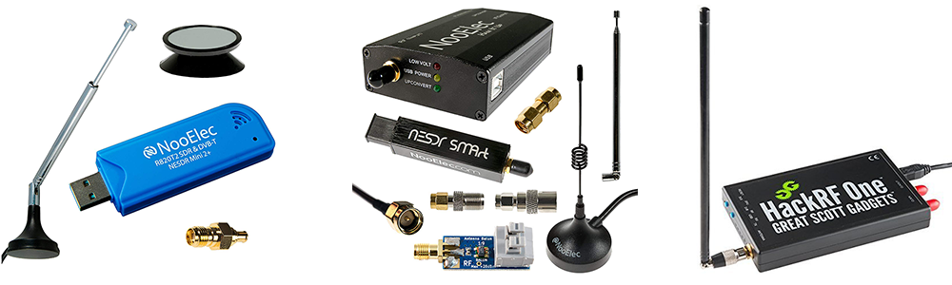

Slide 4
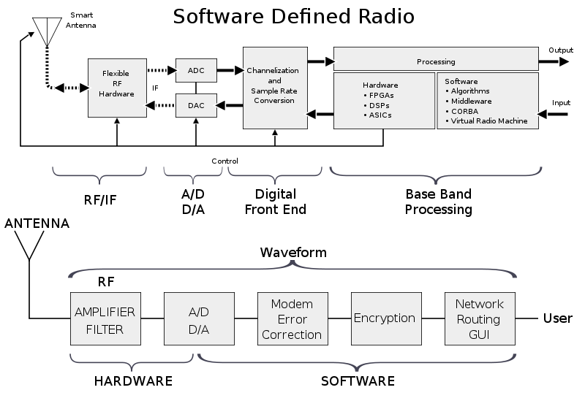

Slide 5
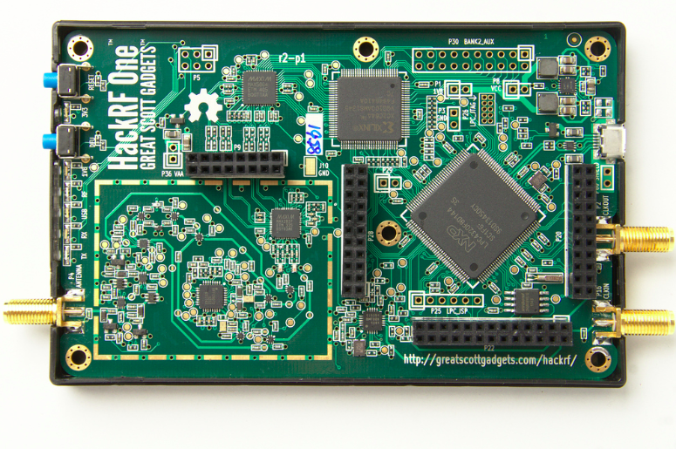
HackRF ONE
- 1 MHz to 6 GHz operating frequency
- half-duplex transceiver
- up to 20 million samples per second
- 8-bit quadrature samples (8-bit I and 8-bit Q)
- compatible with GNU Radio, SDR#, and more
- software-configurable RX and TX gain and baseband filter
-software-controlled antenna port power (50 mA at 3.3 V)
- SMA female antenna connector
-SMA female clock input and output for synchronization
-convenient buttons for programming
- internal pin headers for expansion
- Hi-Speed USB 2.0
- USB-powered
- open source hardware

