Slide 1

Solution:
Tri-Protos: UART + I2C + SPI

Slide 2
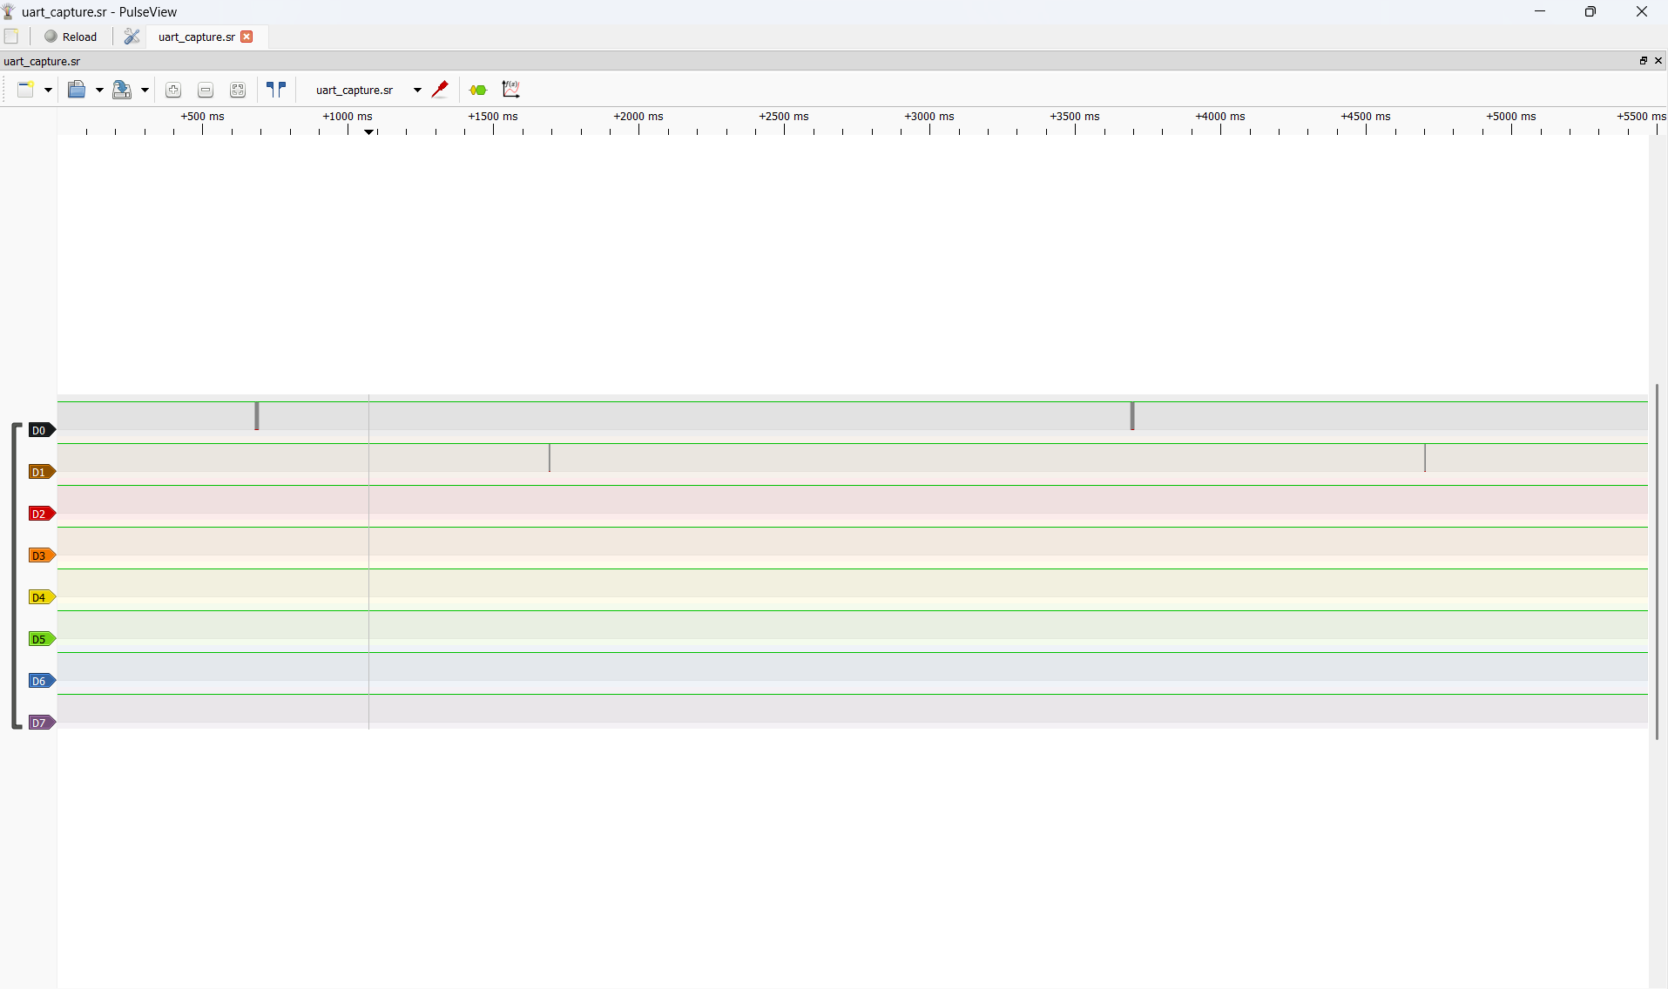

Solution Uart
1
3
1: Open the capture file.
2: Section containing the captured frames.
3: Click here to add protocole (UART)
2

Slide 3
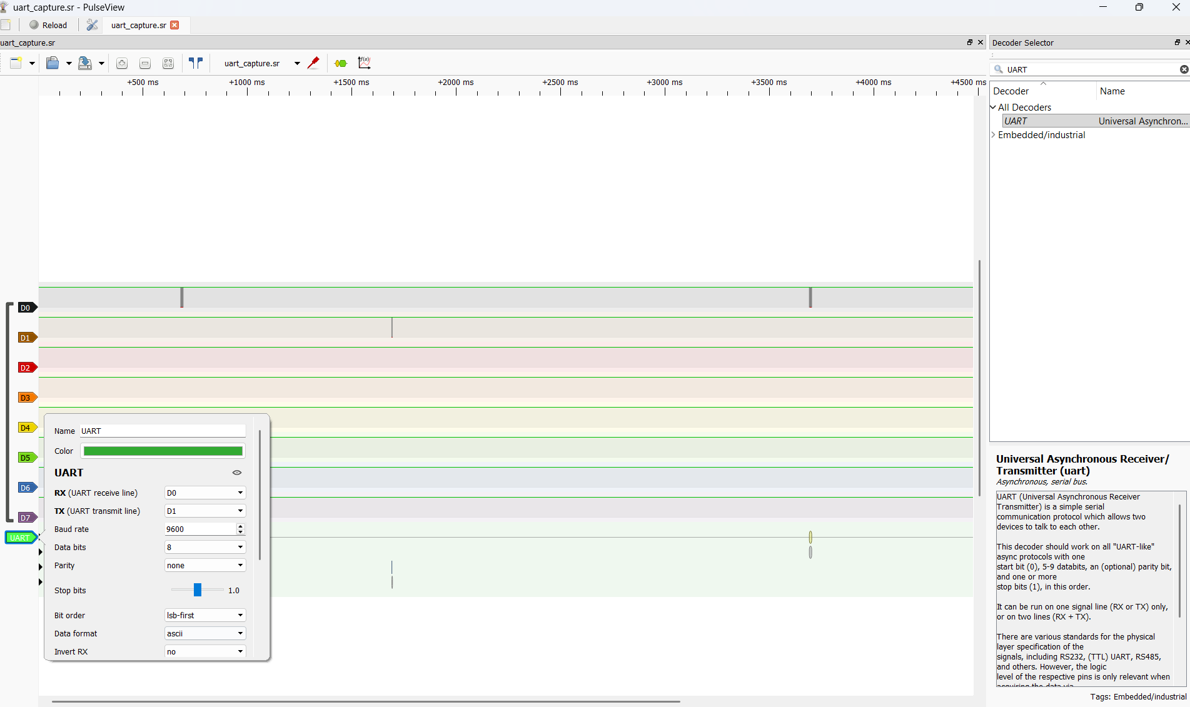
Solution Uart
4
4: Search UART and click on
5: Open menu, a settings are:
RX: D0
TX: D1
Baud rate: 9600
Data bits: 8
Parity: None
Stop bits: 1.0
Bit order: lsb-fist
Data format: ASCII
5

Slide 4
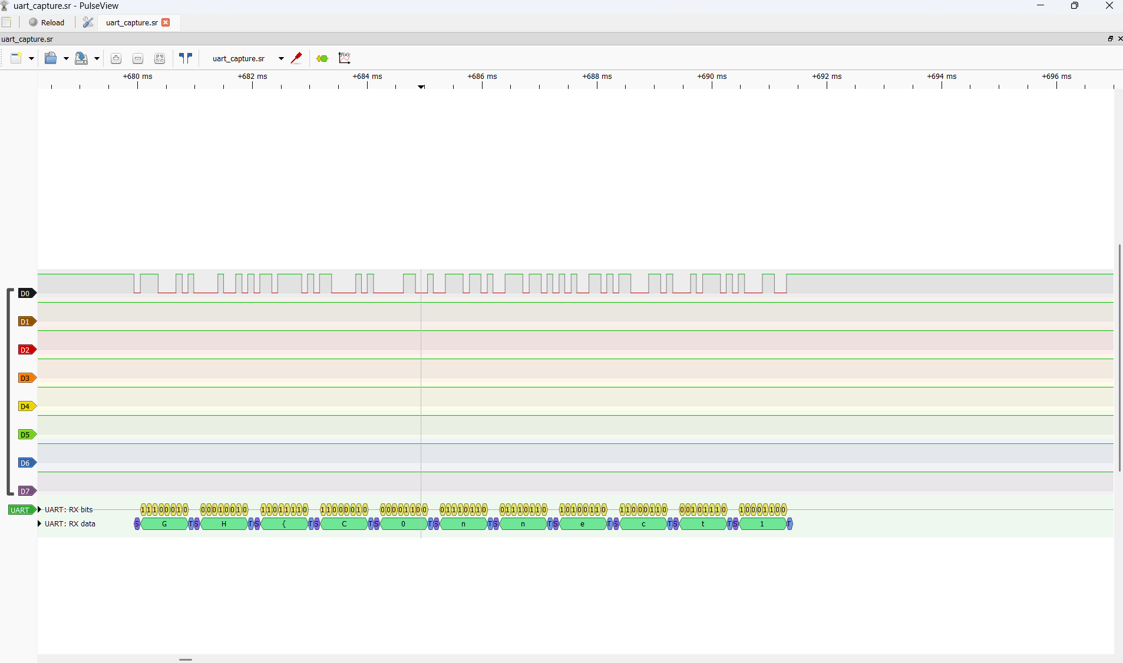

Solution Uart
4
Zoom on largest tram
5

Slide 5
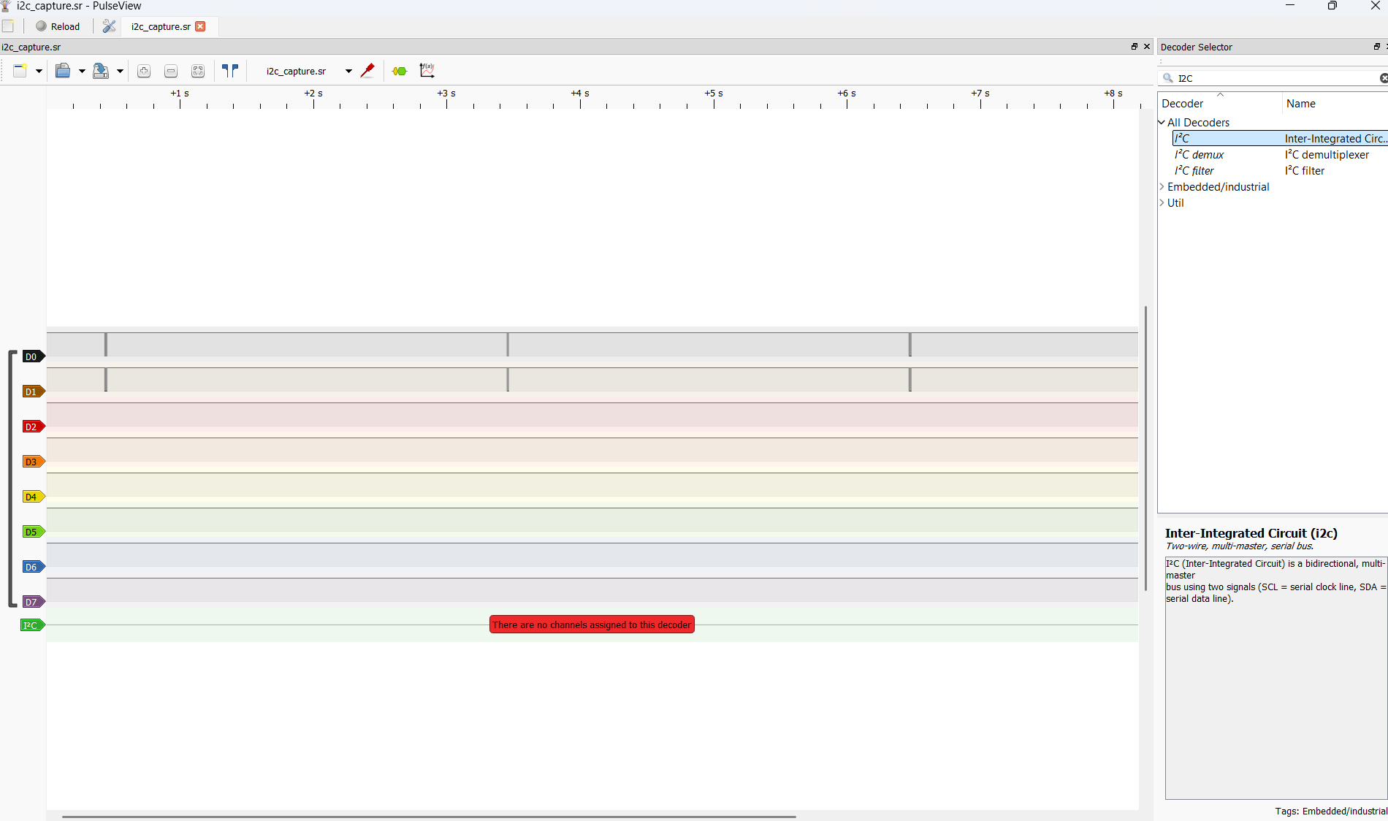
Solution I2C
1
3
1: Open the capture file.
2: Section containing the captured frames.
3: Click here to add protocole (I2C)
3
2

Slide 6
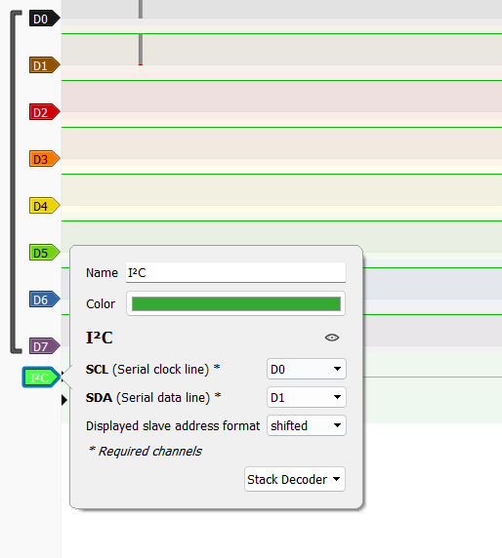
Solution I2C
Like UART, put D0 on SCL and SDA on D1

Slide 7
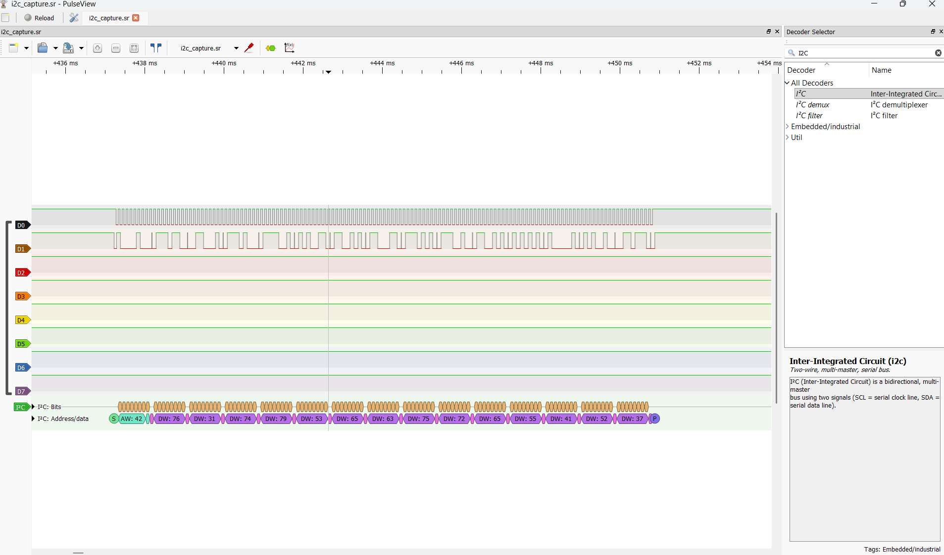

Solution I2C
In DW case, you have flag. But there is second option.

Slide 8
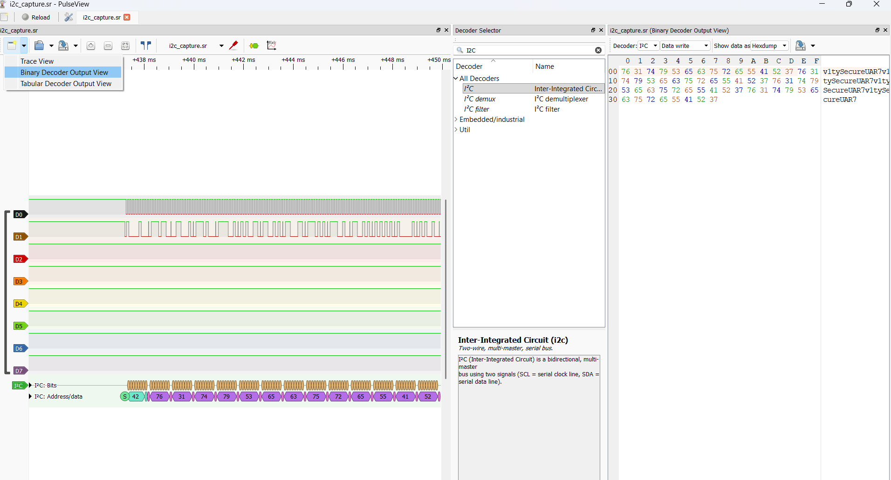

Solution I2C
1: click on down arrow and choose « Binary decoder output view»
2: Choose data write
3: part of flag is here
2
1
3

