Slide 1
ADB Glue Service
OCTOBER 2026
Orders and true stock between an Adobe Commerce shop, eMAG and one warehouse
Pantelimon Gulie
Senior Forward Deployed Engineer
SHOP · ADOBE COMMERCE
ORDERS · STOCK
GLUE
Electronic Market
Every order once.
True stock back.
A person for the rest.
RESERVE · STOCK
WAREHOUSE
Bucharest warehouse
MARKETPLACE · EMAG
ORDERS · STOCK
eMAG
Notes:
- One line about me, then the plan: about 35 minutes of slides with a 5-minute live demo, then the code and your questions.
- The scenario is my choice: a Romanian electronics reseller with its own Adobe Commerce shop, the eMAG Marketplace, and one warehouse in Bucharest.
- The brief was a glue service that keeps systems in sync and handles conflicts, retries and partial failures.
- The picture on this slide is the whole idea: every order reaches the warehouse once, the warehouse's true stock goes back to both channels, and a person decides what is not safe to decide automatically.
- Everything runs locally with Docker Compose. The shop, eMAG and the warehouse are mocks shaped like the real APIs.

Slide 2
The customer and the problem
CONTEXT
A Romanian electronics reseller sells Apple products on its own Adobe Commerce shop and on the eMAG Marketplace. Both sell from one warehouse in Bucharest.
SHOP · ADOBE COMMERCE
BY HAND
WAREHOUSE
BY HAND
MARKETPLACE · EMAG
Electronic Market
A FEW TIMES A DAY
Bucharest warehouse
A FEW TIMES A DAY
eMAG
Today nothing connects the three. Staff copy orders into the warehouse system and type stock back into both channels. In between, the channels show stale stock.
The last unit sells twice
Orders missed or doubled
Stock is stale
eMAG penalises cancelling
Both channels still show it for minutes. One customer has paid for something that does not exist.
eMAG orders typed in by hand get skipped or entered twice.
A recount in the warehouse reaches the channels hours later.
eMAG measures the seller's cancellation rate, so an oversell there costs more than the one sale.
Notes:
- The customer sells Apple products in Romania through two channels: Electronic Market, its own Adobe Commerce store, and the eMAG Marketplace. One warehouse in Bucharest serves both.
- Today nothing connects them. A person copies orders into the warehouse system and types stock figures back into both channels a few times a day.
- The painful case is the last unit: it sells on both channels within minutes, and one customer has paid for something that does not exist.
- eMAG measures the seller's cancellation rate and penalises sellers who cancel too often, so every oversell on eMAG costs more than the one sale.
- So the job is not just moving data. It is moving it once, keeping stock honest, and being careful with paid orders.

Slide 3
What the glue does
CONTEXT
SHOP
ORDERS
GLUE
What it promises
Electronic Market
Glue
Every order reaches the warehouse once
1
TRUE STOCK
dedupes
retries
reconciles
asks
RESERVE ONCE
WAREHOUSE
whatever is duplicated, delayed or out of order.
Bucharest
warehouse
STOCK, SHIPPED
MARKETPLACE
ORDERS
2
Both channels show the warehouse's figure
eMAG
TRUE STOCK
seconds after a change, and any drift heals within 10 seconds.
WHEN UNSURE
3
When it cannot decide safely, it asks
PERSON
a person sees the order, the reason and what each choice does.
Operator
the review queue
Notes:
- One picture: orders come in from both channels as they happen. The glue reserves each one at the warehouse exactly once.
- After every change it pushes the warehouse's true figure back to both channels, and it repeats that every 10 seconds so drift heals on its own.
- Duplicates, outages and slow systems are handled without anyone watching.
- When it cannot decide safely, for example the warehouse refuses an order a customer already paid for, it does not guess. It puts the order in a review queue with the reason, and a person picks.
- Those three promises are what the rest of the talk backs up.

Slide 4
Architecture
DESIGN
SHOP · ADOBE COMMERCE
SIGNED EVENTS
GLUE · ONE FASTAPI PROCESS · :8000
Electronic Market
Inbox
Worker
Router
mock, :8001
STOCK, STATUS
verify, save,
answer 202
one order
at a time
only writer of
order status
RESERVE, CANCEL
WAREHOUSE
Bucharest
warehouse
Audit log
Reconciler
Review queue
SHIPPED, RECOUNT
NOTIFY: ID ONLY
every step, with
a correlation id
true stock to
both channels
a person
decides
mock, :8003
MARKETPLACE · EMAG
eMAG
mock, :8002
READ, ACK, STOCK
SQLite inbox, orders, stock, audit
Retry policy
JSON API
OPENAI-COMPATIBLE
PEOPLE
BROWSER
OLLAMA CONTAINER
Docker Compose: four services from one image, plus Ollama.
Operator
SIGNS IN
React dashboard
Local model
viewer, operator, admin
served by the glue
qwen2.5:3b, read-only use
Notes:
- Four services from one Docker image: the three mocks and the glue, plus the Ollama container for the local model.
- The glue is one FastAPI process with one SQLite file. Inside, the work is split so each job has exactly one owner.
- Inbox: checks the HMAC signature and the schema, saves the event and answers 202. Nothing is processed inside the request, so nothing is lost if processing fails.
- Worker: claims pending events, up to 10 at a time, and runs events for the same order one at a time.
- Router: the only code that changes an order's status. Reconciler: the only code that pushes stock. One retry policy wraps every outbound call.
- Review queue: what the glue will not decide alone. Audit log: one row per step with a correlation id, mirrored as a JSON log line.
- The React dashboard is built once and served by the same FastAPI process over a JSON API with sessions, roles and a CSRF header.
- The warehouse owns the truth. The channels only show what the glue last told them.
- Detailed diagrams (component map, both order sequences, the oversell, order and review item states) are in docs/presentation/diagrams and docs/architecture.md.

Slide 5
Technologies, and why each one
DESIGN
Sync core Python 3.12, FastAPI, httpx, SQLite | One language for the glue and the mocks; async calls with explicit timeouts; a durable inbox with no extra service
Operator console React + TypeScript | The person in the loop needs a screen; built once and served by the glue
Local AI Ollama | No API key; order data never leaves the machine
Run and test Docker Compose, pytest, Vitest | One command to start; 245 backend and 223 frontend tests
Deliberately not used
A message broker. The inbox table is the queue and survives restarts. One shop does not need more yet.
Postgres. One writer is enough here. All SQL is in glue/db.py, so the move is one file.
An ORM. Plain SQL in one file is easier to review.
Websockets. Polling every few seconds is fine for one operator.
A hosted model. Order data stays local. Hosted models show as coming soon.
Notes:
- Python and FastAPI: one language everywhere, and pydantic models validate every inbound payload strictly at the edge.
- httpx: explicit timeouts on every call, and its ASGI transport lets the tests run all four apps in one process with no network.
- SQLite: the glue needs durability more than throughput. The inbox, orders and audit log survive restarts with no extra service. The schema is versioned with PRAGMA user_version and an ordered list of migrations.
- React and TypeScript: the dashboard is the operator's product, with live views, so a typed SPA is worth it. TanStack Query does the polling and caching, Recharts the Flow charts, cmdk the command palette.
- Ollama through the OpenAI SDK: a local model, no key, no order data leaving the machine. The same SDK can point at a hosted model later.
- Not used, on purpose: a broker, Postgres, an ORM, websockets, a hosted model. Each has a clear trigger for when I would add it, which I cover on the scaling slide.
- Test counts are after the final fix wave, as in the README: 245 backend, 223 frontend.

Slide 6
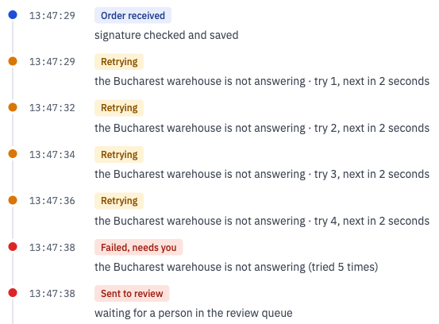
A shop order, with retries
HOW IT WORKS
1
Customer pays
2
Inbox
3
Worker
4
Warehouse reserve
5
Stock pushed
order.placed, signed, with an event id
verify, save, answer 202
claims it, takes the order's lock
Idempotency-Key: shop-1001
new figure to the shop and eMAG
Step 4 when the warehouse is struggling
503 · Retry-After: 2
wait 2 s
503
wait 2 s
201
201
Reserved. The reconciler pushes the new figure for that product to both channels.
409
Sold out. Review item; a person decides: retry later, cancel, or close.
5 tries
Warehouse outage. Review item: Retry, Retry all, or the auto-retry rule once the warehouse answers.
A real order's history: four retries 2 s apart, then review. A person retried it later and it was reserved.
Notes:
- The shop, shaped like Adobe Commerce, sends order.placed with an event id and an HMAC signature. The inbox verifies it, validates it, saves it and answers 202.
- The worker claims pending events and takes a lock for that order id, so two events for the same order never run at the same time.
- The router reserves at the warehouse with the glue's order id as the Idempotency-Key. If the warehouse reserved but the reply was lost, the retry gets the first answer back.
- The middle row and the screenshot are the same pattern: the warehouse answers 503 with Retry-After 2, the glue waits exactly that, and every wait is a row in the order's history, in plain words.
- Three outcomes. 201: reserved and stock pushed. 409: the warehouse has none, so it goes to review as sold out. Still failing after 5 tries: review as a warehouse outage, which Retry, Retry all, or the auto-retry rule can clear once the warehouse answers. Only the warehouse not answering counts as an outage; a channel that ran out of tries is filed under other.
- The order in the screenshot was later given a suggestion, retried by admin and reserved, and its stock pushes follow on the same page.

Slide 7
Stock: pull the truth, push it everywhere
HOW IT WORKS
When it runs
Product | Free | To shop | To eMAG | State
AirPods Pro 3 | 37 | 37 | 37 | sent to both
iPad A16 | 14 | 14 | 14 | sent to both
iPhone 16 · 128GB | 24 | 24 | 24 | sent to both
iPhone 16 · 256GB | 9 | 9 | 9 | sent to both
MacBook Air M4 | 20 | 20 | 20 | eMAG refused
Apple Watch S10 | 7 | 7 | 7 | sent to both
at startup
every 10 s
on a warehouse recount
after every reservation or cancel
What it pushes
max(0, on_hand - reserved) - held back by a rule
Every product, every run, even when nothing seems to have changed. A restarted channel or a lost update is fixed on the next run.
Events make it fast; the pull makes it correct.
A recount below reserved caps both channels at 0 and sends only the newest orders the shelf cannot cover to review.
Free to sell against the last figure Glue sent each channel, from the Stock page in a dry run with eMAG refusing MacBook Air M4.
Batch of 6
5 applied
MacBook dirty
Next run
product_offer/save
MacBook refused
stock_push_failed
all 6 again, flag cleared
A partial batch failure on eMAG, healed without anyone touching it.
Notes:
- The warehouse owns stock. Its figure, on hand minus reserved, is the truth; the channels only show what the glue last told them.
- The reconciler runs at startup, every 10 seconds, after every reservation or cancellation, and on every recount event. Runs hold one lock, so a slower run cannot overwrite a newer figure.
- It pushes every product on every run, even when the cache says nothing changed. That costs a few calls and heals any drift: a missed event, a restarted channel, a rejected update.
- eMAG's batch API answers per item. In the table eMAG refused the MacBook Air update: that one row is marked dirty, the other five applied, and the next run fixes it. A rate limit (429 with Retry-After 1) works the same way after its retries.
- The Stock page shows what Glue last sent each channel and whether the channel accepted it. Honest limit: Glue knows what a channel accepted, not what it shows; reading eMAG's offers back during reconcile would close that.
- The stock buffer rule can hold units back from one channel, so the last unit sells on the shop only. It is off by default; it is a business decision.
- A recount below reserved caps both channels at 0. Glue works out how many units are short and sends only the newest reserved orders that cover the shortfall to review, under 'Shelf count too low'. A later count that covers them closes those items by itself. Retry is not offered there, because those orders still hold a reservation.

Slide 8
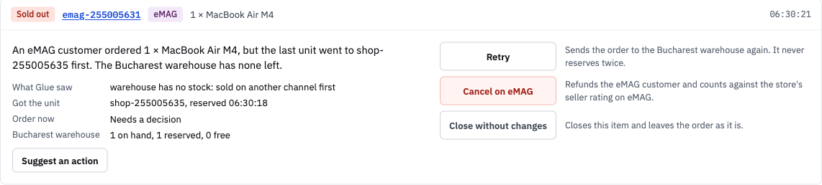
The oversell, decided by a person
CONFLICTS
Why a person decides
The customer has paid. Stock may arrive tomorrow. On eMAG a seller cancellation costs rating. That is a business call.
How it happens
Causes in the queue
What each action does
The last MacBook Air sells on the shop; the warehouse reserves it.
eMAG has not applied the new figure yet and still shows 1.
An eMAG customer buys it; the warehouse answers 409.
Glue acknowledges it on eMAG and queues it as sold out, naming the order that got the unit.
Warehouse outage: the warehouse did not answer
Sold out: the other channel won
Shelf count too low: the newest orders a short shelf cannot cover
Other: shown with what Glue saw
Retry: sends it again, never reserves twice
Cancel: after a confirm, on its channel; the customer is refunded
Close without changes: handled elsewhere
Notes:
- The conflict that matters is the cross-channel oversell: both channels show the last unit for a moment and two customers pay for it.
- The rule is first to reach the warehouse wins. The warehouse's reservation is atomic, so exactly one order gets the unit and the other gets 409. Neither channel is preferred.
- The loser is a paid order. Cancelling it is a business decision: maybe stock arrives tomorrow, maybe the customer takes another model, and on eMAG the cancellation counts against the seller's rating.
- So the glue does the safe part: it reserves nothing it cannot fill, never offers below zero, acknowledges the order on eMAG because it exists there either way, and queues it with the reason.
- The card says what happened in plain words, what Glue saw, which order got the unit, and what each button will do. Cancel asks for a confirm first (Yes, cancel it). Actions depend on the order's state: Retry only from the state the failed step left it in, Cancel unless shipped or cancelled.
- Suggest an action asks the local model for a triage suggestion on this card. The rule is in code, the model writes the reason, and it never acts.
- Each decision is recorded under the signed-in user, and only operator and admin roles may decide.

Slide 9
When things fail: retries, duplicates, crashes
ROBUSTNESS
Retries
Duplicates
Crashes
One policy for every call out: 5 tries, 2 s timeout
Backoff from 0.5 s with jitter; Retry-After honoured, capped at 30 s
Out of tries: the order goes to the review queue; Retry all once the warehouse is back
Event id per source: a repeat is dropped at the inbox
Channel order id: a redelivery under a new id is recognised
Idempotency-Key: the warehouse replays its first answer
Together: effectively once
41 → 0
stops that broke something, before and after the fix
Glue was stopped before each of 132 database writes in 11 flows, then restarted
Each state change is saved with its audit row in one transaction
Proof: tests/test_crash_points.py
The detail is in the README and docs/architecture.md.
Notes:
Three ways a glue service fails, and one answer each.
- Retries: one policy for every outbound call. Five tries, exponential backoff with jitter, Retry-After parsed and capped at 30 s. Out of tries, the order becomes a review item, and Retry all or the auto-retry rule sends it again when the warehouse is back.
- Duplicates: three layers. The inbox is keyed by source and event id; the order id dedupes a redelivery under a new event id; the warehouse replays its first answer for a repeated Idempotency-Key. Exactly once across three systems is not possible; at-least-once plus idempotency gives effectively once.
- Crashes: the crash-point test stops Glue before each of 132 writes in 11 flows, restarts it and checks five rules. 41 stops broke something before the fix: a failed order with no review item, a reservation with no audit row, a channel told twice. The fix: each state change, its audit row and its review item commit in one local transaction, never across an await.

Slide 10
Operating it: what on-call sees, and how it scales
OPERATIONS
~527
3,800+
0.31 s
20 → 527
orders/s reserved, 10 worker slots
events/s accepted by the inbox
p50 received to reserved; p95 0.53 s (300 orders)
orders/s before and after the loop fix the probe found
In-process on a laptop (Apple M4 Pro): signed shop orders through the inbox and the real worker loop, mock warehouse, no network. 300 and 1,000 orders, each reserved once, no duplicates. scripts/load_probe.py
What on-call watches, on /metrics
Alerts I would set, as sentences
Oldest pending event: the worker keeps up
Oldest review item: a paid order waits for a person
Warehouse down, last good reconcile: stock is fresh
First real bottleneck: eMAG's rate limit, not the glue
Page: oldest pending event older than 60 s
Page: warehouse down for more than 5 min
Page: no good reconcile in 3 intervals, warehouse up
Warn: a review item waiting 30 min in business hours
Notes:
Measured, not guessed: scripts/load_probe.py sends signed shop orders through the inbox and the real worker loop in-process on this laptop. About 527 orders/s with 10 worker slots; p50 0.31 s and p95 0.53 s at 300 orders, mostly queue wait. The first probe found the production loop capped at 20 orders/s because it slept whenever every slot was busy; the fix claims the next event as soon as a slot frees.
On-call reads /metrics, which needs a signed-in viewer; /health stays a liveness check. The gauges say whether the worker keeps up, whether a paid order waits for a person, and whether stock is fresh. The first real limit is eMAG's rate limit; next steps are coalesced pushes, a circuit breaker, then Postgres with SKIP LOCKED and workers partitioned by order id.

Slide 11
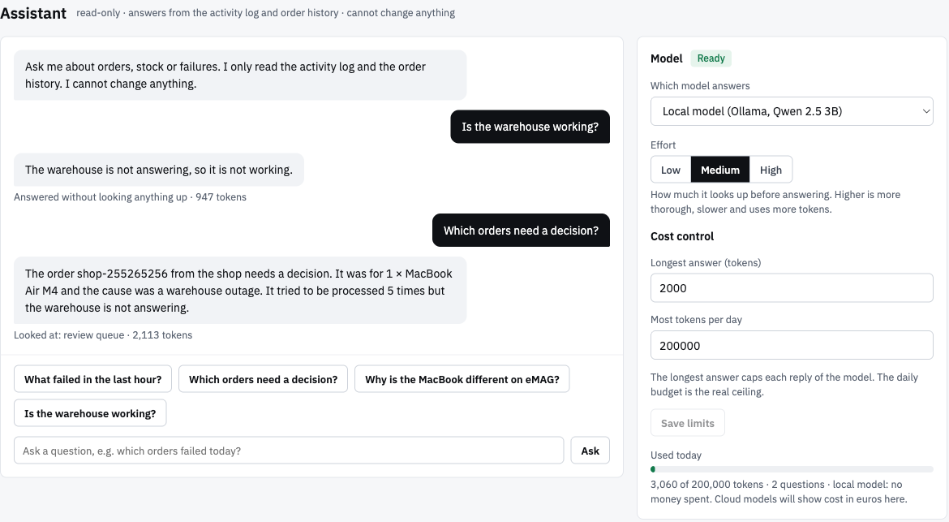
The local model explains; it never acts
OPERATIONS
What it does
Assistant: answers from a block of live facts and five read-only lookups, at temperature 0
Triage: Suggest an action on a review card gives retry, cancel or close, with a short reason
What it does not do
Change anything: there is no tool that writes
Decide: the suggestion is shown, audited, and a person still clicks
Limits and first run
Effort (2, 4 or 6 tool rounds), longest answer and a daily token budget that resets at midnight in Bucharest
Ollama pulls qwen2.5:3b once, about 2 GB; Glue works meanwhile and shows progress
Claude, GPT and Gemini are listed as coming soon
Triage on a review item
Facts
Rule, in code
Model
Checked
order, stock, warehouse state
picks the choice
writes the reason
allowed choices only; never acts
Notes:
- The model runs locally in Ollama: qwen2.5:3b, downloaded once in the background, about 2 GB. Everything else works while it downloads; on a fresh clone the Assistant page says 'Downloading the local model, about 2 GB, one time' with a progress bar, and the triage and ask buttons say why they wait.
- Each question starts with a block of live facts built in code: each system's state, what waits for a person by cause, the last hour's counts, a stock line for every product, and the orders that failed in the last hour. Then a tool loop over five read-only lookups: system health, a summary, the review items (their plain cause, never the stored reason text), one order with its timeline, and stock by product name. It runs at temperature 0, answers with product names and Bucharest time, and lists the lookups it used.
- Honest about quality: a 3B model is often vague and sometimes wrong. The common questions were right in the last measured runs; answers still vary a little between runs.
- Triage decides nothing and runs no tool loop. The rule is decided in code from the facts: for example, the warehouse is answering again, so retry; or the warehouse cannot cover this order, so cancel. The model only writes the explanation the operator reads.
- The suggestion is kept only if it is one of the actions the item allows, and dropped if the reasoning talks about a different order; sentences that name internal tools or fields are dropped too. It is stored on the item, audited as triage_suggested, and it never acts.
- Why a small local model: no key, no order data leaving the machine, no cost. The budgets exist for when this points at a paid model, and the daily budget follows the business day, so it resets at midnight in Bucharest. I would not lead with them.
- Would I ship it? As an explainer, yes. As a decider, no: a stronger model could be given the open choice later, still behind a person.

Slide 12
How it was built
PROCESS
1
2
3
4
5
6
7
Requirement
Scenario
Design first
Written plan
Task by task
Analysis, then hardening
Final review and QA
Sync orders and stock; handle conflicts, retries and partial failures.
A real-shaped customer; the real APIs' delivery rules researched first.
Mockups of every screen, approved before any code.
Small tasks with acceptance checks; the sync core before anything else.
Each task reviewed independently, with fix rounds until clean.
A fresh review reproduced 8 core gaps as failing tests; a load probe found a 20 orders/s cap.
Whole-branch review, a last fix wave, browser checks, a run from a fresh clone.
Habits throughout
Core first
A failing test first
Checked against the code
sync, conflicts and retries worked end to end before the console
for every core gap; 18 planted bugs, each caught by the suite
docs and slides say only what the code does
Notes:
- I treated this like a small customer engagement. First the requirement, then a scenario I could defend: Adobe Commerce plus eMAG plus one warehouse, with the real delivery rules researched before writing code (at-least-once events, eMAG's acknowledge, batch results per item).
- Design first: HTML mockups of every dashboard screen and the three mocks were agreed before any code. They are the spec the UI was checked against.
- A written plan with small tasks and acceptance checks, sync core first. Each task was built, then reviewed by someone who had not written it, with fix rounds until the review came back clean.
- When the branch was feature-complete, an independent analysis looked at it fresh. It reproduced eight gaps in the sync core as failing tests: for example a ship notice with no retry path, a crash during a decision, stale review items, and an unsafe Retry-After. The hardening wave fixed each one test-first. The new load probe then found the worker loop capped at about 20 orders per second, which was fixed the same way.
- Then a final whole-branch review and a last fix wave: plain-word reasons everywhere, Bucharest business days, an outage cause that covers only the warehouse, auto-retry only for outage items, a confirm before cancelling. Then browser QA at several screen widths and a run from a fresh clone, including the first-run model download. 245 backend and 223 frontend tests at the end.
- A mutation check keeps the tests honest: 18 bugs planted one at a time (dedupe off, Retry-After uncapped, no per-order lock, event id left out of the signature, CSRF header not checked, and others), and the backend suite fails for each. The first version of that check missed two webhook rules; tests were added until every planted bug was caught.

Slide 13
Trade-offs, and how I'd roll it out
REFLECTION
1
Shadow mode
2
Shop stock
3
eMAG stock
4
Orders
Receives and reads everything, sends nothing. Compared daily with the staff's work.
Glue pushes stock to the shop only. Staff keep everything else.
Then eMAG. Oversell risk drops; eMAG's real rate limits are met here.
eMAG first, as it re-sends until confirmed, then the shop. The queue owner starts.
About a week per stage. Shadow mode and the per-stage switches are not built yet: each is a flag checked before Glue calls a system.
I chose | It costs
SQLite and one process | One writer, one instance
First to the warehouse wins | Does not protect eMAG's rating
A person decides oversells | Someone must watch the queue
Mocks, not sandboxes | Real API quirks are untested
Success after 30 days
Missed orders: zero, and Flow shows no lost orders
Oversells well below the baseline
eMAG seller cancellation rate inside eMAG's threshold
Oldest open review item under 30 min in business hours
Notes:
Four trade-offs I would defend: SQLite and one process (one writer; Postgres is a one-file move because all SQL is in glue/db.py), first to the warehouse wins (simple and atomic, but it does not protect eMAG's rating, so a person decides), a person in the loop (someone must own the queue), and mocks instead of sandboxes (real API quirks are untested).
Rollout: shadow mode first, receiving and reading everything and sending nothing, compared daily with the staff's work; then shop stock, then eMAG stock, then orders. About a week per stage. Shadow mode and the stage switches are not built yet: each is a flag checked before Glue calls a system. Success after 30 days is measured, not felt. Full limitations are in the README; what the customer provides is in docs/customer-context.md.

Slide 14
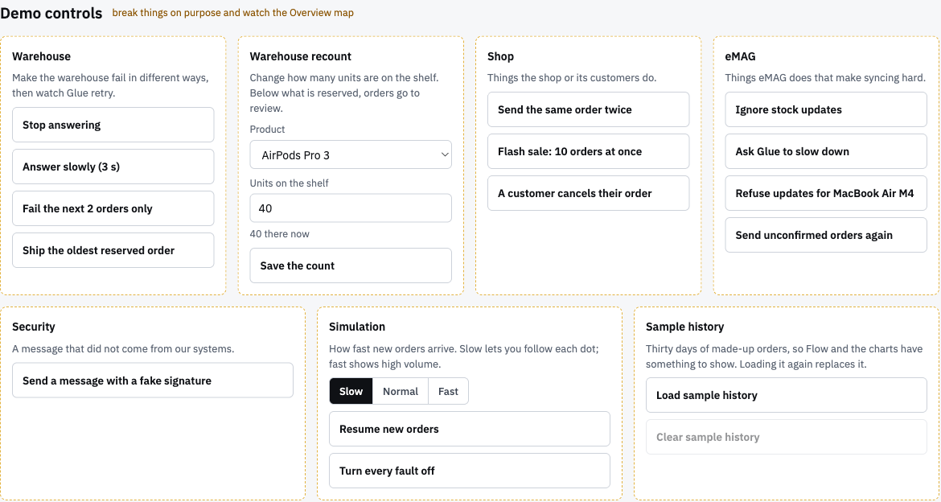
Five minutes, on the real screens
LIVE DEMO
1
Live map
Traffic is on: orders flow, stock follows.
30 s
2
Duplicate
Send the same order twice: one order, one duplicate ignored.
30 s
3
Outage
Stop answering: retries honour Retry-After, then review. Bring it back, Retry all.
75 s
4
Oversell
Last MacBook, eMAG ignores stock: sold on both, the second goes to review. Cancel on eMAG, confirm.
75 s
docker compose up --build
:8000 Glue :8001 shop
:8002 eMAG :8003 warehouse
5
Partial batch
eMAG refuses one product: one row dirty, the rest applied, healed next run.
40 s
6
Timeline
Open the order's history, then ask the assistant about it.
30 s
If a step misbehaves: Turn every fault off.
Clean start, after down:
docker volume rm glueservice_glue-data
Notes:
- Switch to the browser. Follow docs/presentation/demo-script.md: Glue at :8000 signed in as admin, shop :8001, marketplace :8002, warehouse :8003.
- Say what is about to break before clicking. Keep each step under its time.
- If anything misbehaves: Demo controls, Turn every fault off. For a clean start: docker compose down, then docker volume rm glueservice_glue-data, then up. Never down -v: it also deletes the downloaded model.
- After the demo, offer the code: glue/router.py for order states, glue/retry.py for the policy, glue/reconciler.py for stock, glue/review.py and glue/settle.py for the queue, tests/conftest.py for how the tests run all four apps in one process.

