Slide 1


DNQ Alien
Panteleimon Pappas mscaidl-0030

Slide 2
Architecture
A Deep Q-Network learning (DQN) model should consist of:
  The Q-Network
  The Agent
  The Replay buffer
  The target network (a copy of the Q-Network)

Slide 3
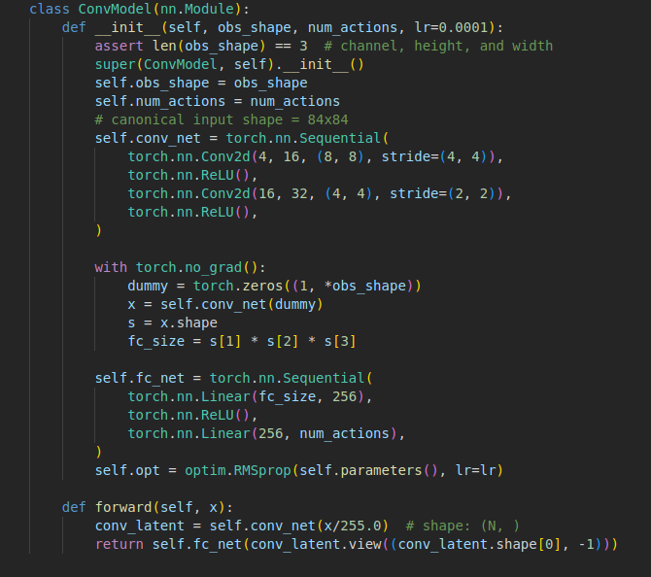
The Q-Network for Atari games

Slide 4
The Q-Network for Atari games
The Q-Network takes (84 x 84 x 4) [4 stacked (84x84) frames]
Outputs n actions
  18 for Atari games

Slide 5
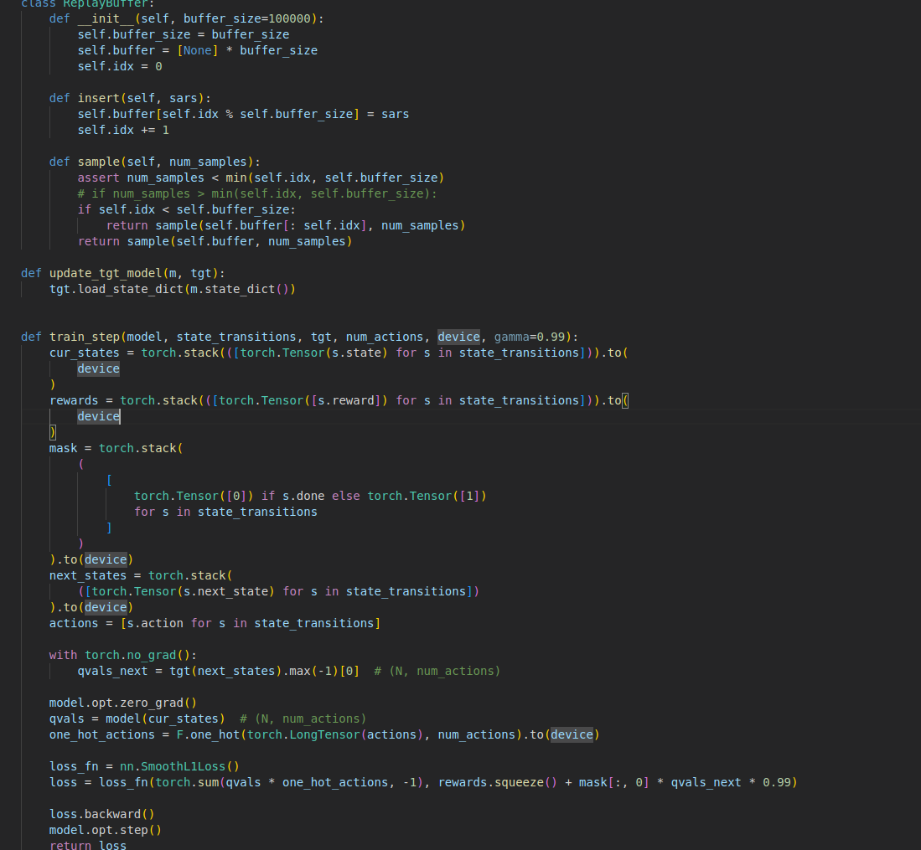
The replay buffer records frames and can be used to train the network instead of the Q-network when it recalls experiences

Slide 6
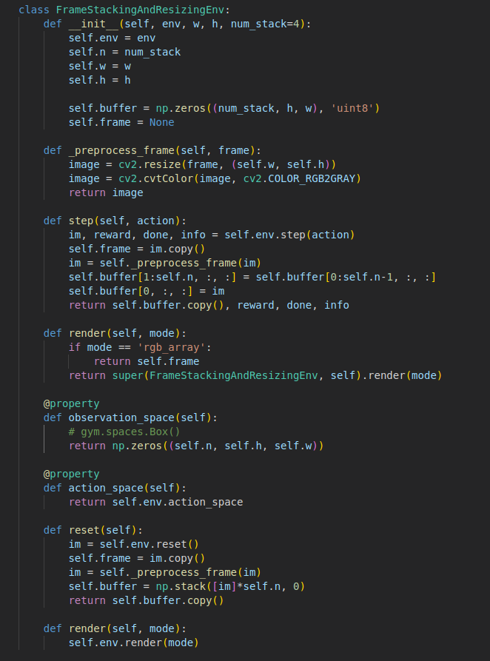
The frame stacking class
This is where preprocessing of our environment frames is done

Slide 7
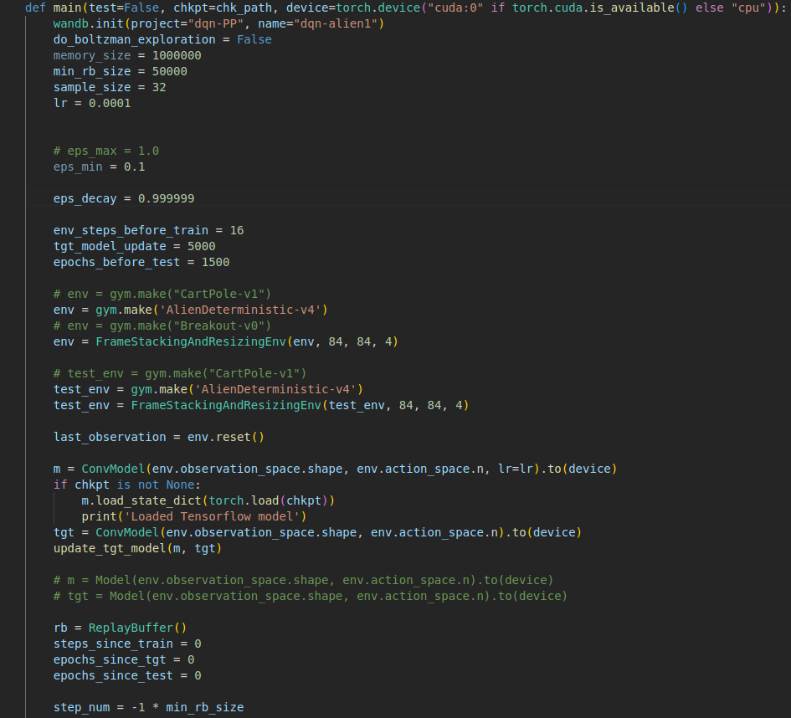
Main

Slide 8
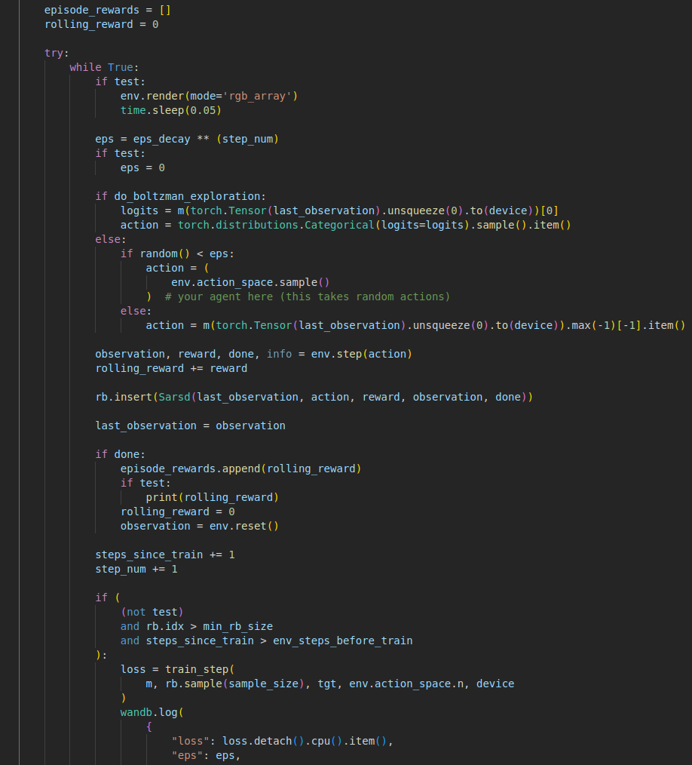
Main

Slide 9
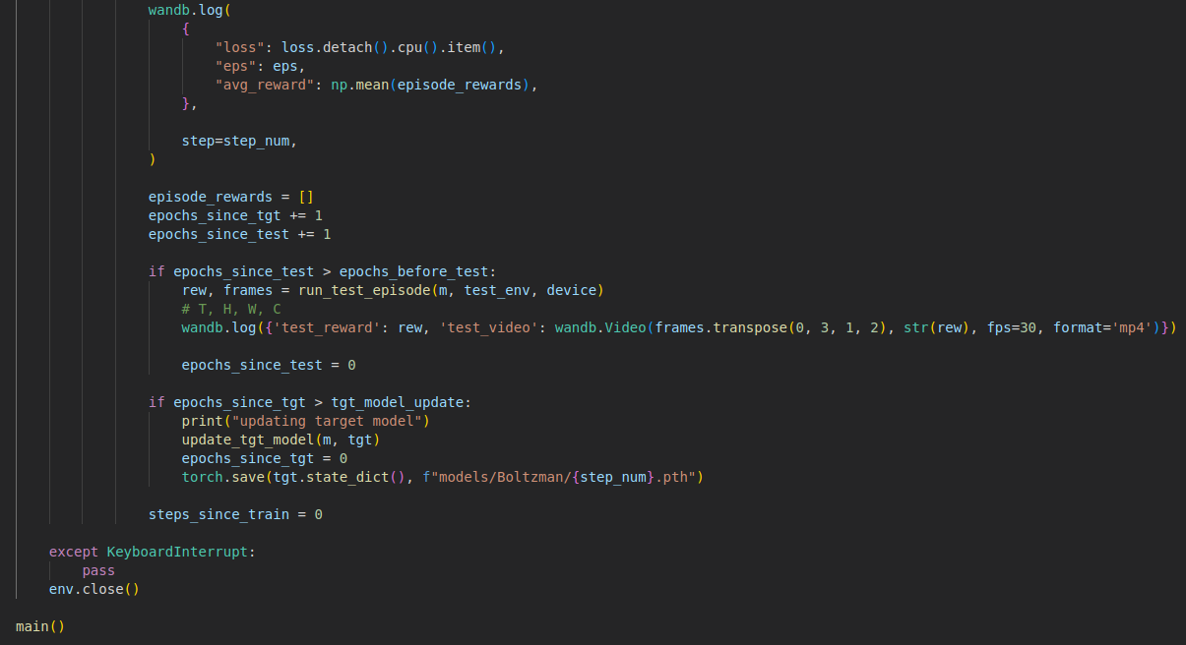
Main

Slide 10
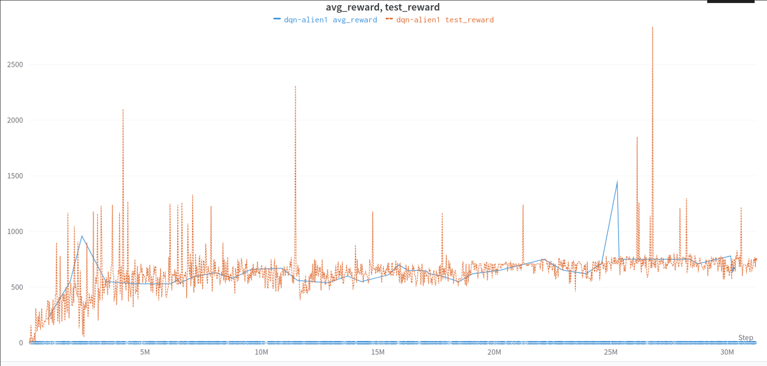
ε Greedy exploration training

Slide 11
Report magic links
https://api.wandb.ai/links/pantelpapp/t843y7u3
https://wandb.ai/pantelpapp/dqn-PP/reports/DNQ-Alien-Boltzman--VmlldzozNjQ0NTk1?accessToken=hb2sc1fl5wawq0ck2a0mnycwo69xgwdz0evpta20c0u839rymmsqr5zym7l44dat

Slide 12
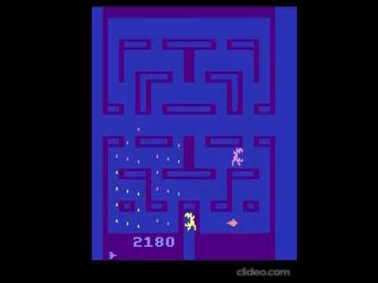
Best iteration (2180 points)

Slide 13
Thank you for your time.

