Slide 1

BLOCKCHAIN TECHNOLOGY (CRYPTOCURRENCY)
MAYANK KUSHWAHA

Slide 2
BLOCKCHAIN TECHNOLOGY
Blockchain technology is most simply defined as a decentralized, distributed ledger that records the provenance of a digital asset.

Slide 3
Big Data and Data Analytics

Slide 4
Internet of Things (IoT)

Slide 5
CRYPTOCURRENCY
A cryptocurrency is a tradable digital asset or digital form of money, built on blockchain technology that only exists online.

Slide 6
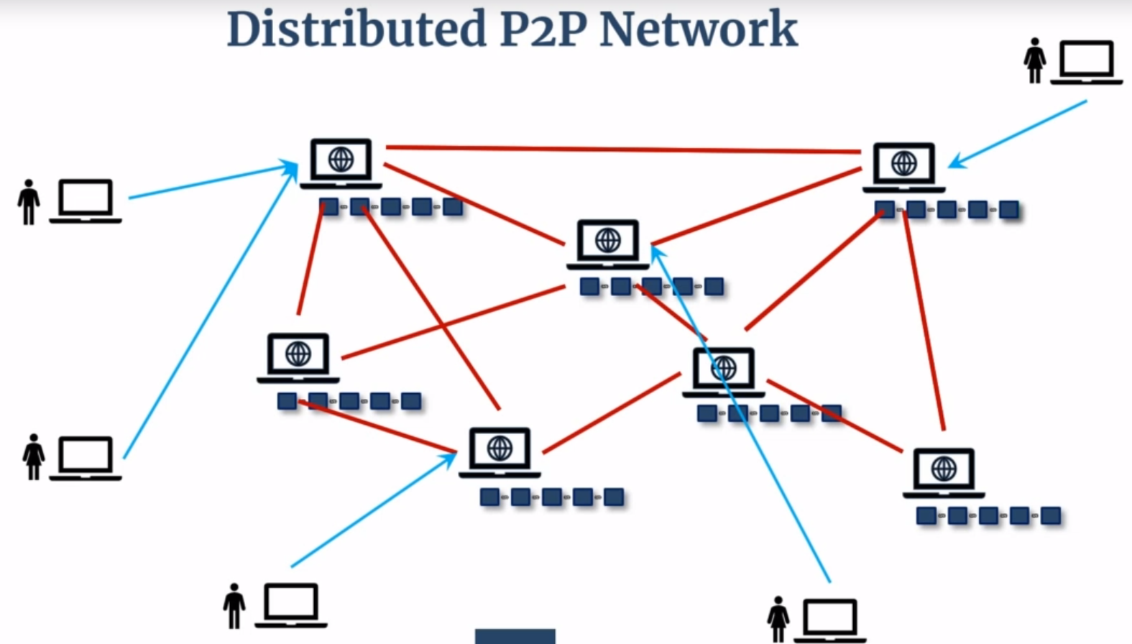
BUILDING BLOCKCHAIN

