Slide 1

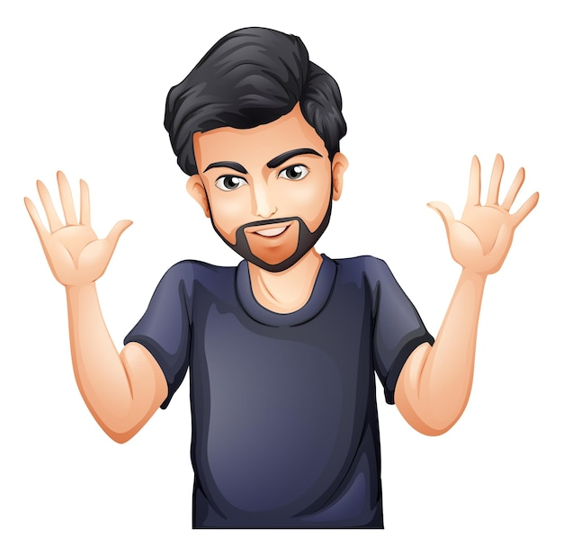
Notes:
He is Our friend shakil

Slide 2
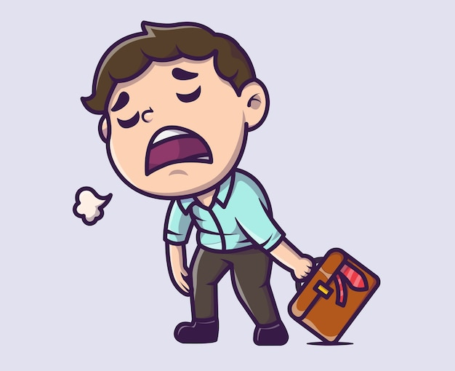
Notes:
He is so lazy

Slide 3
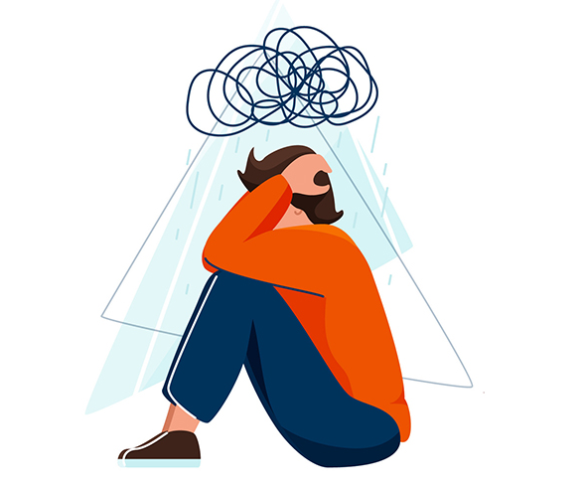

Can’t maintain
The performance at
Contest
GYM
Quiz
Notes:
Nijer moto guchay likhte hbe

Slide 4
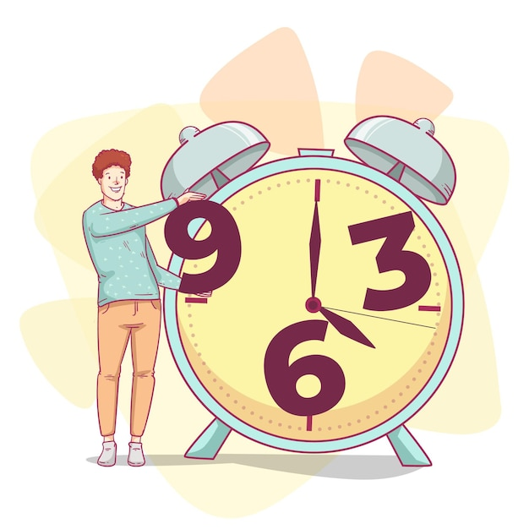

Notes:
Here comes our app – Timecraft

Slide 5
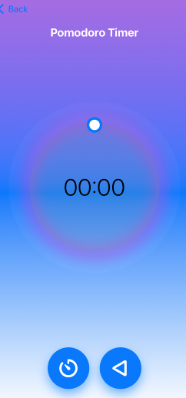
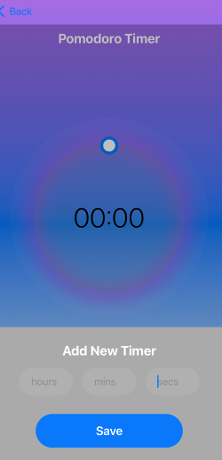
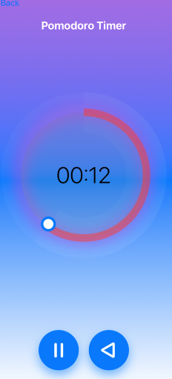
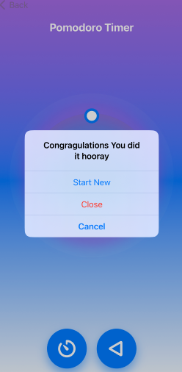

Slide 6
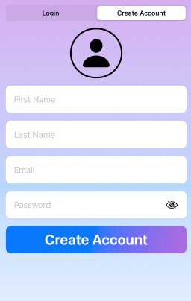
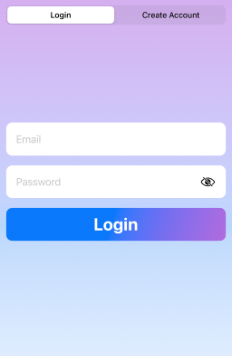
Authentication
User count
Verification
Statistics
User Info

Slide 7


Slide 8
Developer Team –
MD. Rabby(1907061)
Nafisur Rahman Shuvro (1907064)
Arnob Bhowmik (1907065)
Asifur Rahman (1907070)
Pantho Haque (1907075)

