Slide 1


The first Hub for Developers

Slide 2
Descriptive Analytics Load, Clean, and Explore

Slide 3
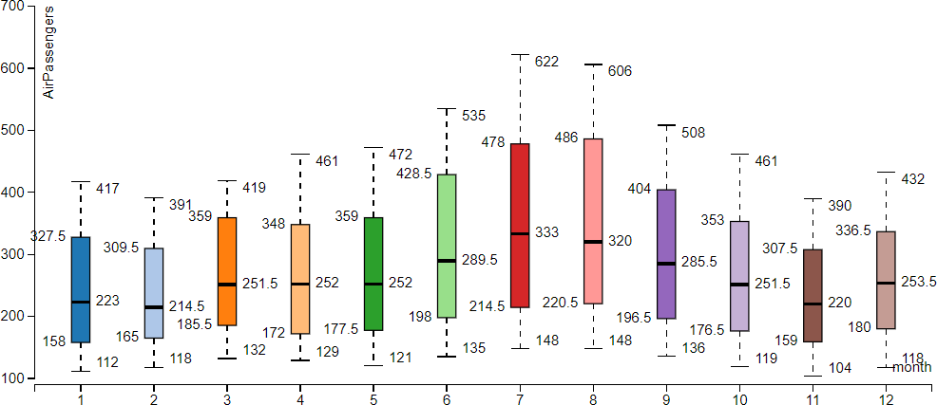
Granularity and Line Plots
Create the conditional Box plot of the Time series in order to deeply understand the distribution of data in the same period of each seasons and focusing on specific aspects such as outliers, skewness, variability,…

Slide 4
AR – Autoregressive Component

Slide 5
AR (AutoRegressive) Component
AR(2) Model Representation:
Tₜ = c + φ₁ Tₜ₋₁ + φ₂ Tₜ₋₂ + εₜ
Where:
Tₜ = Temperature on day t
c = Constant (intercept)
Tₜ₋₁ = Temperature on the previous day (day t - 1)
Tₜ₋₂ = Temperature two days ago (day t - 2)
εₜ = Random error term
c = 1, φ₁ = 0.5, φ₂ = 0.3
We can predict the temperature for Day 6 using temperatures from Day 5 (24°C) and Day 4 (23°C):
T₆ = c + φ₁ T₅ + φ₂ T₄
T₆ = 1 + (0.5 × 24) + (0.3 × 23)
T₆ = 1 + 12 + 6.9 = 19.9°C

Slide 6
MA – Moving Average Component

Slide 7
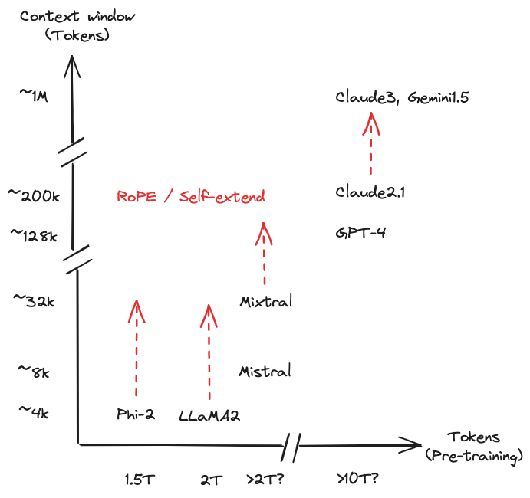

Slide 8
Thank you!

